Slide 1
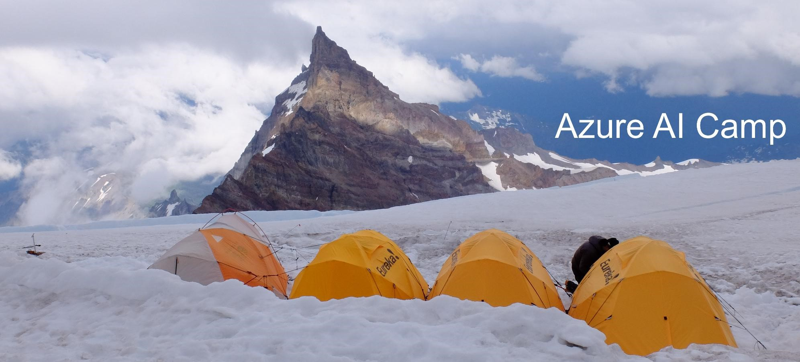
Introduction to Azure Databricks

Slide 2
Agenda
Day #1: Azure Databricks Intro and Overview
Day #2: Hands-on with Azure Databricks
Clusters – Creating, configuring, and managing
Revision history
Notes:
Show:
Creating a cluster
Pausing cluster after x mins of inactivity
Loading custom libraries
Pinning the cluster
Integration with Git and pull request

Slide 3
Day 1

Slide 4
Business challenges
Data trends
Volume: Big data
Frequency
Sources: Human generated, machine generated, organization generated
Types: Structured, Non-Structured, Semi-structured
Diverse skillsets = barrier for collaboration
Need for real/near-time processing
Notes:
Volume
Because of the explosion of new technologies in the last 20 years, like phones getting smarter, IoT, and advanced gaming + telemetry, there has been an exponential growth in the amount of data and data sources.
Frequency
A lot of data today are noisy data… small by numerous. E.g. An IoT device sending environment data every minute. Geospatial or gaming data that is being updated up to many times per second for granular real-time tracking.
Sources
Human-generated: Social media posting, emails, using your cell phone camera to record or take pictures (Audio/video files)
Machine-generated: IoT devices at work and at home. E.g. your Ring doorbell, your smart home devices, Siri and other smart assistants. At work, security cameras. Some of you today are in the business of creating smart edge devices.
Organization-generated: Data generated by the business org. For example in retail, every time something is purchased, inventory is updated. Or data from a manufacturing line that tracks accepted and rejected items based on QC checks.
Types
Traditional structured data follows set and well-formed schemas. But today, many data types are semi or non structured.
Non-structured: Video and audio files. By the way, non-structure data is the most widespread type of data today.
Semi-structured: Inconsistent schemas. E.g. updating a merchandise with new items that have new features not applicable to past versions. E.g. Backpacks vs Backpacks with charging capabilities

Slide 5
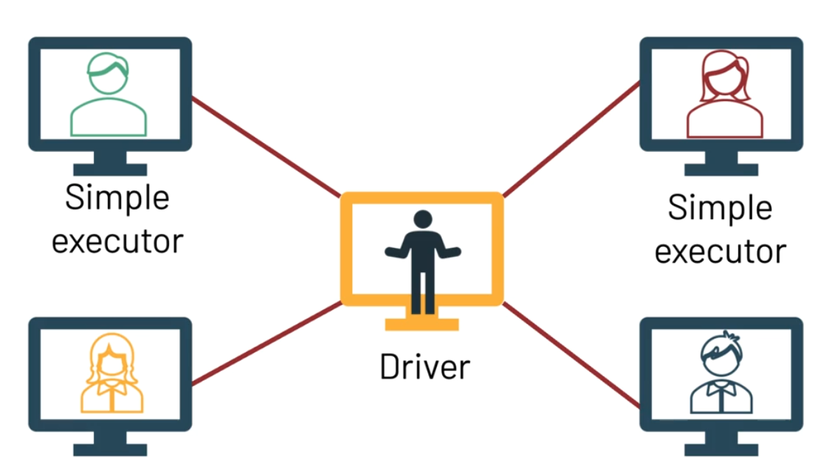
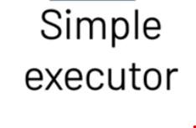
Handling Big Data with Distributed Computing (Apache Spark)
Notes:
To handle Big Data and process them in a timely fashion, we employ distributed computing. The most popular industry standard for distributed computing to process Big Data is Apache Spark.
As a technology, Apache Spark allows us to break Big Data and distribute it across different workers. A Driver node will be used to track and coordinate each worker (also called a simple executor).
While this is a great approach to solving Big Data challenges, IT would now need to provision, maintain, and support Apache Spark and the hardware + software. Organizations that have deployed Spark often face memory and disk space optimization challenges, not to mention the need to update expensive hardware. There is also the need to have sufficient compute cores to use in the Driver and Worker roles.
One of Databricks immediate value add is to take over the overheads of managing a Spark environment, and provide it, along with other tools, a managed Spark environment on a pay for what you use subscription model.

Slide 6
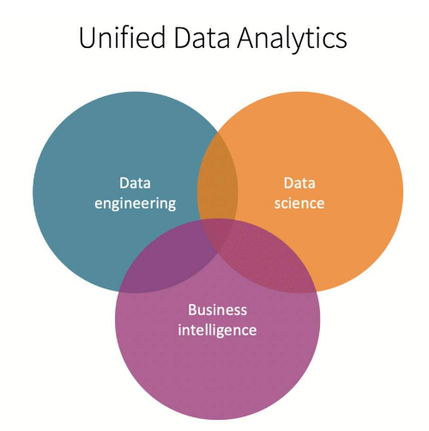
Introducing Azure Databricks
Azure Databricks = Databricks built as a native offering in Azure
Jointly managed by Microsoft and Databricks
Use Spark to make data/big-data driven decisions without having to maintain a Spark environment.
Collaboration by bridging different skillsets (SQL, Python, Scala, R)

Slide 7
Notes – Add why use Databricks for non/semi-structured data Maybe a use case

Slide 8
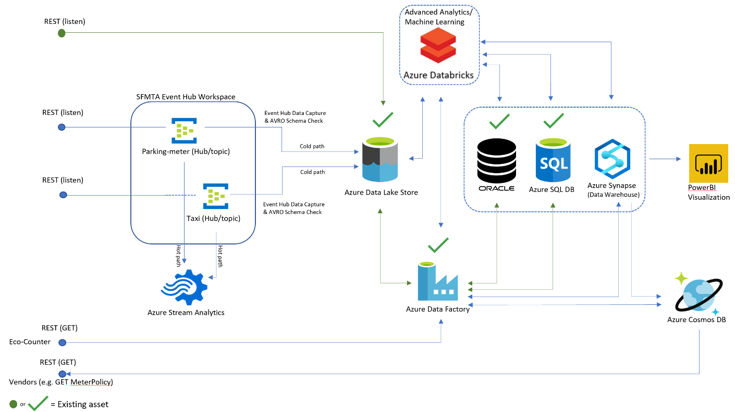
Case Study - Typical architecture

Slide 9
Preview of Day 2 hands-on Tour of Azure Databricks

Slide 10
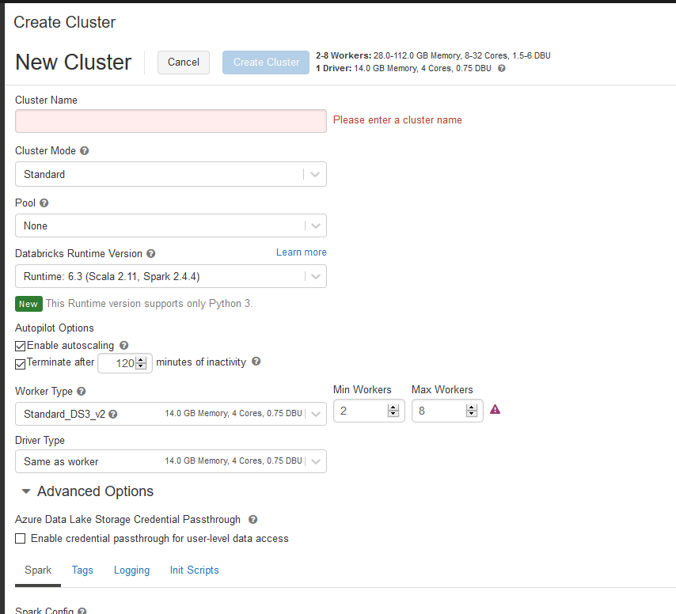
Creating clusters
Reference: https://docs.databricks.com/clusters/configure.html
Notes:
Launch Azure Databricks from the portal
Go to Databricks workspace
Click on Clusters
Explain that clusters is the compute for Databricks
Click Create clusters
Give the cluster a name
Select Cluster Mode = Standard (click question mark for explanation of options)
Leave Pool as none = But click on the question mark to show explanation
Select Runtime = Click More and select Runtime 6.3
Explain autoscaling and Terminate after
Driver node = maintains state information of all notebook. E.g. interpreting commands in notebook
Worker node = Used to run the Spark executors and other services for the proper functioning of clusters (e.g. coordination between nodes in cluster during distributed processing)
AFTER creating the cluster, PIN it and explain what Pinning does.

Slide 11
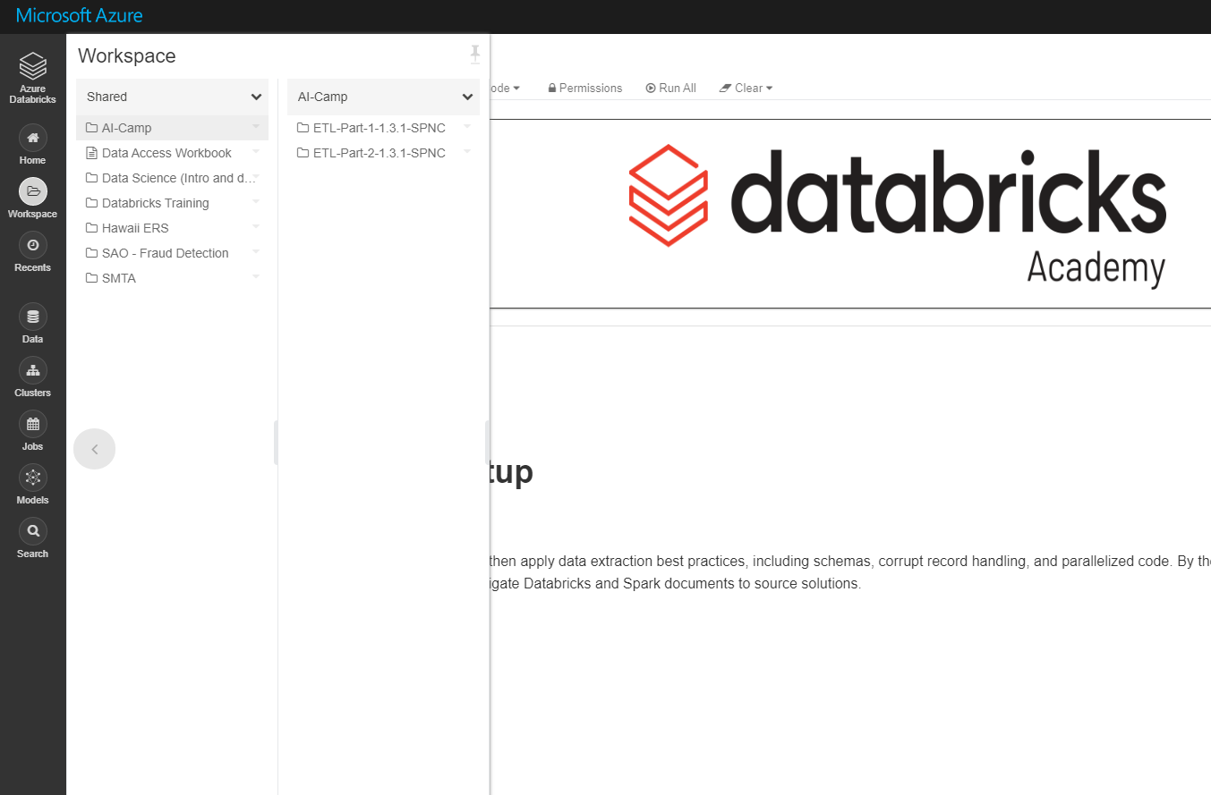
Navigating Workspaces & Notebooks
Reference: https://docs.microsoft.com/en-us/azure/databricks/notebooks/

Slide 12
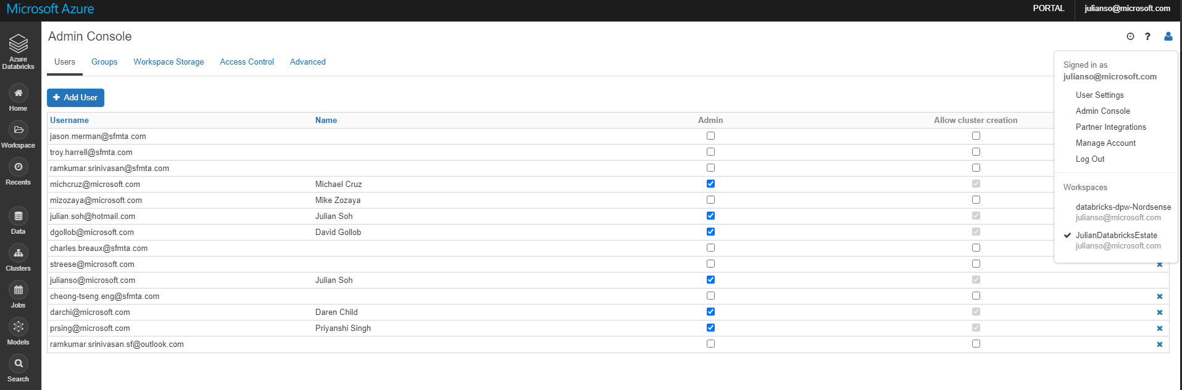
Collaboration and access management
Notes:
Click on user icon from the top left and select Admin Console.
Go to Notebook and then click on dropdown and select Permissions
Walk through the SAO Fraud Audit notebook that was using Kaggle data. Show the different types of languages that are supported by using the % syntax.

Slide 13
Placeholder
Possible content for ML, MLOPS, Parquet/Delta Lake on ADLS

Slide 14
Thank you

Slide 15
Day 2: Hands-on with Azure Databricks

Slide 16
Hands-on labs
Total lab time = 115 minutes
(portal.azure.com)
Setup, environment tour, and cluster creation/management (10 minutes)
Overview – ETL-Part 1, Notebook ETL1-01 (10 minutes)
Common Transformations – ETL-Part 1, Notebook ETL1-02 (15 minutes)
Connecting to Azure Blob– ETL-Part 1, Notebook ETL1-03 (15 minutes)
Joins and lookup – ETL Part 2, Notebook ETL2-05 (15 minutes)
Notebook 5 – (15 minutes)
Notebook 6 – (15 minutes)
Notebook 7 – (15 minutes)

Slide 17
Cluster Creation – Resources and references
https://docs.microsoft.com/en-us/azure/databricks/clusters/configure
GPU Clusters - https://docs.microsoft.com/en-us/azure/databricks/clusters/gpu
GPU Clusters for deep learning - https://docs.microsoft.com/en-us/azure/databricks/applications/deep-learning/
Pools - https://docs.microsoft.com/en-us/azure/databricks/clusters/instance-pools/

