Slide 1
Distributed Deep Learning with Azure Databricks

Slide 2
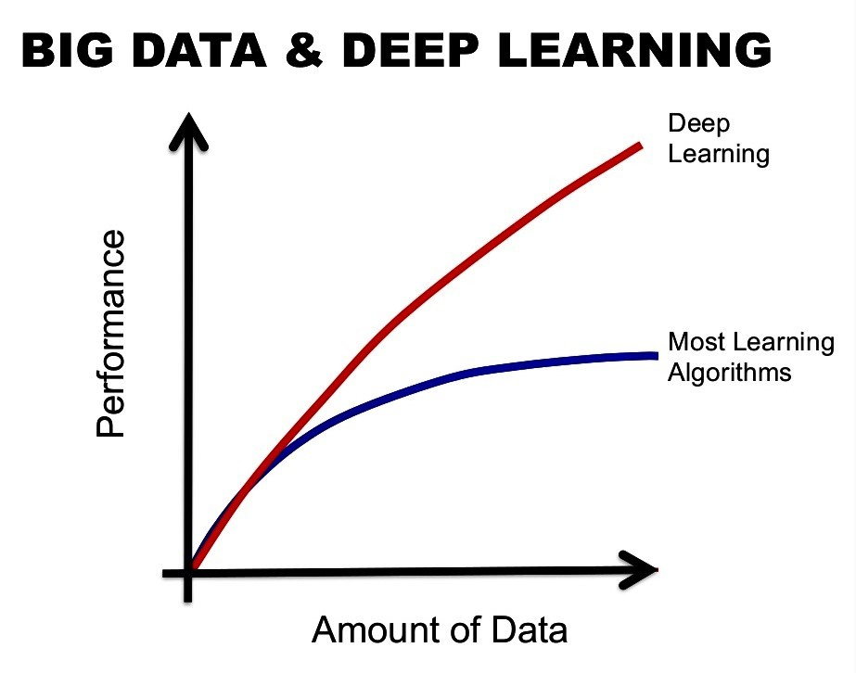
Why Distributed Deep Learning
Value to customers:
DL is known for improving with data
Scale DL training from single node
Improve training speed & reduce time-to-value

Slide 3



How Azure Databricks Helps Deep Learning
Highly performant and reliable data pipelines
Cutting-edge AI models at massive scale
Highly iterative and collaborative process
Pre-configured ML frameworks with simplified distributed training and GPU instances support
Optimized and managed Apache Spark runtime improves data reliability
Unified Workspaces for data engineers and data scientists to collaborate and iterate across the entire lifecycle

Slide 4
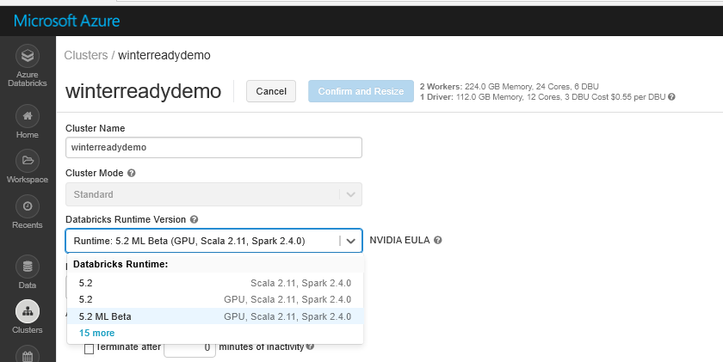







Getting Started
Easily set up ML environments on all cluster nodes with a single click
Leverage pre-configured ML/DL libraries

Slide 5

Introducing HorovodRunner
HorovodRunner provides a simple way to scale up your deep learning training workloads from a single machine to large clusters
Leverages Project Hydrogen and new Spark 2.4 barrier execution mode
Built on top of Horovod
70-80% scaling efficiency
Supports TensorFlow, Keras and PyTorch

Slide 6
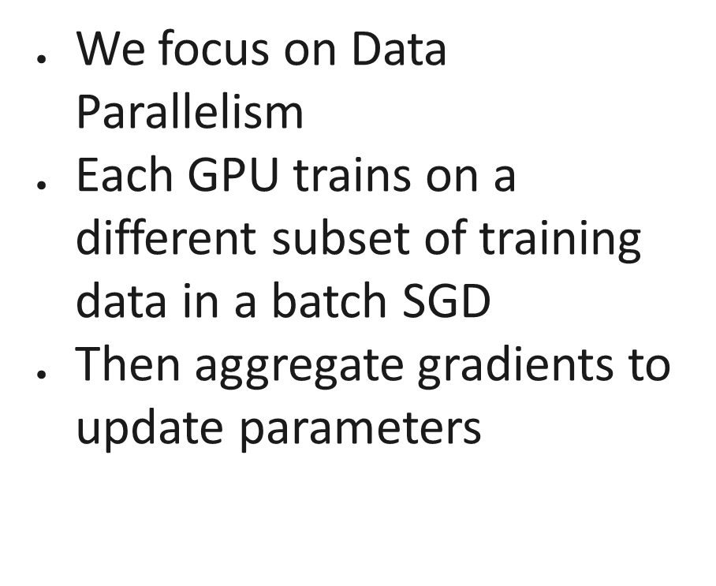
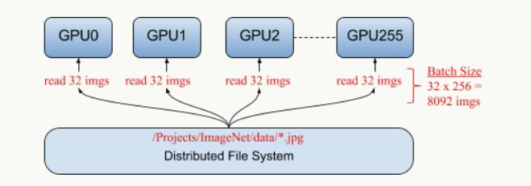
Data Parallelism vs. Model Parallelism

Slide 7
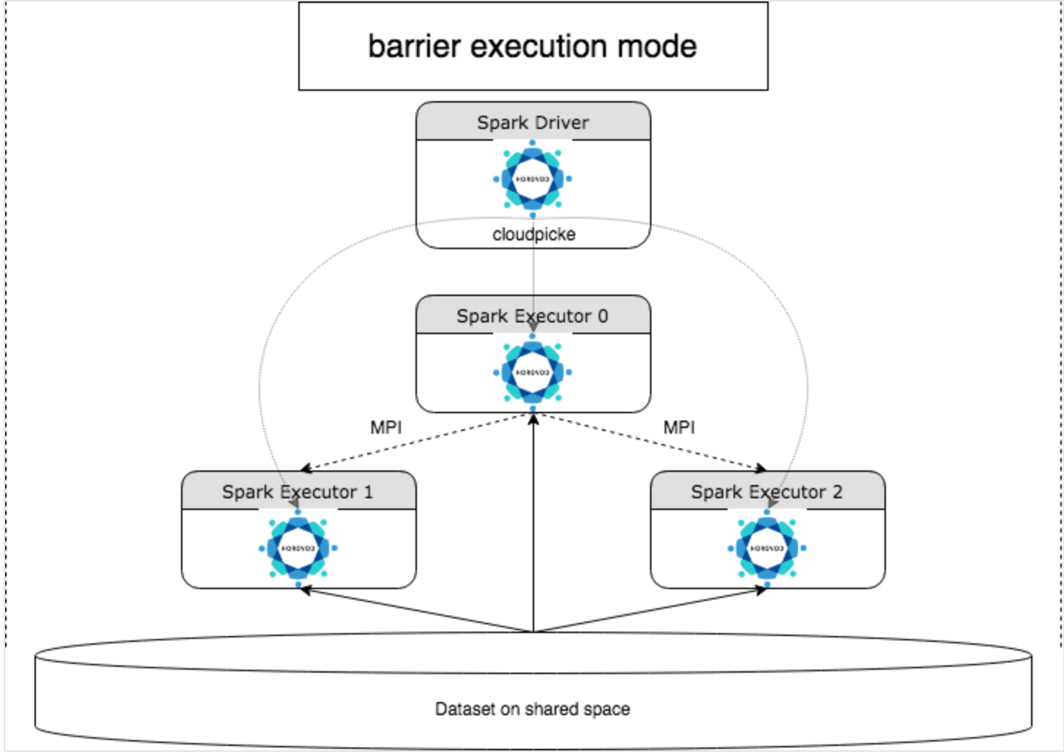
HorovodRunner
For details, see the HorovodRunner API documentation.
The general approach to developing a distributed training program using HorovodRunner is:
Create a HorovodRunner instance initialized with the number of nodes.
Define a Horovod training method according to the methods described in Horovod usage.
Pass the training method to the HorovodRunner instance.

