Slide 1

Cognitive Services

Slide 2
Azure Cognitive Services
Consume AI through packaged services:
Vision
Language
Speech-to-Text/Text-to-Speech
Search
Decision Making and Content
Democratization of AI
Quick to market
AI for developers without the deep Data Science involvement
References: Microsoft Azure 2nd Edition (Chapter 15) – July 17th release date

Slide 3

Exploring Cognitive Services https://azure.microsoft.com/en-us/services/cognitive-services/
Hands-on
Notes:
Go to https://azure.microsoft.com/en-us/services/cognitive-services/
Scroll down and select Language under Azure Cognitive Services, then select Text Analytics.
Figure 15-1. Azure Cognitive Services website
Click on the Examples to use canned phrases and observe the analyzed text, particularly the sentiment that was detected.
Figure 15-2. Negative sentiment of analyzed text
Now replace the text with you own text, then click on the button labled Analyze, and observe the detected sentiment. Is it what you expected?
Then click on the JSON tab to view the JSON results that were returned by the COG service.
Figure 15-3. JSON response from the COG service.
In the “Sentiment” array, there is an element titled score. This score determinesthe sentiment that was detected by COG service. In our example, the graphic in the User Interfaced showed 25%, which is a roundup of the actual score of 0.24628770351409912.
Figure 15-4. Analyzing the JSON response from the Text Sentiment API
This quick hands-on introduction exposes how each COG service accepts inputs, and the JSON response the services provides. You can use the same approach to explore the capabilities of all the Azure COG services.

Slide 4

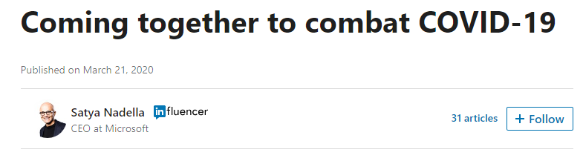
Case Study 1: Bots for COVID-19 response
Notes:
Talk about QnAMaker
Show Satya’s Press Release
Show DOH’s Active Learning in QnAMaker
Show Bot framework
Discuss

Slide 5
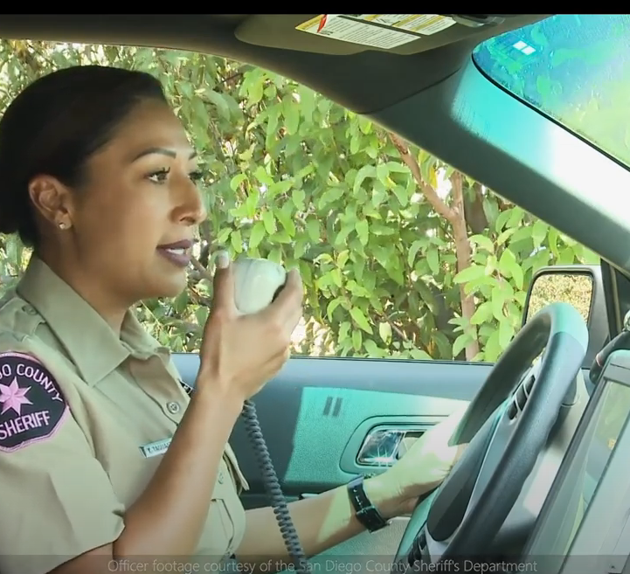
Case Study 2: Coptivity (Speech to Text) https://azure.microsoft.com/en-us/services/cognitive-services/speech-to-text/#overview
https://www.youtube.com/watch?v=w9EHouRK9kQ

Slide 6

Form Recognizer Nassau County, New York City

Slide 7

Thank you.

