Slide 1
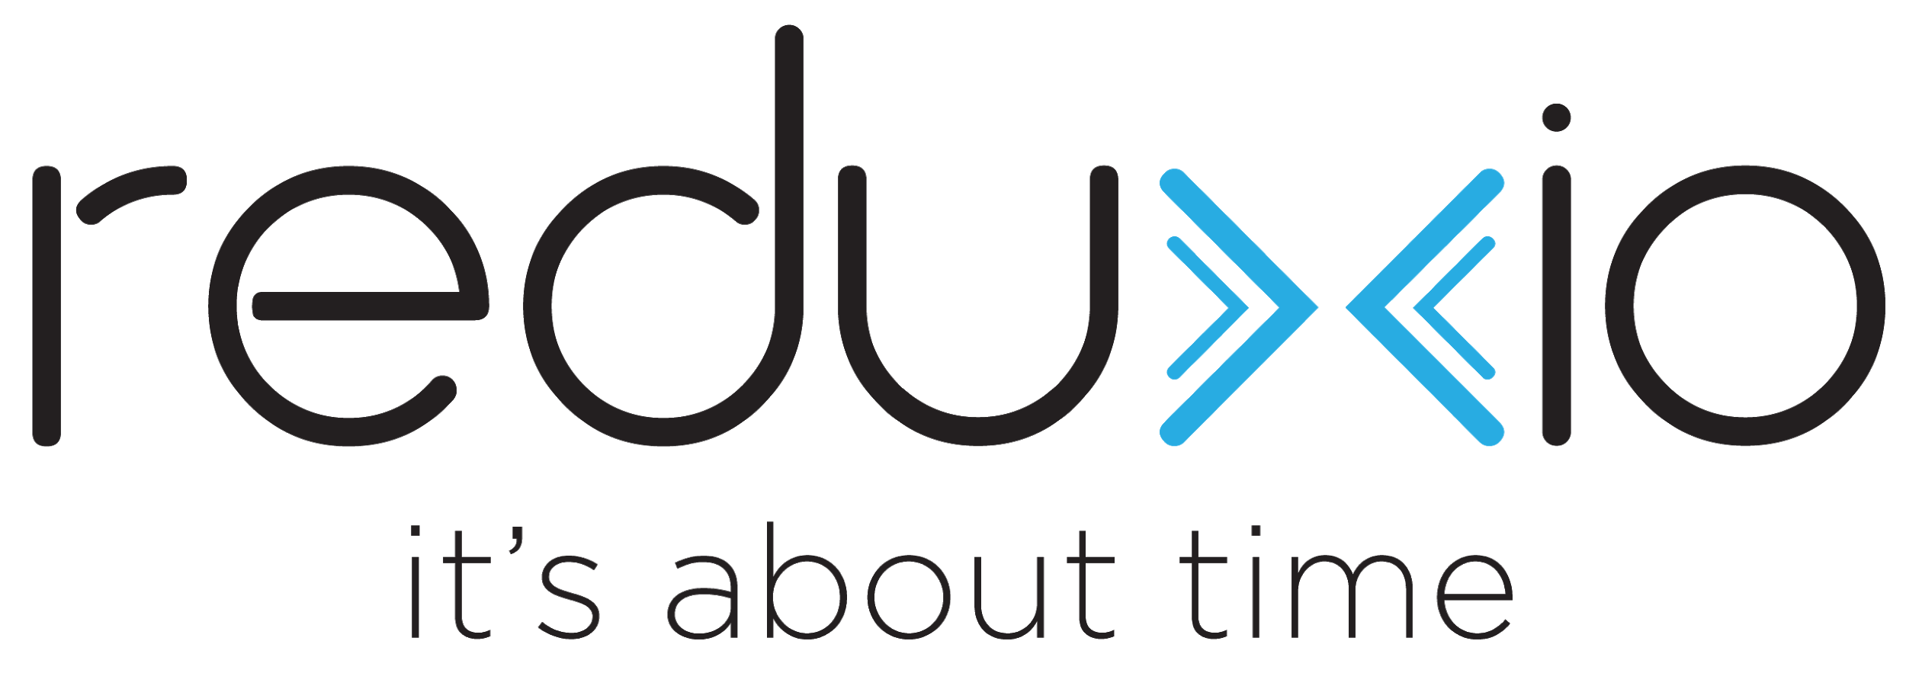
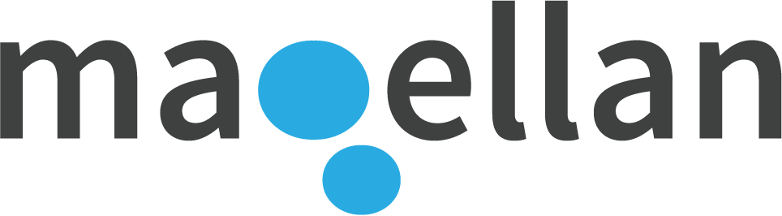
Container Native Storage for Kubernetes
with Instant Data Mobility
One Data Platform for Every Application
On Any Infrastructure, Any Cloud

Slide 2
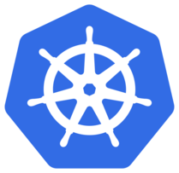
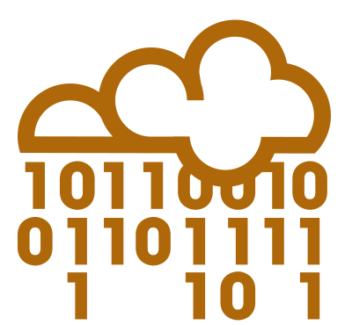

Why Magellan?
Kubernetes Native
Eliminate traditional storage infrastructure and management silos reducing total cost of infrastructure. Runs natively in Kubernetes and delivers performance and complete data management for customer’s business critical applications.
Cloud Infrastructure as Code
Simplify IT deployments in hybrid or multi-cloud deployments with a single cloud platform based on Kubernetes and Magellan, with consistent operational workflows. Runs on any infrastructure where Kubernetes runs - on premise or in the public cloud.
Application Mobility
Defeat the challenge of data gravity with instant application mobility between infrastructure islands. Magellan’s instant data mobility allows an application’s data to move with the application instance without delay.

Slide 3
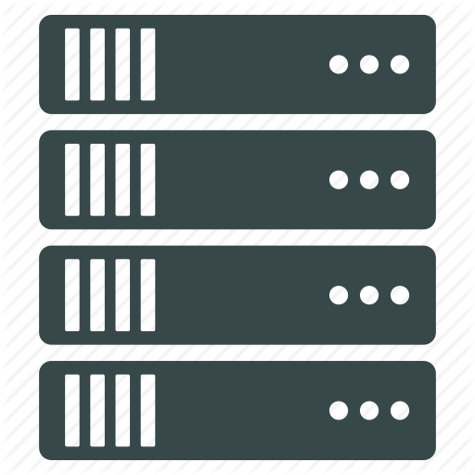
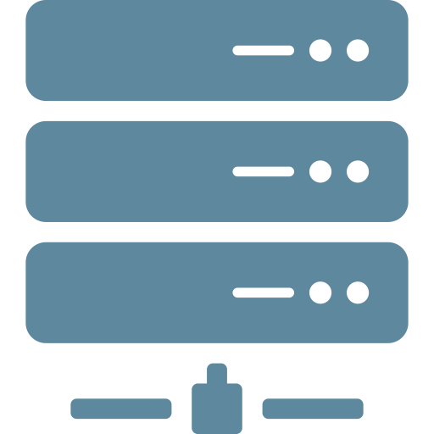




Enterprise Grade Kubernetes Native Storage
Kubernetes with Magellan
Kubernetes with Legacy Storage
Kubernetes
Kubernetes
Application Containers
Magellan
Legacy Storage
Servers with SSDs
Expensive storage appliances
Siloed storage performance and capacity
Operational complexity
Limited to on premise deployments
Reduced infrastructure costs
Commodity HW nodes
Erasure coding across nodes
Global data reduction
Reduced operational costs
Built for Kubernetes
Integrated data management
Runs on any infrastructure
Notes:
Built for Kubernetes - no separate storage management, scales with Kubernetes

Slide 4
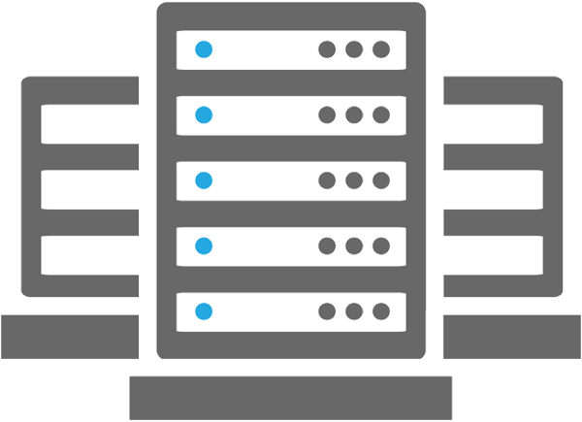
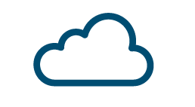
Cloud as Code
For multi-data center, hybrid cloud or multi-cloud
One infrastructure-independent platform for applications
One set of storage and data management workflows
Eliminates cloud vendor lock-in
Single software defined IT platform for applications independent of infrastructure
Kubernetes
Application Containers
Infrastructure Services
(Logging, Monitoring, IDP)
Service Mesh (istio)
Container Network Interface (CNI)
Magellan Container Native Storage
vs. Legacy Deployments
Applications developed to use specific storage layer available in the infrastructure
Infrastructure dependent storage and data management workflows
Moving data requires complex migration between systems
Private Infrastructure
Public Cloud

Slide 5
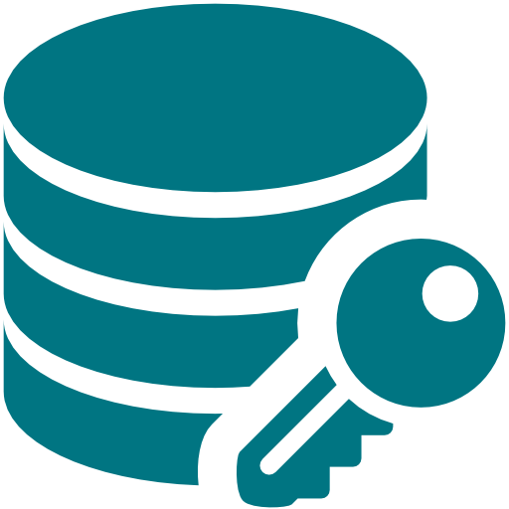
Application Mobility vs. Application Migration
Application mobility without downtime
When an application is moved all associated volumes are moved with it
Data is movement is deferred and smart pre-fetch is used to ensure that important data is transferred first
Global deduplication and compression is used to minimize the amount of data that is moved
Hows Does Mobility Work?
Volume Copy: Copy of a Transportable Data Container (TDC) - a patented lightweight representation of a data set.
Access: On a Magellan that receives a TDC, all data is immediately accessible
Write Handling: always performed locally,
Global Deduplication: global deduplication identifies data that may be available locally
Read on Demand: for data that is not available locally
Background Read: prioritizes data based on previous read and write operations
vs. Legacy Migration with downtime
Application instances with stateful data require all data to be copied before migration
Downtime is required for the migration to be completed
Limits flexibility of multi-data center, hybrid cloud and multi-cloud deployment

Slide 6





The Magellan Platform
Built for Clouds
Kubernetes native container-based software defined storage platform for edge, and private, public, hybrid, and multi-cloud.
Instant Application Mobility
Application aware - manage applications instead of volumes
Start working without waiting for all data to be copied
Instant Copy, Instant Move, and Instant Sync
Unified Data Management
Application aware data management
One-second recovery, DR, and copy data management
Dynamic tiering and global data reduction
Extensible Storage Platform
Microservices based high performance storage platform
Independent performance and capacity scaling
Evergreen and no forklift upgrades ever

Slide 7




The Innovation
Address data by name instead of location
Break the stack into unique components to separate control plane and data plane
Implement each as a microservice that can independently scale
Magellan Components and Operation
Names enable definition of data to be transportable for mobility
Addressing independent, can support any addressing scheme including block
Protocol independent, can support any protocol for applications to access data
Time enables reconstructing data from any point in the past
Media independent, can support any SSD, object store, cloud storage, and tier between them
1
Generates a worldwide unique name for the data and compresses data
1
name, data
2
2
write
(volume, offset, data)
3
Data Plane
Stores data to media and supports retrieval by name
name, context
Control Plane
3
Saves name along with context (volume, offset) and time of the operation. Allows retrieval of name for a given context at a given time
4
5
5
4
Megallen’s microservices are the Pitcher, Catcher, and Keeper !

Slide 8

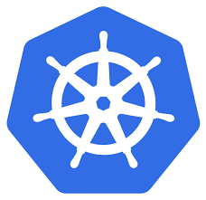
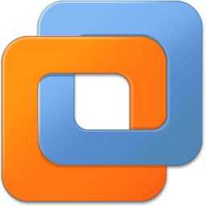
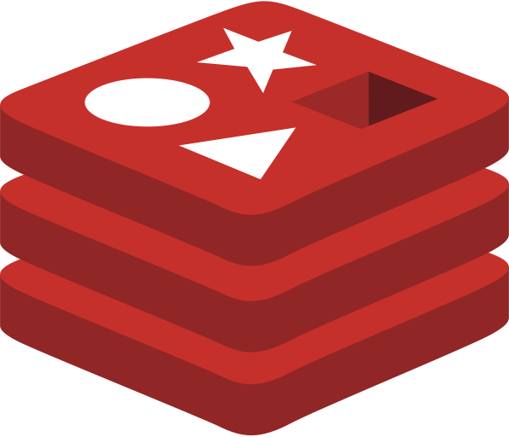


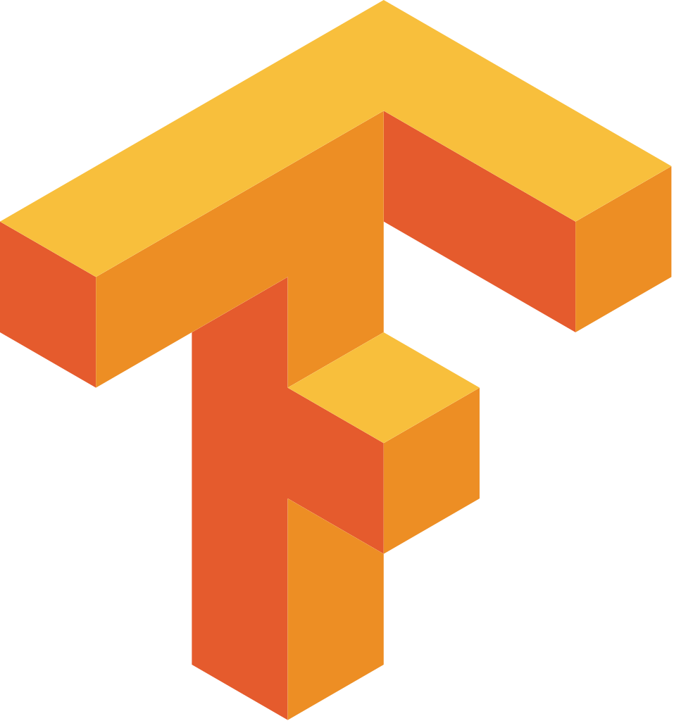
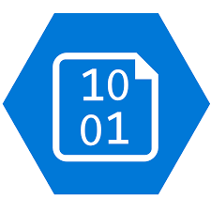
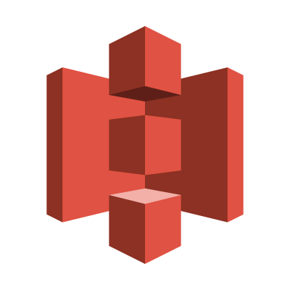
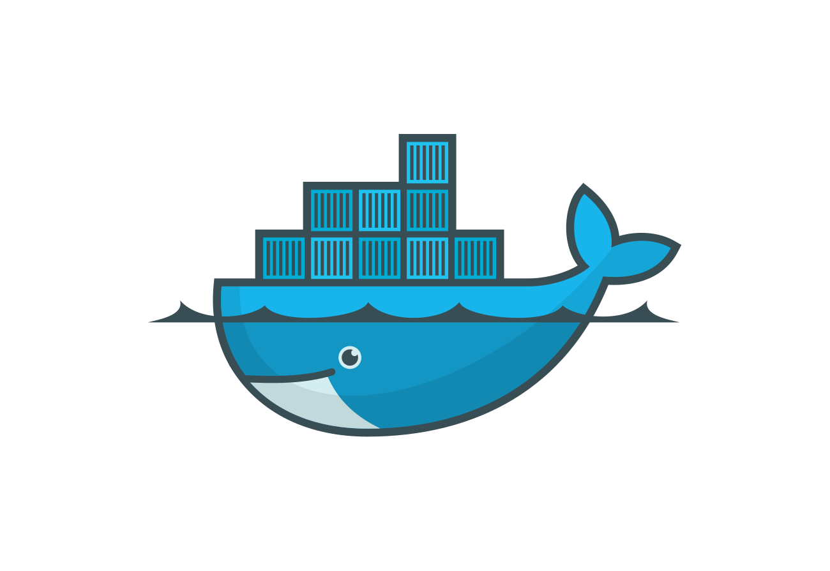
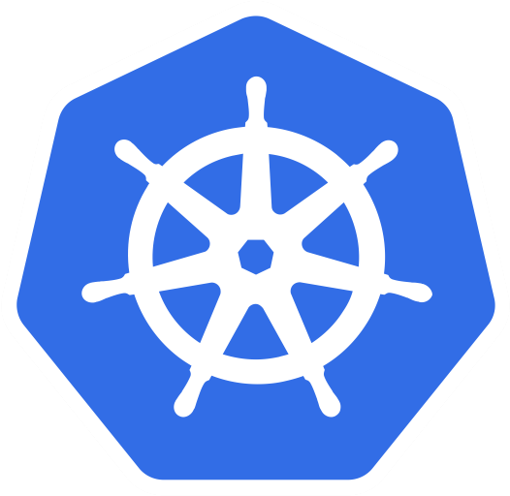
Magellan: Future Proof
Universal Host Interface
High speed NVMeOF & NVMe/TCP for containers (CSI for Kubernetes) & legacy applications
Others added by adding new microservices
Universal Media Support
SSD (block & Key Value), 3D X-Point, Object
Extensible to support novel media types and addressing schemes
Extensible Features
New features can be added to the core without any impact on host or drive side interfaces
Scalable & Elastic
Grows and shrinks based on need
Extensible platform and future proof platform. New features and capabilities can added by adding new, or by modifying existing microservices.
Block Interface
(NVMeOF)
Magellan Platform Core
Host and Media Protocol Independent
Host and Media Addressing Independent
Advanced Data Protection
Dynamic Data Relocation
Cloud Data Mobility
Global Deduplication
NVMe Block SSD
Key Value Interface
NVMe
3D XPoint
GPU Interface
NVMe Key Value SSD
S3 Object/Blob Interface
Object/Blob Storage
Docker
Kubernetes
Private Cloud
Public Cloud

Slide 9
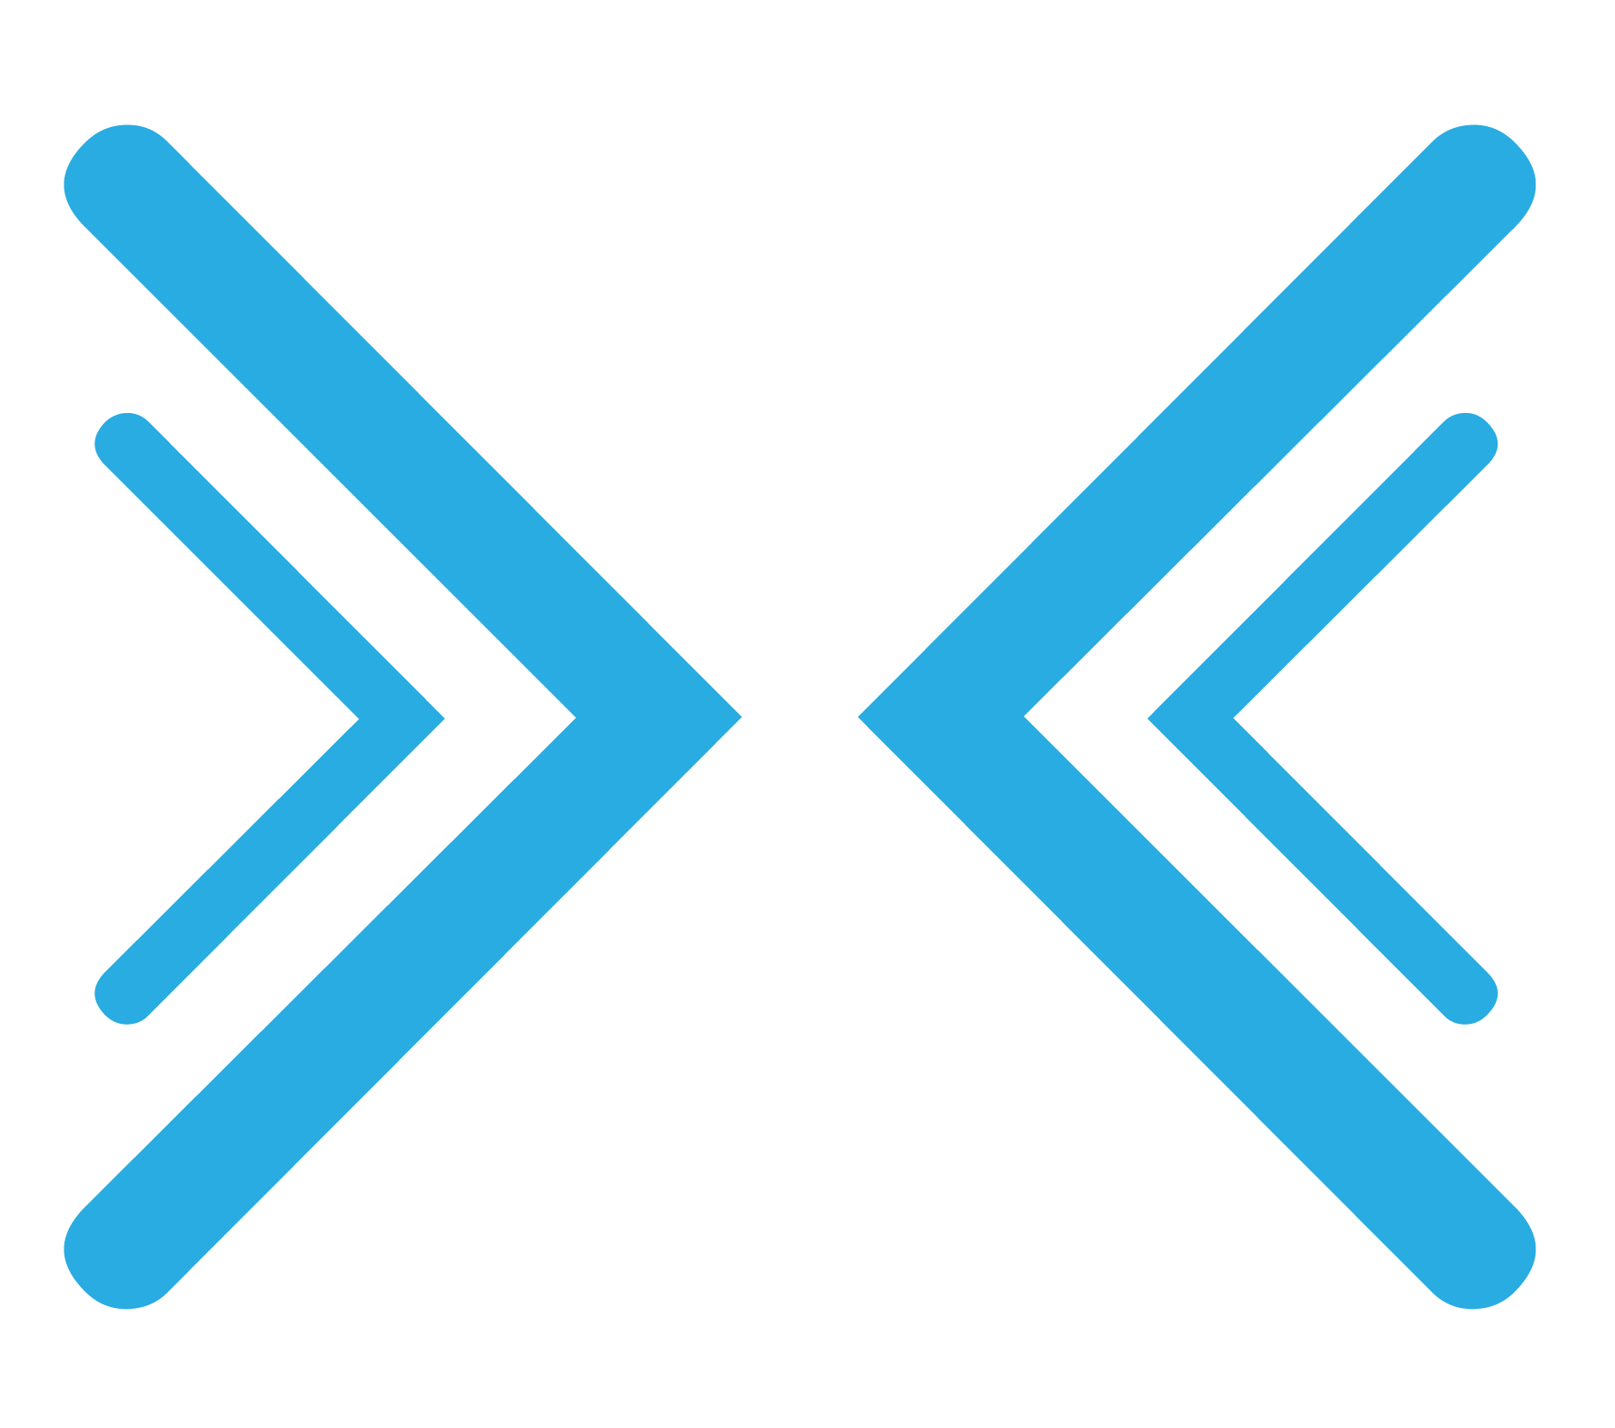
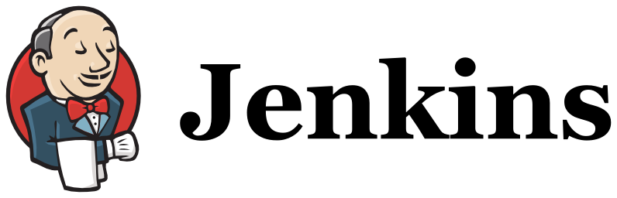

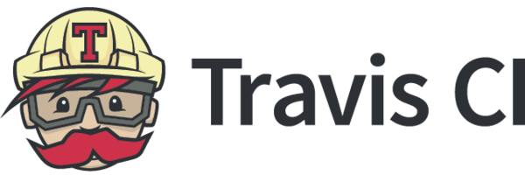
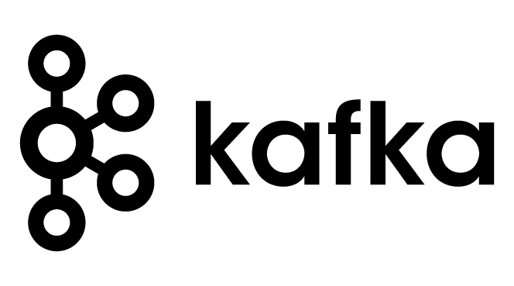
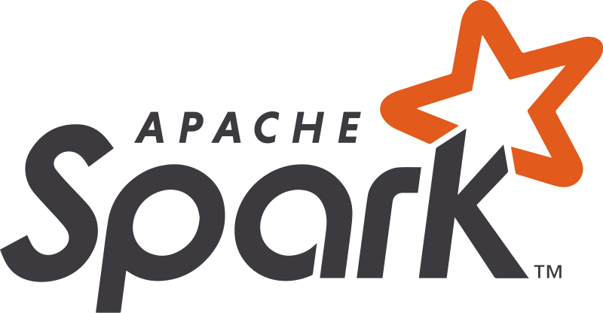
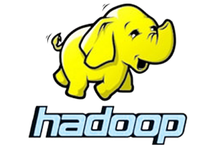

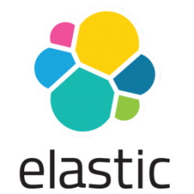
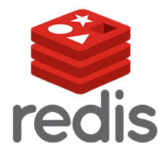
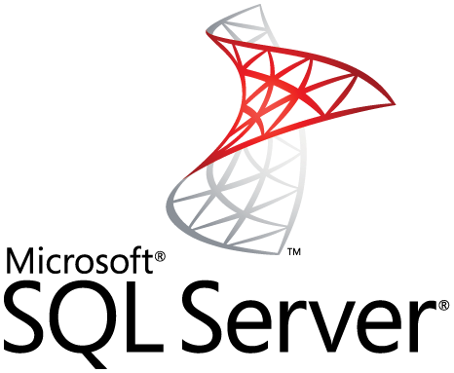

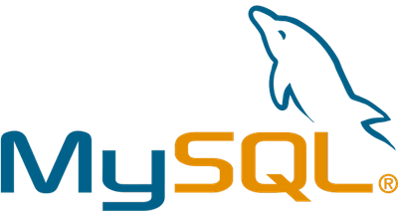
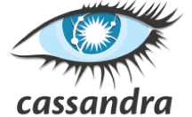
Focus Application Use Cases
CI/CD
Instant copy of applications across clouds and instant clones at one-second granularity for acceleration development and testing
Data Processing
Capacity and performance scaling on demand, and optimized infrastructure with tiering across types of storage
Databases
High performance storage, and common data management and protection workflows

Slide 10
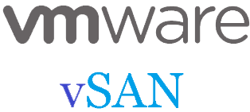
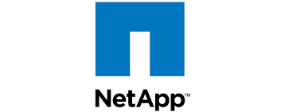
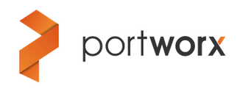
Competition
First Gen. Container Native
Not build for Production
Inefficient hardware use
Limited data management
No Data Mobility
Hyperconverged
High overhead, VM “tax”
Not Kubernetes native
No Data Mobility
Legacy Storage
Not Kubernetes native
Legacy implementation
Not Cloud native
No Data Mobility

Slide 11
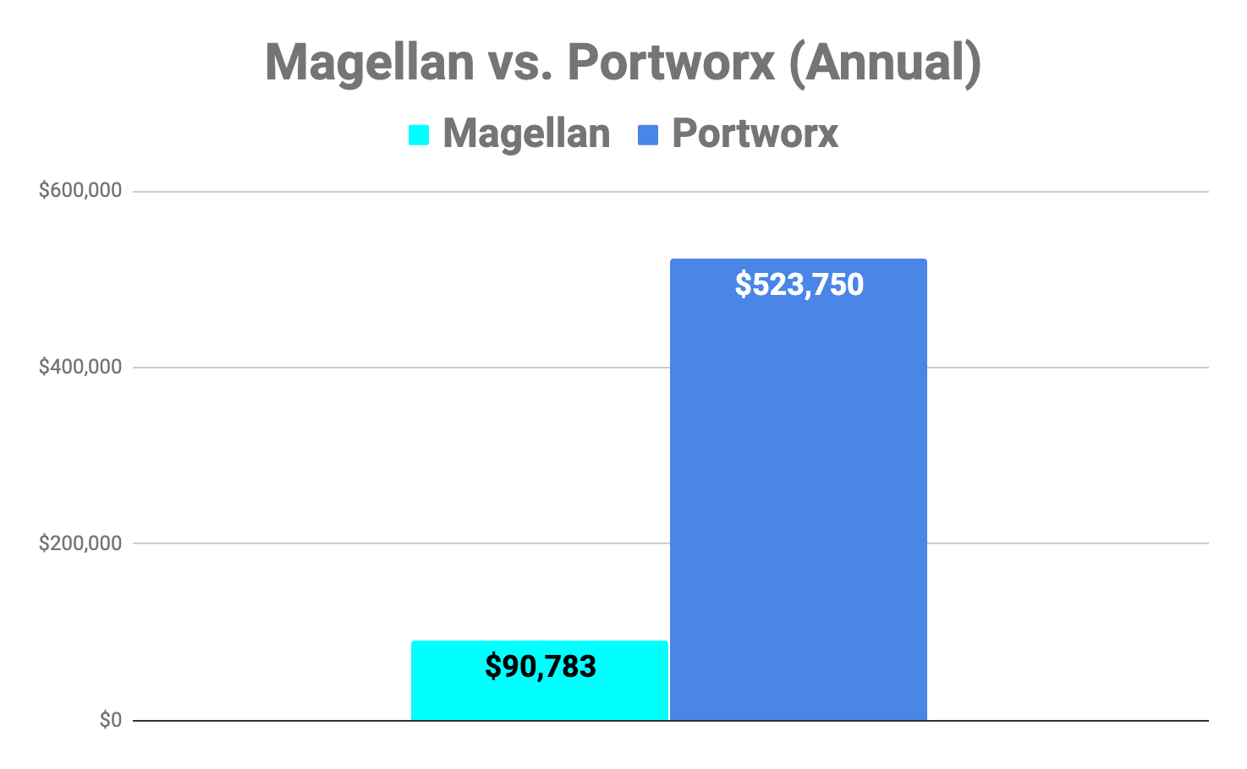
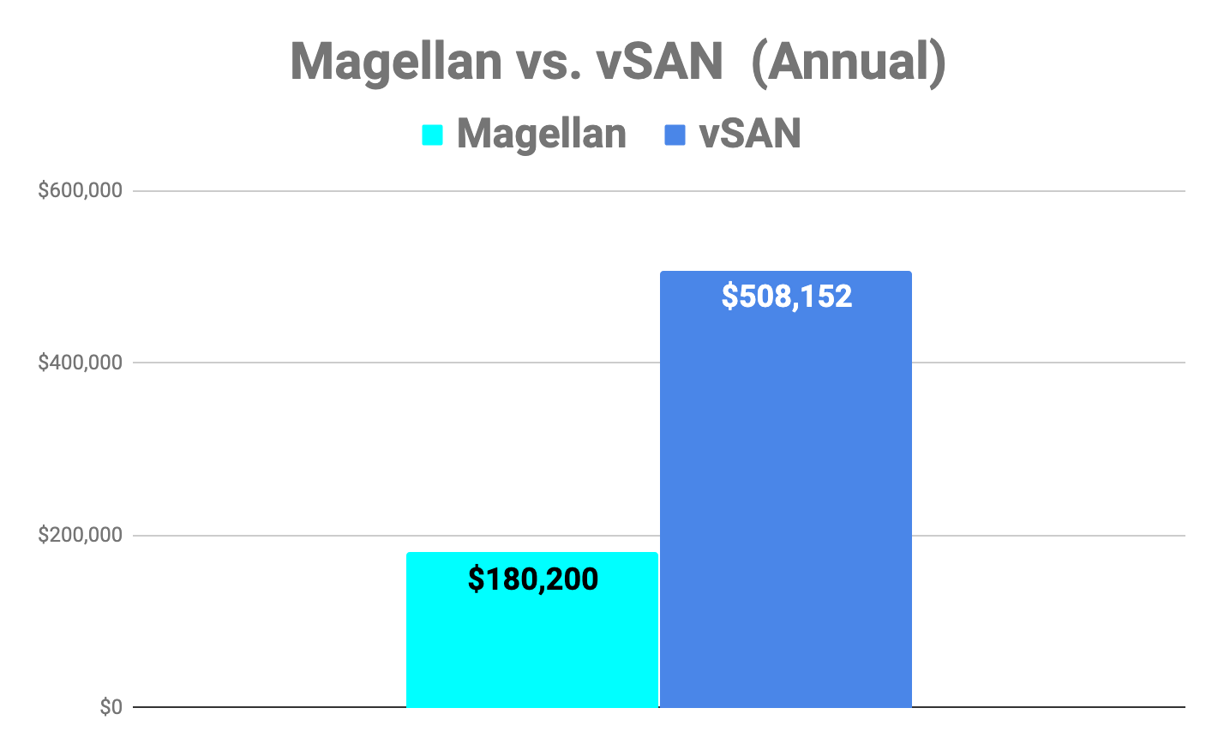
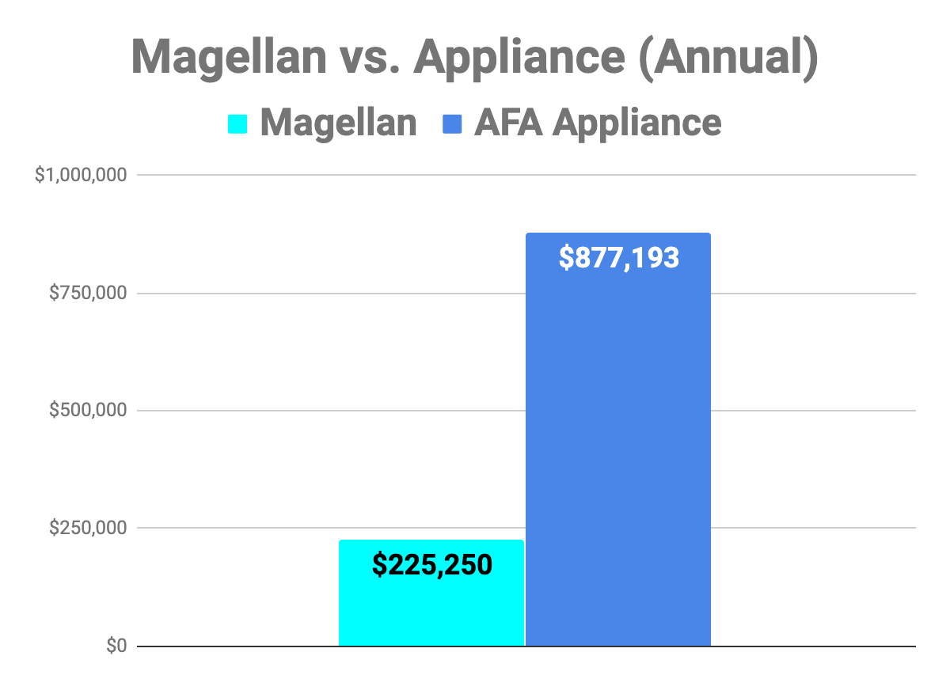
Cost Comparison
Capacity (TB) | 100
Performance (K IOPS) | 200
Nodes for Magellan | 13
Nodes for Portworx | 75
Capacity (TB) | 600
Performance (K IOPS) | 600
Nodes for Magellan | 20
Nodes for VSAN | 30
Capacity (TB) | 1,000
Performance (K IOPS) | 600
Nodes for Magellan | 20
MAGELLAN SAVINGS | 83%
MAGELLAN SAVINGS | 65%
MAGELLAN SAVINGS | 74%

Slide 12
Competitive Strength/Technology Barriers
Competitive Strength
Application/Data Mobility
Data Management - BackDating, DR, Tiering
Enterprise grade storage - Performance, Erasure code
Extensibility - KV support, AI/ML Acceleration
Technology Barriers
The metadata that enables the differentiated capability - Cloud as a Software
Microservices architecture
Multi-disciplinary skill set - Storage, Networking, Containers, Kubernetes, Clouds

Slide 13
Product Status
Magellan Eval results
Successful Customer site installation (CSP)
2 additional successful customer evaluation of Magellan on AWS
Beta (PoC) code - end of August - Done
Successful Early PoC code with Large Bank (August 2019)

Slide 14
Planned PoC
7 engagements agreed and scheduled PoC (one started)
3 Enterprise
3 large OEM
1 Ecosystem partner (Data Base)
5 engagements in advanced discussions, probable PoC during Q4
4 Enterprise customers, 1 channel
4 engagements in earlier stages,potentially Q4/Q1 PoC
5 Enterprises
Channel (SI)

Slide 15


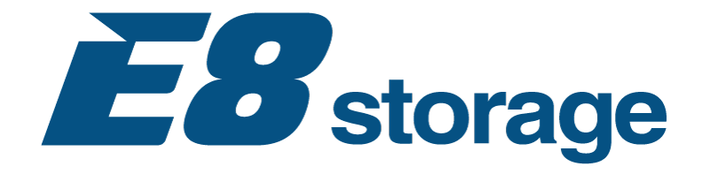
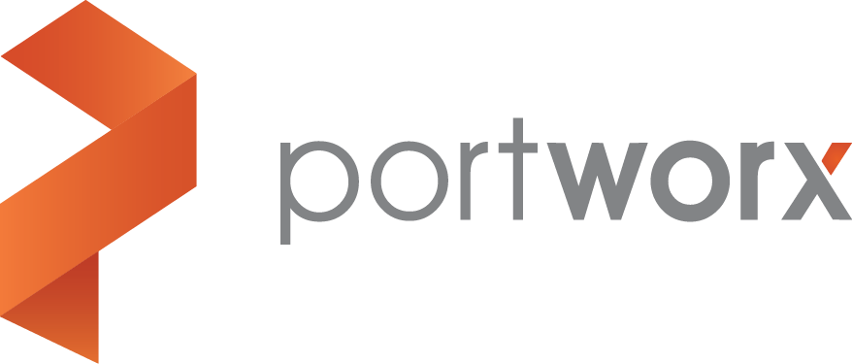
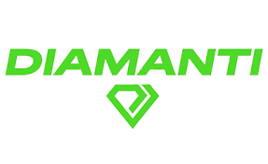
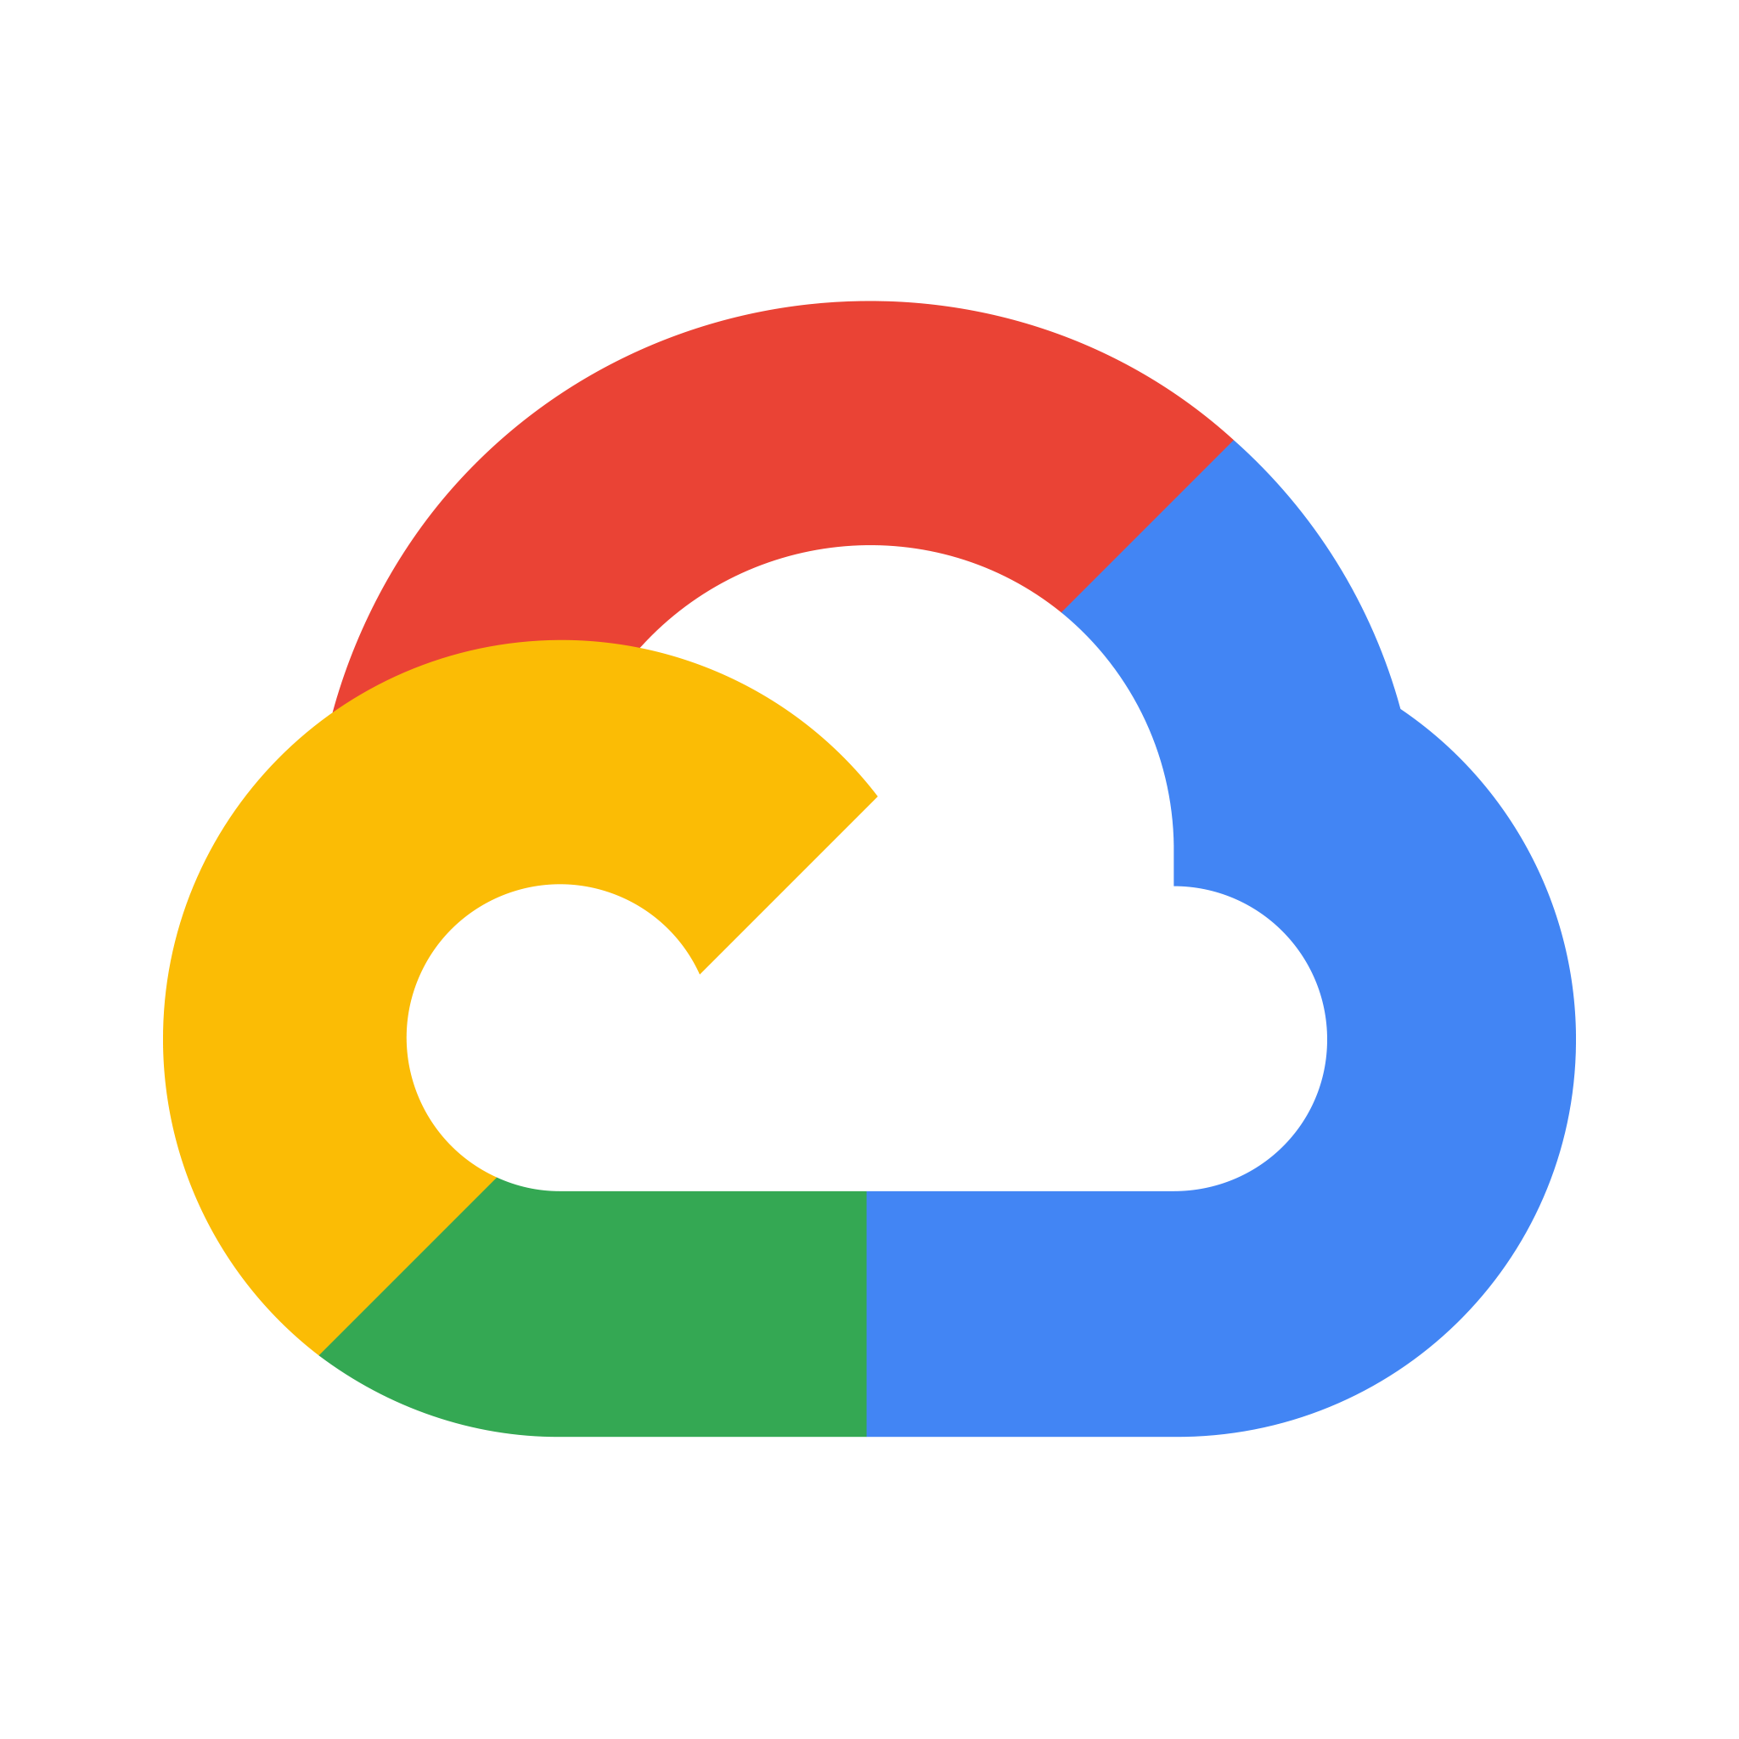
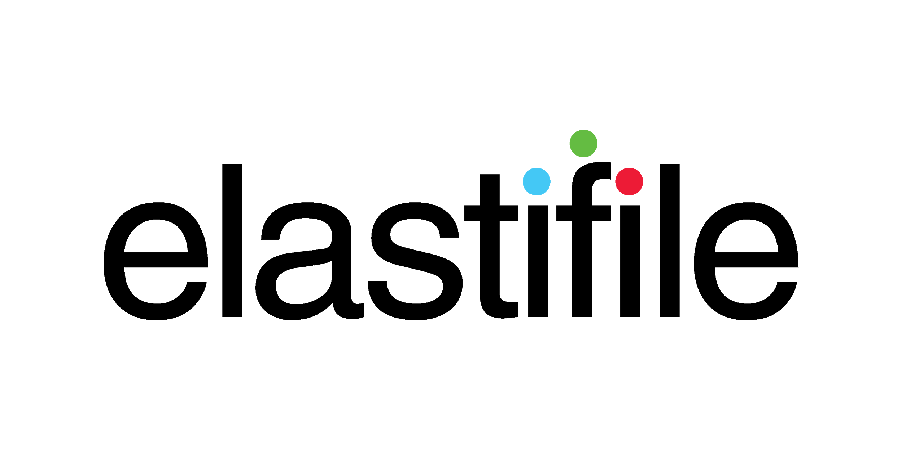

Containers and Cloud - Hot Sector
$2 billion invested across 40 startups - in 2018 alone
$1.2B in container specific venture M&A over the past two years
86.3B Hybrid Cloud Market (40% CAGR)
Israeli Cloud company Acquisition
$33B Acquisition of Containers leader
Competitors Raised Financing Rounds
Israeli Cloud company Acquisition
$2.7B acquisition of K8s distribution
Last two months

Slide 16
Major Trends
Kubernetes is moving to production
Kubernetes is the only Orchestration system for Containers
Software as a Cloud: single platform to run your IT across all Clouds
Forbes names Reduxio: 5 Cloud Native Storage Startups To Watch Out For In 2019
Kubernetes Takes Center Stage at VMworld - "Since Java, the virtual machine or cloud, we haven't seen a technology as critical as Kubernetes," VMware CEO

Slide 17
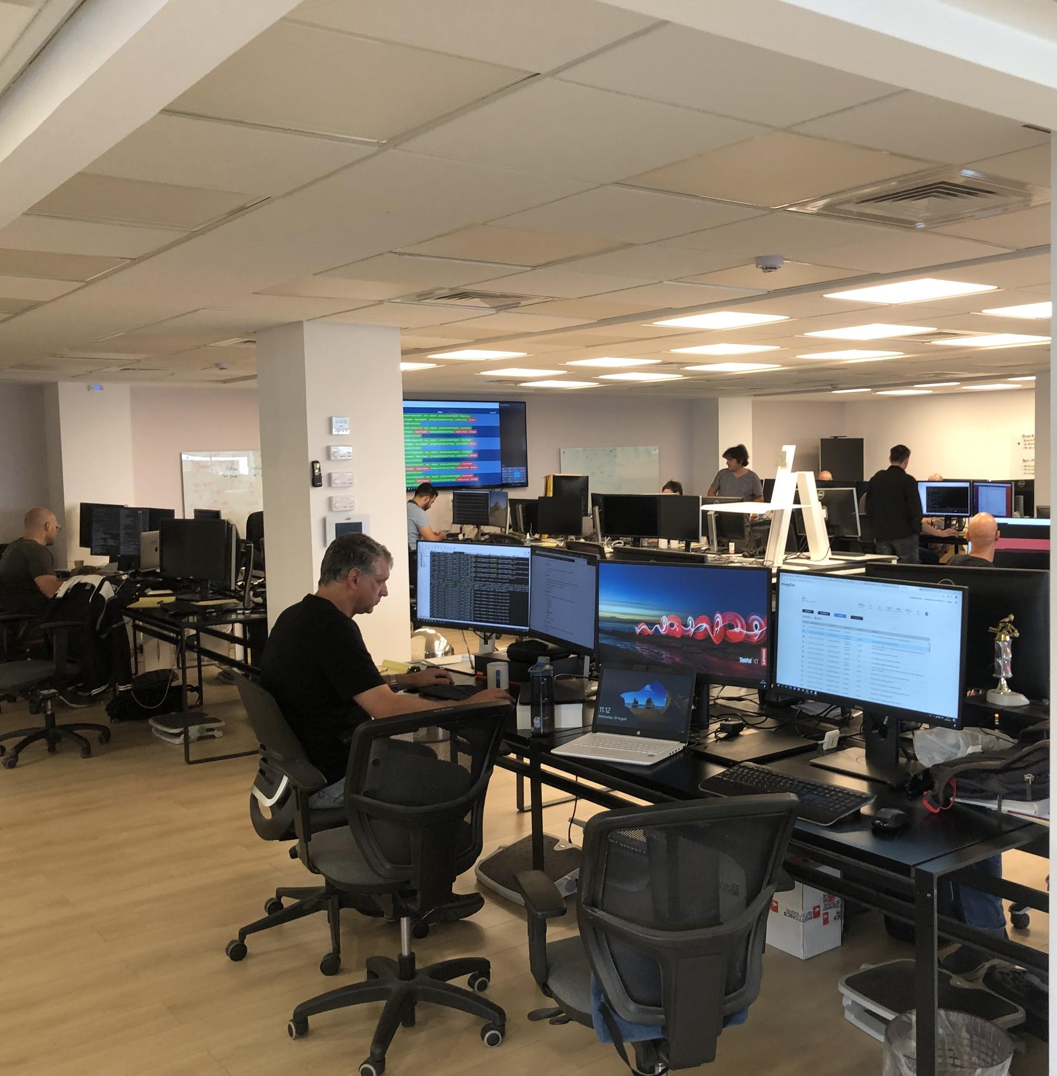
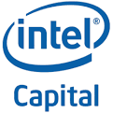

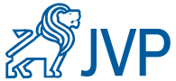
Company Overview
Established 2013, Pivot in 2018
Headquarter in Tel Aviv, Israel. Office in the US
35 employees, mostly engineers
First product in 2015, 150 customers
Magellan Beta in September 2019
Experienced Investors: Intel Capital, JVP, C5 Capital

Slide 18
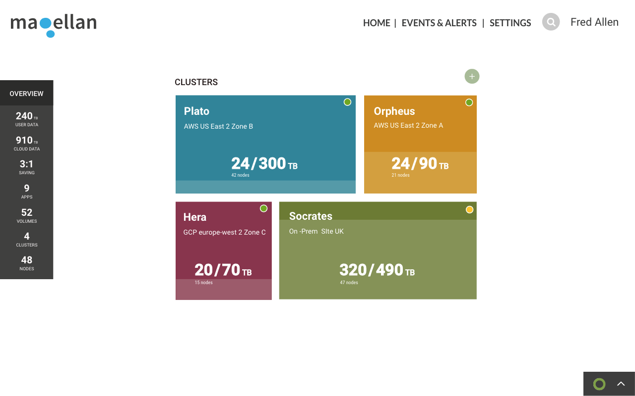
Thank You

