Slide 1
Azure Data Science Virtual Machine
Elastic data science resource on Azure platform.
Le Zhang, Data Scientist at Microsoft

Slide 2
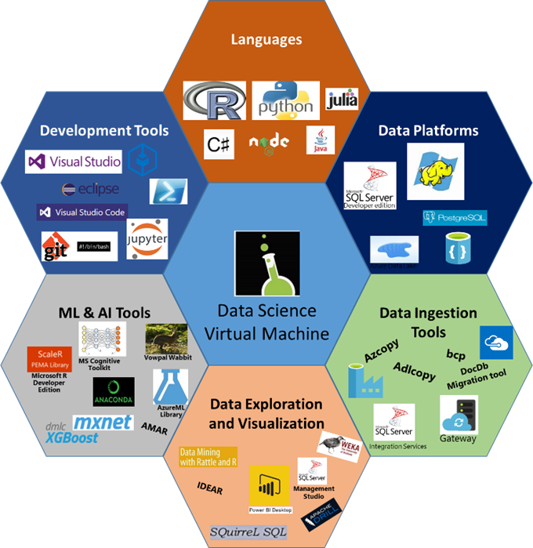
Data Science Virtual Machine

Slide 3




AzureDSR
Connect R session with Azure resources.
Local R session
Azure platform
Solo project
Team project
Resource management

Slide 4
Everything in R
Elasticity
Create a DSVM with customized name, machine size, and OS.
Enjoy all benefits of DSVM.
File transfer and remote execution.
Scalability
Deploy a collection of heterogeneous DSVMs.
Scale up DSVMs to form a cluster.
Parallel execution on DSVM(s) with Microsoft R Server.
Usability
Pay-as-you-go.
Retrieve data consumption on using DSVM(s).
Estimate expense spent on execution of analytical jobs.

Slide 5
Deployment
# authentication with Azure account.
context <- createAzureContext(tenantID=TID, clientID=CID, authKey=KEY)
# create a new resource group.
rg_pre_exists <- existsRG(context, RG, LOC)
if (! rg_pre_exists)
{
azureCreateResourceGroup(context, RG, LOC)
}
# deploy a Linux DSVM.
ldsvm <- deployDSVM(context,
resource.group=RG,
location=LOC,
hostname=HOST,
username=USER,
pubkey=PUBKEY)

Slide 6
Operations
# start the DSVM if the resource is deallocated.
operateDSVM(context,
RG,
HOST,
operation=“Start")
# ... do your work with DSVM ...
# switch off the DSVM.
operateDSVM(context,
RG,
HOST,
operation=“Stop")

Slide 7
Code Execution
# authentication with Azure account.
codes <- paste("library(scales)",
"df <- scale(iris[, -5])",
"rxExec(kmeans, df, centers=2)",
sep=";")
writeLines(codes, "./experiment.R")
# execute codes on remote DSVM in parallel.
executeScript(context,
resourceGroup="resource_group",
machines="machine_names",
remote="ip_address",
user="user",
script="./experiment.R",
master="master_ip_address",
slaves=“slave_ip_addresses",
computeContext=“localParallel")

Slide 8
Data consumption
# obtain data consumption of an Azure instance.
data_consum <-
dataConsumption(context,
instance="dsvm_name",
timeStart="starting_time",
timeEnd="ending_time",
granularity="Daily")
# calculate expense in specified currency.
consum <-
expenseCalculator(context,
instance="dsvm_name",
timeStart="starting_time",
timeEnd="ending_time",
granularity="Daily",
currency="USD",
locale="en-SG",
offerId="MS-AZR-0015P",
region="SG")

Slide 9



Azure cloud
Computing resources
deployed on-demand
Local working environment
DSVM cluster
A pre-defined machine learning process
Optimal initial cluster number of the clustering algorithm.
Worker script
Worker
script
Handle NA.
Create formula.
Scaling of variables.
Feature Engineering
FE1
DSVM
Iterate on clustering algorithm parameters.
Sweeping initial cluster numbers.
Parameter tuning
PT1
PT2
PT3
PT4
HDInsight Spark Cluster
Operating azure resources and execute worker script on remote.
Problem description:
Unsupervised clustering.
Find the optimal initial cluster number for a clustering outcome.
Master script (with AzureDSR)
1
Determination of resource plan – instance, number of nodes, size of each node, etc.
3
Upload and execute worker script on cloud
Data blobs
Data source
4
Stop/deallocate computing resources
2
Deployment of computing resources
5
Master
script
Calculate expense for analytics.

Slide 10
A pre-defined machine learning process
Local working environment
Azure cloud
Worker script
Computing resources
deployed on-demand
Handle NA
Normalization
Feature selection
Feature Engineering
FE1
FE2
Iterate on FE strategies
DSVM cluster
Optimal classifier for the predictive analysis.
Worker
script
Logistic regression
Decision tree
Random forest
Iterate on candidature algorithms
Algorithm selection
AL1
AL2
AL3
DSVM
(for trees)
Number of trees
Depth of tree
Parameter tuning
PT1
PT2
PT3
PT4
HDInsight Spark Cluster
Operating azure resources and execute worker script on remote.
Problem description:
Supervised binary classification problem.
Find the optimal model that yields the best figure of merit (e.g., AUC).
Master script (with AzureDSR)
1
Determination of resource plan – instance, number of nodes, size of each node, etc.
3
Upload and execute worker script on cloud
Data blobs
Data source
4
Stop/deallocate computing resources
2
Deployment of computing resources
5
Master
script
Calculate expense for analytics.

Slide 11
A pre-defined machine learning process
Local working environment
Azure cloud
Worker script
Computing resources
deployed on-demand
Handle NA
Normalization
Feature selection
Feature Engineering
FE1
FE2
Iterate on FE strategies
DSVM cluster
Worker
script
Logistic regression
Decision tree
Random forest
Iterate on candidature algorithms
Basic model Training
AL1
AL2
AL3
DSVM
Meta model
Logistic regression
Meta model training
AL1
HDInsight Spark Cluster
A stacking ensemble model with boosted prediction performance.
Operating azure resources and execute worker script on remote.
Problem description:
Supervised binary classification problem.
Create an ensemble of small models for boosted prediction performance.
Master script (with AzureDSR)
1
Determination of resource plan – instance, number of nodes, size of each node, etc.
3
Upload and execute worker script on cloud
Data blobs
Data source
4
Stop/deallocate computing resources
2
Deployment of computing resources
5
Master
script
Calculate expense for analytics.

