Slide 1
Read Me: This deck contains two sections. One for participants and a second for coaches.
Participant section
This top section is a Tech Scenario description for participants. The section will cover the technology introduction and high-level concepts about the challenges.
Audience: Participants at OpenHack
Coach only section
This section is a Tech Scenario description for coaches. The section will cover the technology, challenge goals, common pit falls, general guidance on solutions. This section is presented to coaches in the ‘know before you go’ call a few days before the OpenHack starts. This section is intended to be more in-depth than the participant section. Do not share the coach section with participants!
Audience: Coaches at OpenHack
Section 1
Section 2

Slide 2

Bring Your Own Data to ChatGPT
Overview
#MSOpenHack

Slide 3
Data Copilot
Technologies
Azure OpenAI Service
Semantic Kernel
Azure Cosmos DB
Azure Cognitive Search
Azure Kubernetes Service
Azure Machine Learning
Azure Functions
is a broad term used to describe technological solutions using GPT Large Language Models that enable users to query, analyze, summarize and reason about their data using natural language in a chat like interface. The data integrated can range in shape from frequently changing, structured transactional data to infrequently changing unstructured data and in volumes from small to large.

Slide 4
Scenario
The scenario centers around a consumer retail "Intelligent Agent" that allows users to ask questions on vectorized product, customer and sales order data stored in a database. The data in this solution is the Cosmic Works sample for Azure Cosmos DB. This data is an adapted subset of the Adventure Works 2017 dataset for a retail Bike Shop that sells bicycles, biking accessories, components and clothing.
BUT you can bring your own data instead.

Slide 5







Reference Architecture
DATA SOURCES
CONSUMERS
6
2
Submit Question & History
Persist Q&A
2
Change Feed: Source Documents
Databases
3
Request Embeddings (Embeddings API)
Vector & Search
Pod
Request Question Embedding (Embeddings API)
3
Apps
Azure OpenAI (Embeddings API)
Cosmos DB
4
Index Documents & Embedding Vectors
Search for context data
4
Cognitive Search (Hybrid Index)
Data Engineers
DBAs
End Users
Files
Source Data
+
Embeddings, Prompts & Completions
5
Persist Embedding Vectors
1
Batch / CDC / Stream
5
Request Completion (Completions API)
Azure OpenAI (Completions API)
1
Ask Question
0
Load Q&A Session
Q&A Web App
Legend:
Source Data
Semantic Kernel Orchestrated Call
Other Service Call
User Interaction
Source data loading
Q&A interaction
1
1

Slide 6
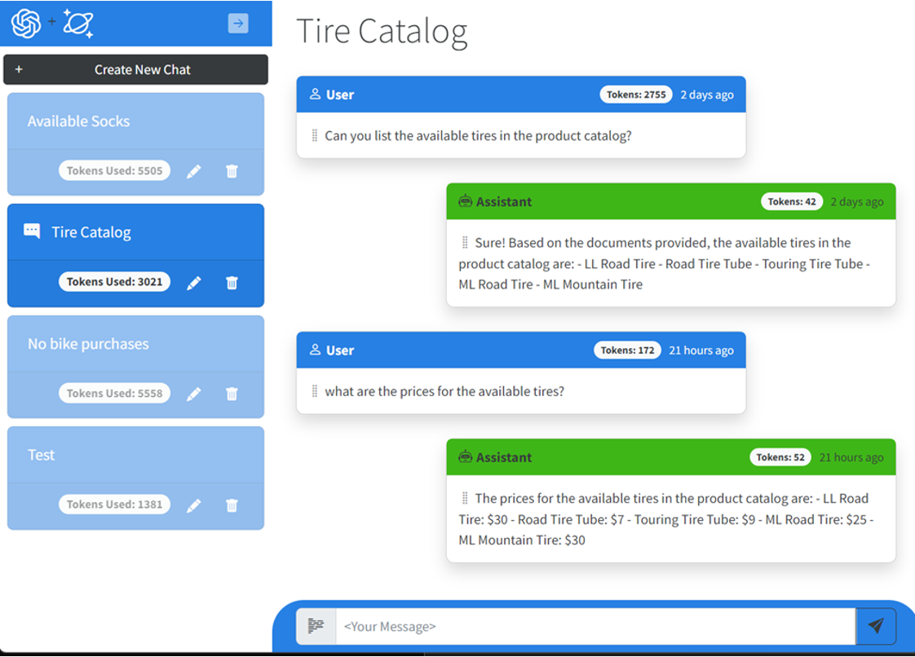
User Interface
Notes:
The application frontend is a Blazor application with Intelligent Agent UI functionality.

Slide 7
Common Patterns
Retrieval Augmented Generation (RAG) – Intelligently retrieves a subset of data from data stores to provide specific, contextual knowledge to the large language model to support how it answers a user’s prompt
Chain of Thought (COT) – Leverages the capability of large language models to reason and provide answers from its reasoning combined with its knowledge
Reason and Act (ReAct) – In response to a user’s prompt, utilizes larges language models to create and coordinate the execution of plans that may invoke external systems via API’s

Slide 8
What are embeddings?
Embeddings are a technique for representing words or data as vectors in a high-dimensional space, allowing us to measure their relatedness.
In AI models, embeddings help computers understand the meaning and context of words or data. To use embeddings, the text is transformed into vectors, and a search query is converted into its vector representation to find similar vectors. This process resembles searching on a search engine, providing ranked matches based on similarity.
Azure OpenAI embeddings utilize cosine similarity, measuring the angle between vectors in a multi-dimensional space, even when documents are far apart by Euclidean distance.
Notes:
Embeddings are a method of representing words or data as vectors in a high-dimensional space. Vectors are mathematical entities that resemble arrows, having both direction and length. In this context, high-dimensional means that the space has numerous dimensions beyond what we can perceive. Embeddings aim to assign similar words or data with similar vectors, while different words or data are assigned different vectors. This allows us to measure the relatedness or unrelatedness of words or data and perform various operations on them, such as addition, subtraction, and multiplication. Embeddings are particularly valuable for AI models as they enable computers to comprehend and process the meaning and context of words or data.
To utilize embeddings, a sentence, paragraph, or page of text is transformed into an embedding vector. When a search query is conducted, it is converted into its corresponding embedding representation. Then, a search is performed among the existing embedding vectors to find the most similar ones. This process resembles making a search query on a search engine, which provides multiple results that are closely related to the query. Semantic memory may not yield an exact match, but it will always provide a set of matches ranked based on how similar the query is to other text pieces.
Azure OpenAI embeddings employ cosine similarity to calculate the similarity between documents and a query. Cosine similarity measures the cosine of the angle between two vectors projected in a multi-dimensional space. This approach is advantageous because even if two documents are far apart in terms of Euclidean distance due to their size, they may still exhibit a smaller angle between them, resulting in higher cosine similarity.

Slide 9
Meet the lightweight Kernel of Semantic Kernel.
“
I’ve been designed to orchestrate complicated LLM AI prompts combined with native code, use multiple AI models, and use a goal-oriented approach to achieving asks.”
STEPS
👋
PLANNER
1
2
3
…
ernel
ASK
K
“
I take a user’s ask and generate a step-by-step plan that draws upon available skills.”
Planner generates steps that use available Skills
SKILLS
Notes:
It all starts from an Ask. The user has a need that needs to be filled. Kernel, in Semantic Kernel, is the orchestrator for the Ask. It sends the Ask over to the Planner to the right skills can be found and the right steps can be created from the Ask and Skills.

Slide 10
Goals-First AI
ernel
ASK
K
It all starts with a user’s AI ask …
Steps ready from planner
1
2
3
…
Gather Skills
Gather Memories
V1 READY
Gather Connectors
SKILLS
APIs
… resulting in new productivity
GET
RUNNING STEPS PIPELINE
Result is ready
1
2
3
…
Execute Steps
Notes:
It always starts with an Ask. A user has a goal they want to achieve. We have seen how the Kernel orchestrates the ask to the planner. The Planner finds the right AI skills that can be used to solve that need. Some skills are enhanced with memories and with live data connections. The steps to complete the users ask are executed as part of the plan and the results are returned to the user, resulting in productivity gains and ideally the goal reached.

Slide 11

Let’s get started!
aka.ms/TBD
Follow the instructions to get started.
Notes:
To get started, visit the OpenHack portal:

Slide 12
Bring Your Own Data to ChatGPT
Challenge walkthrough for coaches
Notes:
This guide is only meant to be a reference. Please do not rely on this guide in place of completing the challenges before coaching.

Slide 13
Challenge 1: The Landing Before the Launch
For this challenge, you will deploy the services into the landing zone in preparation for the launch of the POC.
Learning objectives:
Deploy the Azure services needed to support the chat interface
Understand the setup of the development environment

Slide 14
Challenge 2: It's All About the Payload
In this challenge participants will learn to create vector embeddings using Azure OpenAI from data stored in Cosmos DB.
Learning objectives:
Load data from storage into Cosmos DB
Use Azure Open AI to create vector embeddings
Store the vector embeddings for later use in a vector database provided by Azure Cognitive Search

Slide 15
Challenge 3: Now We're Flying
In this challenge participants will create the workflow that ties everything together and displays it in chat form, from acquiring a vector embedding for the user’s question to producing the completion that contains the response from the large language model.
Learning objectives:
Update the chat interface to initiate the workflow
Invoke the Azure OpenAI completion endpoint
Perform prompt engineering to create the system prompt
Store the user’s questions and generated respones
Notes:
Challenge 3: Expanding the Search
In this challenge, you will Update the index and demonstrate code that successfully retrieves information.
Learning objectives:
Add built-in cognitive skills to an Azure Search index to return:
Key Phrases
Entities (including links)
Sentiment (especially reviews)

Slide 16
Challenge 4: Getting the Full Picture
In this challenge participants will load new data using the data loading mechanism created in a previously, observe the automatic vectorization ask a question through the prompt interface to returns an answer about the new data loaded.
Learning objectives:
Load new data using the data loading mechanism
Experiment with various prompting strategies to answer questions about the new data
Notes:
Challenge 4: Getting the Full Picture
In this challenge, you will use the OCR skill to expand the index to extract AI-generated descriptions of images embedded in documents.
Learning objectives:
Add built-in cognitive skills to an Azure Search index to return:
Image Descriptions and Tags
OCR extracted Text

Slide 17
Challenge 5: It's All About the Payload, The Sequel
In this challenge participants will test their workflow loading a new type of data previously unseen by the language model.
Learning objectives:
Create a new index in the vector database for the new data type.
Load the new data type into Cosmos DB.
Use the chat interface to ask questions about the new data type.
Notes:
Challenge 5: What is the Frequency?
In this challenge, you will create a web API custom skill for your Azure Search index.
Learning objectives:
Create a custom skill to find the top ten most frequent words
Incorporate your custom skill into your web content index

Slide 18
Challenge 6: The Punctual Engineer
In this challenge participants will use a technique called prompt engineering to generate improved prompts that are used to generate completions.
Learning objectives:
Create different response formats from the completions model:
Respond with a single number
Respond with a bulleted list of products
Respond with JSON-formatted data
Have the agent reject off topic questions
Notes:
Challenge 6: The Search for Relevance
In this challenge, you will create return search results based on synonyms and display suggestions and autocomplete options.
Learning objectives:
Add Synonyms to Azure Search index to ensure relevant results
Implement query suggestions / autocomplete
Add scoring profiles that boost documents in results

Slide 19
Challenge 7: The Colonel Needs a Promotion
In this challenge participants will augment the solution by creating a new plugin for Semantic Kernel that is used in the completions process
Learning objectives:
Implement a plugin for Semantic Kernel
Notes:
Challenge 7: Knowledge preservation
In this challenge, you will modify the index skillset to generate knowledge store assets. Browse the blobs and tables in the knowledge store using the Storage Explorer interface.
Learning objectives:
Implement knowledge stores.

Slide 20
Challenge 8: Workin' on the LangChain Gang!
In this challenge participants will substitute Semantic Kernel with LangChain.
Learning objectives:
Create a custom skill that calls the Form Recognizer Service
Notes:
Challenge 8: Finding Your Form
In this challenge, you will train a Form Recognizer model and integrate into a new Azure Search index.
Learning objectives:
Create a custom skill that calls the Forms Understanding Service

Slide 21
Challenge 9: Getting Into the Flow
In this challenge participants will use Azure Machine Learning Prompt Flow for the entire process instead of Semantic Kernel.
Learning objectives:
Replace the endpoint used by the solution with one created using Azure Machine Learning.
Notes:
Challenge 9: Use Your Intelligence
In this challenge, you will publish a machine learning model as a web service to predict claim probability.
Learning objectives:
Build a custom skill that consumes a custom machine learning model

Slide 22


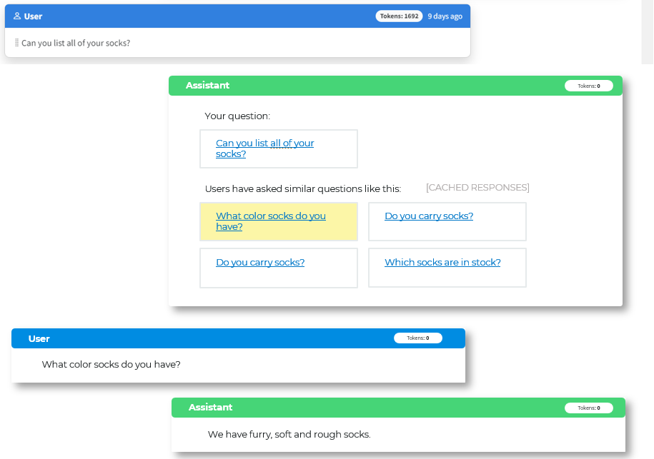
Challenge 9: HINT
Data Storage
Vector & Search Processing
Application
Prompt Flow
Azure OpenAI
QA Web App
Cosmos DB
Source Data/Enriched Documents
Get user query vector
(LLM Tool)
Generate embedding
Q/A interactions
Embedding Vectors: Document Data
Cognitive Search
Search for context data (Vector DB Lookup Tool)
Embedding Vectors: User Questions
Hybrid index
Log of Questions/Answers
Request completion (LLM Tool)
Azure OpenAI
Session State
Generate completion
Store & return result (Python Tool)

Slide 23
Coach solutions folder
https://aka.ms/TBD

Slide 24
Thank you coaches!

