Slide 1









Azure X Session 2 Architecture
Virtual Network
Web Subnet
Biz Subnet
NSG
NSG
Internet
Public Load Balancer
Virtual Machine Availability Set
Internal Load Balancer
Virtual Machine Availability Set
Document DB
(Mongo DB API)
Mgmt Subnet
NSG
SSH
(whitelisted IP)
App Storage
Admin
Jumpbox
Redis Cache

Slide 2

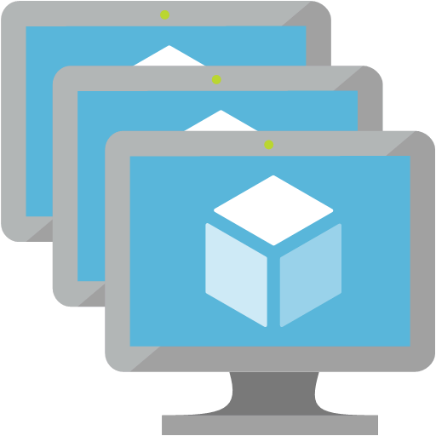


Azure X Session 3 Architecture
Internet
Resource Group
Resource Group
West US Data Center
East US Data Center
Virtual Network
Virtual Network
Biz Subnet
Web Subnet
Web Subnet
Biz Subnet
Traffic Manager
NSG
NSG
NSG
NSG
Virtual Machine Scale Set
Internal Load Balancer
Virtual Machine Scale Set
Public Load Balancer
Public Load Balancer
Virtual Machine Scale Set
Internal Load Balancer
Virtual Machine Scale Set
Mgmt Subnet
Mgmt Subnet
NSG
Admin
NSG
Jumpbox
Jumpbox
Redis Cache
Redis Cache
Resource Group
Document DB
App Storage
App Insights
CDN

