Slide 1




OpenDev Single-Virtual Machine Architecture
Resource Group
Virtual Network
Dev Subnet
Internet
NSG
PIP
Dev Virtual Machine
Admin

Slide 2



OpenDev Single-Virtual Machine Architecture
Resource Group
Virtual Network
Dev Subnet
Document DB
(Mongo DB API)
Internet
NSG
PIP
Dev Virtual Machine
Blob Storage
Admin
Redis Cache

Slide 3


OpenDev Single-Region Multi-Instance Architecture
Resource Group
Virtual Network
Web Subnet
Biz Subnet
NSG
NSG
Internet
Public Load Balancer
Virtual Machine Availability Set
Internal Load Balancer
Virtual Machine Availability Set
Document DB
(Mongo DB API)
Mgmt Subnet
NSG
SSH
(whitelisted IP)
Blob Storage
Admin
Jumpbox
Redis Cache

Slide 4

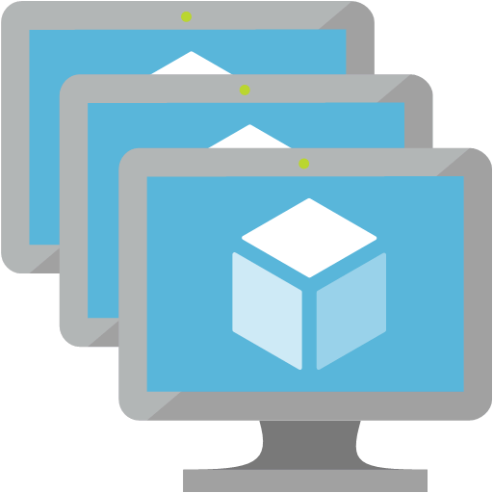


OpenDev Multi-Region Multi-Instance Architecture
Internet
Resource Group (West US)
Resource Group (East US)
Virtual Network
Virtual Network
Biz Subnet
Web Subnet
Web Subnet
Biz Subnet
NSG
NSG
Traffic Manager
NSG
NSG
Virtual Machine Scale Set
Internal Load Balancer
Virtual Machine Scale Set
Public Load Balancer
Public Load Balancer
Virtual Machine Scale Set
Internal Load Balancer
Virtual Machine Scale Set
Mgmt Subnet
Mgmt Subnet
NSG
NSG
Jumpbox
Jumpbox
Admin
Redis Cache
Redis Cache
Resource Group
Document DB
App Storage
App Insights
CDN

