Slide 2
Migrating your app to Azure and extending it for global scale
P4122
Steven Follis
Ross Sponholtz

Slide 3




Single Virtual Machine Architecture
Resource Group
Virtual Network
Dev Subnet
Internet
NSG
PIP
Dev Virtual Machine
Admin

Slide 4

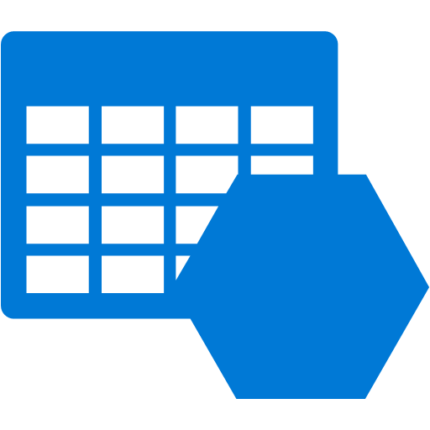

Enhanced Single VM Architecture
Resource Group
Virtual Network
Dev Subnet
Document DB
(Mongo DB API)
Internet
NSG
PIP
Dev Virtual Machine
Blob Storage
Admin
Redis Cache

Slide 5

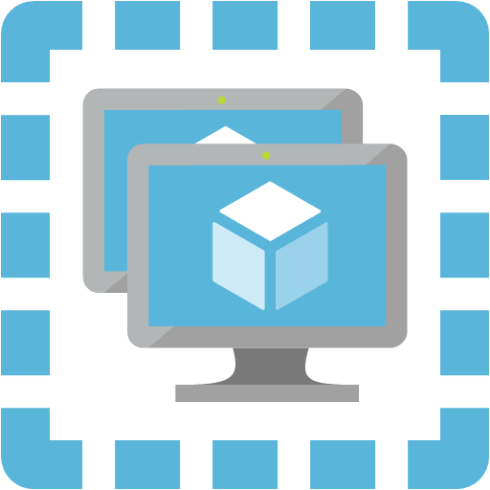
Single-Region Multi-Instance Architecture
Resource Group
Virtual Network
Web Subnet
Biz Subnet
NSG
NSG
Document DB
(Mongo DB API)
Internet
Public Load Balancer
Virtual Machine Availability Set
Internal Load Balancer
Virtual Machine Availability Set
Mgmt Subnet
Blob Storage
NSG
SSH
(whitelisted IP)
Admin
Jumpbox
Redis Cache

Slide 6

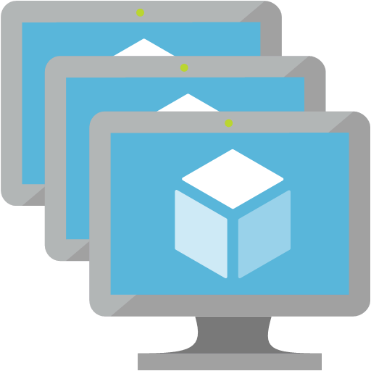


Multi-Region Multi-Instance Architecture
Resource Group (West US)
Internet
Resource Group (East US)
Virtual Network
Virtual Network
Biz Subnet
Web Subnet
Web Subnet
Biz Subnet
NSG
NSG
NSG
NSG
Traffic Manager
Virtual Machine Scale Set
Internal Load Balancer
Virtual Machine Scale Set
Public Load Balancer
Public Load Balancer
Virtual Machine Scale Set
Internal Load Balancer
Virtual Machine Scale Set
Mgmt Subnet
Mgmt Subnet
NSG
NSG
Jumpbox
Jumpbox
Admin
Redis Cache
Redis Cache
Resource Group
Document DB
App Storage
App Insights
CDN

