Slide 1
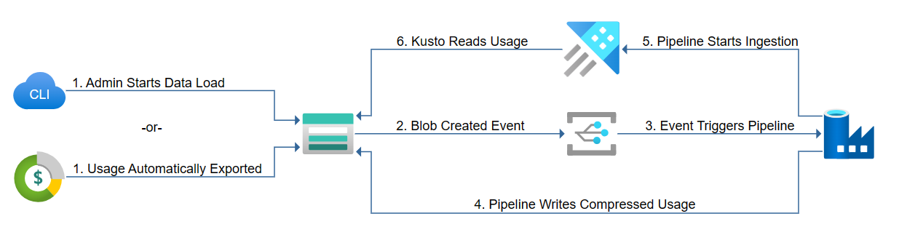

Slide 2

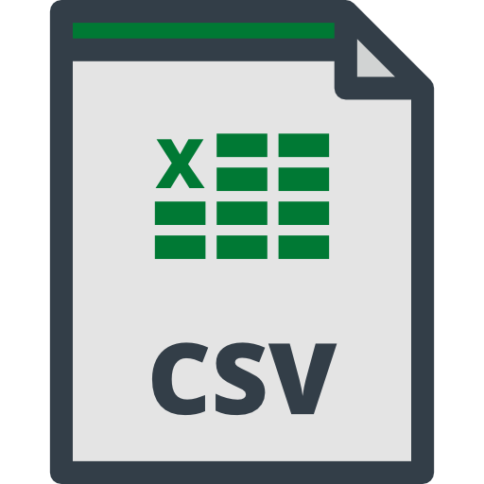




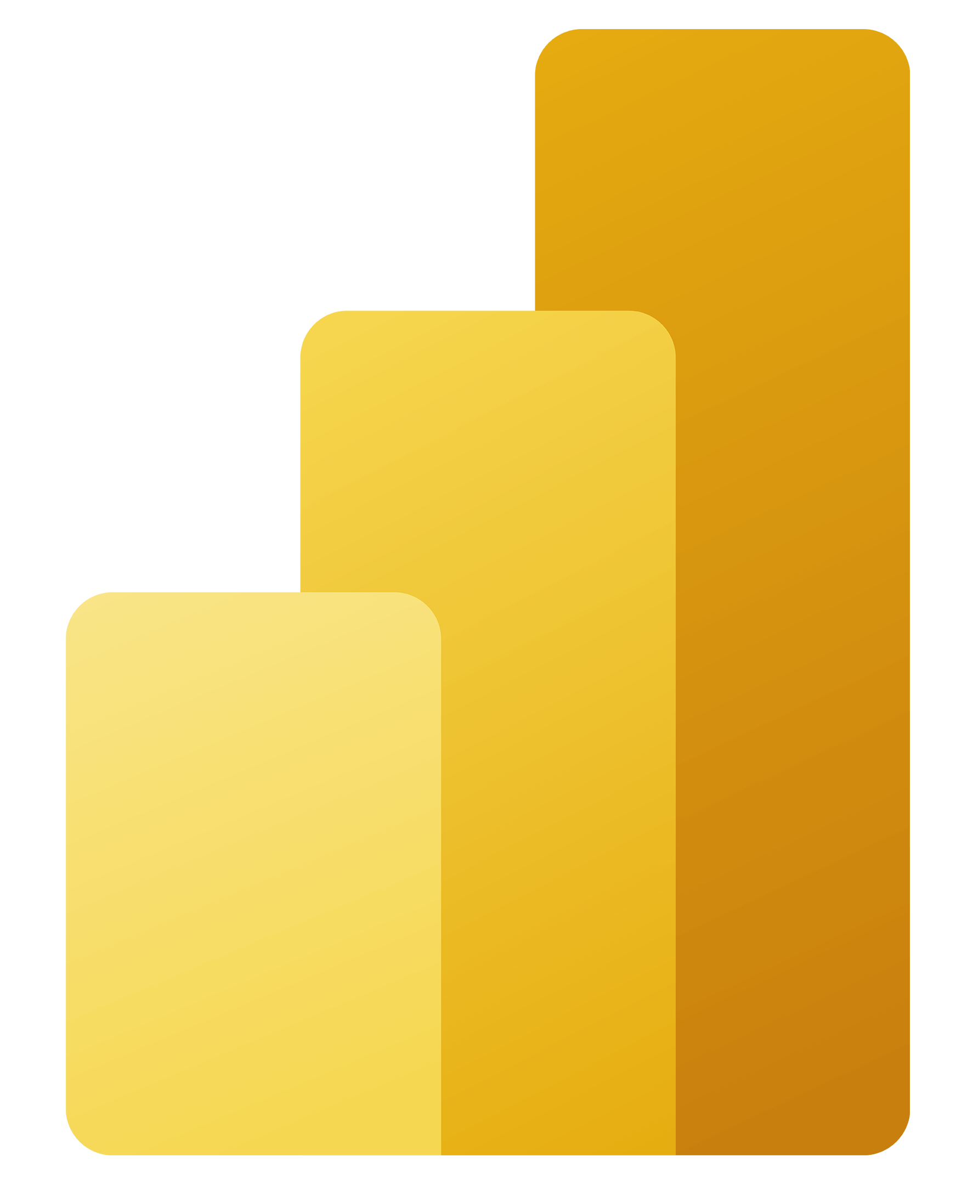

Web Apps
(SDKs)
Blob Storage
(export destination)
Daily exports
Orchestrates
pipeline
Big Data
Analytics
Report
Visuals
Sink (loads csv)
Command (drop old data)
if has month
Direct Query
CSV
blob created
Azure Cost Management
Daily exports (CSV)
month-to-date
Runs update policy
for simple
transformation
Trigger ADF pipeline
Realtime
ADX
Dashboard

Slide 3
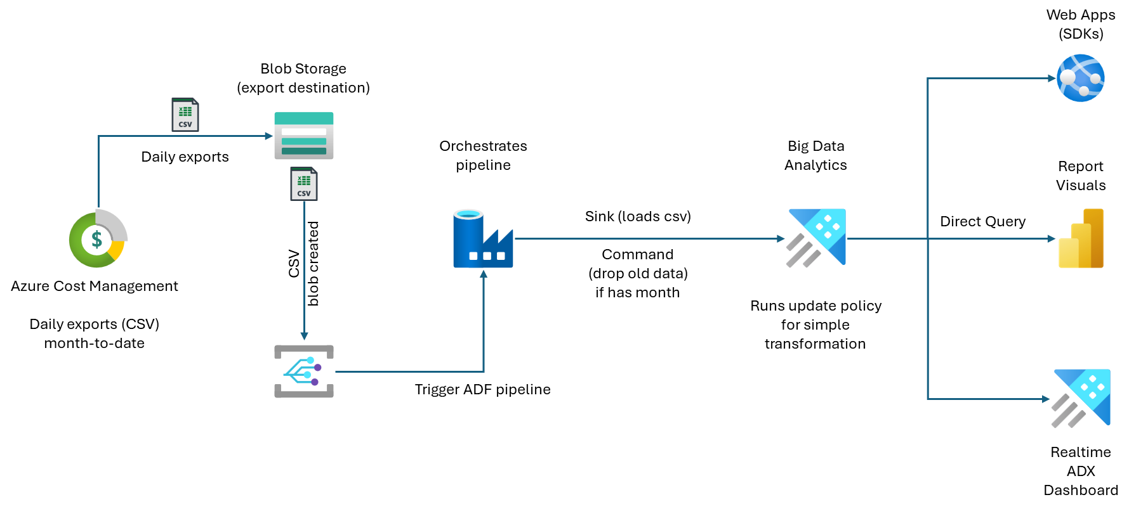

Slide 4
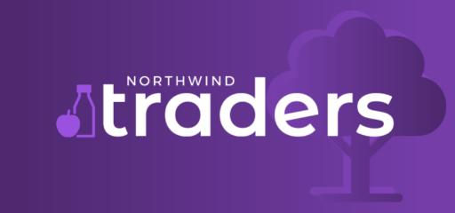




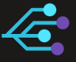


Lab Architecture
IoT Central
Event Hubs
Event Grid
Digital Twins
Data Explorer
Store Apps
iotdata
historicdata
historicdata
office
floor
thermostat
StageIoTRawData Thermostats
Thermostat_January2022
adxscript
Notes:
IoT Central:
Has an IoT application called Store Apps for simulated activity by Northwind Traders. This exports the device telemetry to Event Hubs.
Event Hubs:
Has 2 name spaces. One for live incoming IoTdata from Store Apps. Second, for historicdata, which we use to auto ingest our CSV during the initial deployment of the lab.
Event Grid:
Has one event name called historicdata to connect ADX and auto ingest when the file is uploaded.
Digital Twins:
Has 3 DT models

