Slide 1
DASH Testing Workflows v3
Chris Sommers
2021.11.17
SW Architect

Slide 2
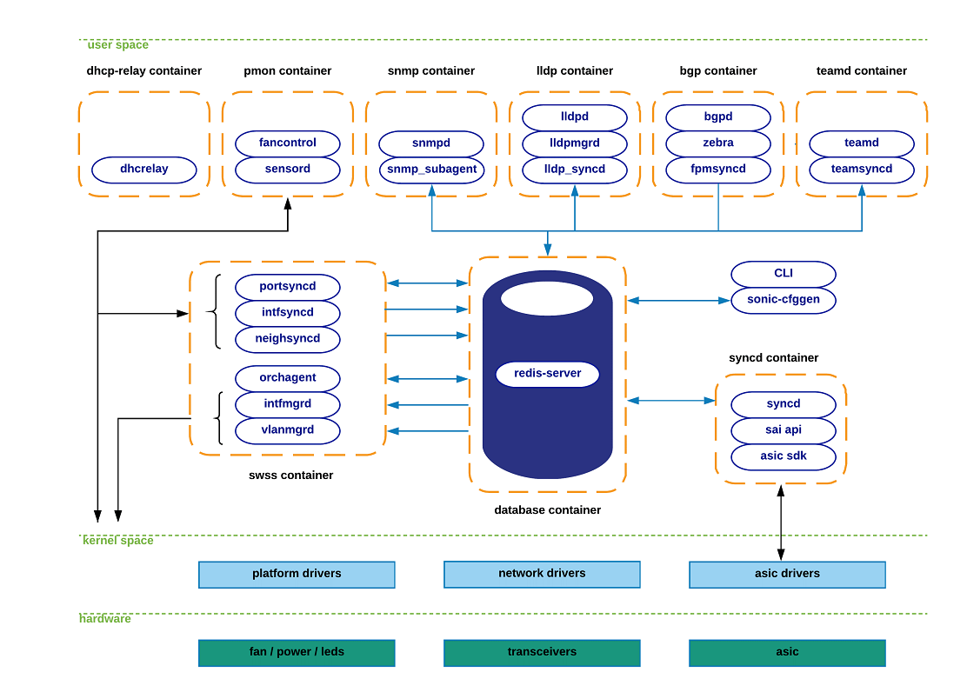











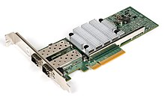
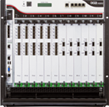
Idealized DASH Test Workflow – using P4 & saithrift
Reusable for SAI or gNMI (even possibly P4)
Future?
Hand-written and/or templatized test cases
Abstract format
generate
gNMI test-case scripts
Requires SONiC Stack on DUT
{…}
inputs
Hand and/or machine-generated
generate
p4info metadata
P4-based test-case generator
Begin
Traffic Generator commands (OTG/snappi)
Sirius P4
Behavioral Model
Primary Source of truth
p4c backend(s)
import
generate
Python Client
PTF Helpers
saithrift commands
generate
Std. OCP SAI header file subset (underlay)
Test-case scripts
generate
inputs
Automated & repeatable traffic tests
{…}
saithrift code generator
generate
Sirius.json
Bmv2 “program”
DASH SAI header files (overlay)
Automatic saithrift client & server code generator
Thrift server skeleton c++ code
DUT Config
inputs
+
inputs
DUT Image
Build image
Traffic cables
Traffic veths
SW Traffic Generator
Device Under Test (DUT)
Bmv2
simulator
Vendor libsai
HW/SW Traffic Generator
P4Runtime Config
Tgen commands
Test-case scripts
Simulation test case origins: Manual & auto same as for the tests for real HW.

Slide 3
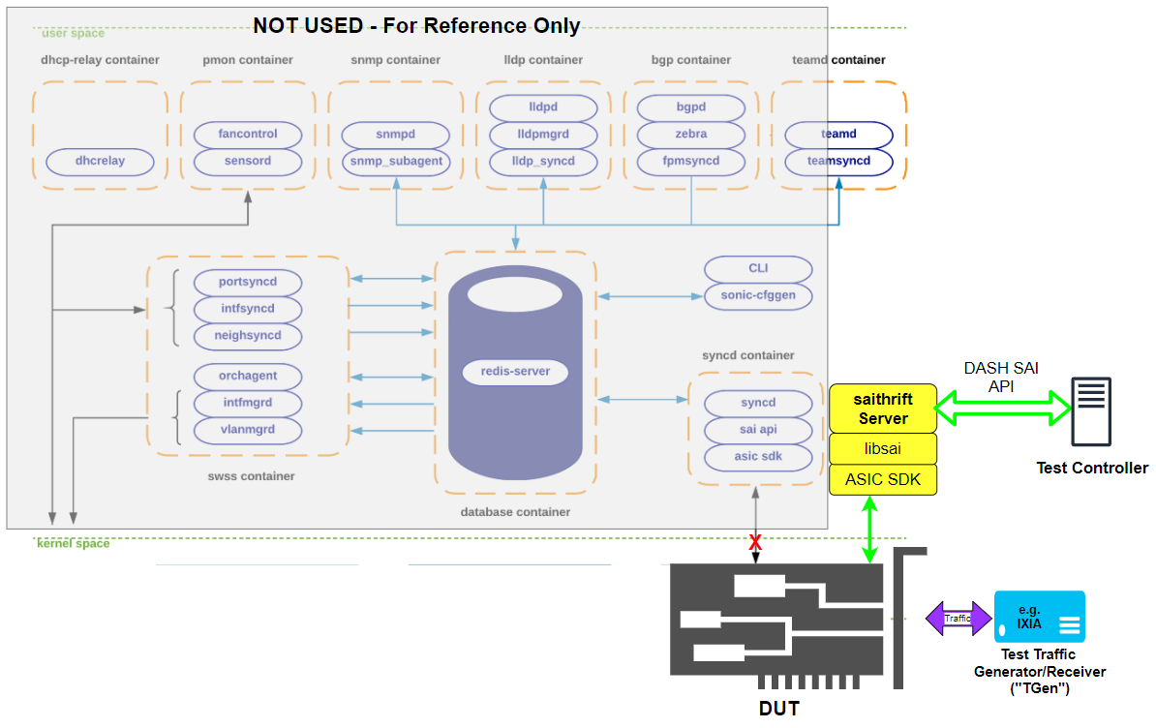




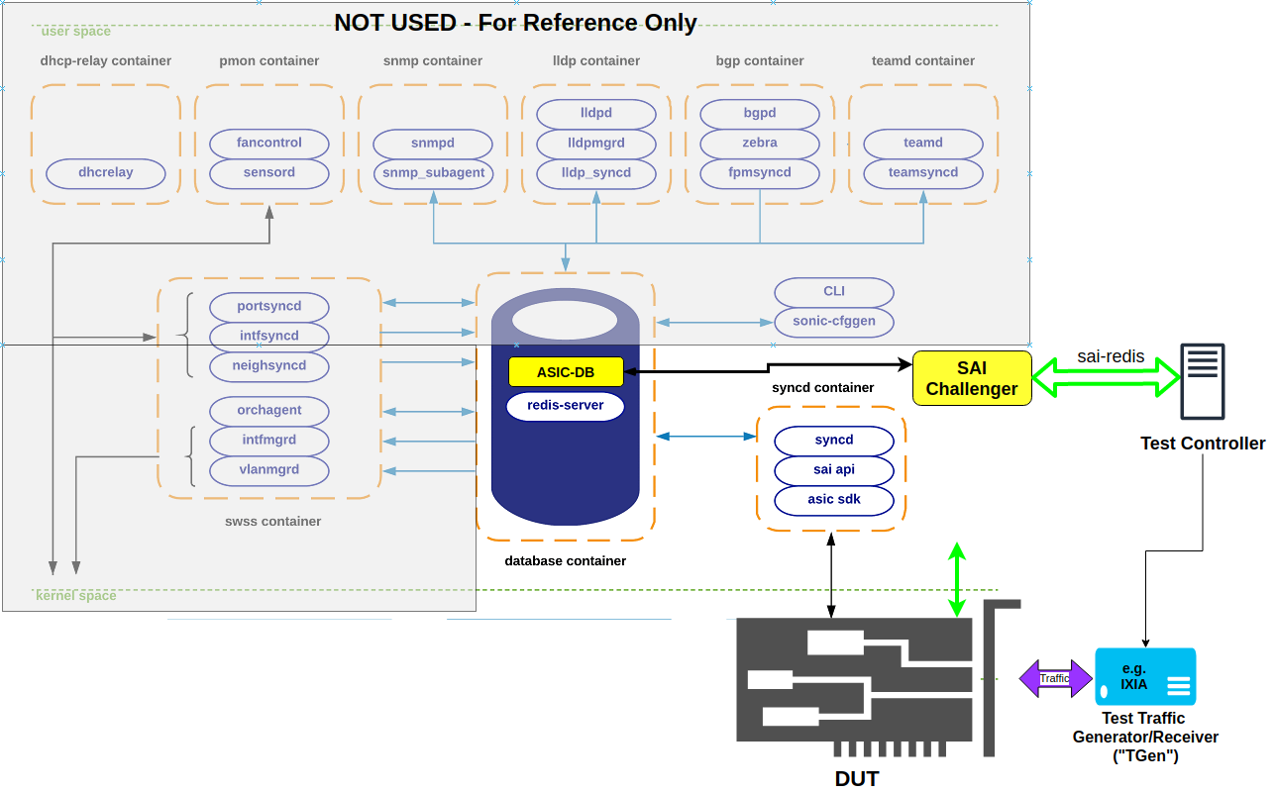
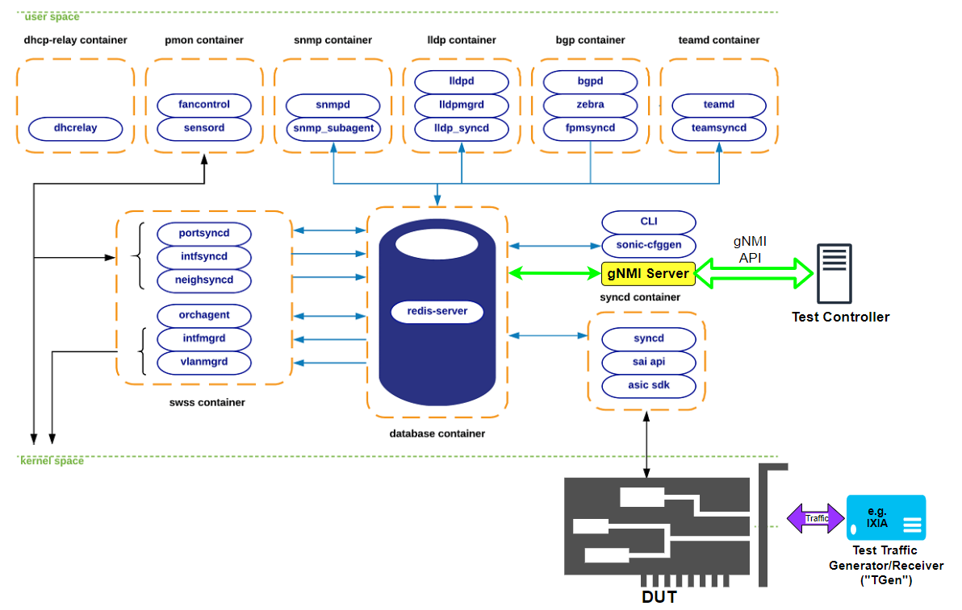
Progressive DASH Dataplane Testing through the layers
Dataplane-only via SAI-Thrift
Via P4RT/BMV2
Validate P4 Model & test-cases (lightweight testing)
P4RT Config
Tgen Config
CI/CD Automation
P4RT Scripts
veths
SW Tgen
“Lower SONiC Stack” via SAI-Redis
Bmv2
simulator
{…}
Wish-list
https://github.com/andriy-kokhan/sai-challenger-1 (PLVision)
Sirius P4
Sirius.json
Bmv2 “program”
Can P4 code be used to generate abstract test-cases for all APIs?
Full SONiC stack via gNMI Northbound
Sirius P4
saithrift scripts
sai-redis scripts
inputs
generate
Hand-written and/or templatized test cases
Abstract format
P4RT Scripts
Render into specific dataplane APIs
gNMI scripts

