Slide 1
DASH Testing Workflows v2
Chris Sommers
2021.11.12
SW Architect

Slide 2
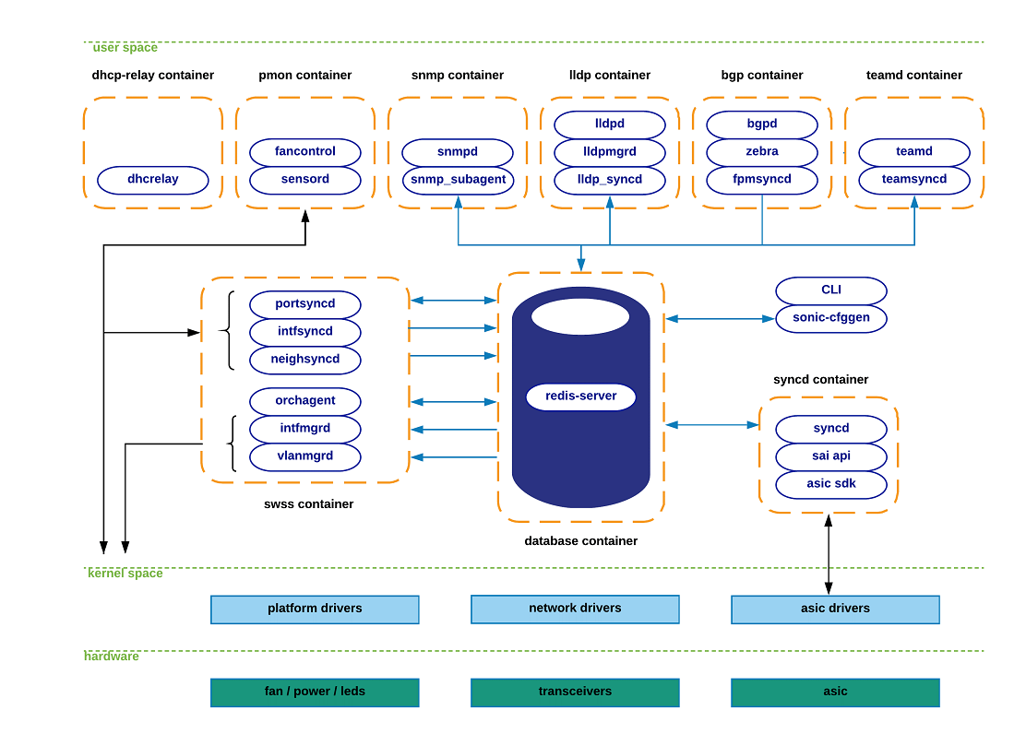
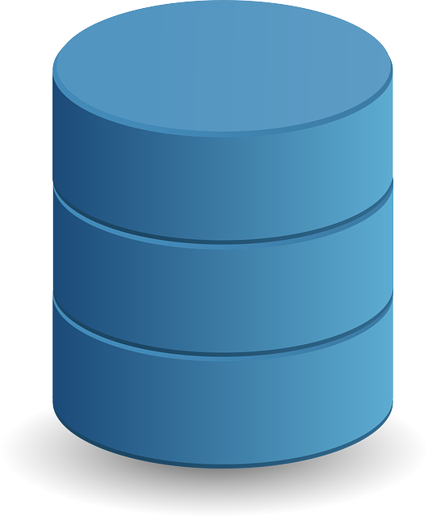







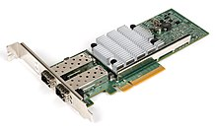
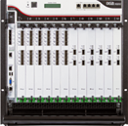
Idealized DASH Test Workflow – using saithrift
Reusable for SAI or gNMI (even possibly P4)
Future?
Hand-written and/or templatized test cases
Abstract format
gNMI test-case scripts
Requires SONiC Stack on DUT
Hand and/or machine-generated
Traffic Generator commands (OTG/snappi)
import
generate
Python Client
PTF Helpers
saithrift commands
Test-case scripts
inputs
Sai header files
saithrift code generator
generate
Automated & repeatable traffic tests
Thrift server skeleton c++ code
DUT Config
inputs
DUT Image
+
Automatic saithrift client & server code generator
Vendor build process
Device Under Test (DUT)
Vendor libsai
Traffic Generator

Slide 3
Idealized DASH Test Workflow – using saithrift (post-meeting update)
Reusable for SAI or gNMI (even possibly P4)
Future?
Hand-written and/or templatized test cases
Abstract format
gNMI test-case scripts
Requires SONiC Stack on DUT
Hand and/or machine-generated
Traffic Generator commands (OTG/snappi)
import
generate
Python Client
PTF Helpers
saithrift commands
Test-case scripts
inputs
Sai header files
generate
SONiC build-image SAI rpc server option
Automated & repeatable traffic tests
saithrift code generator
Thrift server skeleton c++ code
DUT Config
inputs
DUT Image
+
Automatic saithrift client & server code generator
Alternative: Vendor build process (offline builds)
Device Under Test (DUT)
Vendor libsai
Traffic Generator

Slide 4
Idealized DASH Test Workflow – gaps
An alternative approach would be to encode SAI-specific test cases, which would not be reusable for gNMI test cases later. They would be harder to fathom and maintain because they’d be tied to SAI semantics & schema.
SONiC DASH stack available on any DUTs?
Need standard tests (e.g. policies) in machine-readable, standardized form. Need schema. gNMI?
gNMI schema not available (openconfig, but what is mapping to DASH?)
Future?
Hand-written and/or templatized test cases
Abstract format
Need mapping from abstract test-cases to sai. Re-use SONiC gNMI orchd code which has to do similar task?
gNMI test-case scripts
Requires SONiC Stack on DUT
Hand and/or machine-generated
SONiC stack enhanced for DASH
Traffic Generator commands (OTG/snappi)
Are there DASH additions to standard sai requiring sai header changes?
import
generate
Python Client
PTF Helpers
saithrift commands
Develop automatable, robust traffic streams, stats gathering and and test conditions, preferably using agnostic format (OTG/snappi) – early work in progress.
Saithrift test-case scripts
inputs
Sai header files
saithrift code generator
generate
Thrift server skeleton c++ code
DUT Config
Pull-request pending. Lack of community experience to date. Tool generates PTF test helpers, not pytests. Needs adapting for DASH-SAI extensions and use-cases?
inputs
DUT Image
+
Vendor build process
https://github.com/opencomputeproject/SAI/pull/1325/files
Vendors must make special saithrift image available
Device Under Test (DUT)
Vendor libsai
Traffic Generator
Vendors must implement sai API to their platform.

Slide 5
Notes from 2021-11-12 Meeting of the SONiC-DASH Test WG
The following pertain to the preceding diagrams and aren’t meant to be complete meeting notes.
Guohan: we should consider using SONiC Management Testbed for consistency to allow users to have a reproducible framework. Test-cases should utilize this framework. [ See https://github.com/Azure/sonic-mgmt/blob/master/docs/testbed/README.testbed.Overview.md ] Chris: We were proposing something simpler for early dataplane testing. Kristina: We’ll keep in mind for long-term goal.
Q: Why does saithrift build step say “vendor build process?” Shouldn’t it be built in the standard SONiC pipeline? A: Guohan: Correct, the sonic-buildimage can make a version with saithrift RPC server using the normal build process. A: Chris: vendors can make their own builds outside of sonic-buildimage process during early development (prior to full SONiC integration). See updated diagram (slide 3) updated post-meeting.
Q: Why not use the P4 Behavioral model (e.g. https://github.com/Azure/DASH/tree/main/sirius-pipeline) as the single source-of-truth for test-case generation? A: Chris: Great idea, let’s study this at the next WG meeting. We need to propose practical ways of turning the model into concrete test cases. Let’s all study and be prepared to discuss this.
Q: Should saithrift server be maintained long-term? A: Chris: Seems like a valuable option to maintain for regression etc. A: Guohan: Based on SONiC experience, we need to maintain this as a permanent part of the qualification process to isolate bugs and simplify dataplane testing.
Q: Can we make this diagram available? A: Chris: I’ll post to the repo.

