Slide 1
Packet classification problem: The worst case is bad, but typical case is often better
Andy Fingerhut
2023-Nov-29

Slide 2
Introduction
There are many research papers on the “normal” packet classification problem
Survey of techniques up to 2005 [1]
Very incomplete list of citations after 2005 can be found here [2]
A common theme:
The worst case is expensive in memory, or classification time, or both (summarized later)
But the rules that people tend to want to configure do not exhibit these worst-case properties.
e.g. a large fraction of pairs of rules are disjoint, i.e. there is no packet that can match both rules.
Any single packet tends to match at most a handful of the rules in a rule set.
Algorithms have been devised that take advantage of these “typical case” properties.
[1] David E. Taylor, "Survey and taxonomy of packet classification techniques", 2005, https://dl.acm.org/doi/10.1145/1108956.1108958
[2] https://github.com/jafingerhut/p4-guide/tree/master/packet-classification/group-based#references

Slide 3
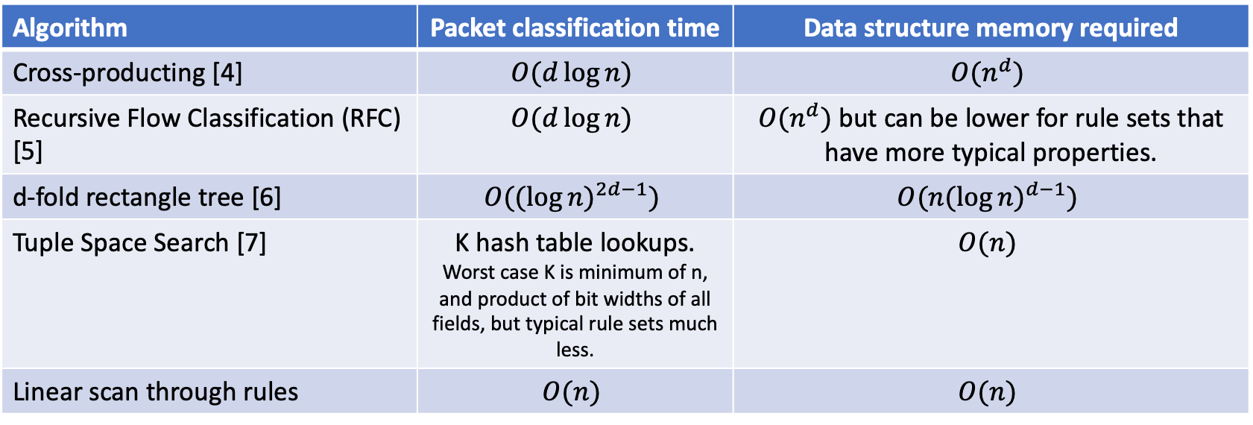
Worst case (general # of fields)
n is number of rules in a rule set
d is “dimension”, i.e. number of fields with independent match specifications.
d=5 for (IP SA, IP DA, IP proto, L4 src port, L4 dest port)
But because IP proto is typically all wildcard or exact match, can transform problem into d=4.
Algorithm | Packet classification time | Data structure memory required
Cross-producting [4] | $$O(d\log{n)}$$ | $$O(n^{d})$$
Recursive Flow Classification (RFC) [5] | $$O(d\log{n)}$$ | $O(n^{d})$ but can be lower for rule sets that have more typical properties.
d-fold rectangle tree [6] | $$O({(\log{n)}}^{2d−1})$$ | $$O({n(\log{n)}}^{d−1})$$
Tuple Space Search [7] | K hash table lookups. Worst case K is minimum of n, and product of bit widths of all fields, but typical rule sets much less. | $$O(n)$$
Linear scan through rules | $$O(n)$$ | $$O(n)$$

Slide 4
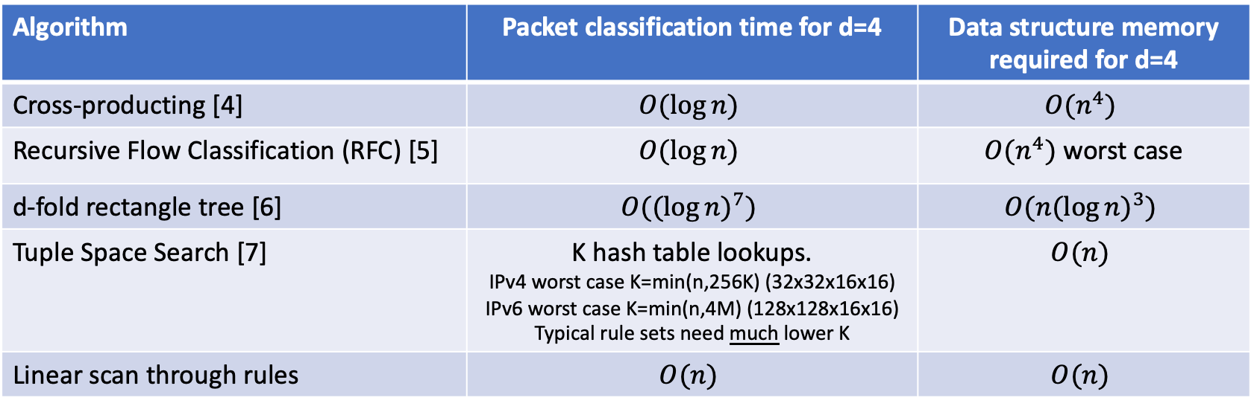
Worst case (4 fields)
n is number of rules in a rule set
d is “dimension”, i.e. number of fields with independent match specifications.
d=5 for (IP SA, IP DA, IP proto, L4 src port, L4 dest port)
But because IP proto is typically all wildcard or exact match, can transform problem into d=4.
Algorithm | Packet classification time for d=4 | Data structure memory required for d=4
Cross-producting [4] | $$O(\log{n)}$$ | $$O(n^{4})$$
Recursive Flow Classification (RFC) [5] | $$O(\log{n)}$$ | $O(n^{4})$ worst case
d-fold rectangle tree [6] | $$O({(\log{n)}}^{7})$$ | $$O({n(\log{n)}}^{3})$$
Tuple Space Search [7] | K hash table lookups. IPv4 worst case K=min(n,256K) (32x32x16x16) IPv6 worst case K=min(n,4M) (128x128x16x16) Typical rule sets need much lower K | $$O(n)$$
Linear scan through rules | $$O(n)$$ | $$O(n)$$

Slide 5
A problem of knowledge
People who write these rules in operational networks do not want to publish them
When classification is used for blocking malicious traffic, it makes sense that you do not want to publish the blueprints of your defense perimeter.
People who want to develop new classification algorithms are often not the same people operating these networks.
How do algorithm developers use realistic classification problem instances for memory/runtime evaluation?

Slide 6
One approach: trust to maintain secrets
Occasionally an algorithm developer (Alice) is trusted by someone with access to classification rule sets (Bob)
Bob gives Alice a copy of rule sets used in production.
Alice can evaluate their algorithms on these rule sets and publish the results.
Alice agrees not to publish the rule sets.
Without becoming trusted by Bob or someone like him, other algorithm developers cannot:
Reproduce Alice’s results.
Gain access to the rule sets.

Slide 7
ClassBench Filter Set Analyzer
In 2005, David Taylor and Jonathan Turner gained trusted access to some rule sets used in production.
And permission to publish anonymized statistical data about them:
How many rules are exact match vs. wildcard on IP protocol values, and what is the relative frequency of different values
Among rules that use L4 source and destination ports, what fraction fall in each of these categories:
(*, *)
(*, one_exact_dest_port)
(*, dest_port_range)
(one_exact_source_port, *)
And more not listed here …
IPv4 prefix length distribution, and anonymous statistics about the “shape” of the prefix trees
They also created a Filter Set Generator program that takes such statistics, and randomly generates sets of rules with similar statistics.
They did not publish the Filter Set Analyzer code, and the authors no longer can find it. It seems like it would be low effort to write it again.
If such a Filter Set Analyzer program were freely available as source code, would network operators be willing to publish the output of running it on rule sets used in production?
[3] ClassBench paper, code, and stats files: https://www.arl.wustl.edu/classbench

Slide 8
Possible future scenario
A Filter Set Analyzer program is rewritten, generalized to the “group-based” classification problem that DASH ACLs require
i.e. where packet fields can match on a set of prefixes/ranges, not only one, in a single rule
People with access to the production rule sets run the analyzer on many of them, and publish the resulting data files
DASH vendors, DASH stress tests, and researchers use these data files and the Filter Set Generator to randomly generate DASH ACL rule sets that have realistic properties.
DASH product vendors can share these results with potential customers, if the vendors wish.
Researchers can also publish results for new algorithms based on rule sets with realistic properties.
… perhaps leading to cheaper products

Slide 9
Potential anonymous statistics to be collected
n = # of rules for a single rule set
Distribution of IP SA group sizes, and similarly for other fields.
Number of distinct IP SA groups across all rules (can be significantly less than n if the same IP SA groups are used in multiple rules), and similarly for other fields.
Among rules that use L4 source and destination ports, what fraction fall in each of these categories:
(*, *)
(*, one_exact_dest_port)
(*, dest_port_range)
(one_exact_source_port, *)
And more not listed here …
IPv4 prefix length distribution, and anonymous statistics about the “shape” of the prefix trees
Number of rule pairs that overlap, i.e. a single packet could match both of them.
Number of distinct IP SA groups that overlap, i.e. a single IP SA value can match both of them.
Similarly for other fields.
Maximum number of rules that any single packet can match at the same time.
Data structure memory required by some algorithms that are sensitive to properties of the rules, e.g.:
Cross-producting [4]
RFC [5]
Tuple Space Search? [7] (if it can be generalized to group-based classification problem, which is not yet clear to me how)
Possibly others

Slide 10
CAIDA
CAIDA is the Center for Applied Internet Data Analysis
https://www.caida.org
CAIDA maintains many data sets, including packet traces of production network links
CAIDA gives copies to researchers who request access.
Researchers agree not to publish the packet traces.
Other networking-related data sets are available:
https://catalog.caida.org/search?query=types=dataset%20links=tag:caida%20
I have not seen any classification rule sets in this list, but I could have missed it.
Would people who configure classification rules be willing to trust CAIDA and the researchers that CAIDA gives access to?
Perhaps with some kind of anonymizing process performed on the rule sets?
This seems unlikely to me, given the sensitivity of these rule sets, but I thought I would mention it.

Slide 11
References
[1] David E. Taylor, "Survey and taxonomy of packet classification techniques", 2005, https://dl.acm.org/doi/10.1145/1108956.1108958
[2] https://github.com/jafingerhut/p4-guide/tree/master/packet-classification/group-based#references
[3] ClassBench paper, code, and stats files: https://www.arl.wustl.edu/classbench
[4] V. Srinivasan, G. Varghese, S. Suri, M. Waldvogel, “Fast and scalable layer four switching”, 1998, https://dl.acm.org/doi/10.1145/285243.285282
Cross-production is in Section 6
[5] P. Gupta, N. McKeown, “Packet classification on multiple fields”, 1999, https://api.semanticscholar.org/CorpusID:9766038
[6] H. Edelsbrunner, “A new approach to rectangle intersections, Part I”, 1983, https://api.semanticscholar.org/CorpusID:123041210
d-fold rectangle tree is in Section 3
[7] V. Srinivasan, S. Suri, G. Varghese, "Packet Classification using Tuple Space Search", 1999, https://dl.acm.org/doi/10.1145/316194.316216

