Slide 1
Read Me: This deck contains two sections. One for participants and a second for coaches.
Participant section
This top section is a Tech Scenario description for participants. The section will cover the technology introduction and high-level concepts about the challenges.
Audience: Participants at OpenHack
Coach only section
This section is a Tech Scenario description for coaches. The section will cover the technology, challenge goals, common pit falls, general guidance on solutions. This section is presented to coaches in the ‘know before you go’ call a few days before the OpenHack starts. This section is intended to be more in-depth than the participant section. Do not share the coach section with participants!
Audience: Coaches at OpenHack
Section 1
Section 2

Slide 2

Claims Management Application
#MSOpenHack

Slide 3
Claims Management
Technologies
Azure Cosmos DB
Azure OpenAI Service
Semantic Kernel
Azure Functions
Event Hubs
Azure Static Website
Azure Storage
Are a category of solutions that include medical, home, and auto insurance applications.

Slide 4
Scenario
The scenario centers around a medical claims management solution. Members having coverage and making claims, providers who deliver services to the member and payers who provide the insurance coverage that pays providers for services to the members.
Claims submitted are submitted in a stream and loaded into the backing database for review and approval.
Business rules govern the automated or human approval of claims.
An AI powered co-pilot empowers agents with recommendations on how to process the claim.

Slide 5












Reference Architecture
DATA
SOURCES
CONSUMERS
Completions API
Azure OpenAI
Claims Ingestion / Claims Events
Event Hubs
External System
Databases
Apps
Data Management / Loading
Azure Synapse Analytics
Claims API /
Worker Service
Azure Kubernetes Service (AKS) or Azure Container Apps (ACA)
Claims
Management
Static Web App
Agents
Files
Claims Data
Azure Cosmos DB
Notes:
(Display the architecture diagram while speaking to the below points)
The front end is a React web application deployed to an Azure Static Web app. This is how users interact with the solution.
The API is an ASP.NET Core API app that serves as a lightweight layer for the business logic that lives inside of a .NET 7 class library. It is containerized in Docker and deployed to an Azure Container App (ACA) or Azure Kubernetes Service (AKS).
The background worker service is a Microsoft.NET.Sdk.Worker project that also references the .NET 7 class library and is deployed into a different Docker container within the same AKS service or a dedicated ACA instance.
All data is stored in Azure Cosmos DB. The background worker service acts as the Azure Cosmos DB change feed processor, which executes as data within the monitored Cosmos DB containers are inserted or updated, allowing for the application of business rules and automated updating of data within various containers.
There is an Event Hubs instance that helps us simulate stream processing of incoming medical claims data from a fictitious external system. The background worker service also acts as the Event Hubs processor to write incoming claims added through Event Hubs into Cosmos DB.
There is an Azure OpenAI deployment that provides a completion model, orchestrated by Semantic Kernel. This enables the application to provide recommendations to a claims adjudicator on whether to approve or reject a claim, based on the claims data and business rules.

Slide 6
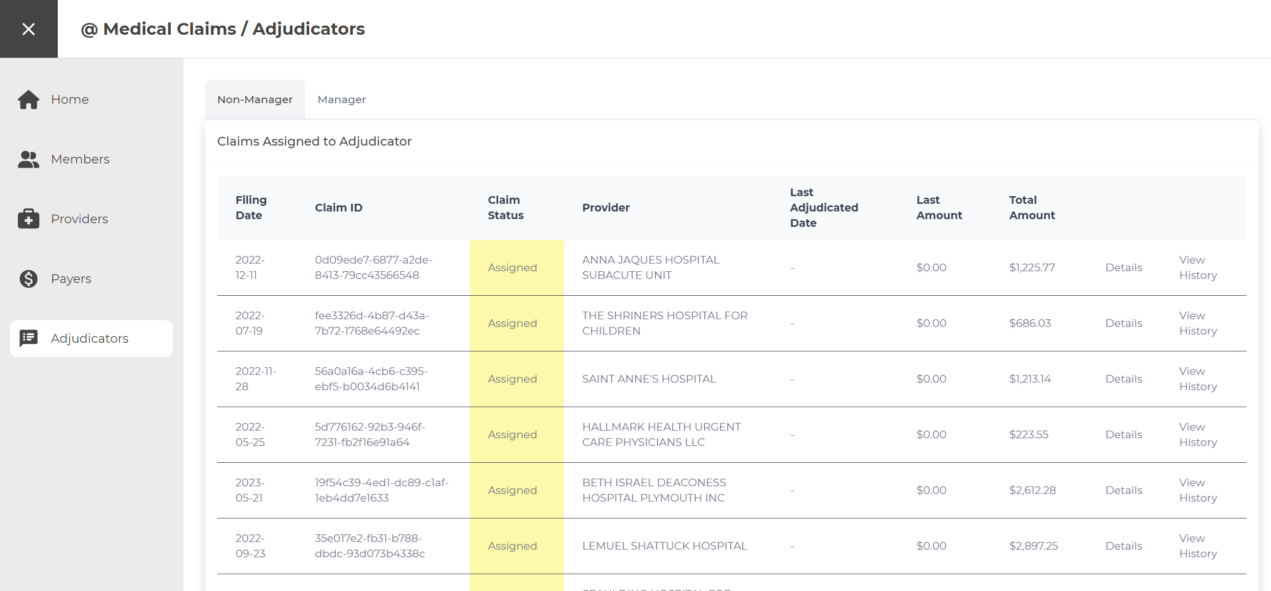
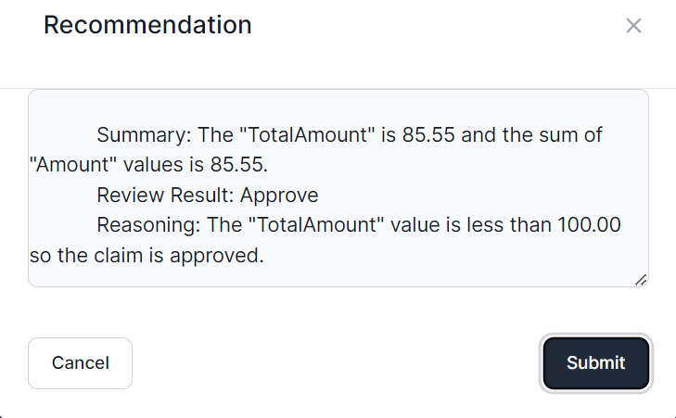
User Interface
Notes:
The application frontend is a React single-page application with Intelligent Agent UI functionality.

Slide 7
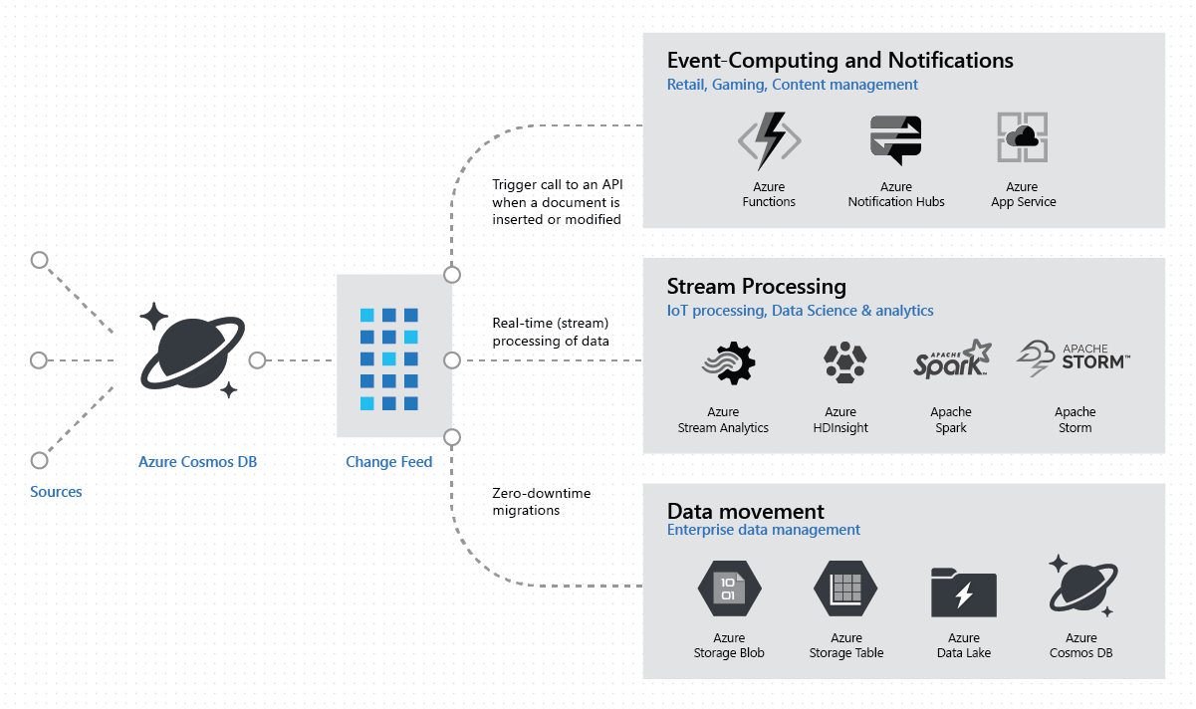
Common Change Feed scenarios
Notes:
The Azure Cosmos DB change feed enables efficient processing of large datasets that have a high volume of writes. Change feed also offers an alternative to querying an entire dataset to identify what has changed. With it, we can implement common patterns, like Event Sourcing.
Generally speaking, Azure Cosmos DB is well-suited for IoT, gaming, retail, and operational logging applications. A common design pattern in these applications is to use changes to the data to trigger other actions. Examples of these actions include:
Triggering a notification or a call to an API when an item is inserted, updated, or deleted.
Real-time stream processing for IoT or real-time analytics processing on operational data.
Data movement such as synchronizing with a cache, a search engine, a data warehouse, or cold storage.
The change feed in Azure Cosmos DB enables you to build efficient and scalable solutions for each of these patterns, as shown in this image.

Slide 8
Azure Cosmos DB Change Feed Summary
Automatically enabled in any Cosmos DB database account
Uses the existing allocated request units for processing events
Executed on insert and update operations.
Delete support can be implemented by creating a property called isDeleted (or similar), modifying this property (to act as an update), and then setting a TTL on the document to delete it.

Slide 9
Meet the lightweight Kernel of Semantic Kernel.
“
I’ve been designed to orchestrate complicated LLM AI prompts combined with native code, use multiple AI models, and use a goal-oriented approach to achieving asks.”
STEPS
👋
PLANNER
1
2
3
…
ernel
ASK
K
“
I take a user’s ask and generate a step-by-step plan that draws upon available skills.”
Planner generates steps that use available Skills
SKILLS
Notes:
It all starts from an Ask. The user has a need that needs to be filled. Kernel, in Semantic Kernel, is the orchestrator for the Ask. It sends the Ask over to the Planner to the right skills can be found and the right steps can be created from the Ask and Skills.

Slide 10


Semantic Kernel pays down future technical debt asap.
💪 THE CORE
Everything you need to manage complex prompts, chains, long-running tasks, and planning.
SKILLS
RUNTIME
PLANNER
…
3
2
1
1
2
3
…
MEMORIES
DATA & SERVICES CONNECTORS
🤯 THE SWITCH
But wait, there’s more! All the longform memories readily available in the MS Graph. Plus, add data connectors.
MS GRAPH
+ YOUR DATA
APIs
Notes:
Models + skills are amazing and when you add personalized memories and real-time data they become an enabler for warp speed productivity.

Slide 11

Let’s get started!
aka.ms/TBD
Login with the credentials supplied to your team.
Notes:
To get started, visit the OpenHack portal:

Slide 12
Claims Management Application
Challenge walkthrough for coaches
Notes:
This guide is only meant to be a reference. Please do not rely on this guide in place of completing the challenges before coaching.

Slide 13
Challenge 1: Get Up, Set Up, Don't Let Up
In this challenge, participants deploy the services into the landing zone in preparation for the launch of the POC.
Learning objectives:
Deploy the Azure services needed to support the claims application
Understand the setup of the development environment

Slide 14
Challenge 2: Get Loaded
In this challenge, participants will load the pre-generated sample claims data using a Synapse pipeline.
Learning objectives:
Load high volumes of data into Azure Cosmos DB with Azure Synapse Analytics integration pipelines

Slide 15
Challenge 3: Rules Are Made to be Broken
In this challenge, participants will familiarize themselves with the core of the application, by seeing the end-to-end in action.
Learning objectives:
Run the claim publisher and examine how it drives the change feed.
As an adjudicator, acknowledge a claim using the UI and then adjudicate that claim.
Understand the business rules that are in place.
Review the claim history

Slide 16
Challenge 4: Not Your High School Guidance Counselor
In this challenge, participants will augment the functionality of the Claim Details pane by providing the adjudicator with AI-generated guidance on what action to take.
Learning objectives:
Use the Microsoft Semantic Kernel with Azure OpenAI to create a SemanticFunction that will respond with with guidance for the claim

Slide 17
Challenge 5: Domo Arigato, AI Roboto
In this challenge, participants will create a SemanticFunction to automatically review, approve, deny, or forward the claim to a manager, replacing the hardcoded rule logic currently used by the solution.
Learning objectives:
Automatically orchestrate functions with the extensibility of Semantic Kernel planner
Create an automated rules engine that you can augment with powerful plugins and additional data sources

Slide 18
Coach solutions folder
https://aka.ms/TBD

Slide 19
Thank you coaches!

