Slide 1
Read Me: This deck contains two sections. One for participants and a second for coaches.
Participant section
This top section is a Tech Scenario description for participants. The section will cover the technology introduction and high-level concepts about the challenges.
Audience: Participants at OpenHack
Coach only section
This section is a Tech Scenario description for coaches. The section will cover the technology, challenge goals, common pit falls, general guidance on solutions. This section is presented to coaches in the ‘know before you go’ call a few days before the OpenHack starts. This section is intended to be more in-depth than the participant section. Do not share the coach section with participants!
Audience: Coaches at OpenHack
Section 1
Section 2

Slide 2

Payments Reference Application
#MSOpenHack

Slide 3
Payments & Transactions
Technologies
Azure Cosmos DB
Azure OpenAI Service
Semantic Kernel
Azure Front Door
Azure Static Website
Azure Storage
Are a category of solutions that include loyalty programs, merchant services, payments, banking and statement analysis.

Slide 4
Scenario
The scenario centers around a payments and transactions solution. Members having accounts, each account with corresponding balances, overdraft limits and credit/debit transactions.
Transaction data is replicated across multiple geographic regions for both reads and writes, while maintaining consistency. Updates are made efficiently with the patch operation with ACID guarantees, an important feature when dealing with payments.
Business rules govern if a transaction is allowed.
An AI powered co-pilot enables agents to analyze transactions using natural language.
Notes:
In this solution, members manage their accounts, engage with transaction histories, and set overdraft limits to navigate their financial activities. The system assures that all transaction data is dependably replicated across multiple geographic regions, ensuring data consistency and reliable updates through efficient patch operations. Business rules are in place to validate each transaction, ensuring transactions do not exceed overdraft limits and Azure Cosmos DB Transactional Batch ensures ACID scope between new transactions and balance changes . We've incorporated an AI co-pilot to assist our agents by providing them with a live, detailed view into every transaction, enabling robust analysis and decision-making support. As we walk through the demo, we will explore how these features work cohesively to manage member and account transaction data in a scalable and reliable way.

Slide 5




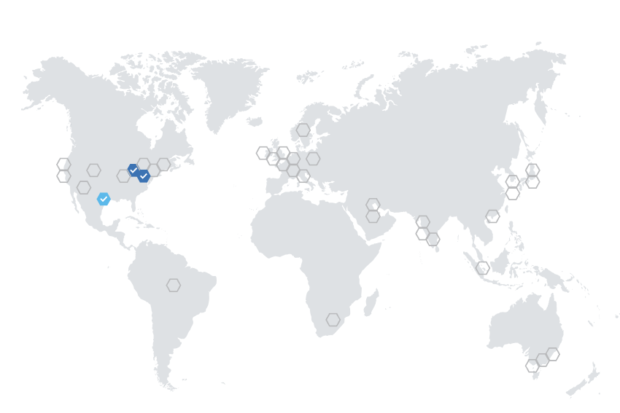






Reference Architecture
DATA
SOURCES
CONSUMERS
Completions API
Azure OpenAI
Databases
Apps
Account Data
Azure Cosmos DB
Payments API /
Worker Service
Azure Kubernetes Service (AKS)
Azure Front Door
Account
Management
Static Web App
Agents
Files
Account Data
Azure Cosmos DB
Account Data
Azure Cosmos DB
Notes:
(Display the architecture diagram while speaking to the below points)
This is a very high-level overview of the architecture:
All services are deployed across three regions to ensure high availability and to demonstrate Azure Cosmos DB replication and concurrency features.
The front end is a React web application deployed to an Azure Static Web app. This is how users interact with the solution.
The static web app sends all requests through Azure Front Door, which routes the requests to a Payments API instance, according to routing rules.
The API is an ASP.NET Core API app that serves as a lightweight layer for the business logic that lives inside of a .NET 7 class library. It is containerized in Docker and deployed to an Azure Container App (ACA) or Azure Kubernetes Service (AKS).
The background worker service is a Microsoft.NET.Sdk.Worker project that also references the .NET 7 class library and is deployed into a different Docker container within the same AKS service or a dedicated ACA instance.
All data is stored in Azure Cosmos DB. The background worker service acts as the Azure Cosmos DB change feed processor, which executes as data within the monitored Cosmos DB containers are inserted or updated, allowing for the application of business rules and automated updating of data within various containers. For this architecture, a CQRS pattern is in place to allow independent scalability between writes (new transactions) and reads (balances or statement queries) and Azure Cosmos DB change feed is the key to replicate data between containers.
There is an Azure OpenAI deployment that provides a completion model, orchestrated by Semantic Kernel. This enables users to ask questions about transactions in an account.
CQRS pattern is also important to mention to explain why there are 2 containers storing transactions and why change feed is the key.

Slide 6
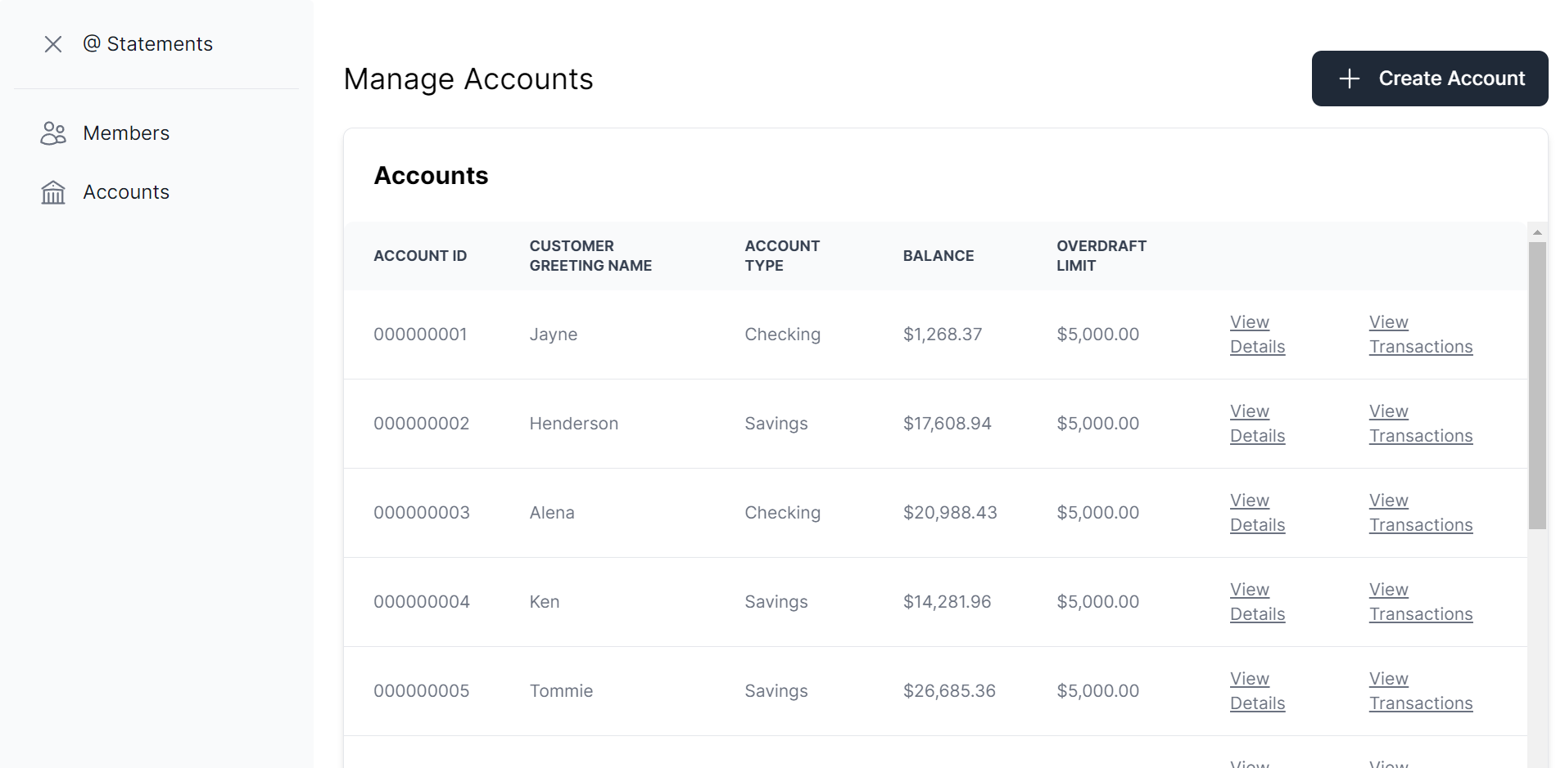
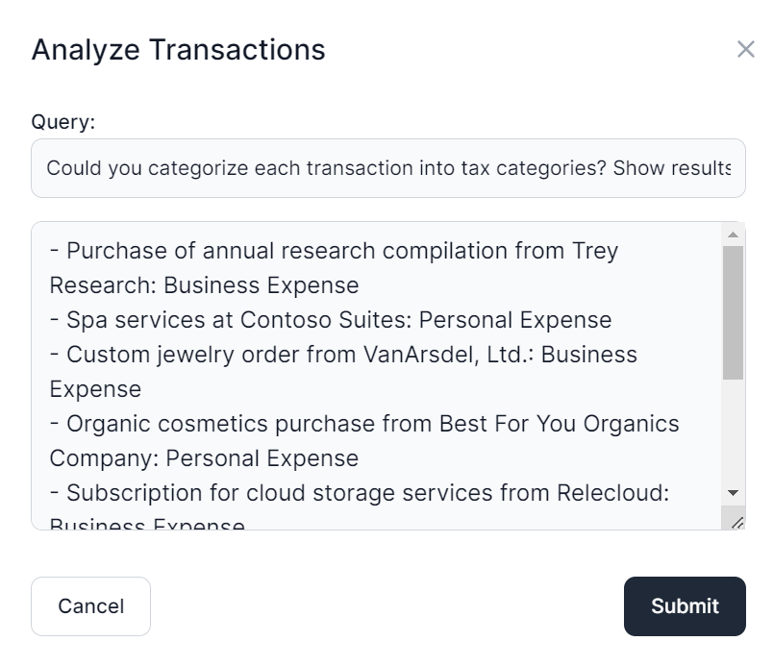
User Interface
Notes:
The application frontend is a React single-page application with Intelligent Agent UI functionality.

Slide 7
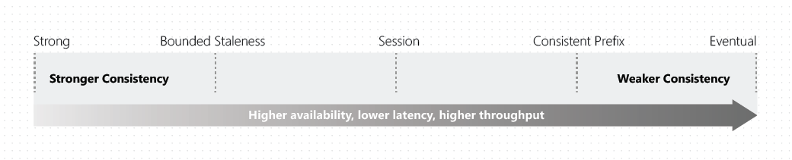
Strong Consistency
Notes:
Cosmos DB provides consistency levels on a spectrum. Each level provides availability and performance tradeoffs.
In our solution, we are using a single write region and two additional read regions for global distribution, with the default consistency level set to Strong.
Strong Consistency means that reads are guaranteed to see the most recent write. This offers the simplest programming model out of the five consistency levels and is also ideal for applications where seeing the latest version of data that in the correct chronological order is critically important.
Strong consistency offers a linearizability guarantee. Linearizability refers to serving requests concurrently. The reads are guaranteed to return the most recent committed version of an item. A client never sees an uncommitted or partial write. Users are always guaranteed to read the latest committed write. Since we are using a single write region, our solution benefits from a recovery point objective (RPO) of zero, because strong consistency guarantees a global majority on writes.
The following graphic illustrates the strong consistency with musical notes. After the data is written to the "West US 2" region, when you read the data from other regions, you get the most recent value:

Slide 8
Eventual Consistency
Notes:
In Eventual consistency, the client issues read requests against any one of the four replicas in the specified region. This replica may be lagging and could return stale or no data.
Eventual consistency is the weakest form of consistency because a client may read the values that are older than the ones it read in the past. Eventual consistency is ideal where the application doesn't require any ordering guarantees. Examples include count of Retweets, Likes, or non-threaded comments. The following graphic illustrates the eventual consistency with musical notes.

Slide 9
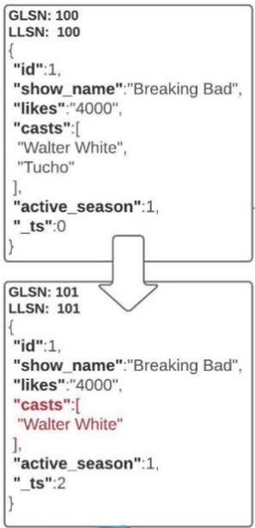
PATCH Operation
Allows partial updates to documents in Cosmos DB
With PATCH you can update select document properties instead of having to replace the entire document.
Notes:
Partial document update feature improves this experience significantly. The client can only send the modified properties/fields in a document without doing a full document replace operation. Key benefits of this feature include:
Improved developer productivity: Provides a convenient API for ease of use and the ability to conditionally update the document.
Performance improvements: Avoids extra CPU cycles on the client side, reduces end-to-end latency and network bandwidth.
Multi-region writes: Supports automatic and transparent conflict resolution with partial updates on discrete paths within the same document.
Ref.: Partial document update - Azure Cosmos DB for NoSQL | Microsoft Learn

Slide 10
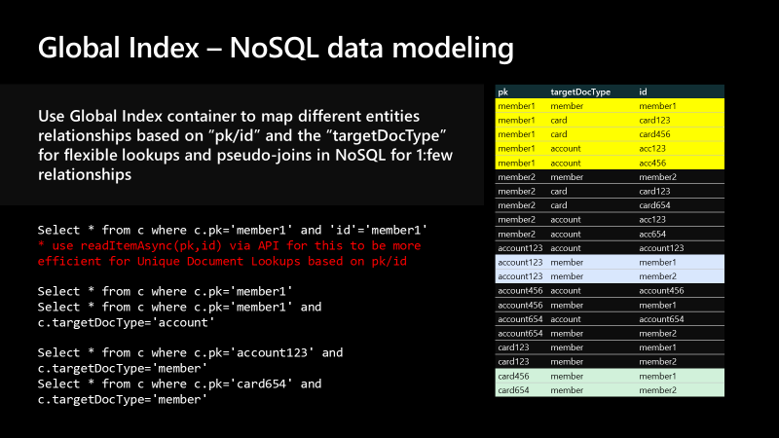
Reverse Lookups With Global Index
Notes:
The other thing that we'd like to highlight is the notion of a global index. Remember, we're using the NoSQL API. That means that we do not have an enforced schema within the database or containers. And we're also not dealing with a traditional relational database system. The global index container we looked at earlier is used to map different entity relationships based on the partition key, ID, and target doc type. This gives us the ability to have flexible lookups and pseudo joins in NoSQL for one-to-few and one-to-one relationships.
You can see here some of the sample queries that you can run using the global index. On the grid to the right, we can see the target doc type. In this example, we have member, card, and account doc types.
Looking at the top, the partition key for this member is member1, and that also is the ID of that member. We also have two cards associated with this same member. They're in the same partition key, but the card has its own ID. We can search the global index if we want to be able to find all the cards for a member within the containers for where the member document lives and the card documents live. They could very well have different partition keys. Maybe they're not even in the same container. Without a global index, we would need to execute several cross-partition queries to locate all of the related documents. The global index gives us a quick way to look up that relationship and get the IDs for the item that we're looking for.

Slide 11
ACID Guarantees With Cosmos DB Transactional Batch
var batch = Container.CreateTransactionalBatch(pk);
batch.PatchItem(account.id, new List<PatchOperation>()
{
PatchOperation.Increment("/balance", transaction.type.ToLowerInvariant() == Constants.DocumentTypes.TransactionDebit ? -transaction.amount : transaction.amount)
},
new TransactionalBatchPatchItemRequestOptions()
{
IfMatchEtag = responseRead.ETag
}
);
batch.CreateItem<Transaction>(transaction);
var responseBatch = await batch.ExecuteAsync();
Notes:
Transactional batch describes a group of point operations that need to either succeed or fail together with the same partition key in a container.
A transaction in a typical database can be defined as a sequence of operations performed as a single logical unit of work. Each transaction provides ACID (Atomicity, Consistency, Isolation, Durability) property guarantees.
Atomicity guarantees that all the operations done inside a transaction are treated as a single unit, and either all of them are committed or none of them are.
Consistency makes sure that the data is always in a valid state across transactions.
Isolation guarantees that no two transactions interfere with each other – many commercial systems provide multiple isolation levels that can be used based on the application needs.
Durability ensures that any change that is committed in a database will always be present. Azure Cosmos DB supports full ACID compliant transactions with snapshot isolation for operations within the same logical partition key.
Within the TransactionRepository class of our application, we create a transactional batch to update the account balance using a Patch Increment operation on the Account document, then insert the new Transaction record. Notice that the Transactional Batch operation is scoped to the same Partition Key. All batch operations must occur on the same partition.
* ETags (Entity Tags) are used for concurrency checking when updating resources.

Slide 12
Meet the lightweight Kernel of Semantic Kernel.
“
I’ve been designed to orchestrate complicated LLM AI prompts combined with native code, use multiple AI models, and use a goal-oriented approach to achieving asks.”
STEPS
👋
PLANNER
1
2
3
…
ernel
ASK
K
“
I take a user’s ask and generate a step-by-step plan that draws upon available skills.”
Planner generates steps that use available Skills
SKILLS
Notes:
It all starts from an Ask. The user has a need that needs to be filled. Kernel, in Semantic Kernel, is the orchestrator for the Ask. It sends the Ask over to the Planner to the right skills can be found and the right steps can be created from the Ask and Skills.

Slide 13
Goals-First AI
ernel
ASK
K
It all starts with a user’s AI ask …
Steps ready from planner
1
2
3
…
Gather Skills
Gather Memories
V1 READY
Gather Connectors
SKILLS
APIs
… resulting in new productivity
GET
RUNNING STEPS PIPELINE
Result is ready
1
2
3
…
Execute Steps
Notes:
It always starts with an Ask. A user has a goal they want to achieve. We have seen how the Kernel orchestrates the ask to the planner. The Planner finds the right AI skills that can be used to solve that need. Some skills are enhanced with memories and with live data connections. The steps to complete the users ask are executed as part of the plan and the results are returned to the user, resulting in productivity gains and ideally the goal reached.

Slide 14

Let’s get started!
aka.ms/TBD
Login with the credentials supplied to your team.
Notes:
To get started, visit the OpenHack portal:

Slide 15
Payments Reference Application
Challenge walkthrough for coaches
Notes:
This guide is only meant to be a reference. Please do not rely on this guide in place of completing the challenges before coaching.

Slide 16
Challenge 1: The Landing Before the Launch
In this challenge, participants deploy the services into the landing zone in preparation for the launch of the POC.
Learning objectives:
Deploy the Azure services needed to support the payments application
Understand the setup of the development environment

Slide 17
Challenge 2: Account for and Count the Accounts
In this challenge, Run the data generator to load the sample account and member data.
Learning objectives:
Learn how to check for the existence of data in Azure Cosmos DB in a data-loading process
Generate mock data with a given schema
Run parallel batch or continuous processing to load larger volumes of data

Slide 18
Challenge 3: Visualize World (Global) Peace … or at least the members, accounts, and transaction data
In this challenge, participants will wire up the Members, Account Summary, and Transaction Statement functionality to load the data from Cosmos DB and present it in the UI and see the end-to-end solution action. They will also complete the global index code that associates members with their accounts.
Learning objectives:
How to conduct batch write operations to Azure Cosmos DB
Understand the core application functionality and its data; useful for later challenges
How to conduct patch operations using the Azure Cosmos DB SDK
Using a global index to associate related documents in Cosmos DB that do not share a common partition key (or even container) and to look up the relationship without a cross-partition query

Slide 19
Challenge 4: This Challenge is Questionable
In this challenge, participants will add functionality to the transactions screen that allows the user to ask questions about a member's transactions using natural language and viewing the results.
Learning objectives:
Use the Microsoft Semantic Kernel with Azure OpenAI to create a SemanticFunction that will respond with the results of the user’s question

Slide 20
Challenge 5: Home Improvement: AI Edition
In this challenge, participants will improve the prompt text to reduce any dependency on the model's parametric knowledge and improve the handling of numeric computations.
Learning objectives:
TBD

Slide 21
Coach solutions folder
https://aka.ms/TBD

Slide 22
Thank you coaches!

