Slide 1
Read Me: This deck contains two sections. One for participants and a second for coaches.
Participant section
This top section is a Tech Scenario description for participants. The section will cover the technology introduction and high-level concepts about the challenges.
Audience: Participants at OpenHack
Coach only section
This section is a Tech Scenario description for coaches. The section will cover the technology, challenge goals, common pit falls, general guidance on solutions. This section is presented to coaches in the ‘know before you go’ call a few days before the OpenHack starts. This section is intended to be more in-depth than the participant section. Do not share the coach section with participants!
Audience: Coaches at OpenHack
Section 1
Section 2

Slide 2

Payments Reference Application
#MSOpenHack

Slide 3
Payments & Transactions
Technologies
Azure Cosmos DB
Azure OpenAI Service
Semantic Kernel
Azure Front Door
Azure Static Website
Azure Storage
Are a category of solutions that include loyalty programs, merchant services, payments, banking and statement analysis.

Slide 4
Scenario
The scenario centers around a payments and transactions solution. Members having accounts, each account with corresponding balances, overdraft limits and credit/debit transactions.
Transaction data is replicated across multiple geographic regions for both reads and writes, while maintaining consistency. Updates are made efficiently with the patch operation.
Business rules govern if a transaction is allowed.
An AI powered co-pilot enables agents to analyze transactions using natural language.

Slide 5







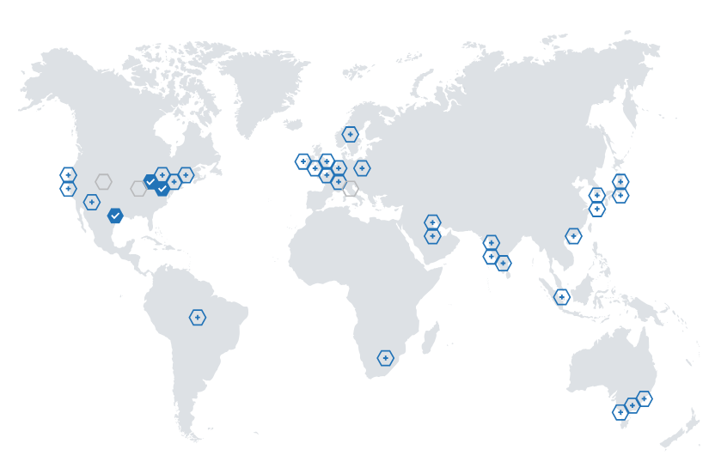

Reference Architecture
DATA SOURCES
CONSUMERS
Databases
Completions API Azure OpenAI
Apps
Payments API Azure Functions
Account Data Cosmos DB
Payments API Azure Functions
Azure Front Door
Account Management Static Web App
Agents
Files
Account Data Cosmos DB
Account Data Cosmos DB
Payments API Azure Functions

Slide 6
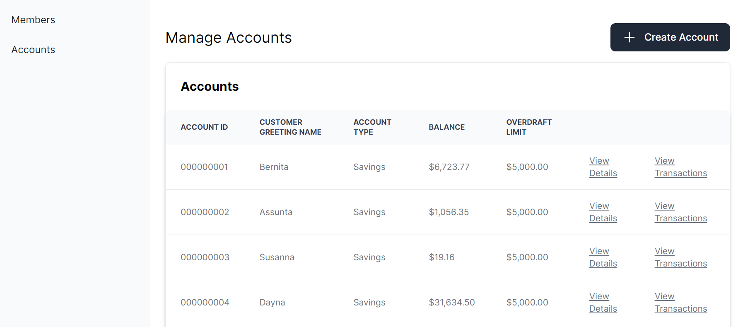
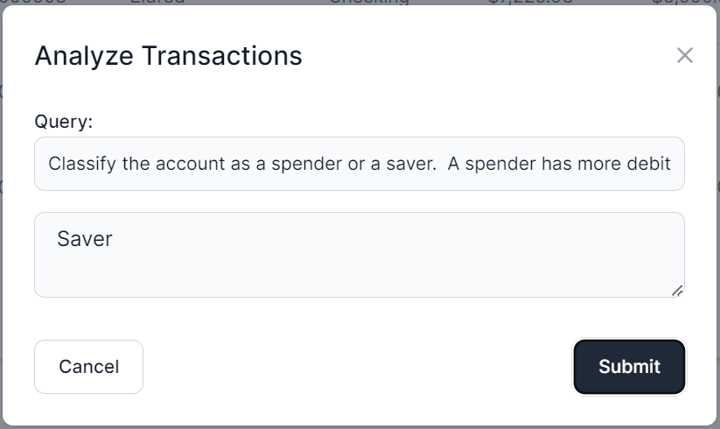
User Interface
Notes:
The application frontend is a Blazor application with Intelligent Agent UI functionality.

Slide 7
Strong Consistency

Slide 8
Bounded Staleness

Slide 9
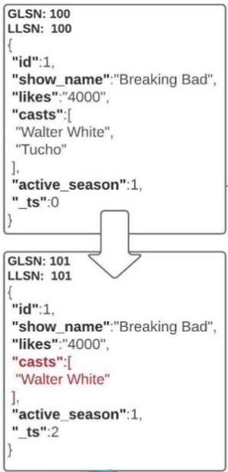
PATCH Operation
Allows partial updates to documents in Cosmos DB
With PATCH you can update select document properties instead of having to replace the entire document.

Slide 10
Meet the lightweight Kernel of Semantic Kernel.
“
I’ve been designed to orchestrate complicated LLM AI prompts combined with native code, use multiple AI models, and use a goal-oriented approach to achieving asks.”
STEPS
👋
PLANNER
1
2
3
…
ernel
ASK
K
“
I take a user’s ask and generate a step-by-step plan that draws upon available skills.”
Planner generates steps that use available Skills
SKILLS
Notes:
It all starts from an Ask. The user has a need that needs to be filled. Kernel, in Semantic Kernel, is the orchestrator for the Ask. It sends the Ask over to the Planner to the right skills can be found and the right steps can be created from the Ask and Skills.

Slide 11
Goals-First AI
ernel
ASK
K
It all starts with a user’s AI ask …
Steps ready from planner
1
2
3
…
Gather Skills
Gather Memories
V1 READY
Gather Connectors
SKILLS
APIs
… resulting in new productivity
GET
RUNNING STEPS PIPELINE
Result is ready
1
2
3
…
Execute Steps
Notes:
It always starts with an Ask. A user has a goal they want to achieve. We have seen how the Kernel orchestrates the ask to the planner. The Planner finds the right AI skills that can be used to solve that need. Some skills are enhanced with memories and with live data connections. The steps to complete the users ask are executed as part of the plan and the results are returned to the user, resulting in productivity gains and ideally the goal reached.

Slide 12

Let’s get started!
aka.ms/TBD
Login with the credentials supplied to your team.
Notes:
To get started, visit the OpenHack portal:

Slide 13
Payments Reference Application
Challenge walkthrough for coaches
Notes:
This guide is only meant to be a reference. Please do not rely on this guide in place of completing the challenges before coaching.

Slide 14
Challenge 1: The Landing Before the Launch
In this challenge, participants deploy the services into the landing zone in preparation for the launch of the POC.
Learning objectives:
Deploy the Azure services needed to support the payments application
Understand the setup of the development environment

Slide 15
Challenge 2: Account for and Count the Accounts
In this challenge, Run the data generator to load the sample account and member data.
Learning objectives:
Learn how to check for the existence of data in Azure Cosmos DB in a data-loading process
Generate mock data with a given schema
Run parallel batch or continuous processing to load larger volumes of data

Slide 16
Challenge 3: Visualize World Peace … or at least the members, accounts, and transaction data
In this challenge, participants will wire up the Members, Account Summary, and Transaction Statement functionality to load the data from Cosmos DB and present it in the UI and see the end-to-end solution action.
Learning objectives:
How to conduct batch write operations to Azure Cosmos DB
Understand the core application functionality and its data; useful for later challenges
How to conduct patch operations using the Azure Cosmos DB SDK and observe how those operations merge when patching the same document across regions

Slide 17
Challenge 4: This Challenge is Questionable
In this challenge, participants will add functionality to the transactions screen that allows the user to ask questions about a member's transactions using natural language and viewing the results.
Learning objectives:
Use the Microsoft Semantic Kernel with Azure OpenAI to create a SemanticFunction that will respond with the results of the user’s question

Slide 18
Challenge 5: Home Improvement: AI Edition
In this challenge, participants will improve the prompt text to reduce any dependency on the model's parametric knowledge and improve the handling of numeric computations.
Learning objectives:
TBD

Slide 19
Coach solutions folder
https://aka.ms/TBD

Slide 20
Thank you coaches!

