Slide 1




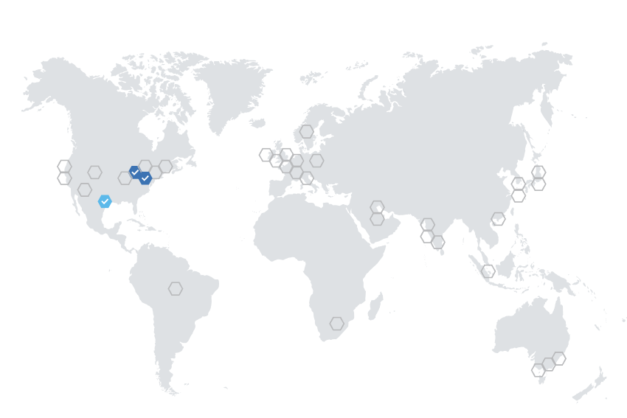






DATA
SOURCES
CONSUMERS
Completions API
Azure OpenAI
Databases
Apps
Account Data
Azure Cosmos DB
Payments API /
Worker Service
Azure Kubernetes Service (AKS)
Azure Front Door
Account
Management
Static Web App
Agents
Files
Account Data
Azure Cosmos DB
Account Data
Azure Cosmos DB

