Slide 1
Microsoft DevOps Capability Review
[Name]
[Title]
[Organization Name]

Slide 2
Agenda
Introduction
You learn about the solution, we learn about you
DevOps Capability Assessment Overview
Engagement Approach
Outcomes
DevOps Recommendations & Optimizations
Proposed tasks and activities to improve your DevOps Capability
Agile Software Development
Version Control
Continuous Integration/Continuous Delivery (CI/CD)
Infrastructure as a Flexible Resource
Continuous Security
Configuration Management
Continuous Monitoring
Culture
Next Steps
Decide how we’re going to complete the work
Proposed activities and timeline

Slide 3
Introduction
DevOps Capability Assessment Overview
Engagement Approach
Outcomes

Slide 4



DevOps Capability Assessment Engagement Approach – Discovery & Insights Delivery
1. Data collection and analysis
2. Fit data into model to generate improvement areas and opportunities backlog
3. DevOps Capability Recommendations and Optimizations Proposal Executive Summary

Slide 5
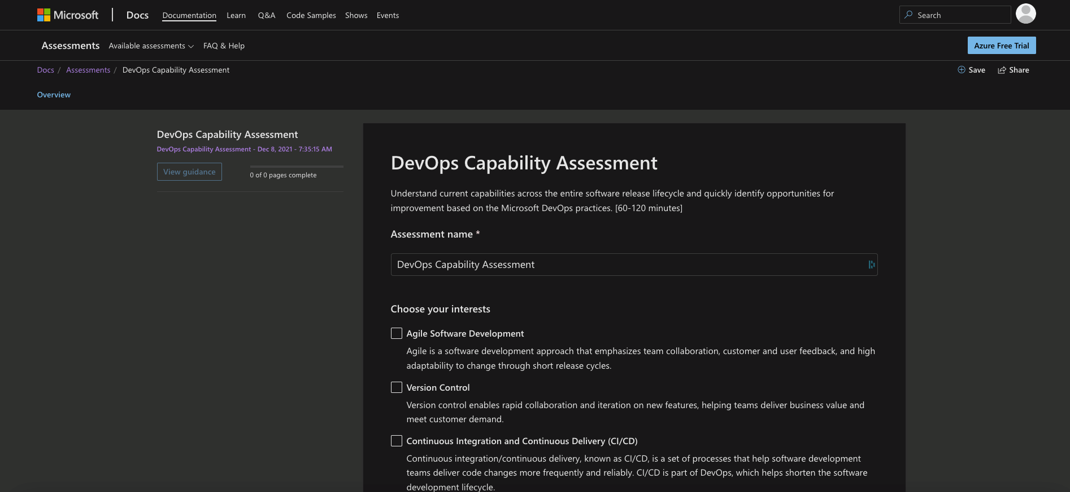
DevOps Capability Assessment Discovery and Insights Solution Overview
The goal of the Discovery & Insights phase is to assess the DevOps capability across the entire software release lifecycle that can be used to improve and optimize your DevOps state.
DevOps Capability Fit/Gap Analysis
Customer Outcomes
Get Insights about current capabilities for your DevOps state.
Identify DevOps Capability improvement priorities and next steps
Optimize your DevOps Capabilities with a Data Driven roadmap of prioritized activities

Slide 6

Discovery & Insights Based on Microsoft DevOps Practices
Agile Software Development
Continuous Integration/Continuous Delivery
Version Control
Culture
Customer Interviews/Fill-out forms
Continuous Monitoring
Configuration Management
Infrastructure as a Flexible Resource
Continuous Security

Slide 7


[WAF_Pillar_Name]
Report generated [Report_Date]

Slide 8

Executive Summary
Areas of focus to raise your DevOps Capability Review Score
Number of high-impact recommendations per practice area:
[S1]
[Domain_1]
DevOps Capability Review Score
[S2]
[Domain_2]
[Sc]
[S3]
[Domain_3]
[Pillar_Maturity_Description]
[S4]
[Domain_4]
[S5]
[Domain_5]
[S6]
[Domain_6]
[S7]
[Domain_7]
[S8]
[Domain_8]

Slide 9

[Domain_Title]
Top X out of Y recommendations:
Focus Area relative weight
[Placeholder_Text_1]
Relative weight indicates the average importance of recommendations in this section
[Sc]
[Domain_Description]

Slide 10
Next steps
Next steps proposed roadmap
Upskill and Design, Configure and Implement Plan

Slide 11
DevOps Capability Assessment Next Steps proposed roadmap
< Depending on the outcome of this assessment, work on a remediation plan to address the findings. Use the timeline chart below to include the tasks from the Recommendations and Optimizations Plan >
 | January | February | March | April | May | June | July | August | September | October | November | December
Task
Task
Task
Task
Task
Task
Task
Task
Task
Task
xxx
Risky
xxx
Risky
xxx
xxx
Customize based on workload findings to show a P0,P1,P2 roadmap to optimized state
xxx
Risky
xxx
xxx
xxx
xxx
xxx
MILESTONE 1
Notes:
Next top 10 based on priority (excluding top 3 recommendations if part of top 10 based on score) from the recommendations and optimization plan.docx

Slide 12
DevOps Capability Assessment Next Steps proposed roadmap
Quick wins (30 days) | Mid-term projects (90 days) | Long-term projects (90+ days)
Define coding standards for your team | Configure credential scanning within the build process | Thrive to have both development and operations to own the process end-to-end
Perform peer code reviews prior to every commit or check-in | Integrate the scanning tools within a CI / CD pipeline | Drive experimentation to Operational Visibility
Customize based on findings from the survey
Notes:
Next top 5 based on priority (excluding top 3 recommendations if part of top 10 based on score) from the recommendations and optimization plan.docx

Slide 13
DevOps Capability Assessment plan Upskill and Design, Configure and Implement Plan for <Customer Name>
TOP Recommended Trainings available from Premier Services
< The Premier offerings listed below are just samples. It depends on the outcome of the assessment which offerings are recommended for the customer. Replace them with appropriate service offerings!>
Training Readiness Plan
Order | Priority | Premier Services offerings | Duration | Delivery Components
1 | High | WorkshopPLUS - DevOps: Fundamentals | 4 days | workshop
2 | High | Activate Azure with DevOps | 4 days | educational sessions + POC
3 | medium | Activate Azure with DevTest Labs | 3 days | deep dive sessions +POC
4 | medium | Security: Azure Security Center - Fundamentals | 4 days | deep dive sessions +POC
5 | medium | WorkshopPLUS - Secure DevOps: Application Security Principles and Practice | 3 days | workshop
Customize based on findings from the survey

Slide 14
DevOps Capability Assessment plan Readiness Plan for <Customer Name>
Recommended Trainings available from Premier Services
WorkshopPLUS DevOps: Fundamentals (5 days training)
The Azure Security workshop provides attendees with broad knowledge and understanding of the key security features available in Azure (3 days) . After completing this workshop you will gain broad knowledge about key Security features available in Azure that will help you decide what is best for you to secure your environment.
Activate Azure with DevOps (3-day training)
The Azure Network Optimization service provides you with deep technical sessions as well as hands-on activities in production systems to measure, baseline and improve Network Connectivity, Performance, Security and other related topics
Secure DevOps: Application Security Principles and Practices (2-day training + 1 optional day: OWASP Top 10)
Secure DevOps: Application Security Principles and Practices is a two-day workshop that focuses on concepts, methodologies, and workflows that have been proven to yield more secure code. This workshop takes a hands-on approach to implementing secure design, secure verification, and secure implementation techniques to produce more secure software.
Application Security Design Review (2-day engagement)
Application Security Design Review (ASDR) uses threat modelling to identify security risks inherent in the design of an application and propose their mitigation. ASDR is a mixture of face-to-face discussions and expert reviews to identify the main avenues through which application security may be compromised. The focus of the engagement is the design of an application, rather than its implementation (e.g. source code). Apart from skill transfer, the engagement results in a report listing identified risks and possible mitigation.
Further scoping is required to focus on identified gaps in these deliveries.
Customize based on findings

