Slide 1
AgentOps
From Agent Prototype to Production
Notes:
- Every team building with GenAI hits the same question - can we safely ship this, and where is the evidence?
- That is what this session addresses: the operating model for moving AI agents from prototype to production on Microsoft Foundry
- Audience: AI application builders, architects, DevOps and platform teams, AI governance stakeholders, and technical decision makers
- Prerequisites in the broader program: Topic 2 (AI Landing Zones) and Topic 3 (Agent Architectures)
- Let us look at the agenda

Slide 2
Agenda
• AgentOps Foundations - why AI ops is different and the four-pillar model
• Evaluate - quality, grounding, behavior, and red teaming
• Ship - gates, evidence, approvals, and environment promotion
• Observe - traces, correlation, telemetry, and feedback
• Operate - incident response, model lifecycle, cost, and capacity
• Your Next Steps - from where you are today to the next level of maturity
Notes:
- We have six content blocks plus demos after each pillar - here is how we have structured the story
- We start with Foundations - why agents need a new operating discipline, the four-pillar model, and where teams sit today
- Then the four pillars: evaluate, ship, observe, operate - each followed by a live demo showing that pillar in action
- We close with your next steps to maturity
- Let us start with Foundations

Slide 3
AgentOps Foundations
Why AI operations need a new discipline

Slide 4
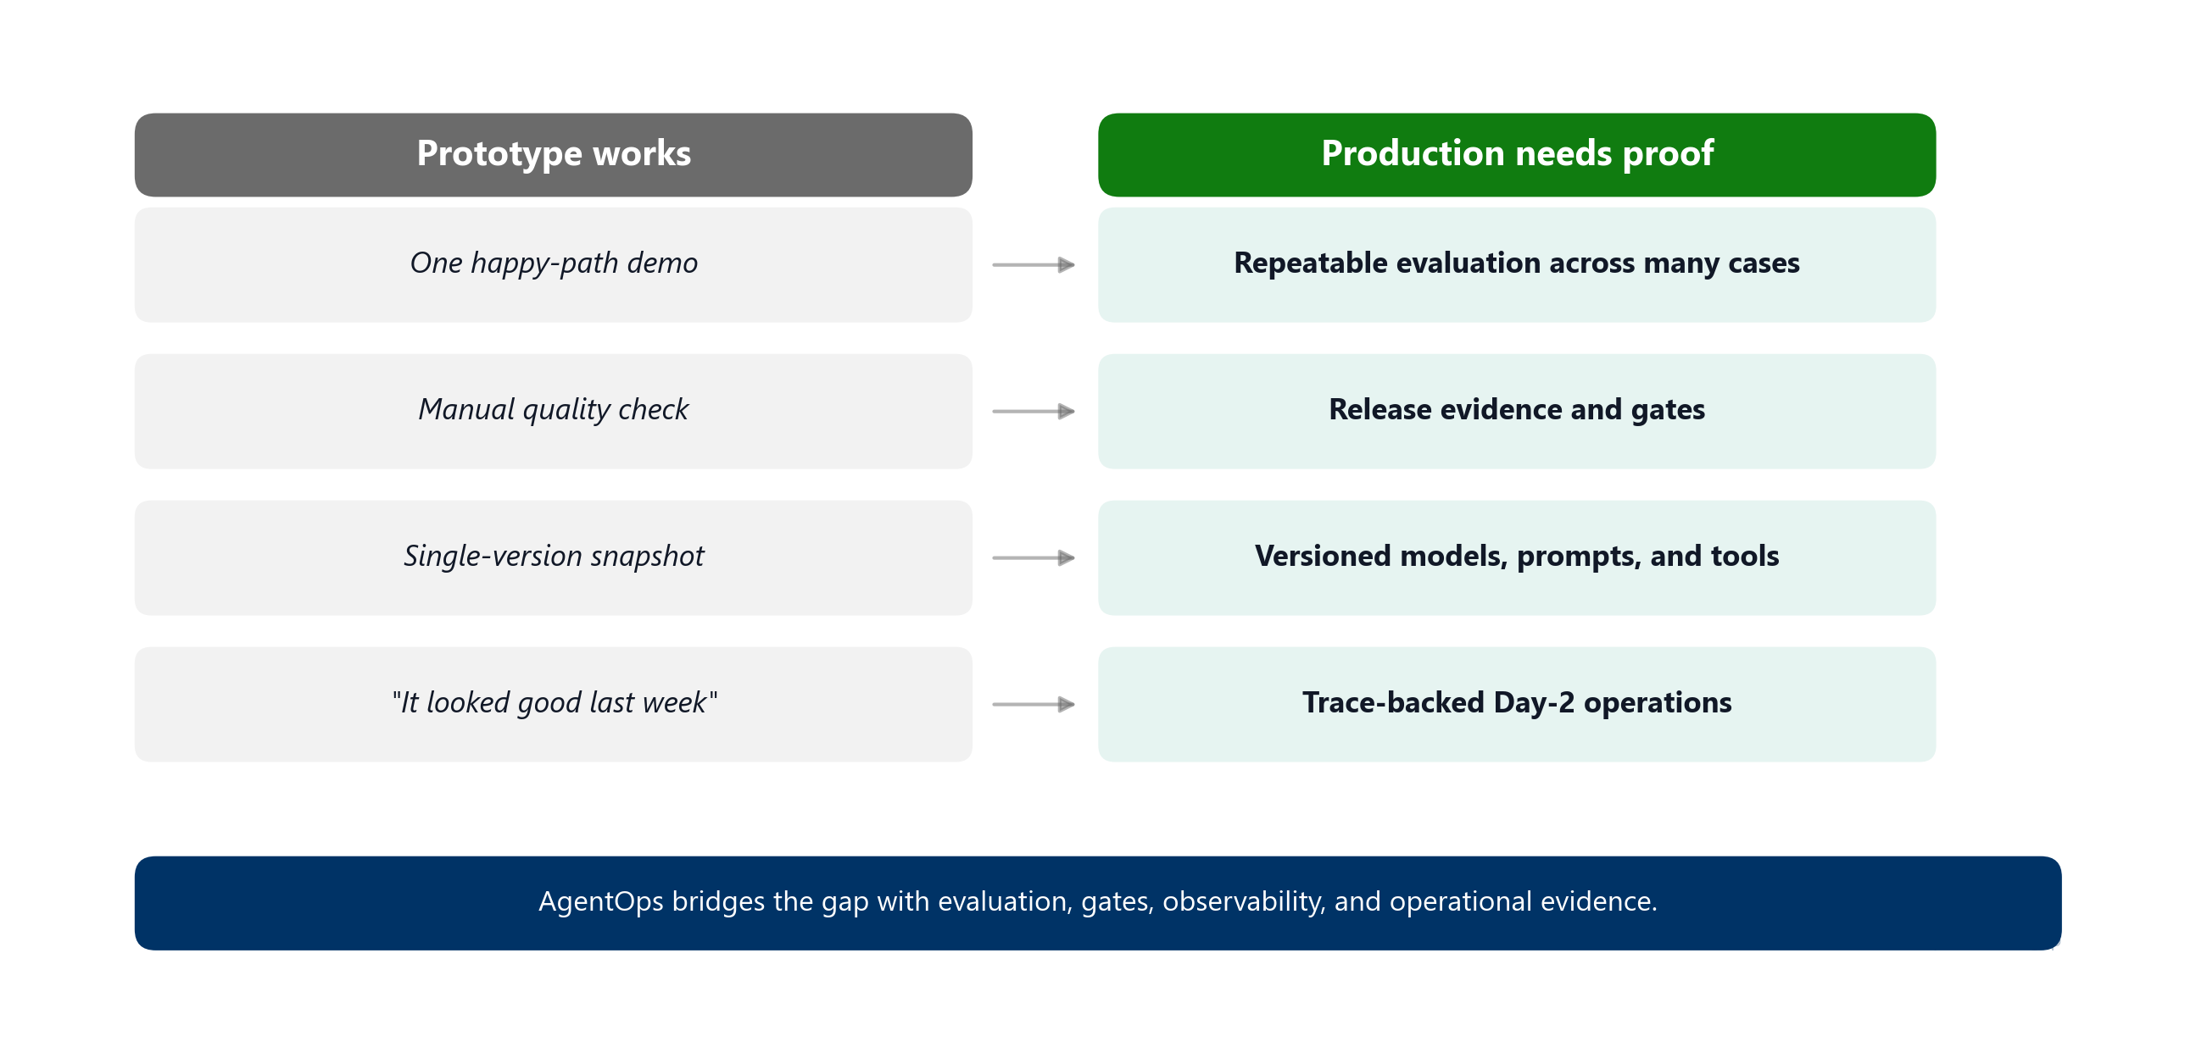
The production gap
The bottleneck moved from building the first demo to proving that the next version is safe to release
Notes:
- Teams can stand up a GenAI prototype in days - but getting to production is a different story. That gap is what we call the production gap
- Production introduces new operational risk: quality, safety, monitoring, cost, operations, and release confidence
- Agents add non-determinism, tool-calling risk, prompt regression, and changing user behavior
- So what exactly are we managing? The next slide breaks open the components that make an agent a production concern

Slide 5
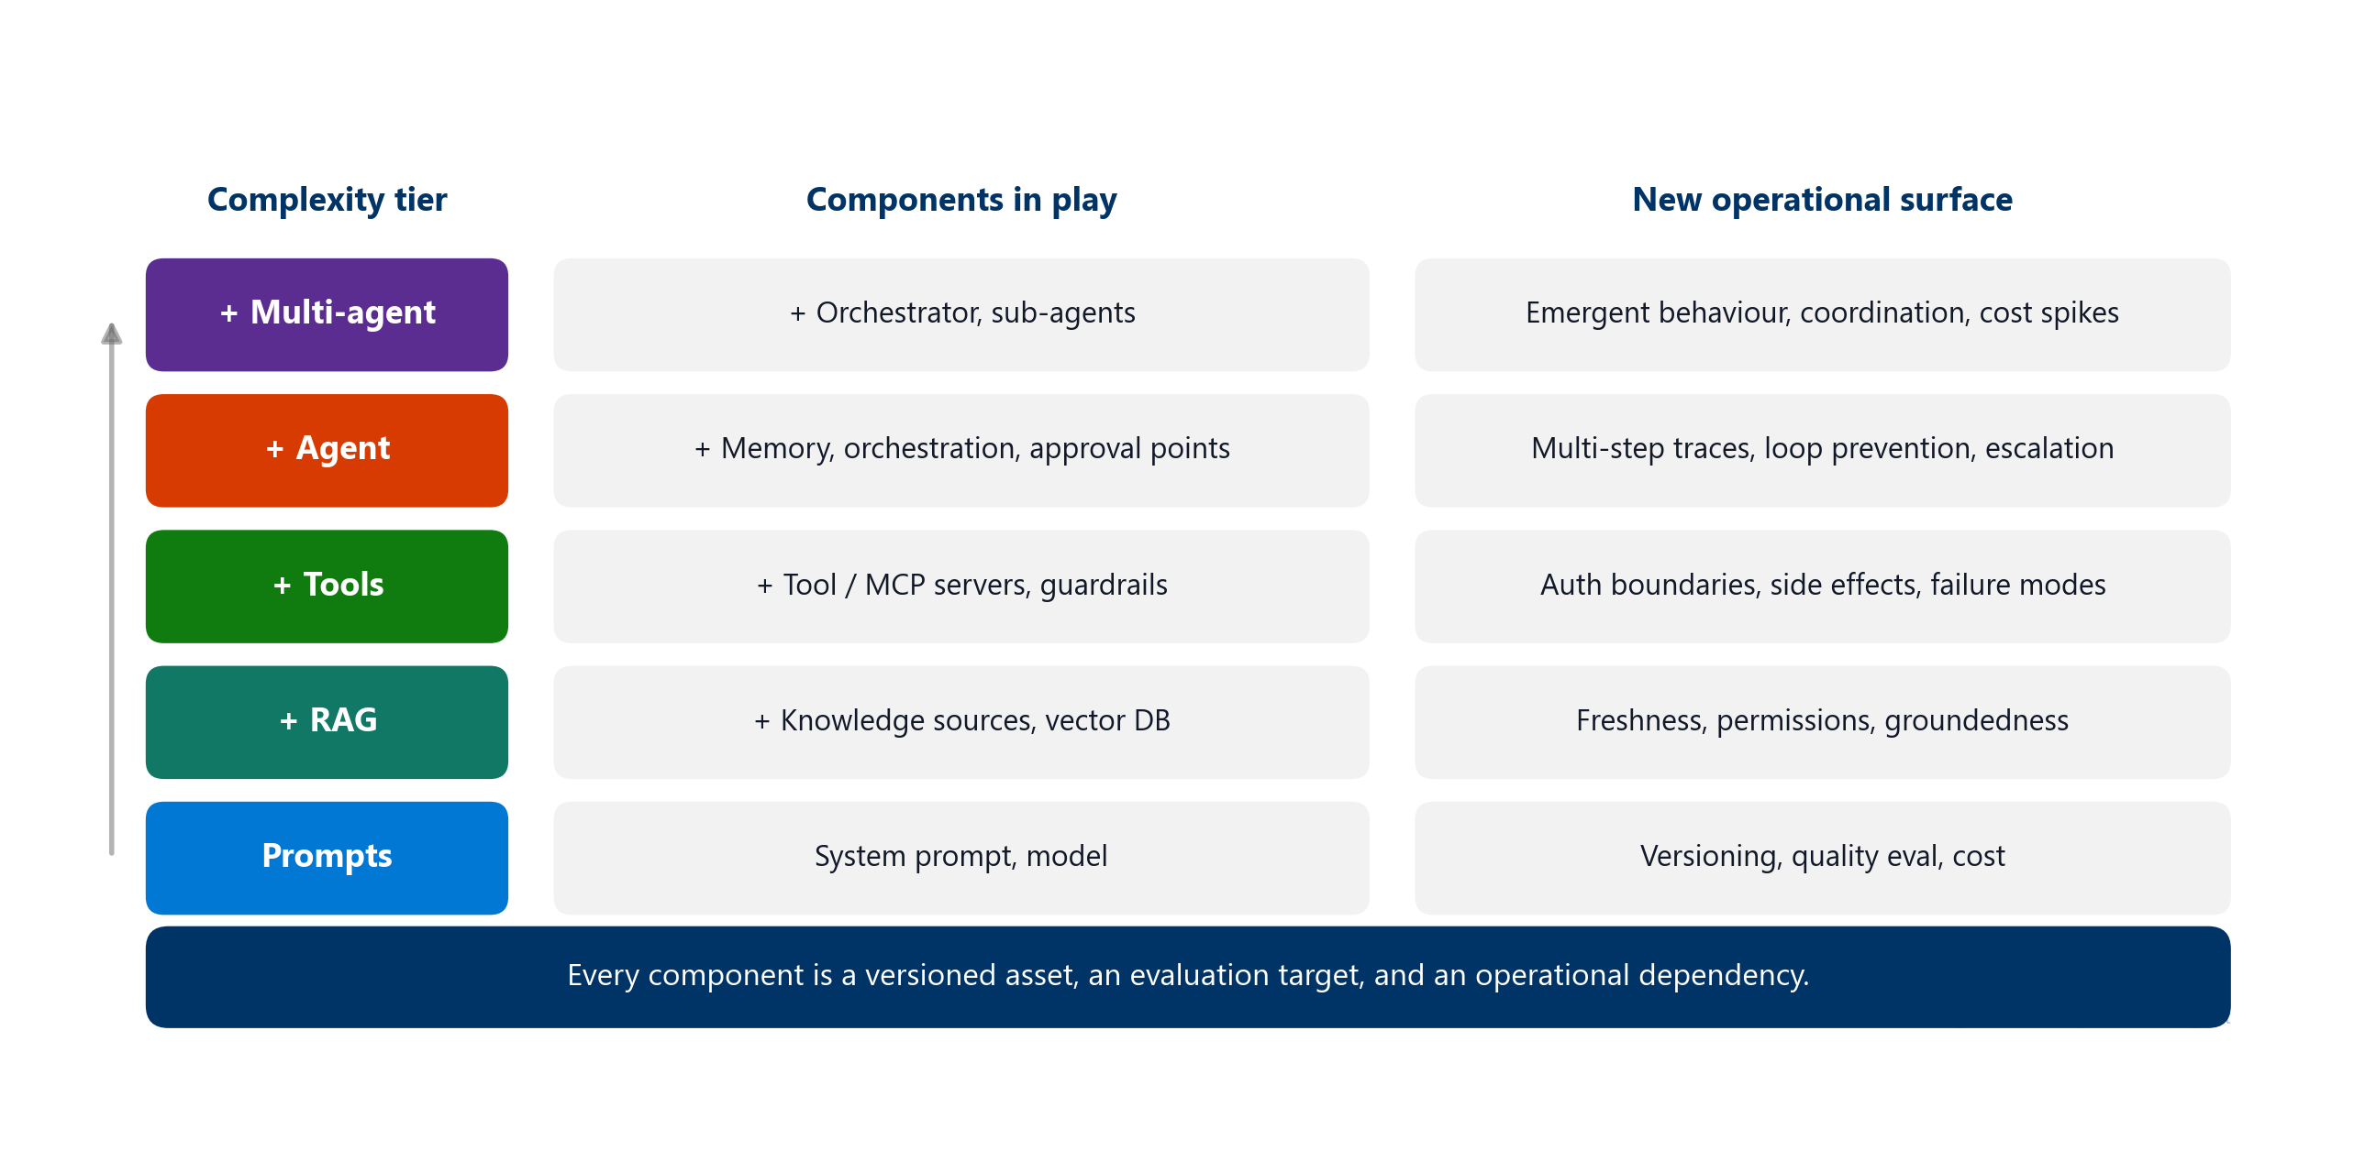
Building blocks of a production agent
Each tier adds components and complexity - a production agent manages all these simultaneously
Notes:
- What makes an agent a production concern? Not just a prompt and a model - layers of capability each bring their own operational surface
- Simple prompts: system prompt + model. Operational surface is versioning, quality eval, and cost
- Add RAG: knowledge sources, freshness, permissions, groundedness
- Add tools: MCP servers, guardrails, auth boundaries, side effects, failure modes
- Add agent autonomy: memory, orchestration, approval points, multi-step traces, loop prevention, escalation
- Add multi-agent: orchestrator, sub-agents, emergent behaviour, coordination, cost spikes
- Even a simple tool-using agent is at tier 3, managing all components simultaneously. Each is a versioned asset, an evaluation target, and an operational dependency
- We need a platform to manage all of this - that is Foundry. Cross-reference: Topic 3 covers agent architectures in detail
- So what does Foundry give us as the control plane?

Slide 6
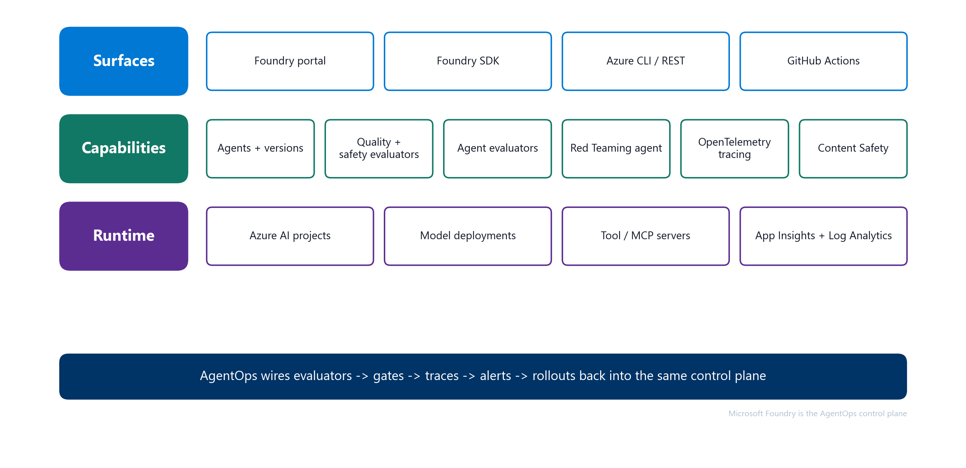
Microsoft Foundry is the control plane
Foundry stays the control plane - AgentOps connects Foundry signals to release decisions and Day-2 action
Notes:
- We need a platform that orchestrates all these components - that platform is Microsoft Foundry, acting as the control plane
- Surfaces: portal, SDK, Azure CLI / REST, and GitHub Actions
- Capabilities: agents and versions, quality + safety evaluators, agent-specific evaluators, Red Teaming agent, OpenTelemetry tracing, Content Safety
- Runtime: Azure AI projects, model deployments, tool / MCP servers, App Insights and Log Analytics
- AgentOps adds the repeatable operating model around Foundry - it is not a replacement
- Now the question becomes: what evidence do we need to prove a version is safe to ship? That is the production readiness checklist

Slide 7
Production readiness checklist
The checklist turns "I think it works" into "we have evidence for this release"
• Target and version are explicit
• Eval dataset and thresholds exist
• CI/CD gate blocks regressions
• Telemetry and traces are wired
• Safety and red-team findings are tracked
• Release evidence is reviewable
• Owners know what to do when signals fail
Notes:
- How do we know a version is actually safe to ship? The production readiness checklist answers that
- It is the contract for any production-candidate agent. Every item maps to one or more later slides
- Walk the audience through each item briefly so they hold it as the mental model for the rest of the session
- Now let us see the operating model that connects these items into a repeatable process

Slide 8
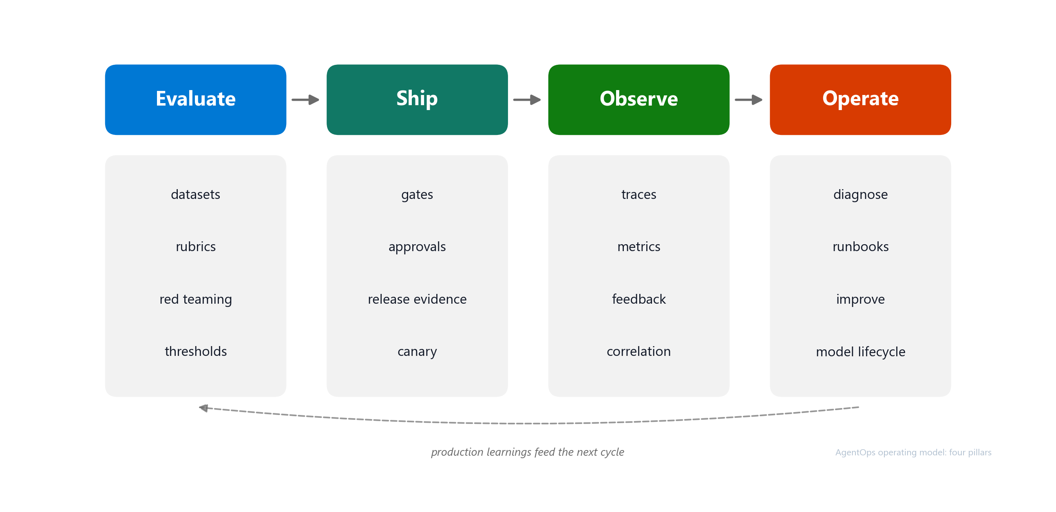
AgentOps operating model
Four pillars - Evaluate, ship, observe, and operate production agents
Notes:
- The checklist tells us what evidence we need. The operating model tells us how to apply it across the agent lifecycle
- AgentOps applies DevOps discipline to AI agents, where behavior is probabilistic and releases need evidence
- The model has four pillars:
- Evaluate pre-production behavior using golden datasets, rubrics, red teaming, and thresholds
- Ship with CI/CD gates, release evidence, human approvals, environment promotion, and canary
- Observe production behavior through traces, metrics, logs, content safety signals, feedback, cost, and latency
- Operate the workload through diagnosis, incident response, runbooks, model lifecycle, cost management, capacity management, and continuous improvement
- The output is release evidence and operational confidence
- Now that we know the model, the question is: where does your team sit today?

Slide 9
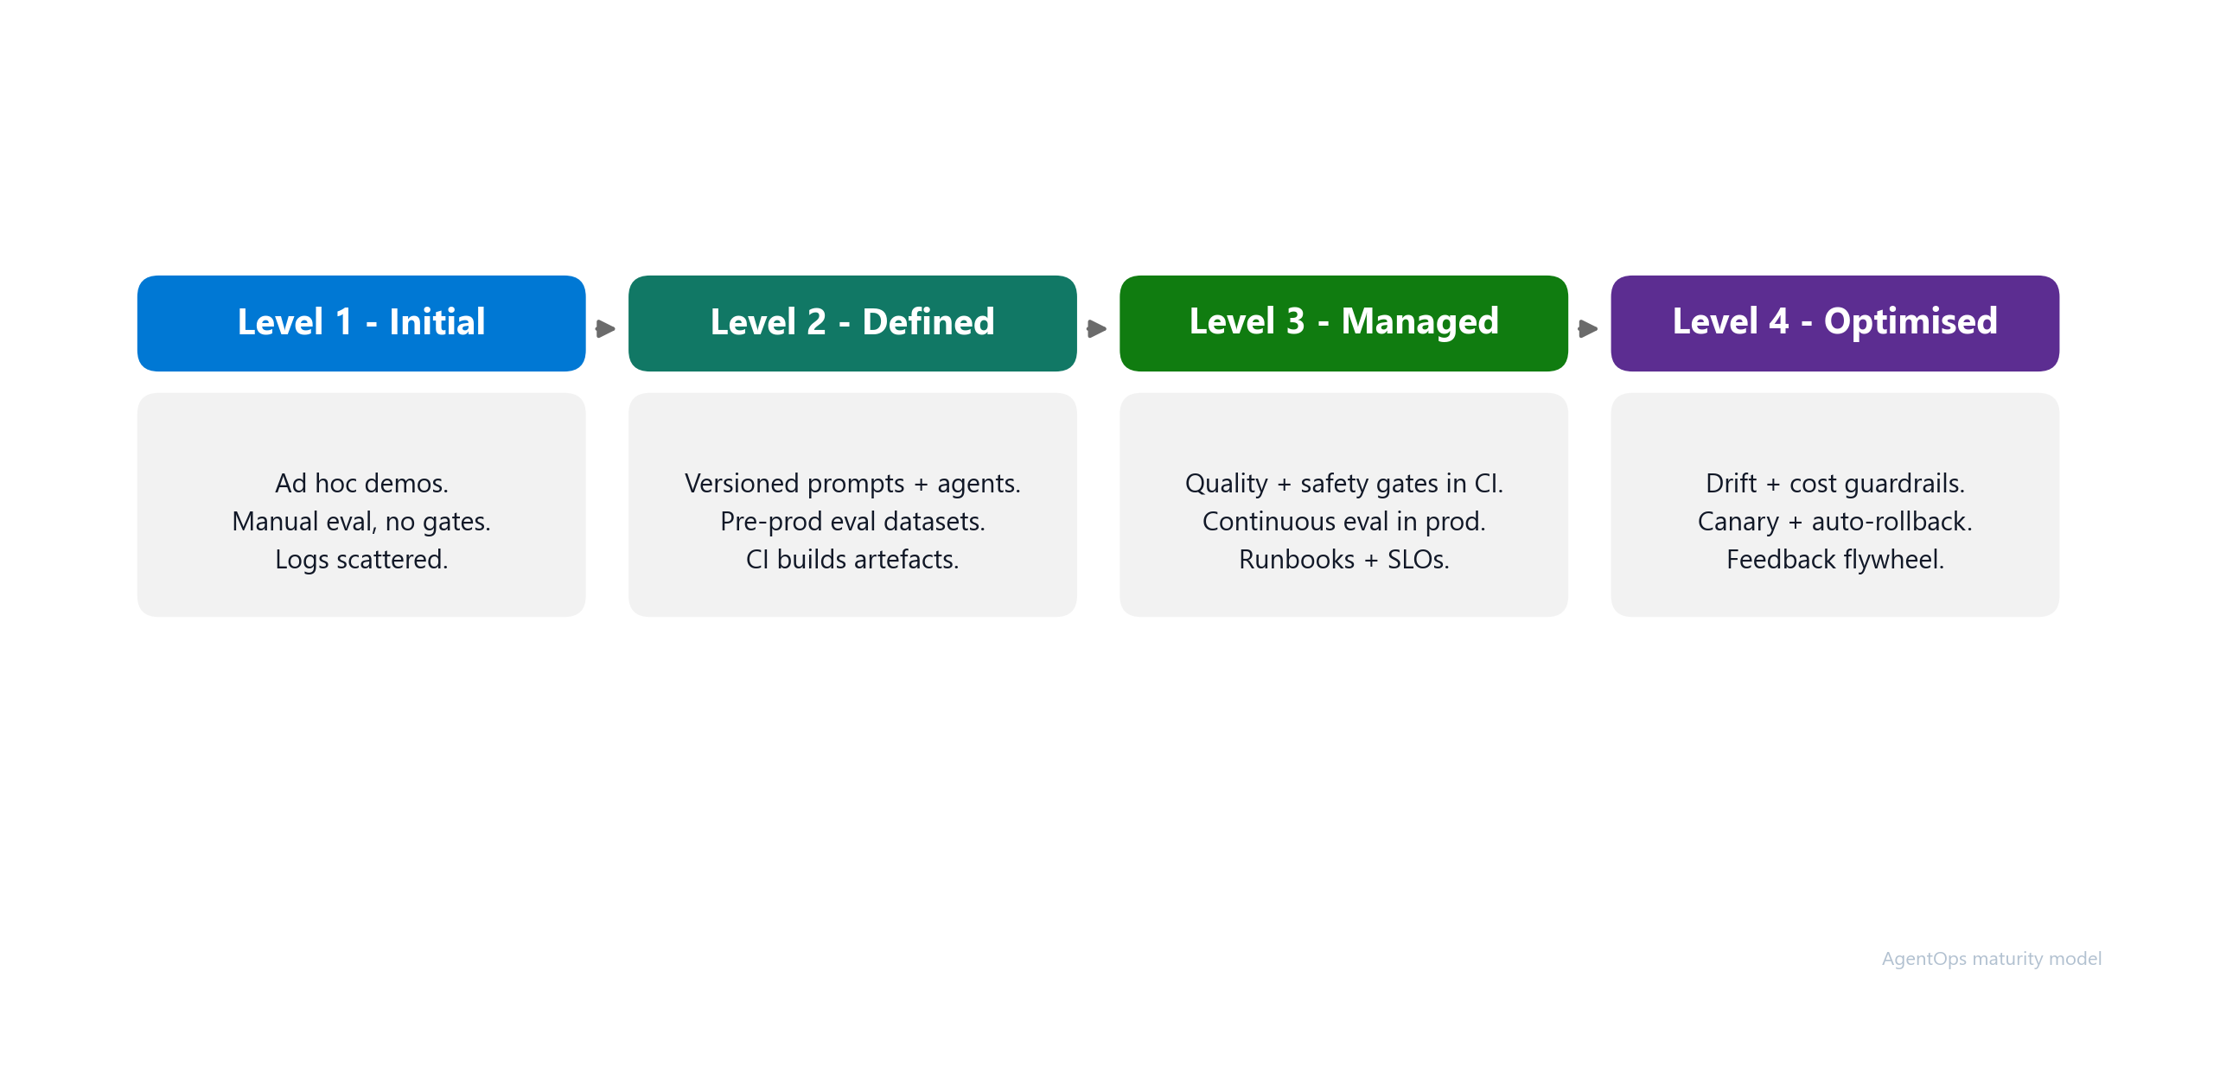
Maturity model
Most teams sit between Initial and Defined - start by moving one production-candidate agent up one level
Notes:
- The checklist defines what good looks like. The operating model tells you how to get there. The maturity model tells you where you are today
- Initial: ad hoc demos, manual eval, no gates, scattered logs
- Defined: versioned prompts and agents, pre-prod eval datasets, CI builds artefacts
- Managed: quality and safety gates in CI, continuous evaluation in production, runbooks and SLOs
- Optimised: drift and cost guardrails, canary plus auto-rollback, feedback flywheel
- The practical move is not to boil the ocean - pick one production-candidate agent and move it up one level
- Before we dive into each pillar, let us see what this model looks like as a reference architecture on Foundry

Slide 10
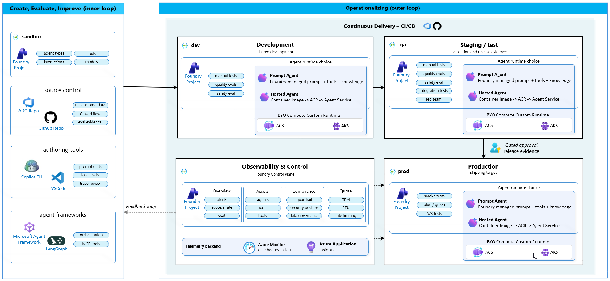
AgentOps Architecture
A complete architecture for AgentOps inner and outer loop
Notes:
- Same four-pillar model, drawn as a reference architecture on Foundry. The conceptual model becomes concrete components on the right
- Inner loop "Create, Evaluate, Improve" (left column): sandbox Foundry Project for agent types / instructions / tools / models, source control in ADO or GitHub holding release candidate + CI workflow + eval evidence, authoring tools (Copilot CLI, VS Code) for prompt edits and local evals, agent frameworks (Microsoft Agent Framework, LangGraph) for orchestration and MCP tools
- Outer loop "Operationalizing" (right block): Continuous Delivery via ADO or GitHub Actions promotes the agent through dev (shared development), qa (staging / test - validation and release evidence), and prod (shipping target) - each one its own Foundry Project
- Pipeline chips get stricter per environment: dev runs manual tests + quality evals + safety eval; qa adds integration tests + red team; prod runs smoke tests plus blue-green or canary rollout (no re-eval - the evidence is locked at qa)
- Agent runtime choice is identical in every environment: Prompt Agent (Foundry-managed prompt + tools + knowledge) or Hosted Agent (Container Image -> ACR -> Agent Service), with BYO Compute Custom Runtime on ACS or AKS for full control
- Between qa and prod, the human Gated approval - backed by the release evidence package, not a rubber-stamp click
- Observability & Control (bottom): the Foundry Control Plane, organised the way the Operate nav organises it - Overview (alerts, success rate, cost), Assets (agents, models, tools), Compliance (guardrail, security posture, data governance), Quota (TPM, PTU, rate limiting)
- Telemetry backend strip: Azure Monitor for dashboards + alerts, Application Insights for traces / spans / app telemetry - this is where Foundry traces flow to
- Two telemetry feeds (dashed): Observability & Control collects signals from dev and from prod
- Feedback loop (dashed, going left): production learnings flow back into the inner loop so the next iteration of prompts, tools and evaluators is informed by what really happened in prod
- With the architecture in mind, let us start with the first pillar: Evaluate

Slide 11
Evaluate
The release signal for agentic systems

Slide 12
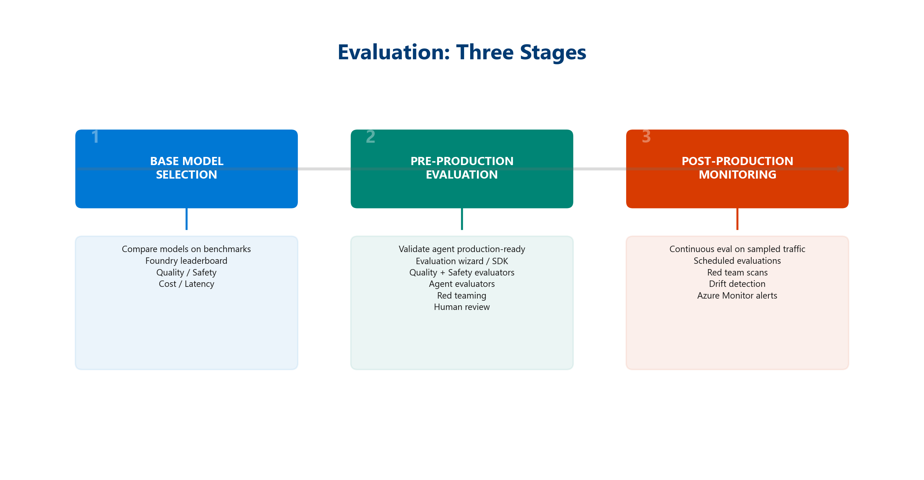
Evaluation strategy
Evaluation is not a one-time score - it's the release signal that grows as production teaches you new failure modes
Notes:
- This is the Evaluate pillar. Without a quality signal, there is nothing to ship with confidence
- Start with a small golden dataset tied to real user journeys
- Evaluate quality, groundedness, latency, cost, and behavior. Compare against baselines and previous versions
- Promote reviewed production traces into future regression cases
- A few dozen representative cases beat zero cases
- Use Foundry's built-in evaluators for quality, groundedness, and agent metrics like intent resolution and tool call accuracy
- The eval dataset is a living artifact - every reviewed production trace can become a new test row
- But quality evaluation alone is not enough - we also need to test adversarial scenarios

Slide 13
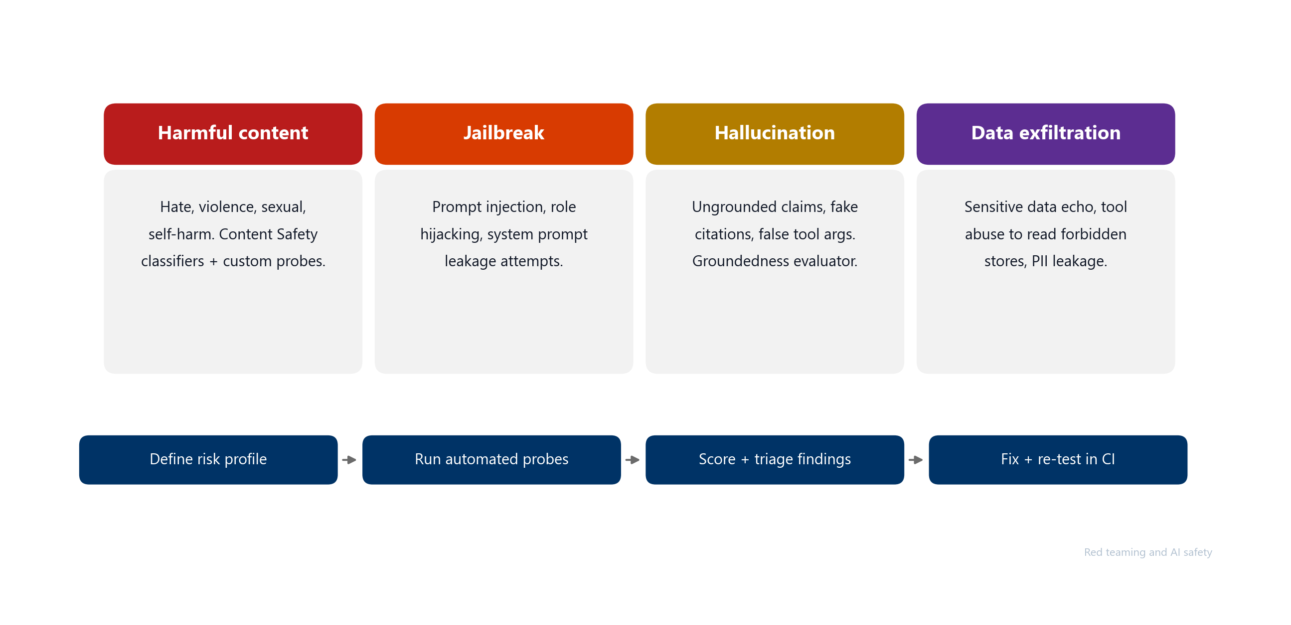
Red teaming and AI safety
Quality asks "is the answer good?" Red teaming asks "can someone make it misbehave?" Both are required
Notes:
- Quality evaluation tells us if the answer is good - but it will not tell us if someone can make the agent misbehave. That is red teaming
- Safety and quality are different signals - quality scoring will not catch a jailbreak
- Foundry ships an AI Red Teaming Agent backed by Microsoft's PyRIT framework for automated adversarial testing
- Four risk categories: harmful content, jailbreak (prompt injection, role hijacking), hallucination (ungrounded claims), data exfiltration (PII leakage, tool abuse)
- Cadence: pre-release gate, scheduled weekly, post-incident
- Findings feed the eval dataset as adversarial rows for future regression coverage
- New at Build 2026: Adaptive Evaluations (preview) convert safety and governance policies directly into automated tests. Paired with ASSERT (Agent Security and Safety Evaluation Run-Time), teams can turn policies into repeatable eval coverage without hand-writing every test case
- Now that we have evaluation and red teaming producing signals, how do we enforce them? That brings us to Ship

Slide 14
DEMO
Evaluate
Paulo Lacerda, Senior Cloud Solution Architect, Microsoft
Notes:
- Live demo showing evaluation in action on Foundry: golden dataset, evaluator runs, score comparison, and the release signal

Slide 15
Ship
Gates that enforce release evidence

Slide 16
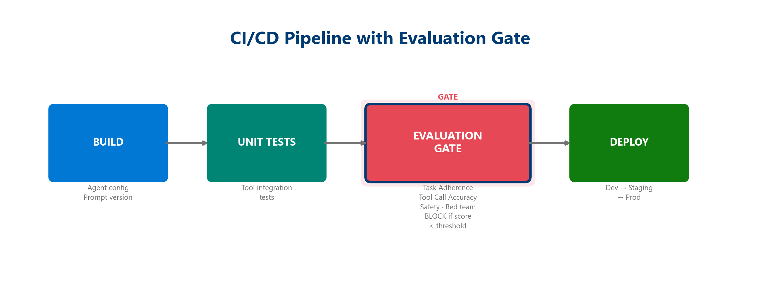
CI/CD gates for agentic AI
The strongest moment is a failed gate - if the prompt regresses, the pipeline stops before users experience it
Notes:
- This is the Ship pillar. Signals without enforcement are just reports nobody reads, and CI/CD gates are where DevOps discipline meets agentic systems
- PR gates block bad prompts before merge
- Deploy gates block bad versions before they reach the next environment
- Watchdogs catch drift between releases
- Every gate produces an artifact: eval report, readiness report, release evidence
- New at Build 2026: Agent Control Specification (ACS) extends gates into runtime. ACS defines eight interception points across the agent lifecycle (startup, input, pre/post-model-call, pre/post-tool-call, output, shutdown) where policies are enforced as code. Works across Foundry, Microsoft Agent Framework, and LangChain. Published open-source under the Agent Governance Toolkit on GitHub
- With gates enforcing quality, the next question is what happens after we ship. That is where Observe comes in

Slide 17
DEMO
Ship
Paulo Lacerda, Senior Cloud Solution Architect, Microsoft
Notes:
- Live demo showing CI/CD gates in action: pipeline build, evaluation gate, failed gate blocking a regression, evidence artifact

Slide 18
Observe
Traces, correlation, and the closed loop

Slide 19
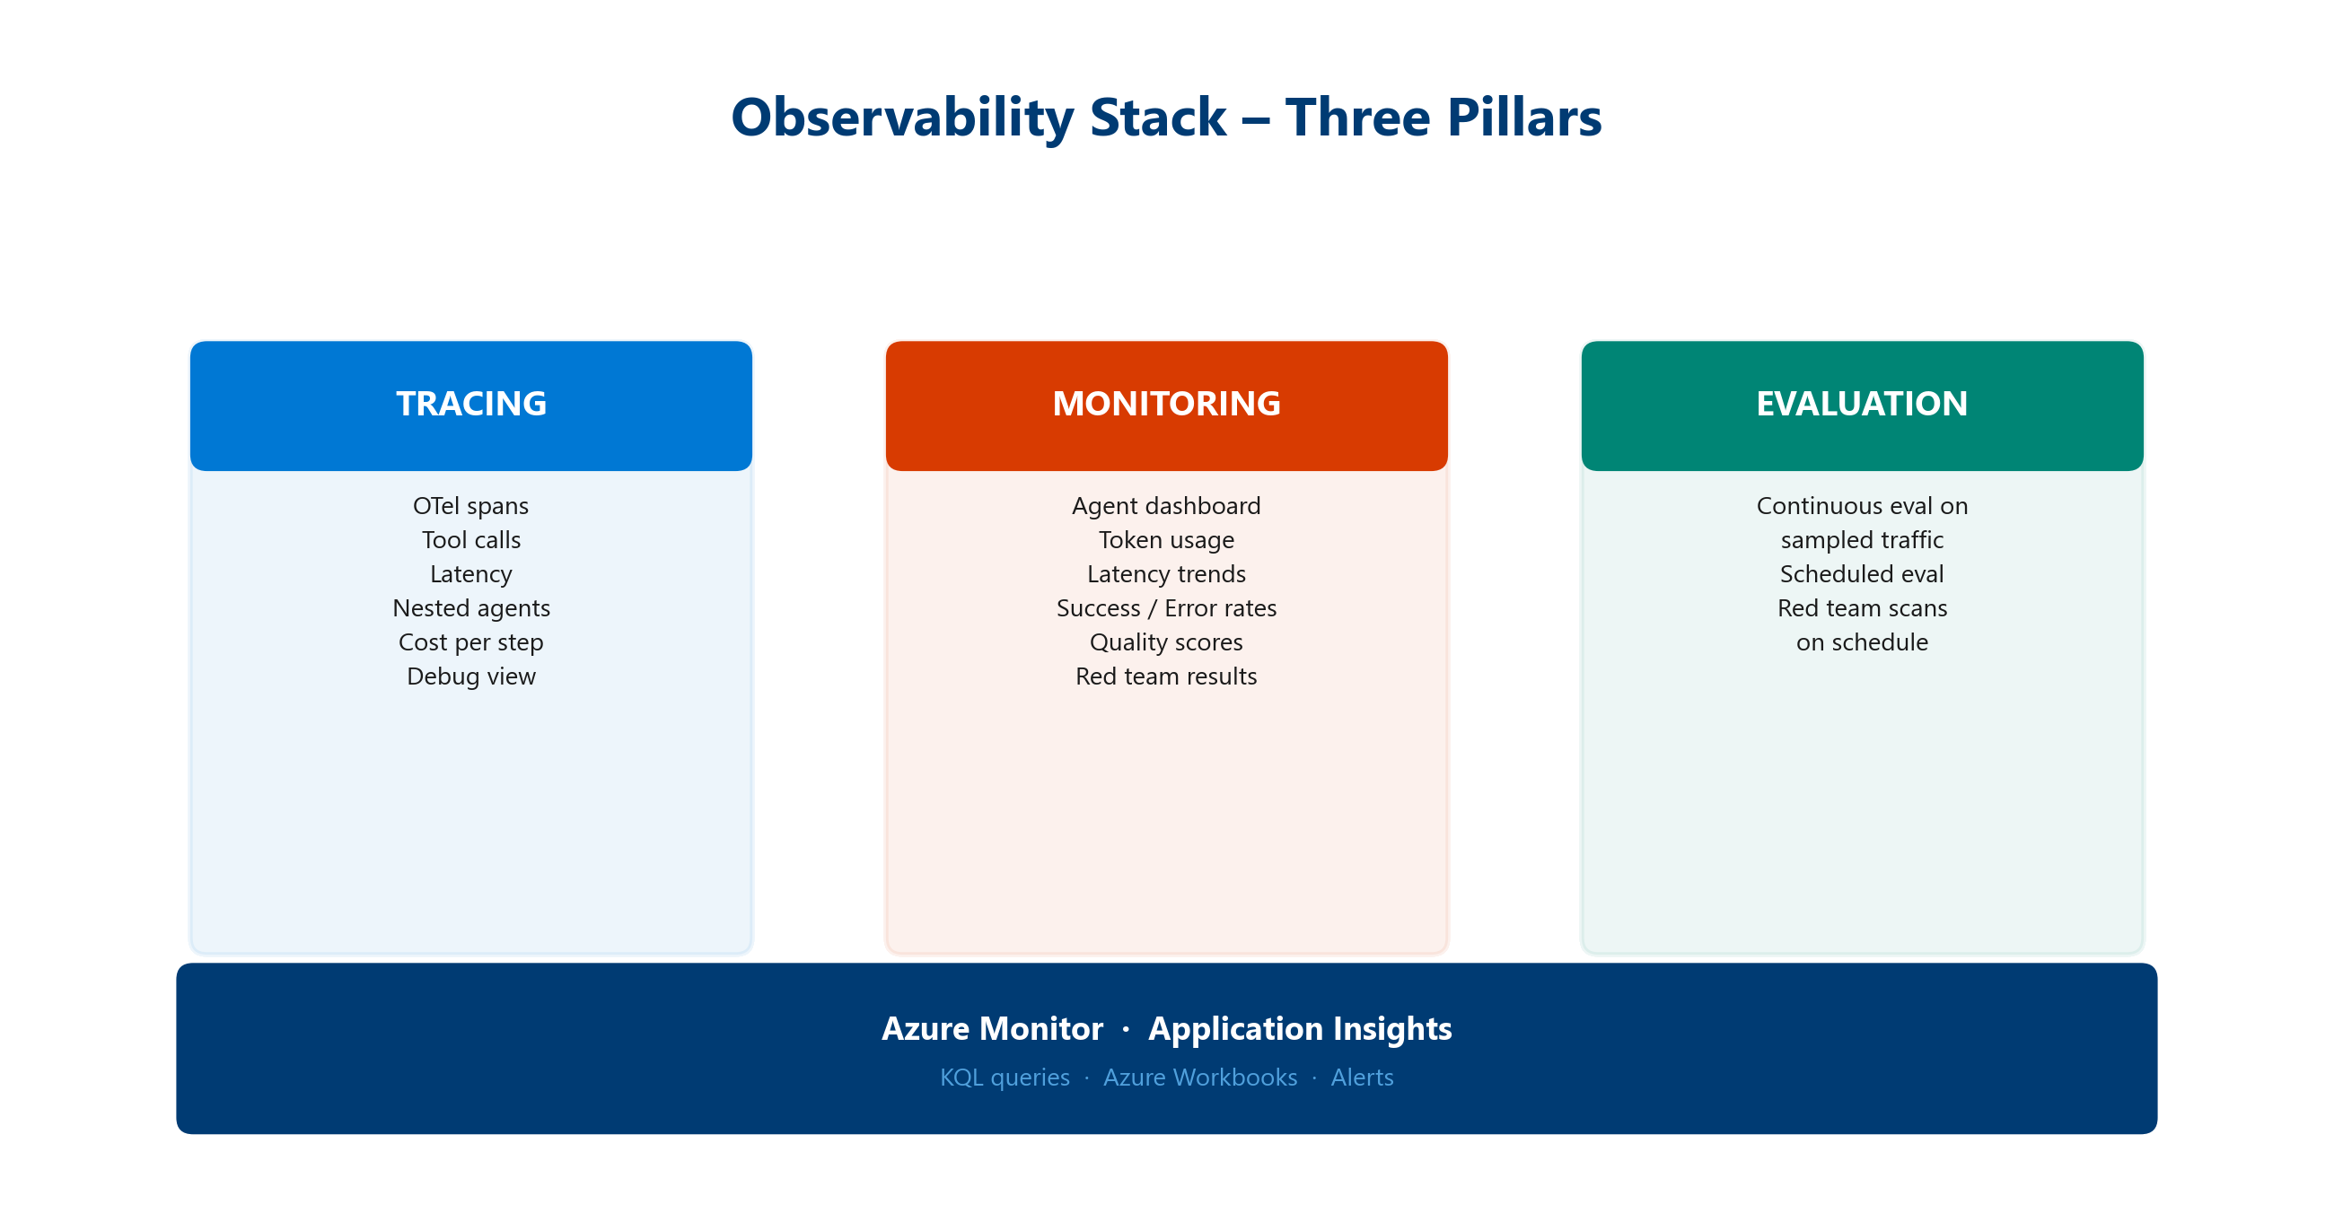
Observability for agents is more than monitoring
Infrastructure monitoring asks "is the service healthy?" Agent observability asks "what did it do and why?"
Notes:
- This is the Observe pillar. Gates enforce quality before release, but once the agent is live we need to understand what it is doing and why
- For agents, the unit of understanding is the trace - the chain of decisions, not just the endpoint status
- Required signals: prompt, plan, model call, retrieval, tool call, safety event, latency, cost, user feedback, release version
- Required correlation: trace ID, session ID, agent version, deployment, eval run, incident, owner
- Without correlation, observability is just disconnected dashboards. With it, the same trace answers questions across release, runtime, evaluation, and Day-2
- But signals alone are not the goal - what matters is what you do with them

Slide 20
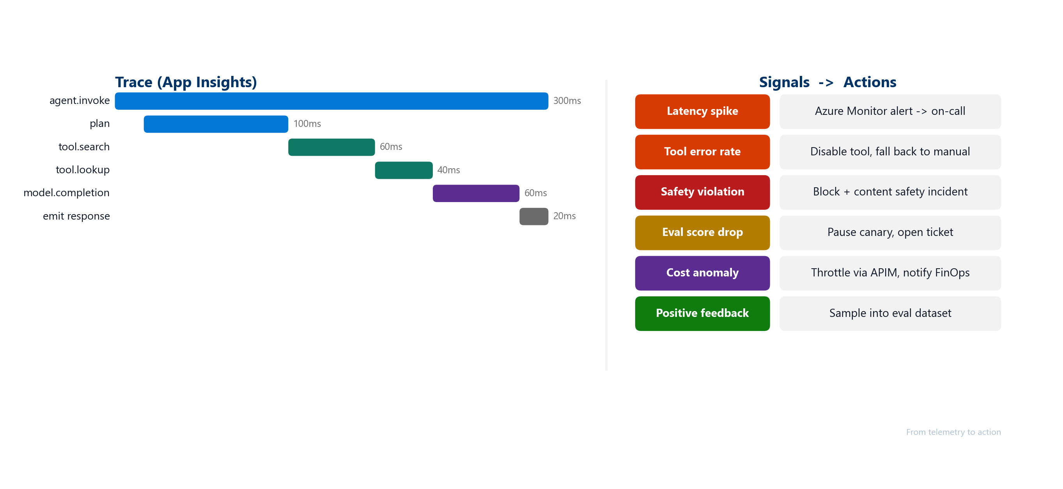
From telemetry to action
The end state is not a dashboard. The end state is action: observe, diagnose, improve, and ship the next version with evidence
Notes:
- Collecting signals is not the end goal - what matters is turning them into action. This slide is the connective tissue of the whole session
- A trace explains a failure. A reviewed trace becomes a new eval row. The eval row enters the gate. The gate prevents recurrence
- Latency spike -> Azure Monitor alert -> on-call
- Tool error rate -> disable tool, fall back to manual
- Safety violation -> block plus content safety incident
- Eval score drop -> pause canary, open ticket
- Cost anomaly -> throttle via APIM, notify FinOps
- Positive feedback -> sample into eval dataset
- This is how Observe feeds Operate, and how Operate feeds the next Evaluate and Ship cycle

Slide 21
DEMO
Observe
Paulo Lacerda, Senior Cloud Solution Architect, Microsoft
Notes:
- Live demo showing observability in action: trace waterfall, correlated spans, continuous evaluation scores, and signal-to-action flow

Slide 22
Operate
Running agents in production

Slide 23
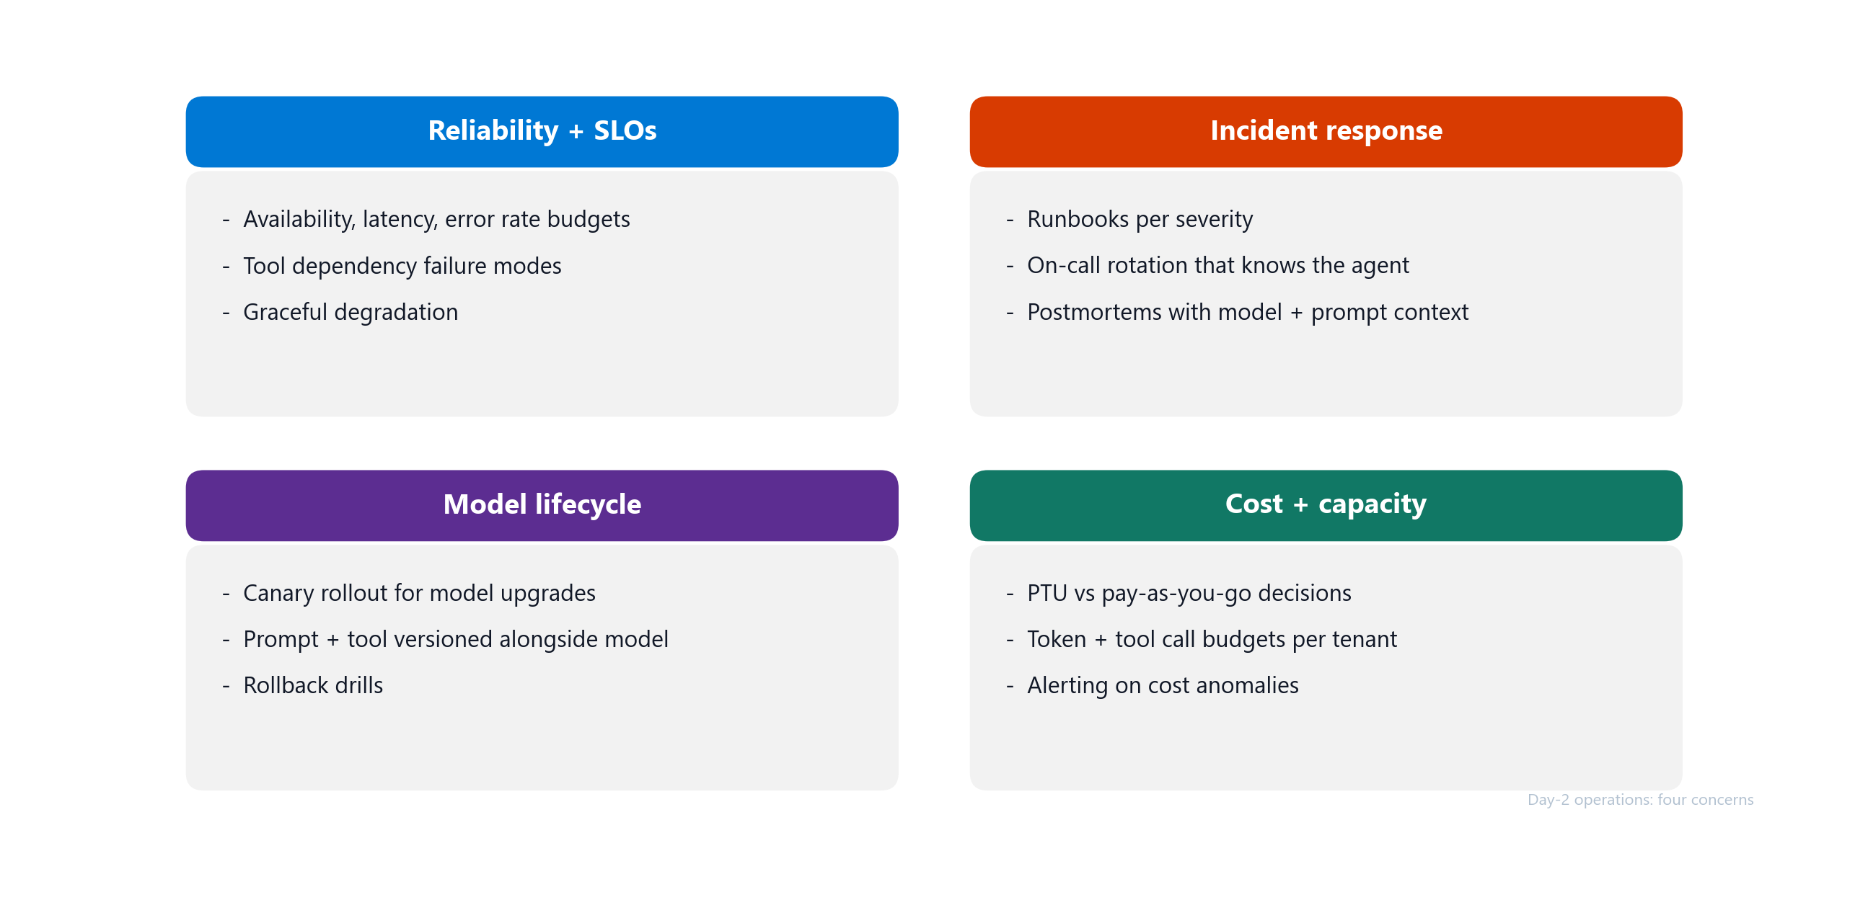
Day-2 operations - four concerns
AgentOps is not done at release - production traces and red-team findings feed the next evaluation set
Notes:
- This is the Operate pillar. Shipping is not the finish line, it is where the real operational work begins. Day-2 has four concerns teams need to manage
- Reliability and SLOs: availability, latency, error rate budgets; tool dependency failure modes; graceful degradation
- Incident response: runbooks per severity; on-call rotation that knows the agent; postmortems with model plus prompt context
- Model lifecycle: canary rollout for upgrades; prompt and tool versioned alongside model; rollback drills
- Cost and capacity: PTU vs pay-as-you-go; token and tool call budgets per tenant; alerting on cost anomalies
- The four concerns are interlocking - each creates signals that feed back into evaluation and the next release
- Governance umbrella: Microsoft Agent 365 (GA May 2026) provides the observe, govern, and secure control plane across all agents in the enterprise. The SDK is free and framework-agnostic - works with Microsoft Agent Framework, OpenAI Agents SDK, LangChain, Semantic Kernel. Brings custom and third-party agents under one governance umbrella so Day-2 visibility and policy enforcement are consistent
- The next two slides go deeper into incident response and model lifecycle

Slide 24
AI incident runbook
Containment first - evidence-backed fix second
Severity | Example | First action
S1 Critical | Safety event or data leak in production | Stop gate, rollback to last good version
S2 High | Quality or grounding regression after deploy | Planned rollback or version pin
S3 Medium | Latency degradation or cost spike | Rate-limit, investigate, then act
S4 Low | Drift indicator on a single metric | Schedule analysis in the next eval cycle
Triage flow:
Detect -> Correlate trace -> Identify version -> Contain -> Analyze -> Fix -> Re-evaluate -> Close with evidence
Notes:
- When something goes wrong in production, you need a structured response - not a fire drill. The runbook turns chaos into a sequence
- The severity table sets expectations so teams do not over-react or under-react
- The triage flow makes containment explicit - stop the bleed before debugging
- The runbook is part of Operate because it turns production signals into containment, evidence-backed fixes, and future evaluation coverage
- Every closed incident produces evidence that updates the eval dataset, the gate criteria, or the operating model
- The other recurring Day-2 challenge is model lifecycle - let us look at that next

Slide 25
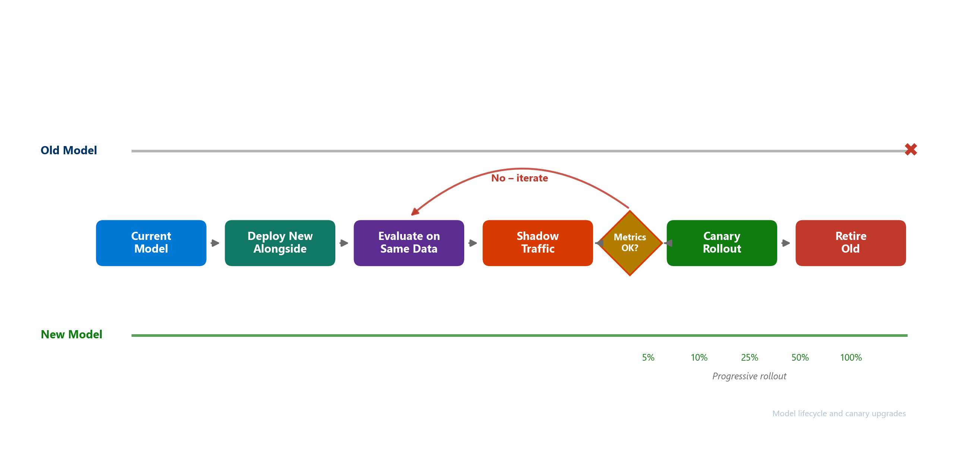
Model lifecycle and canary upgrades
Treat every model change as a release candidate, not a config flip
Notes:
- When the model itself changes - deprecation, new versions, cost pressure - that is model lifecycle. The recurring pain point: "the model we depend on is being deprecated, what now?"
- The answer: same gates and evidence as any other release candidate
- Triggers: deprecation, new model availability, cost or performance pressure, vendor change
- Canary process: pin current model as baseline; run new model against eval dataset offline; promote to canary traffic slice; compare live quality, cost, latency, safety; roll forward or roll back with evidence
- Ownership: AI platform team coordinates, application team validates
- Model lifecycle is part of Operate because every model, prompt, or tool change becomes a new release candidate that must go back through Evaluate and Ship
- Canary upgrades map cleanly to model changes if the eval dataset and release contract are already in place
- We have covered the full loop - now the question is: where do you start?

Slide 26
DEMO
Operate
Paulo Lacerda, Senior Cloud Solution Architect, Microsoft
Notes:
- Live demo showing Day-2 operations: incident triage from trace, model canary comparison, and production learnings feeding back into the eval dataset

Slide 27
Your Next Steps
From where you are today to the next level

Slide 28
Start with one production-candidate agent
Your 30-day goal - move one agent from "it works in testing", to "we can operate it safely"
• Pick one agent that is close to production
• Evaluate it with release criteria and a small eval dataset
• Ship it with PR gates, deploy gates, and readiness evidence
• Observe it with telemetry, traces, dashboards, and alerts
• Operate it with weekly evidence reviews and production learnings
• Feed learnings back into the next evaluation cycle
• Revisit the maturity model - set your goal to reach the next level within 90 days
Notes:
- You do not need to boil the ocean. Start with one production-candidate agent and apply the four pillars end to end
- Revisit the maturity model from earlier - identify where your team sits today (most are Initial or Defined) and set a concrete goal to reach the next level within 90 days
- Once the pattern is proven on one agent, it scales across the portfolio without re-litigating every decision
- The maturity model is not aspirational - it is a concrete checklist of what changes between levels

Slide 29
Thank You!
Notes:
- Thank you for your time today
- If you want to continue the conversation, reach out to your account team or find us after the session

Slide 30
Resources
Further reading
Resource | URL
Evaluation approach in Foundry | https://learn.microsoft.com/azure/ai-foundry/concepts/evaluation-approach-gen-ai
Agent evaluators | https://learn.microsoft.com/azure/ai-foundry/concepts/evaluation-evaluators/agent-evaluators
Agent development lifecycle | https://learn.microsoft.com/azure/ai-foundry/agents/concepts/development-lifecycle
Trace agent overview | https://learn.microsoft.com/azure/ai-foundry/observability/concepts/trace-agent-concept
Monitor agents dashboard | https://learn.microsoft.com/azure/ai-foundry/observability/how-to/how-to-monitor-agents-dashboard
AI red teaming agent | https://learn.microsoft.com/azure/ai-foundry/how-to/develop/run-ai-red-teaming-cloud
Application Insights monitoring | https://learn.microsoft.com/azure/ai-foundry/how-to/monitor-applications
Notes:
- Reference links for deeper exploration of each pillar
- All links point to Microsoft Learn documentation for Azure AI Foundry

