Slide 1
Azure Policy for AKS

Slide 2
Azure Policy

Slide 3
Azure Policy
Active control and governance at scale for your Azure resources
Enforcement & compliance
Apply policies at scale
Remediate & automate
Real-time policy evaluation and enforcement
Periodic & on-demand compliance evaluation
VM In-Guest and Dataplane policy
Apply policies to a Management Group with control across your entire organization
Apply multiple policies and & aggregate policy states with policy initiatives
Exclusion Scope
Remediate existing resources at scale
Automatic remediation resources at deployment time
Trigger alerts when a resource is out of compliance

Slide 4
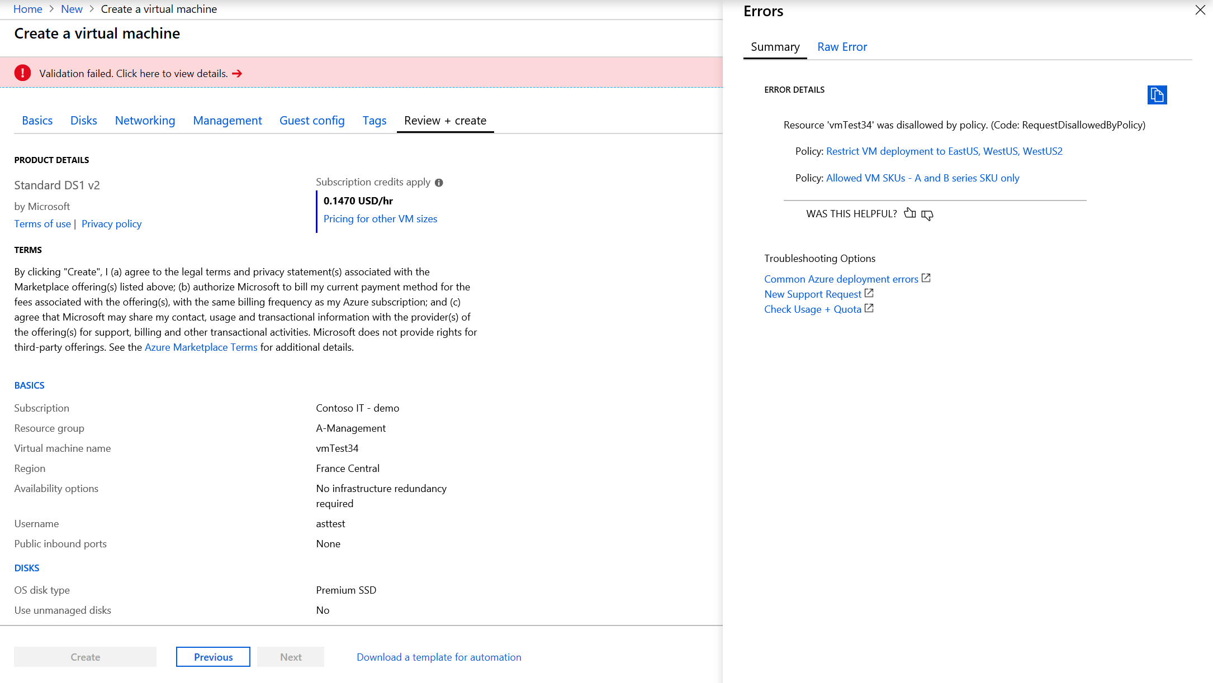

Slide 5
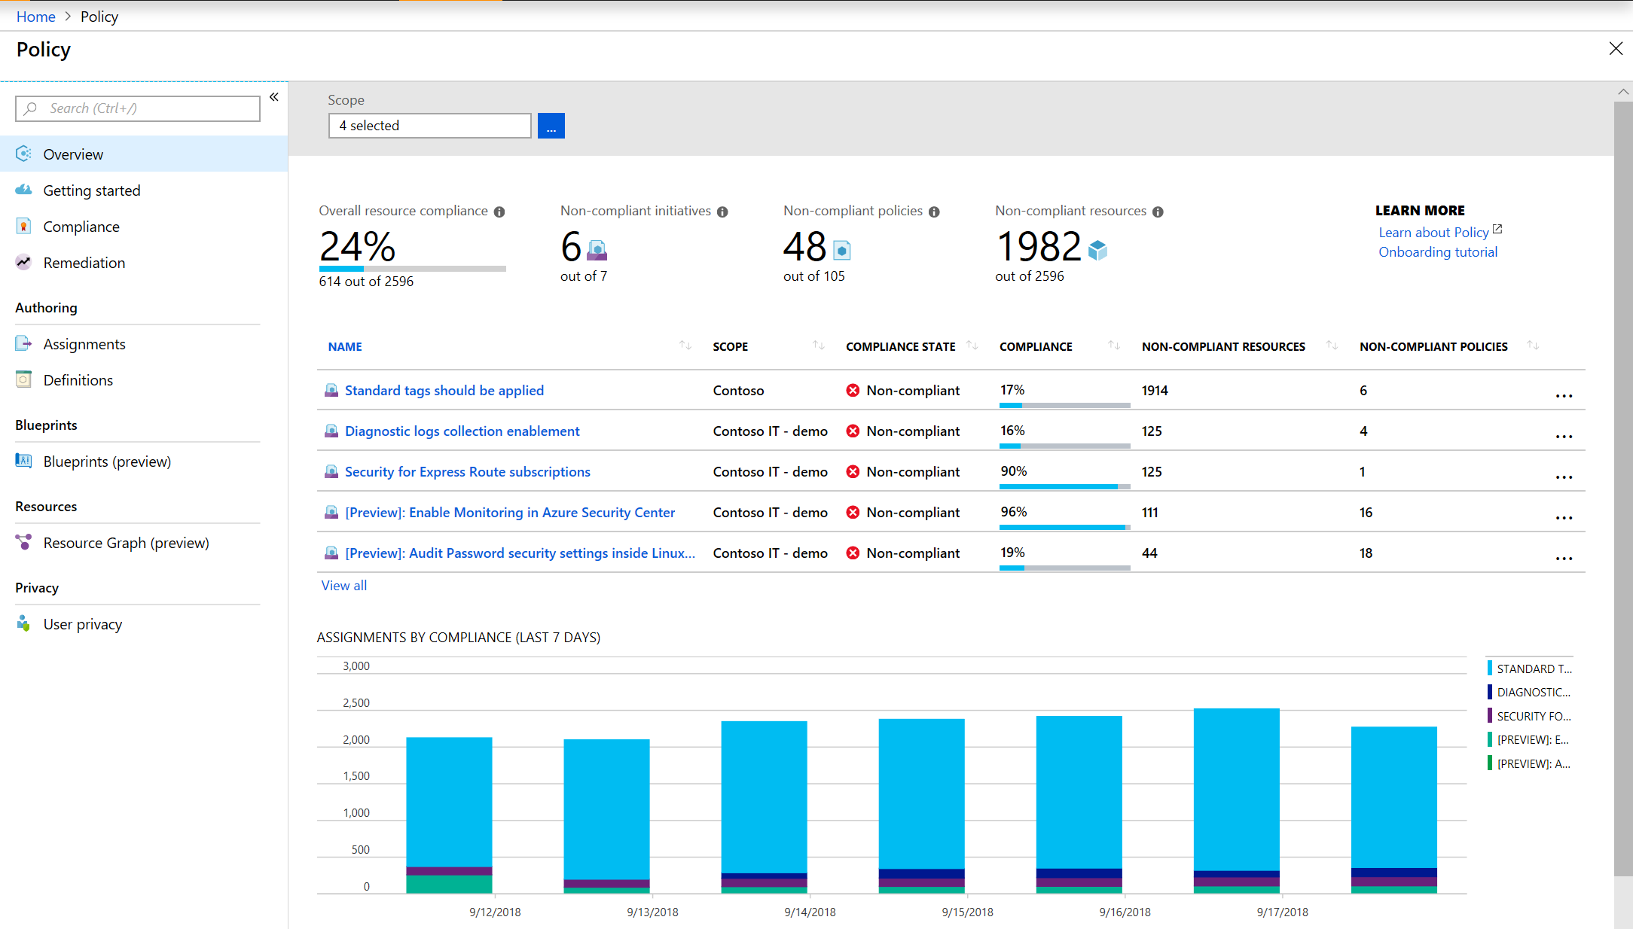

Slide 6
Azure Policy for Kubernetes

Slide 7
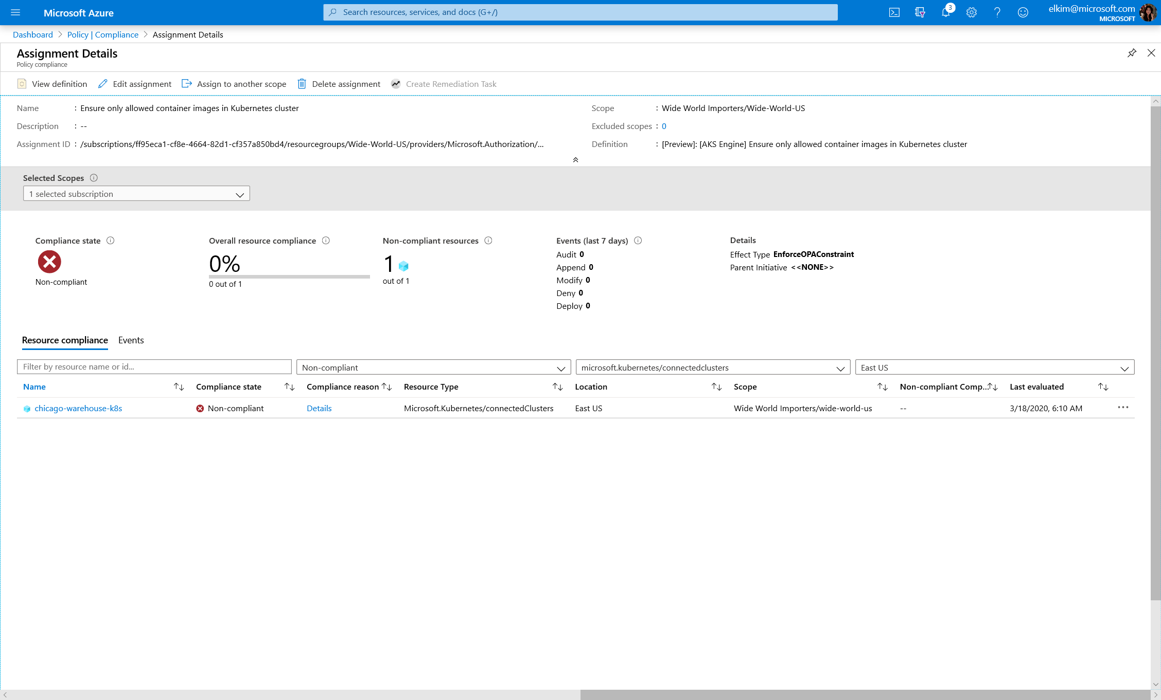

Slide 8
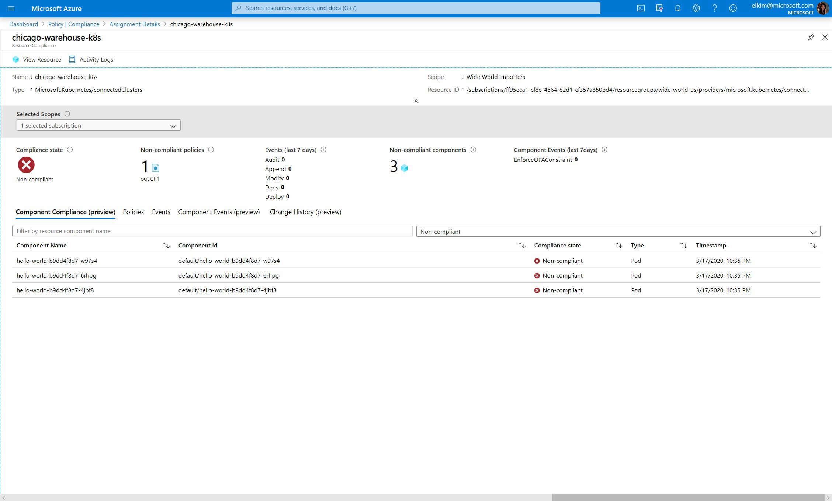

Slide 10
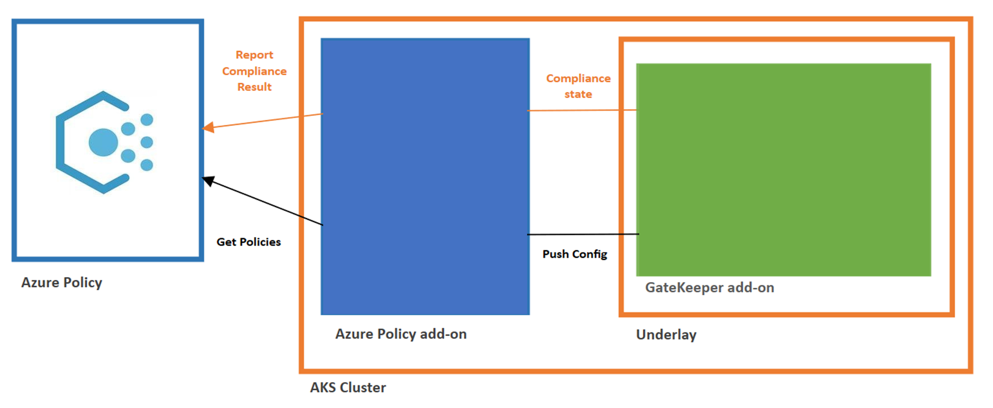
AKS policy architecture

Slide 11
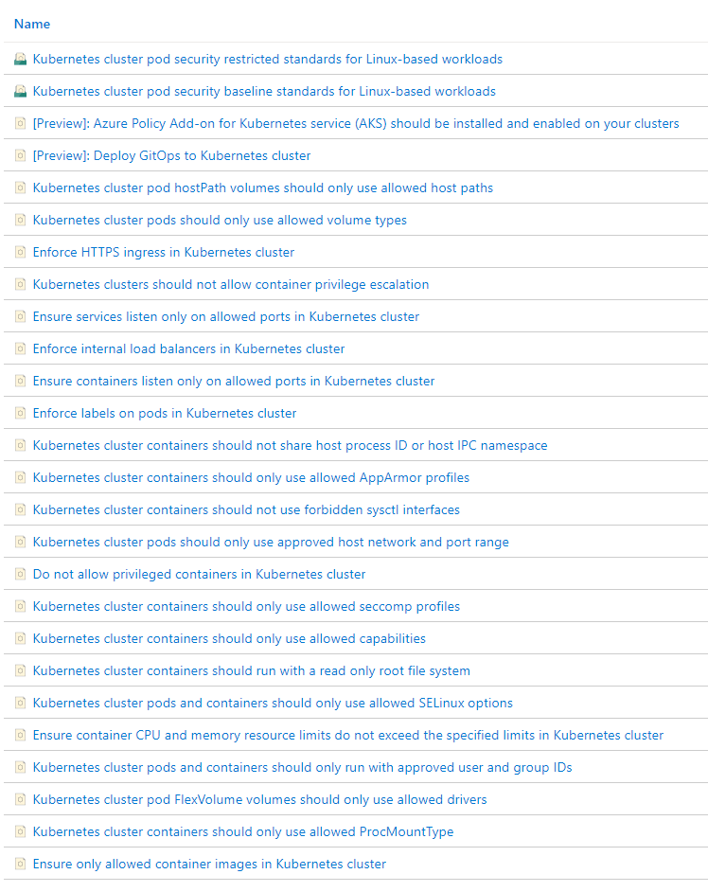
Policy definitions

Slide 12
"properties": {
"displayName": "Ensure only allowed container images in Kubernetes cluster",
"policyType": "BuiltIn",
"mode": "Microsoft.Kubernetes.Data",
"description": "This policy ensures only allowed container images are running in a Kubernetes cluster. For instructions on using this policy, visit https://aka.ms/kubepolicydoc.",
"metadata": {
"version": "4.0.1",
"category": "Kubernetes"
},
"parameters": {
"allowedContainerImagesRegex": {
"type": "String",
"metadata": {
"displayName": "Allowed container images regex",
"description": "The RegEx rule used to match allowed container images in a Kubernetes cluster. For example, to allow any Azure Container Registry image by matching partial path: ^.+azurecr.io/.+$"
}
},
"effect": {
"type": "String",
"metadata": {
"displayName": "Effect",
"description": "'Audit' allows a non-compliant resource to be created, but flags it as non-compliant. 'Deny' blocks the resource creation. 'Disable' turns off the policy."
},
"allowedValues": [
"audit",
"deny",
"disabled"
],
"defaultValue": "deny"
},
"excludedNamespaces": {
"type": "Array",
"metadata": {
"displayName": "Namespace exclusions",
"description": "List of Kubernetes namespaces to exclude from policy evaluation."
},
"defaultValue": [
"kube-system",
"gatekeeper-system",
"azure-arc"
]
}
},
"policyRule": {
"if": {
"field": "type",
"in": [
"AKS Engine",
"Microsoft.Kubernetes/connectedClusters",
"Microsoft.ContainerService/managedClusters"
]
},
"then": {
"effect": "[parameters('effect')]",
"details": {
"constraintTemplate": "https://raw.githubusercontent.com/Azure/azure-policy/master/built-in-references/Kubernetes/container-allowed-images/template.yaml",
"constraint": "https://raw.githubusercontent.com/Azure/azure-policy/master/built-in-references/Kubernetes/container-allowed-images/constraint.yaml",
"values": {
"allowedContainerImagesRegex": "[parameters('allowedContainerImagesRegex')]",
"excludedNamespaces": "[parameters('excludedNamespaces')]"
}
}
}
}
},

Slide 13
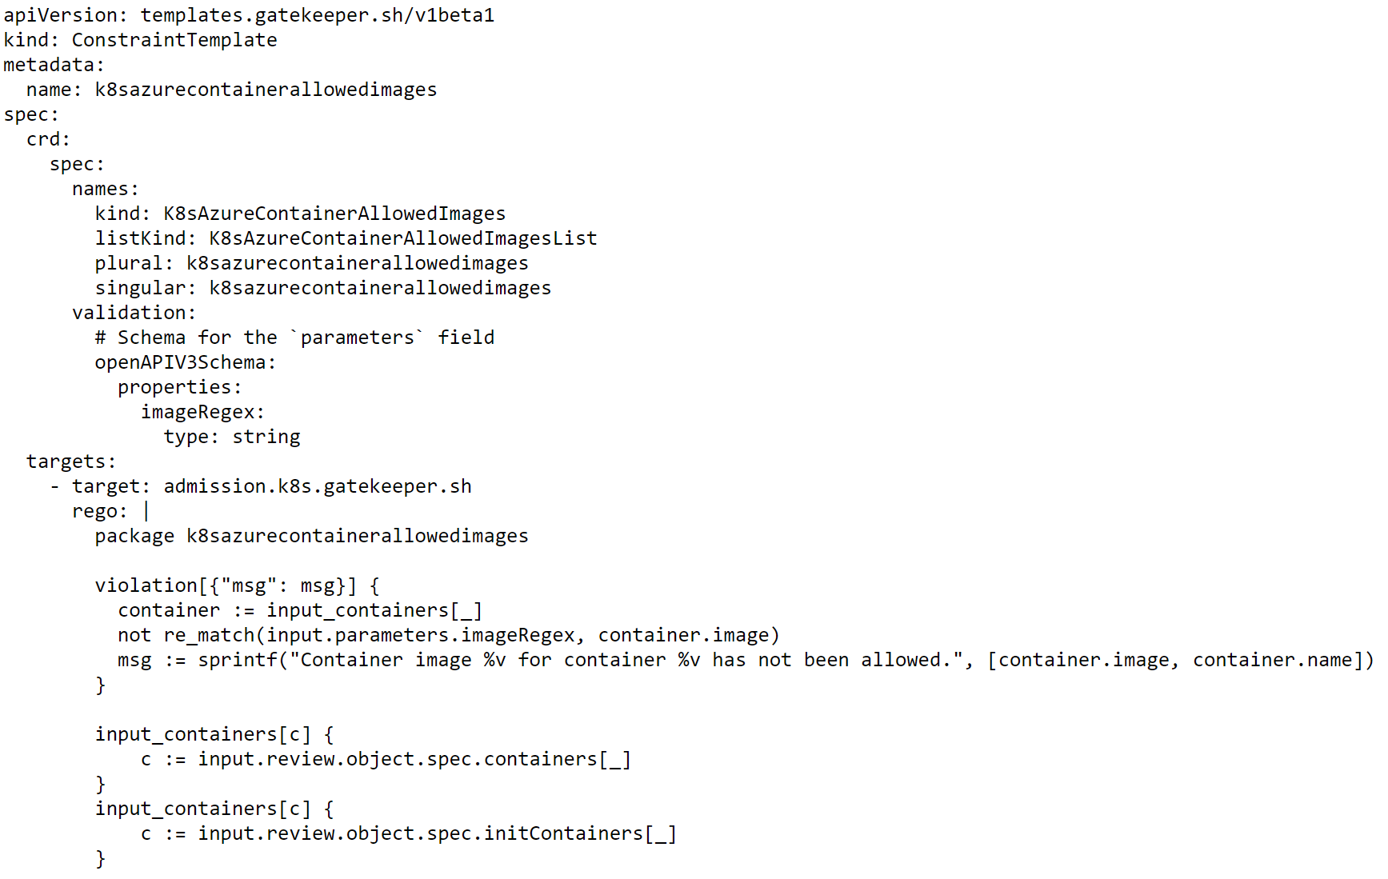

Slide 14
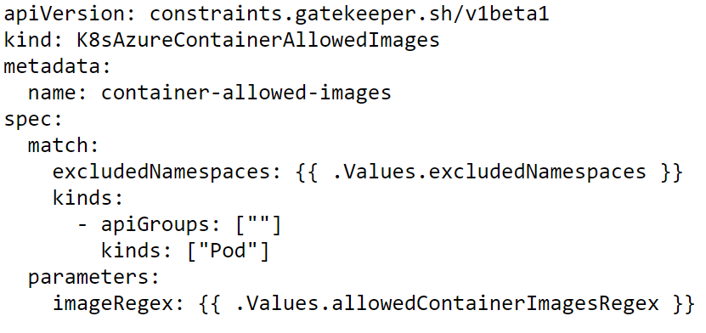

Slide 15
Getting started

Slide 16
Roadmap
Custom policy support for AKS
GitOps integration for Rego policy
Embedded Rego policy for AKS
https://aka.ms/akspolicysurvey2

