Slide 1
LEADERSHIP DEMO | LIVE AZURE SPIKE
Customer-owned sandboxes for every tool call
Keep agent orchestration in Azure Functions. Route model and MCP traffic through APIM. Execute customer code only inside a fresh ACA Sandbox.
Azure Functions
Hosted Skills + MAF
API Management
Foundry + MCP
ACA Sandbox
Isolated local tools
Azure Functions Agents Runtime | Experimental hybrid tool execution | September 2026
Notes:
Open with the outcome: we proved that a serverless agent can keep its model loop and Hosted Skills in Azure Functions while every locally executable tool runs in a fresh, customer-owned ACA Sandbox. APIM remains the governed gateway for both Foundry model calls and remote MCP. This presentation uses the live retained spike environment and actual telemetry.

Slide 2
Powerful agents need a safer place to act
THE DESIGN TENSION
If tools run in the worker
If tools run in ACA Sandbox
Customer code shares the Functions process
Shell and file access expand the blast radius
Credentials and host state are harder to isolate
Cleanup is coupled to request completion
One fresh customer-owned boundary per invocation
Customer managed identity and network policy
No public ingress; deny-by-default egress
Server-side deletion plus lifecycle fallback
The split-plane bet: keep trusted orchestration close to the app; move untrusted execution into customer-controlled isolation.
Private experimental path; no public authoring surface changed.
Notes:
Frame the problem, not just the technology. Agents become dramatically more useful when they can execute customer Python, shell, file, and search tools. But putting those tools inside the Functions worker expands the blast radius. The spike separates trusted orchestration from untrusted execution without moving the model loop or privileged remote connectors into the sandbox.

Slide 3
One request. Two governed execution planes.
LIVE ARCHITECTURE | HOSTED SKILL ORCHESTRATION + CUSTOMER-OWNED TOOL ISOLATION
AZURE FUNCTIONS
APIM
Azure AI Foundry
gpt-4.1-mini
Client
request
AI Gateway
Foundry model API
Remote MCP API
W3C correlation
Hosted Skill
HTTP + streaming
Remote MCP
Microsoft Learn
MAF model loop
Tool middleware
CUSTOMER ACA SANDBOX GROUP
Credentials stay here.
Customer tool modules do not.
customer_probe.py
shell | files | search
Customer UAMI + egress
Fresh sandbox
Local executable tools are intercepted by exact stub identity; remote MCP stays on the worker-side pipeline.
Notes:
Walk left to right. The Hosted Skill endpoint and MAF model loop stay in Azure Functions. Every model call and remote MCP call crosses a dedicated APIM API with subscription protection and W3C correlation. When MAF selects a local tool, middleware intercepts only the exact sandbox-generated stub and routes it down to one fresh customer ACA Sandbox. Customer managed identity, egress policy, and tool code stay on that side of the boundary.

Slide 4
One fresh sandbox, one bounded invocation
MEASURED CRITICAL PATH | FALLBACK-QUALIFIED LIVE RUN
01
02
03
04
05
CREATE
PACKAGE
VERIFY + READY
EXECUTE
HAND OFF
Fresh sandbox
No public ingress
Customer policy
Thin tool bundle
Upload once
No readback
SHA-256 in sandbox
Extract + start
Publish manifest
Strict call journal
Shared executor
Idempotent call_id
Stop admissions
Shutdown marker
Exact-ID fallback
3.15s avg
103ms avg
464ms avg
0.28ms tool avg
77.4ms avg
IDENTITY
Customer UAMI is separate from the Function controller identity.
NETWORK
Deny-by-default egress with full inspection; no sandbox ingress.
LIFECYCLE
Handle delete first; exact-ID provider fallback; 300/600 policy and reaper remain backstops.
End-to-end runtime average: 13.22s. Exact-ID provider deletion recovered 17 of 21 handle stalls.
Notes:
This is the measured lifecycle for each invocation in the exact-source September 5 qualification. A fresh sandbox averaged 3.15 seconds to create. The optimized thin bundle uploaded in 103 milliseconds, executor readiness averaged 464 milliseconds, and deterministic local tool execution averaged 0.28 milliseconds. Terminal lifecycle handoff averaged 77.4 milliseconds. Four invocation-handle delete requests were accepted normally; 17 timed out at the existing five-second bound and all 17 were then confirmed deleted by the separately bounded exact-ID provider fallback. The fallback itself averaged 593 milliseconds. Completed output remained intact, inventory returned to zero at every stage, and the whole runtime averaged 13.22 seconds.

Slide 5
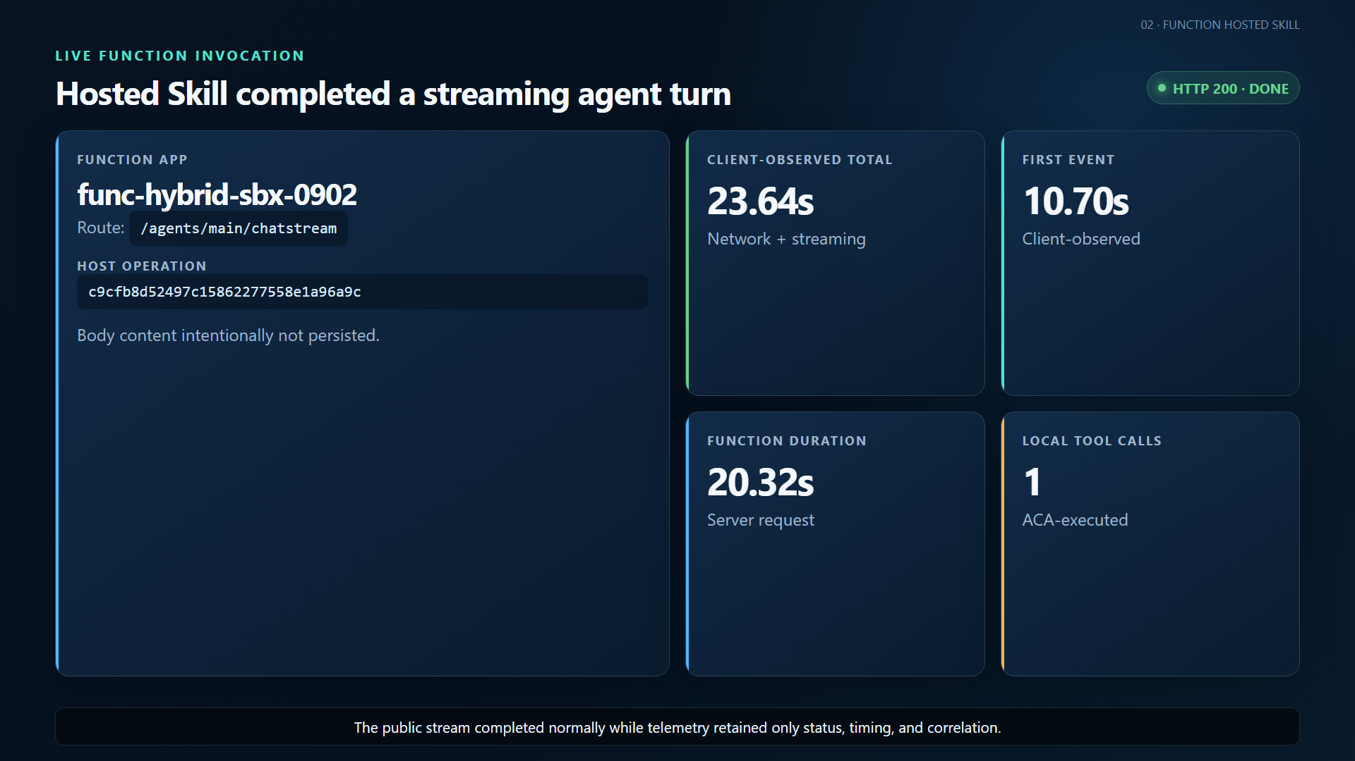
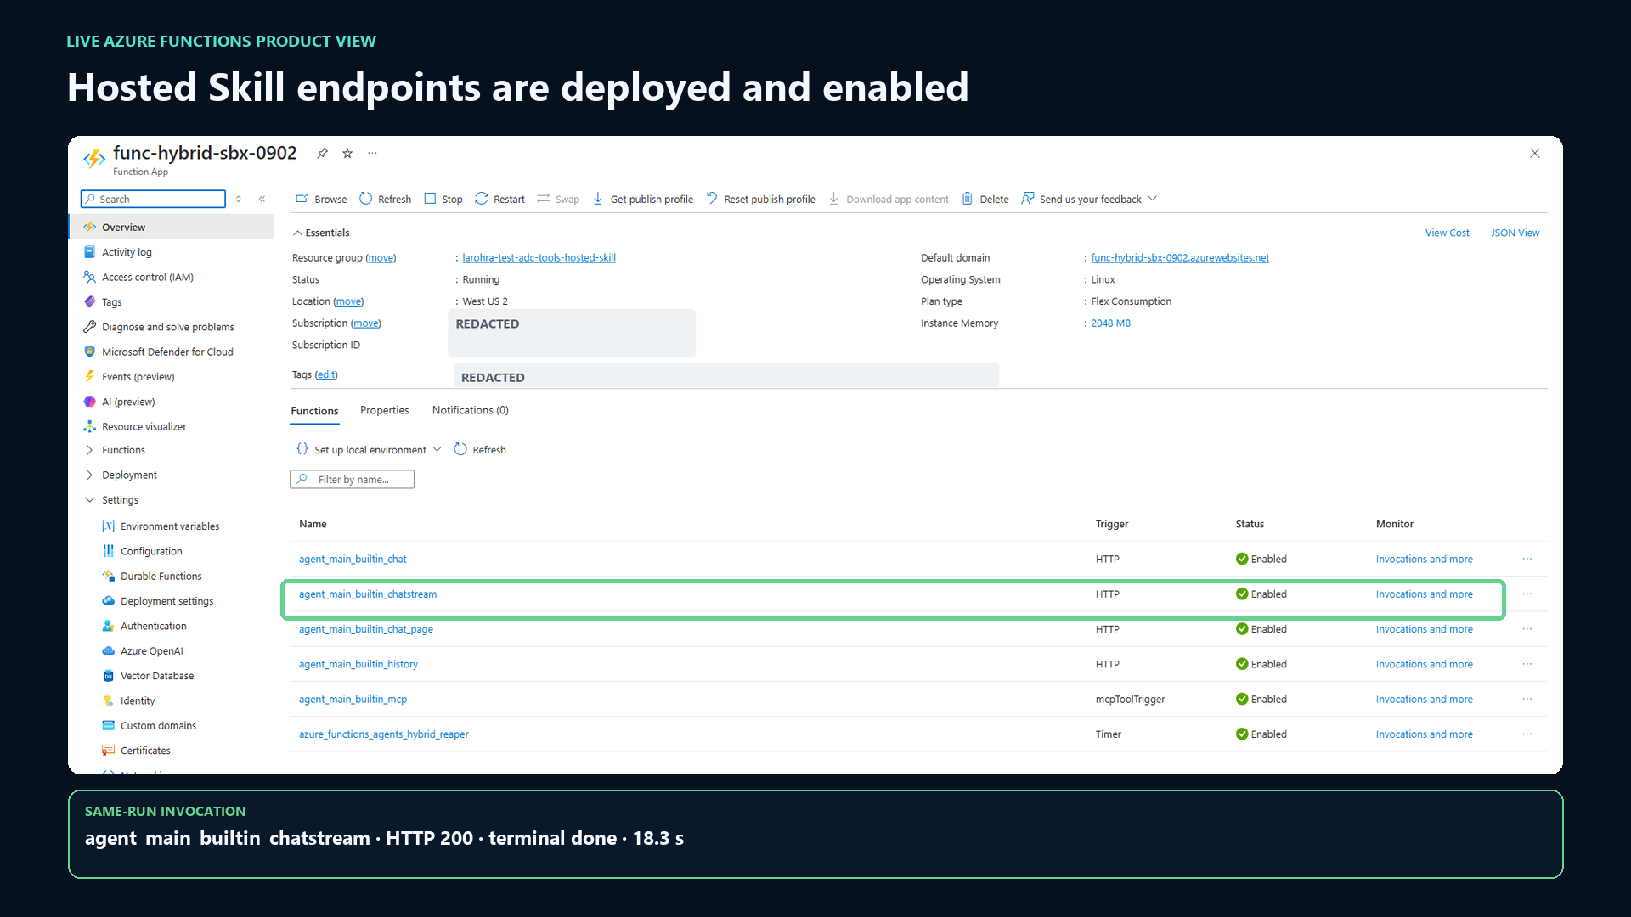
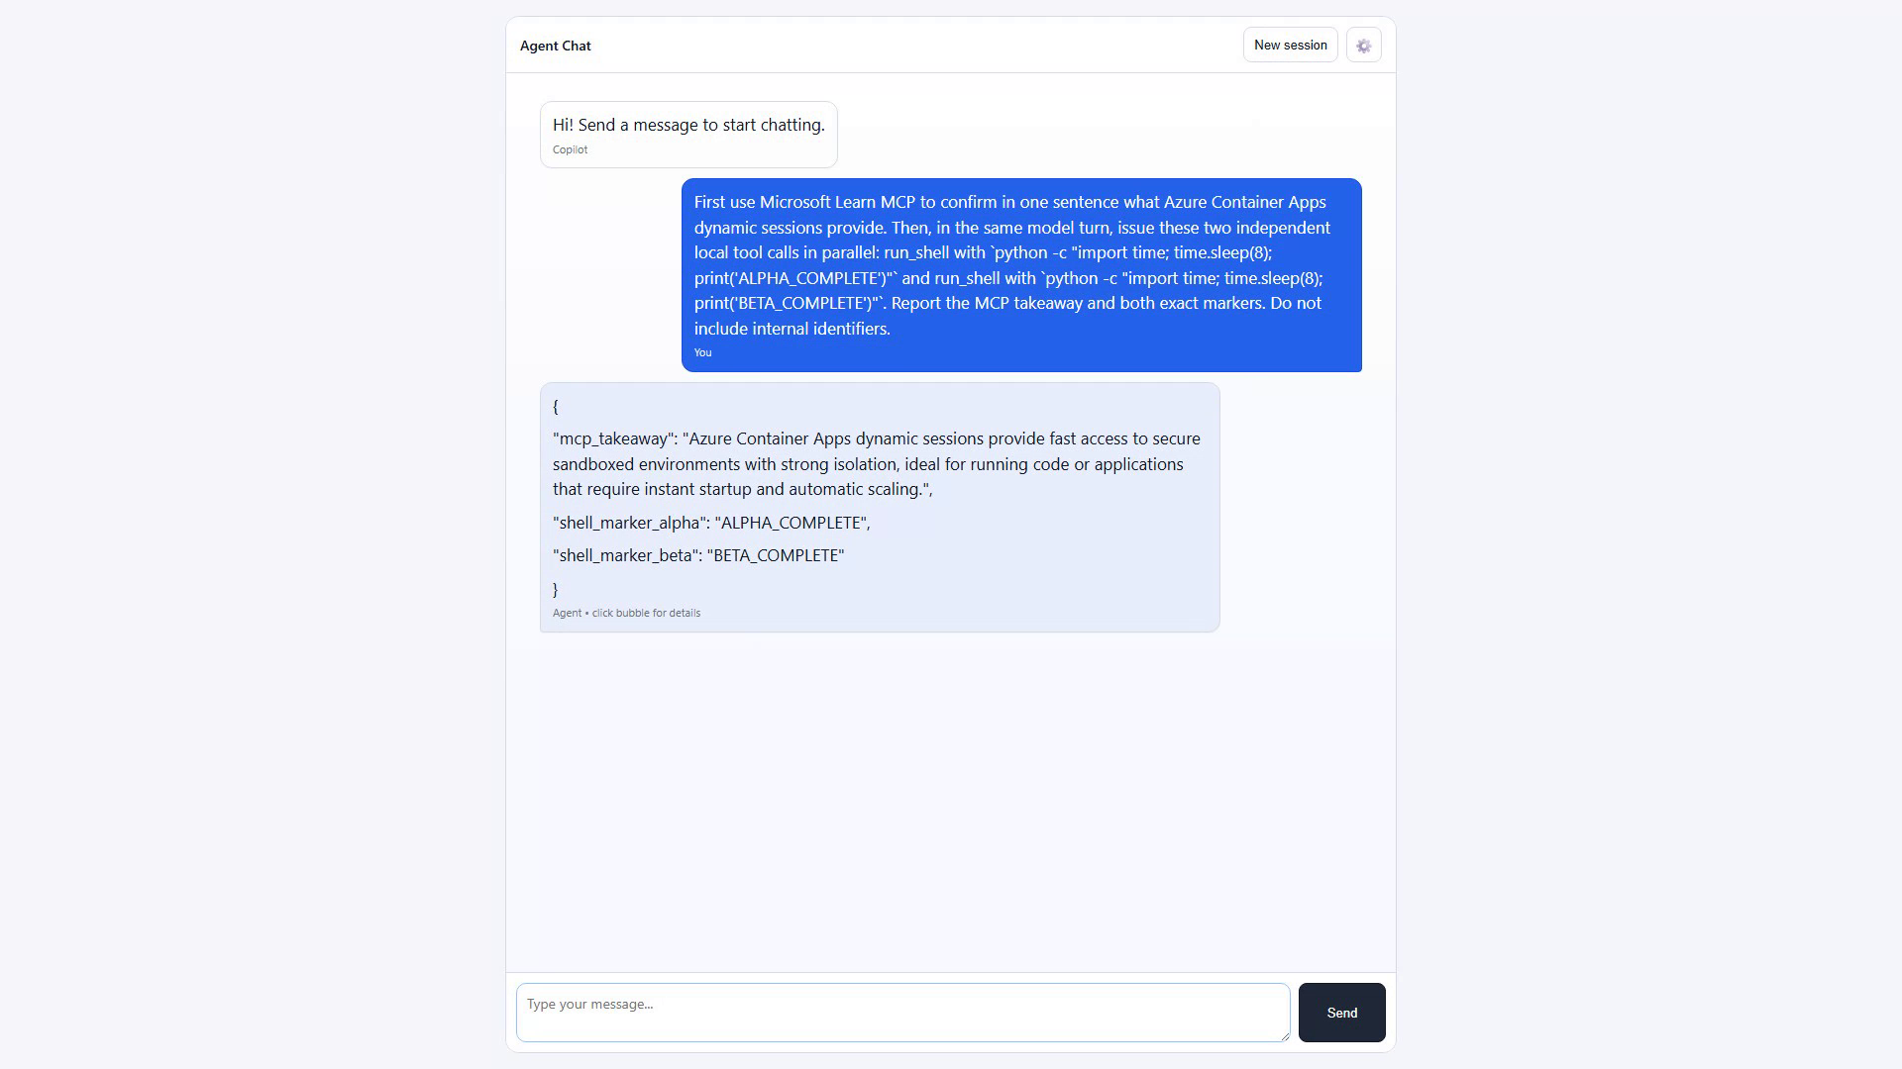
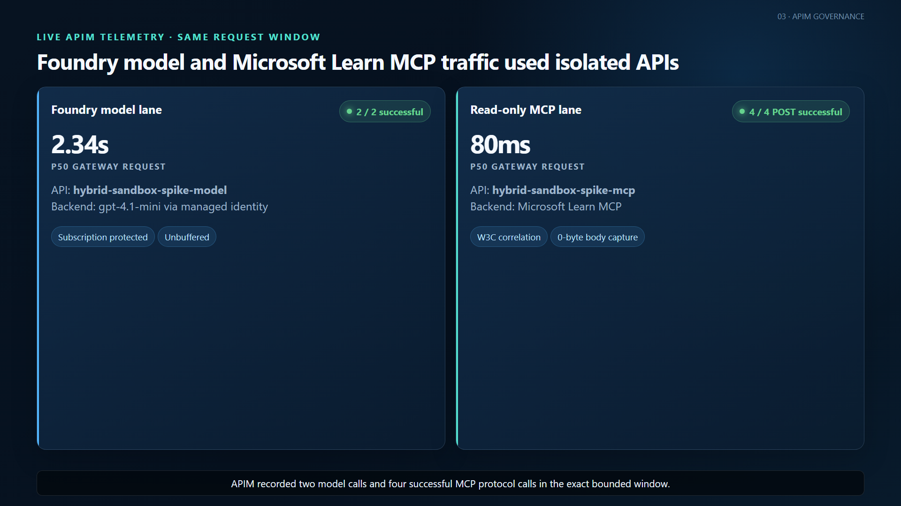
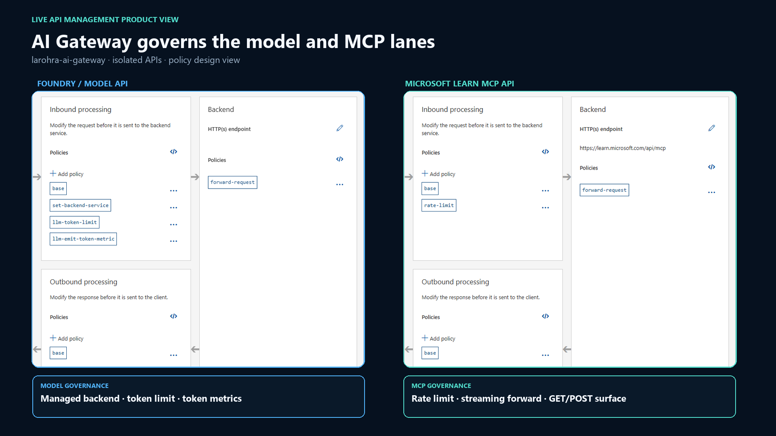
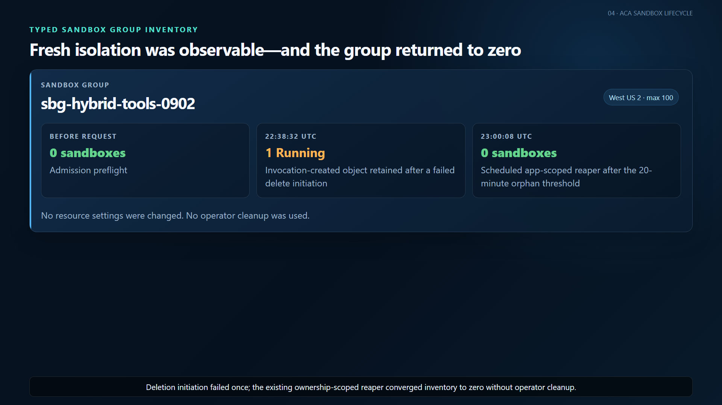
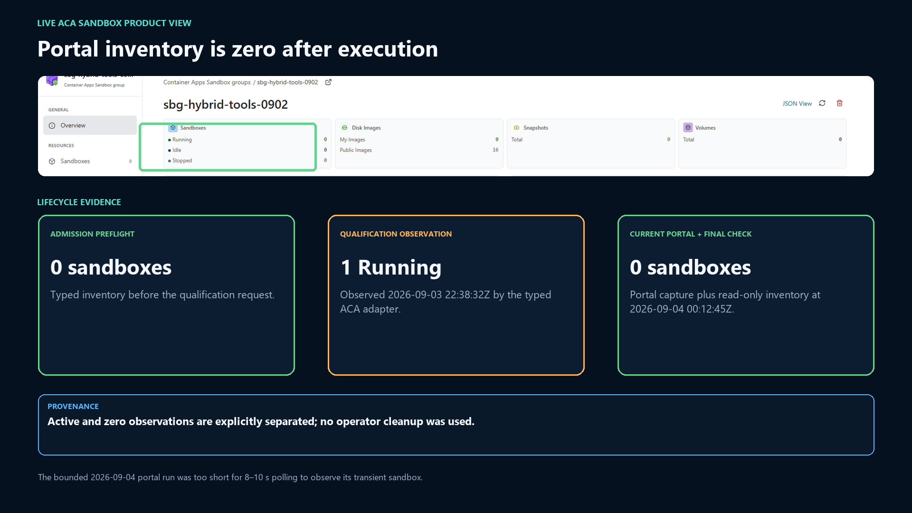
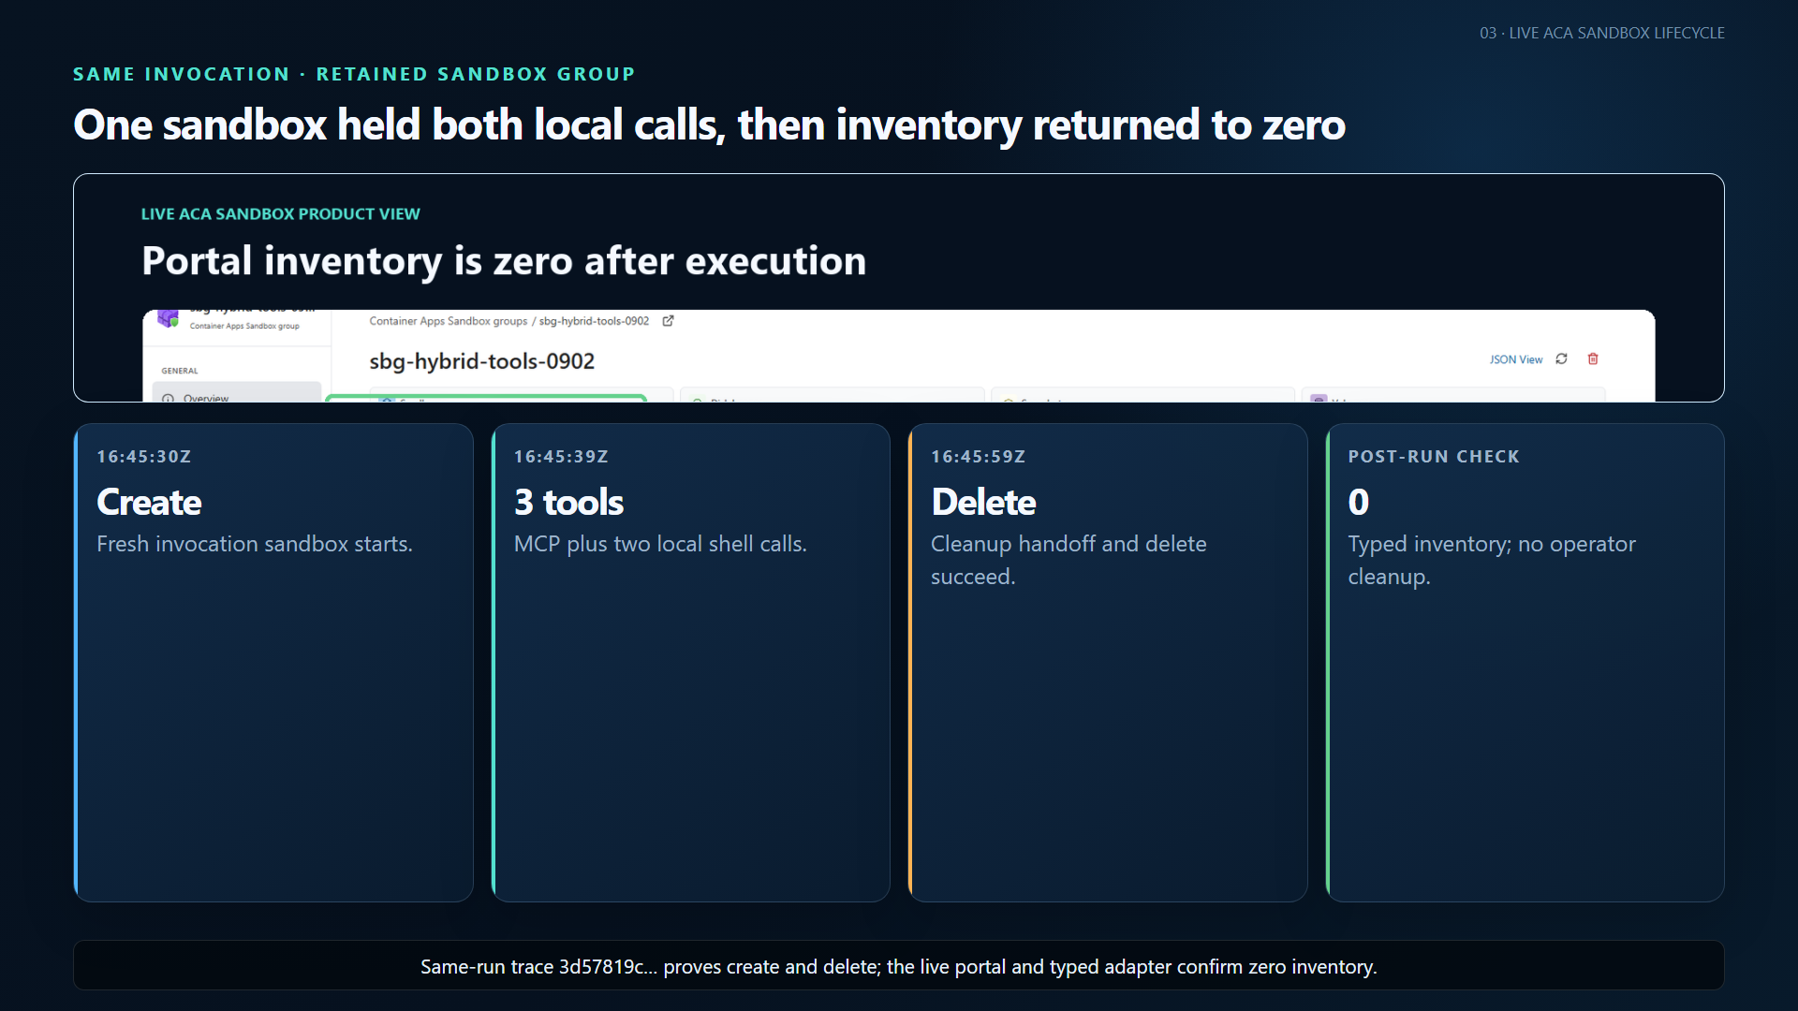
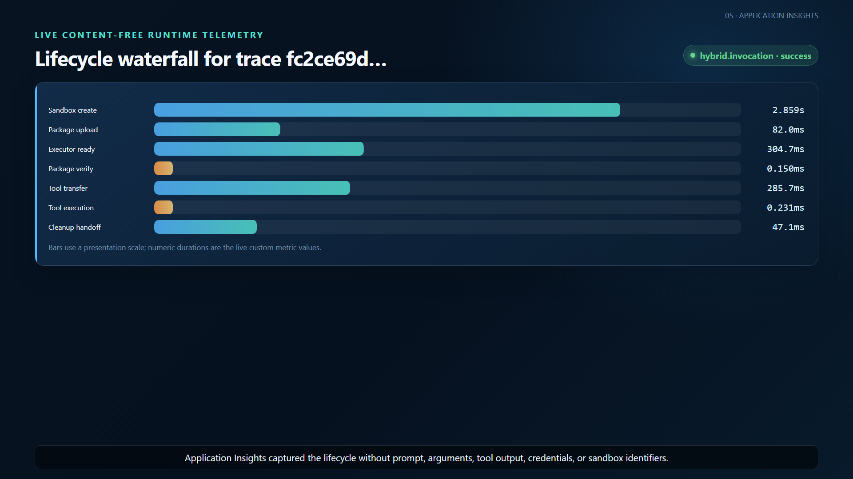
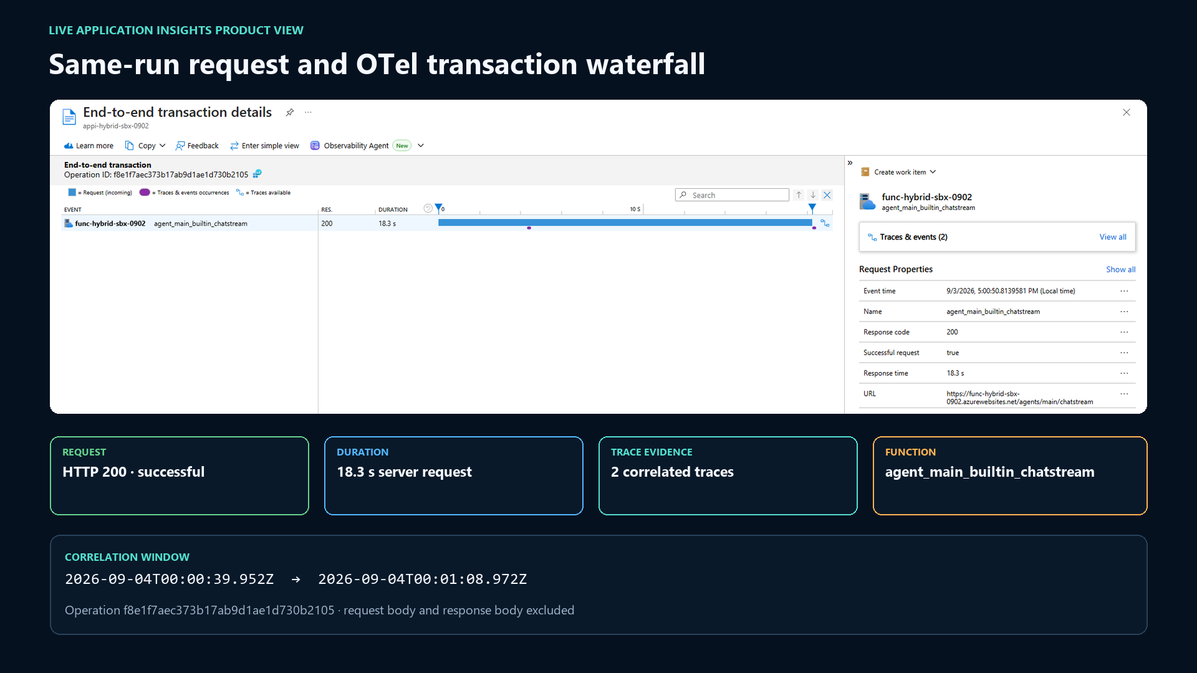
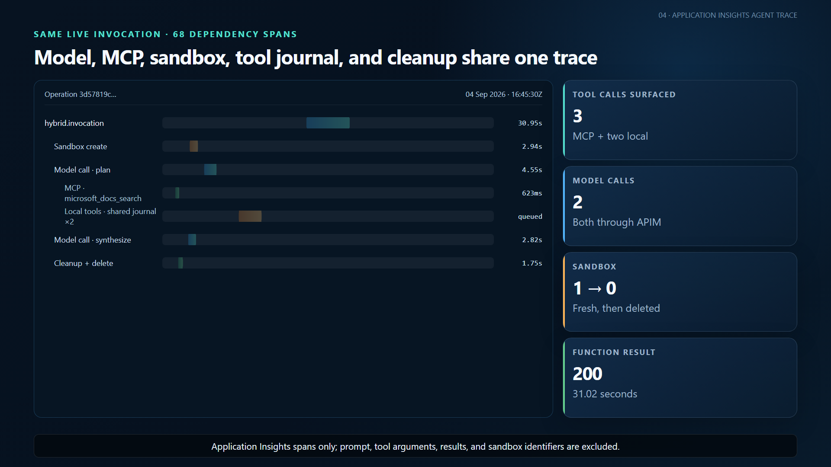
Watch one real request cross every boundary
LIVE-FIRST E2E EVIDENCE | ONE BOUNDED INVOCATION
1 AZURE FUNCTIONS | HOSTED SKILL
2 APIM | FOUNDRY + MCP
LIVE CAPTURE
Request succeeds and streams the tool result.
LIVE CAPTURE
Model and MCP requests share W3C correlation.
3 ACA SANDBOX | TOOL EXECUTION
4 APPLICATION INSIGHTS | WATERFALL
LIVE CAPTURE
Fresh sandbox appears, runs tools, then returns to zero.
LIVE CAPTURE
Create, upload, verify, execute, and cleanup phases.
One live Hosted Skill request: MCP + two ACA tool calls + APIM + final inventory zero.
Notes:
This is the strongest demonstration: one actual Hosted Skills request used Microsoft Learn MCP and two local shell tools, returning the MCP takeaway plus ALPHA_COMPLETE and BETA_COMPLETE. The same bounded window contains two successful model POSTs and five successful MCP POSTs through APIM. The local calls shared one invocation sandbox and were safely queued by the same-sandbox journal; this is parallel model fan-out, not simultaneous local command execution. Correlated telemetry shows 68 runtime dependency spans, create and delete timing, and final typed sandbox inventory zero without operator cleanup. The chat capture is an actual Playwright recording. The APIM and sandbox panels contain live product views. The trace panel is a content-free visualization generated from the same real Application Insights spans because the active Edge session could not be taken over safely.

Slide 6
Fallback-qualified runtime remains 35.5% below baseline
CANONICAL BASELINE VS. EXACT-SOURCE FD6589E QUALIFICATION
TOTAL REQUEST LATENCY
35.5%
Cold start
27.7s
22.0s
lower average runtime
c1 p50
19.7s
12.9s
20.49s -> 13.22s
Saved 7.27s per request
c10 p50
27.6s
22.5s
21 / 21
requests succeeded
0
hybrid failures
0
sandboxes remaining
17 / 17
fallback deletes confirmed
Leadership decision: fund a productization design for the customer-controlled tool execution plane.
Next: supported configuration, capacity guidance, tenant isolation review, richer trace UX, and production SLOs.
Notes:
Close with the exact-source September 5 result and a concrete ask. Against the canonical baseline, average runtime latency dropped 35.50 percent, cold latency dropped 20.52 percent, c1 p50 dropped 34.78 percent, and c10 p50 dropped 18.39 percent. All 21 nonstream requests succeeded, there were no hybrid failures, and inventory was zero before and after every stage. Four handle delete initiations were accepted normally. Seventeen stalled at the five-second bound; all 17 exact-ID provider fallbacks confirmed deletion in 593 milliseconds average without replacing completed output. The run is 2.57 seconds slower on average than the September 3 optimized result because the exceptional path paid the handle bound. APIM gateway diagnostic rows were unavailable for this clean window, so this slide does not repeat the historical gateway-overhead estimate. The recommendation is not to call this production-ready; it is to fund a productization design for a supported customer-controlled tool execution plane.

Slide 7
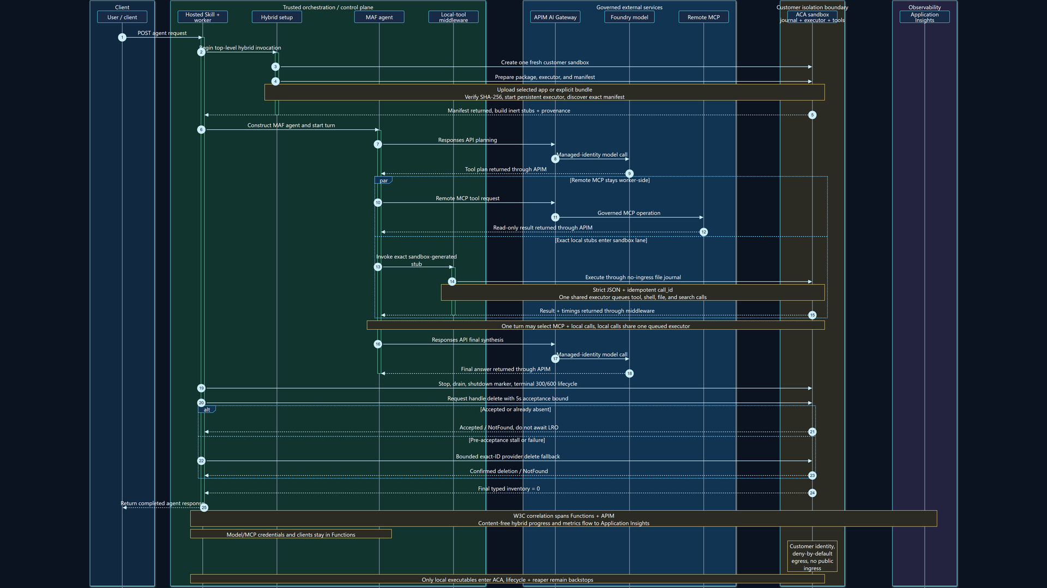
Detailed request flow
APPENDIX | FUNCTIONS CONTROL PLANE + CUSTOMER ACA ISOLATION
Editable source: request-flow.mmd | Vector: evidence/hybrid-request-flow.svg
Notes:
This appendix shows the control-plane split. The request enters Azure Functions, which creates one fresh customer sandbox and completes package verification, executor startup, manifest discovery, and inert stub construction before MAF starts. Model and remote MCP calls remain in Functions and cross APIM; only exact local stubs enter the no-ingress journal. One executor queues local calls in the invocation sandbox. After synthesis, Functions drains work, writes shutdown, applies the 300/600 lifecycle, and requests delete. A bounded exact-ID provider fallback covers pre-acceptance stalls while lifecycle and reaper remain backstops.

