Slide 1
Azure Functions: Custom Redis Cache Binding [P.O.C.]
Proof of Concept Demo & Overview

Slide 2
Custom Binding Components - Extension
Create a start-up class which implements IWebJobsStartup.
Register a configuration provider class with type IExtensionConfigProvider that will provide the primary configuration.
Add binding rules for attributes by calling ExtensionConfigContext.AddBindingRule().

Slide 3
Custom Binding Components – Provider/Listener
Register a configuration provider class with type. ITriggerBindingProvider that will provide the ITriggerBinding with general params and manage it as an async Task.
The ITriggerBinding class manages the IListener and provides it with general params and an Executor for triggering the function on new events.
The IListener class manages the connection to the Redis cache and is responsible for triggering the function on every new event with a message callback (RedisCacheMessageModel).

Slide 4
Functions Trigger Binding – Runtime flow
Load IWebJobsStartup and call Configure.
Call all registered IExtensionConfigProvider to initialize extension.
Read all defined functions.
For all binding attributes defined in each function, invoke the ITriggerBindingProvider.TryCreateAsync with attribute params.
Create and start instance of listener from the binding by calling ITriggerBinding.CreateListenerAsync.
On new event, the listener calls ITriggeredFunctionExecutor.TryExecuteAsync() with the data callback.
Call ITriggerBinding.BindAsync to bind to any custom params.
Execute the function.

Slide 5
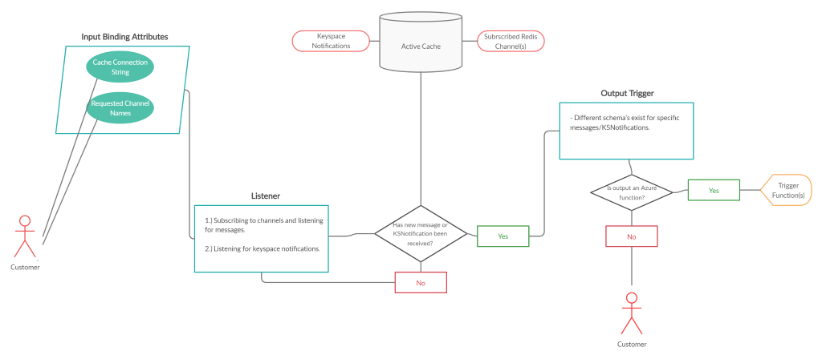
P.O.C. Live Demo/Walkthrough

Slide 6
P.O.C. Development - Challenges
Lack of function extension documentation:
Made it initially difficult to understand how components communicated/worked with each other.
Required me to frequently reach out to a member of the functions team for clarification/debugging help.
Required me to do quite a bit of reverse engineering/debugging.

Slide 7
P.O.C. Development – Going Forward
Adding more redundant error handling (ie. dead letters, retries/back-off, unexpected-cancellation tokens)
Allowing for more sophisticated message callback schemas (ie. including metadata, embedded function triggers).
Adding support for KeySpaceNotifications.
Azure portal implementation.

