Slide 1
Azure Functions: Custom Redis Cache Binding
Demo & Overview
By: Jaden Banson

Slide 2
Overview – Use Cases
Ability to perform management operations based on a cache state change or message consumed. (ie. scale clusters, notify other services.)
Ability to trigger other azure functions given a specific output. (for a variety of function execution patters)

Slide 3
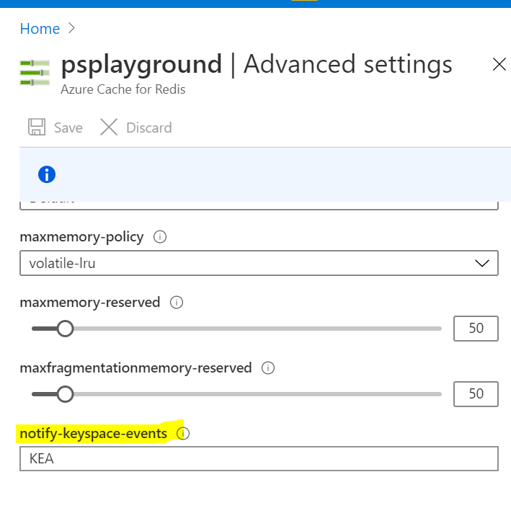
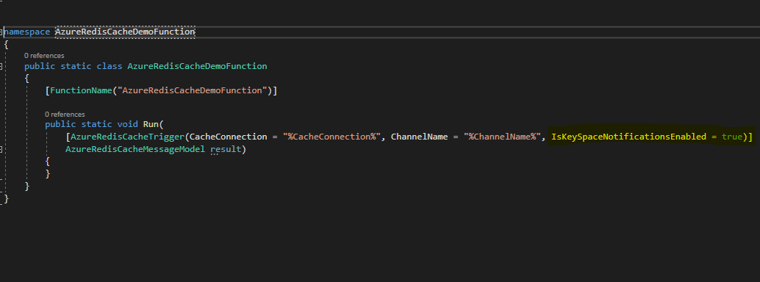
Overview – Features
i. Key space event notifications: Allows users to monitor events in their key space and get back specific notification types and their associated keys via Azure functions.
Enable keys space events in portal under Advanced Settings.
Set isKeySpaceNotificationsEnabled bool in the azure function trigger to true & set the channel name to desired key space notification channel (ie. __keyspace@0__:*).

Slide 4
Overview - Features
ii. Pub/Sub: Allows user to operate a Redis pub/sub channel between their client and an Azure Redis Cache via Azure functions.
1. Set channelName parameter to appropriate pub/sub channel.

Slide 5
Azure Function Trigger
- Input parameters are given.
- Inputs are binded to trigger attribute model.
- Configuration context is created.
Extension Config Provider
- Context passed from trigger is binded to trigger provider here.
- Trigger binding rules, which define function output type are defined here.
Trigger Binding Provider
- Context from extension config provider is passed here.
- Context is used to resolve the cache connection string and channel name. (i.e. resolve literally or pull from local.settings.json)
Trigger Binding
- Extracts final and resolved context, passes parameters to Listener.
- Manages the listener as an Async Task.
Listener
- Responsible for managing connection to Azure Redis Cache.
- Defines message processing for key space event notifications and pub sub.
- Executes function and passes back the call back object to the function trigger interface.
(Azure Redis Cache Function Extension Model)

Slide 6
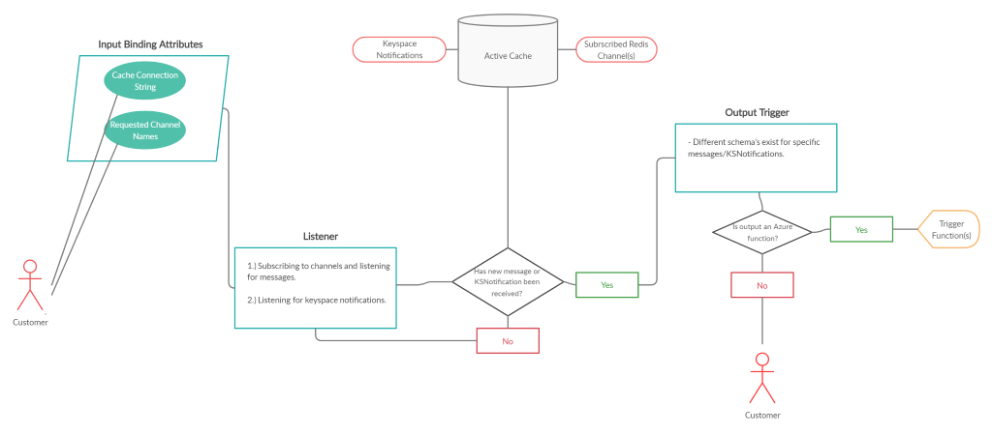
(Azure Redis Cache Function Extension Operational Model)

Slide 7
Development – Going Forward
Discussing supportability.
Adding more unit tests.
Cleaning up documentation.
Pushing to open-source repo.
Azure portal/VS implementation.

Slide 8

A special thanks to…
Lavanya Singampalli
Ankit Kumar
Alfan T. P.

