Slide 1
RntbdTransportClient
A Netty-based RNTBD protocol implementation for Java
David Noble
February 8, 2019

Slide 2
Java direct mode development status
Direct mode consistency stack + RntbdTransportClient
Based on commit from October 2018
Important priorities in February (missing today)
Request diagnostics and other supportability features
One next step
Move comparison branch forward to latest on master

Slide 3
RntbdTransportClient development status
Single-channel netty-based pipeline
Fully integrated with the Java direct-mode client
Pre-release is present in direct-mode client to be published today
Performance, reliability, scalability, and supportability features TBD

Slide 4
What is the RntbdTransportClient?
Processes requests for any number of service endpoints
Service endpoints are created on demand
Kept alive as long as they stay healthy
Destroyed when the client is closed
Service endpoint is composed of
RNTBD channel pool (load balanced, health checked)
Some metadata
Service endpoints run in the context of a single EventLoopGroup
EventLoopGroup is a thread pool
Service endpoints share threads in the pool

Slide 5
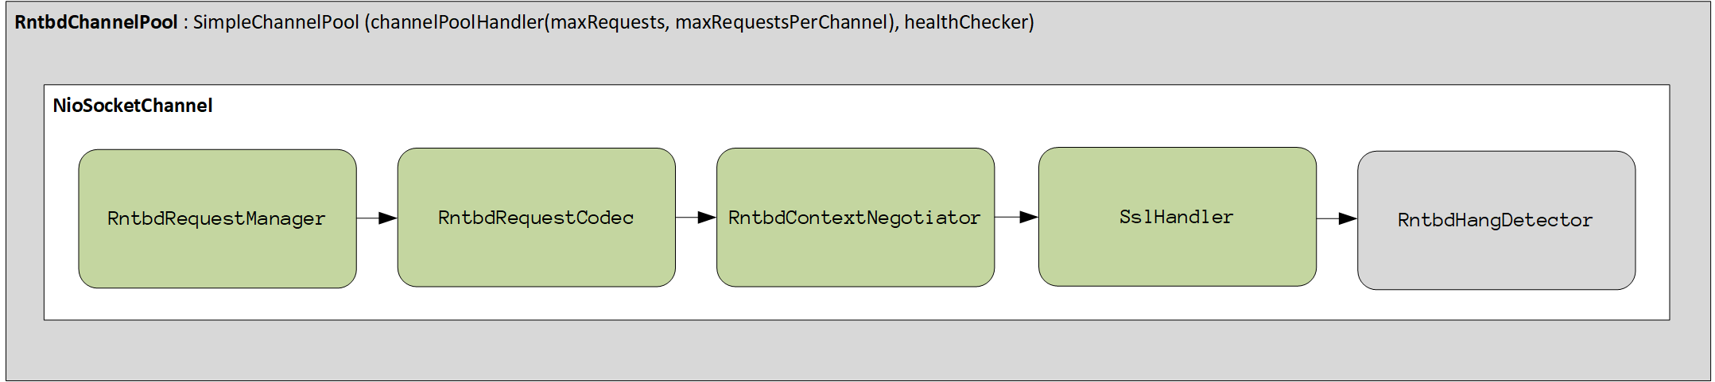
RntbdTransportClient.Endpoint
Grey background : not yet implemented

Slide 6
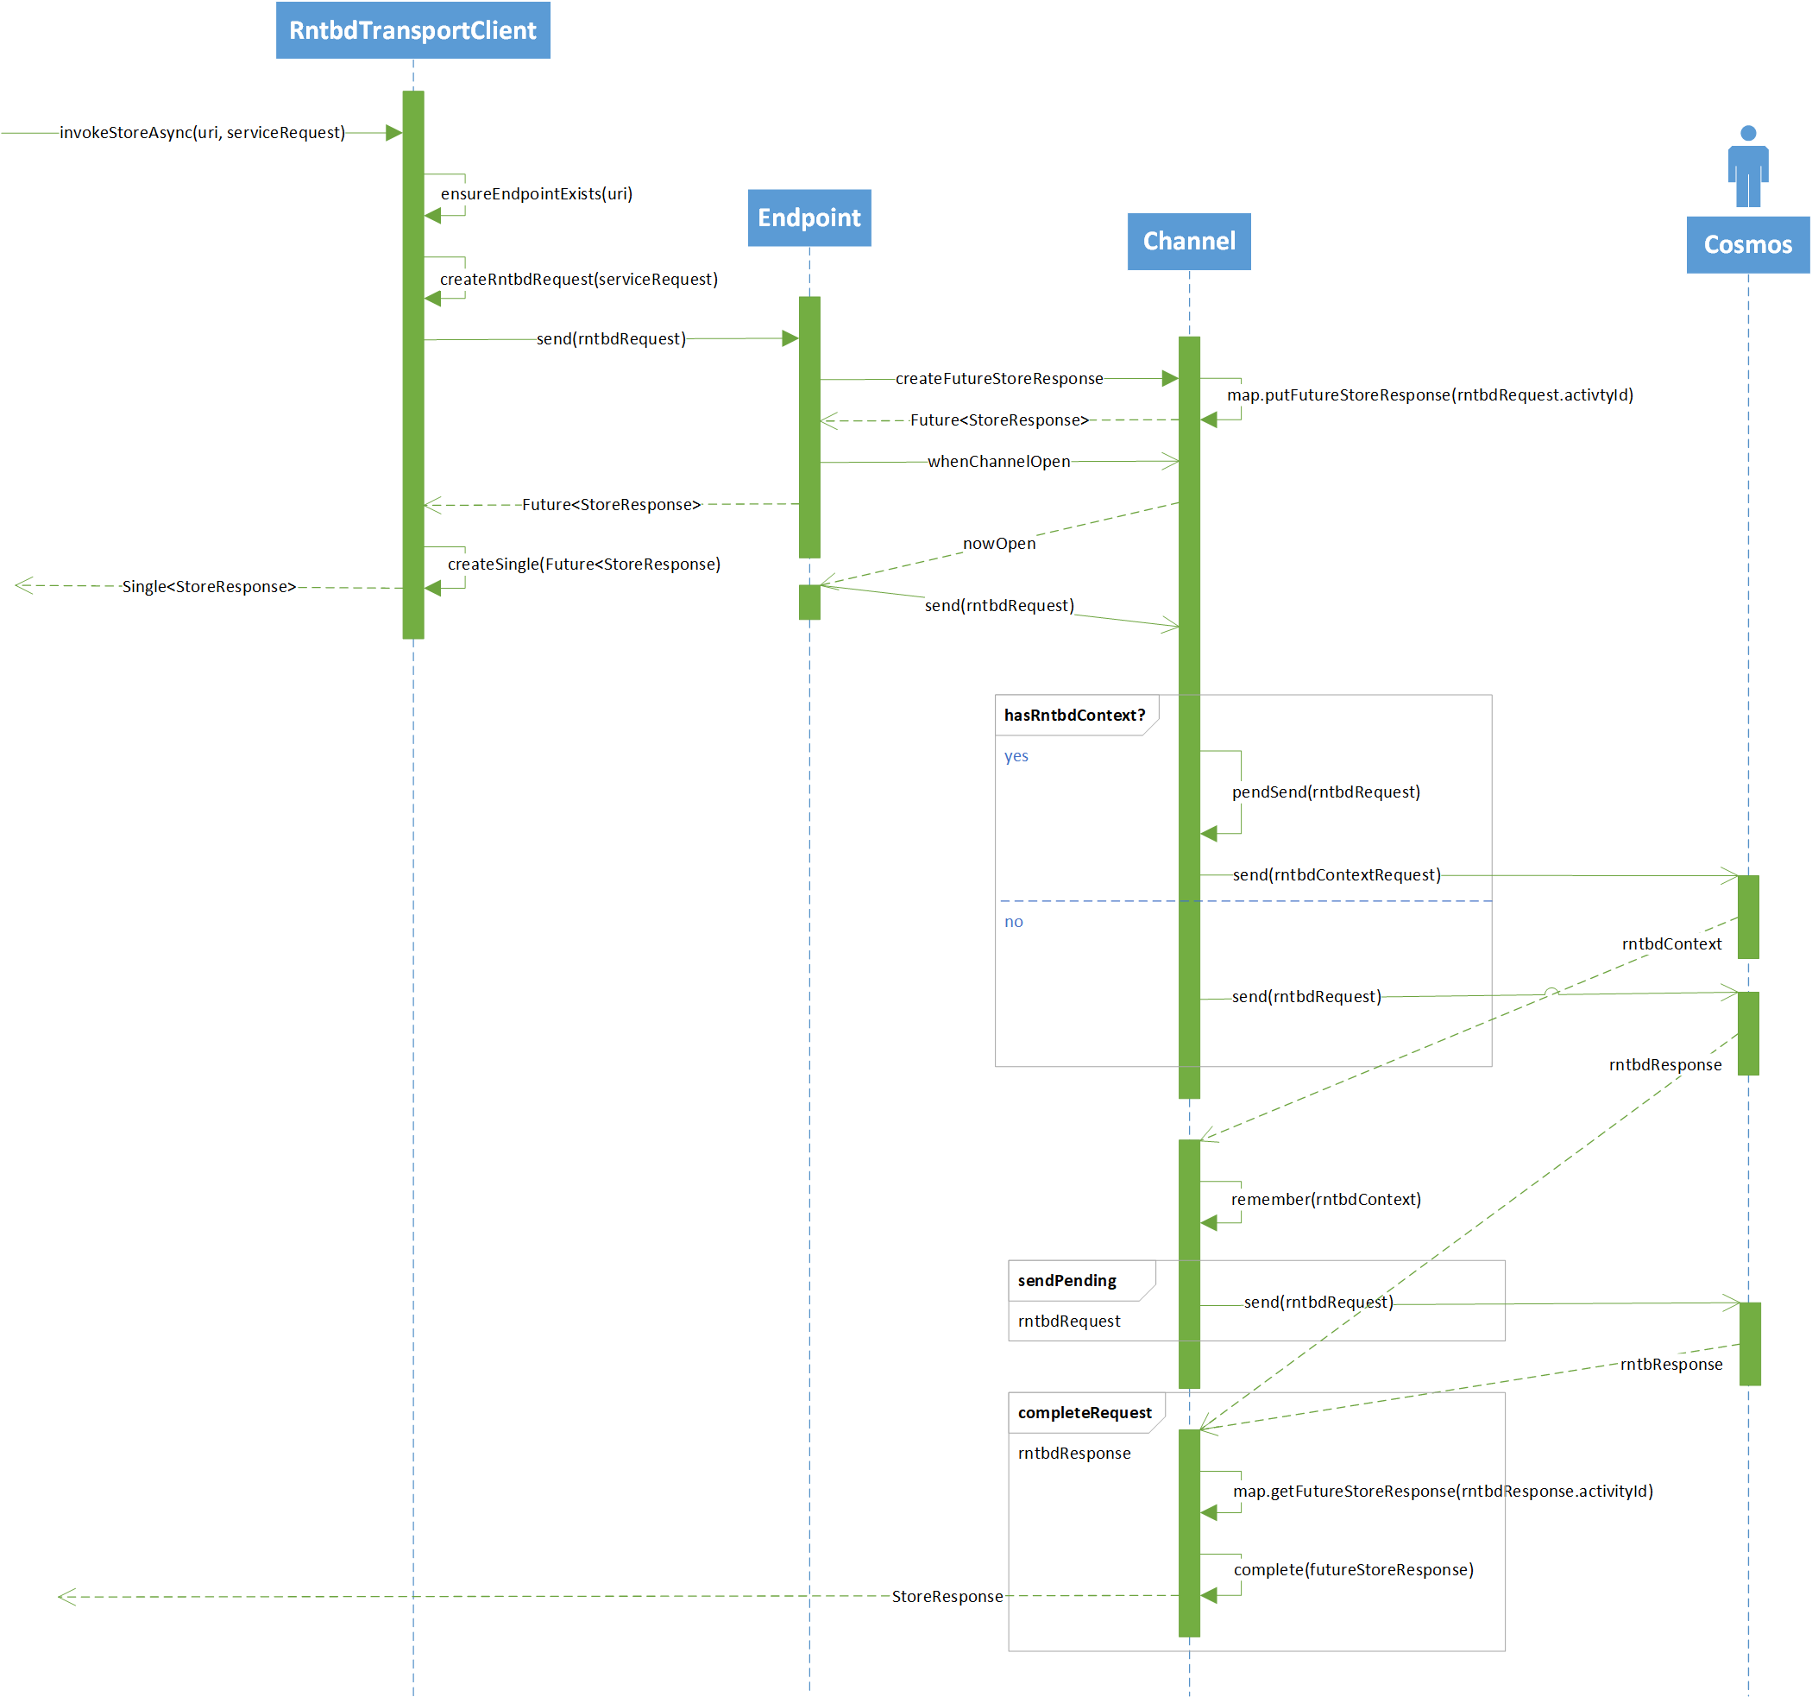
Client/server interaction

Slide 7
RntbdTransportClient specification
Based on Ovidiu’s document and my reading of the C# code
Contains some general information on RNTBD
Largely specific to the Java implementation
Will evolve with the implementation
Maintained here

Slide 8
DEMO – debug slender path through code

Slide 9
Upcoming feature work
331552 Hang detection
Honors
ReceiveHangDetectionTime
SendHangDetectionTime
Based on IdleStateHandler
328301 Health check requests
Occur before each write operation
Initiated by RntbdRequestEncoder
328297 Load-balanced channel pool
Honors
maxChannels
maxRequestsPerChannel
Based on SimpleChannelPool
331567 Request diagnostics and troubleshooting
Provide data to analyze performance, reliability, and scalability issues in the transport layer
Feature of the RntbdRequestManager
Performance, reliability, and scalability testing leading up to production release

Slide 10
Keeping RNTBD implementations consistent
What do we have today?
C# reference implementation on the leading edge
Java implementation that must keep up to date
Plan to hire contractors for other languages
Start of a spec
What might be useful?
Reference spec
Performance, Reliability, and Scalability requirements spec
Better change notifications (based on changes to C# codebase)
Tighter code review process (e.g., Java teammates as required C# reviewers)

