Slide 1





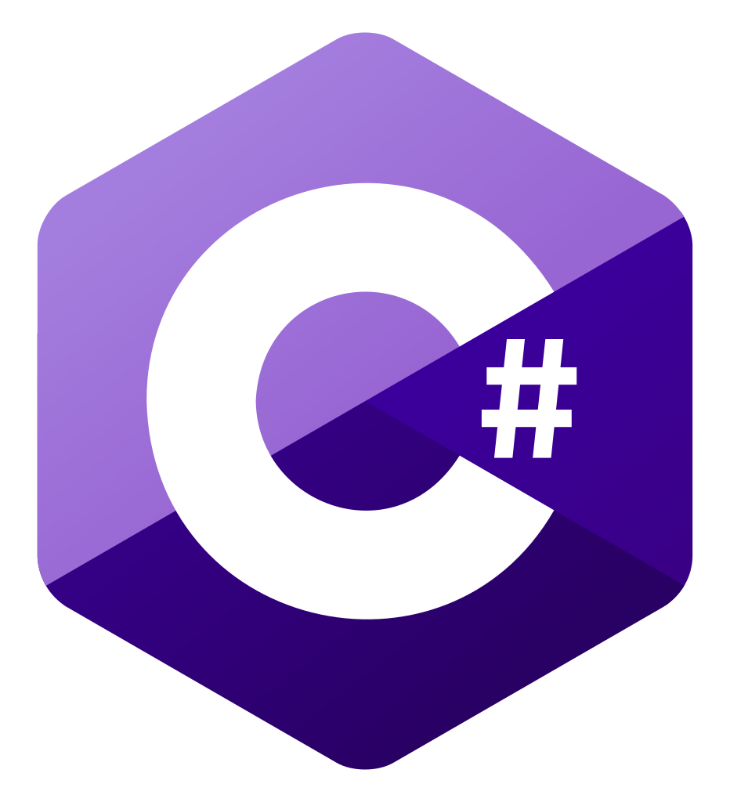





</>
0
-Dependencies
-Templates
-Generator
-example metadata
-transformation xsl
🗂️
publishtobinariesfolder.cmd
create generator
from source (optional)
_
>
1
DataOperations.
Generator.OData.exe
generate SDK
run locally
2
OData SDK
Class
Templates
upload to Azure
metadata.xml

Slide 2
</>
0
-Dependencies
-Templates
-Generator
-example metadata
-transformation xsl
🗂️
publishtobinariesfolder.cmd
create generator
from source (optional)
🐧
>
_
1
DataOperations.
Generator.OData.exe
run locally
generate SDK
OData SDK
2
templates
upload to Azure
metadata.xml

Slide 3
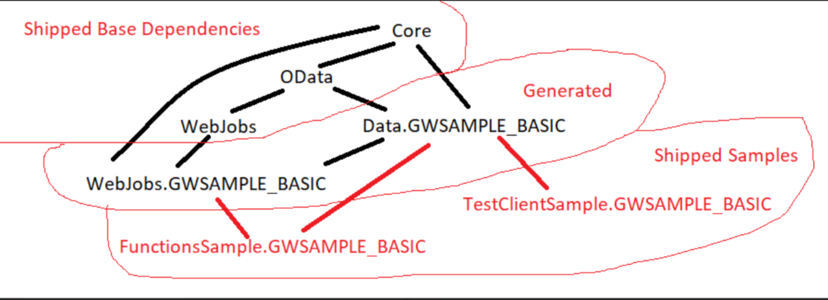
📦 shipped base dependency
WebJobs
OData
Core
🛠️Generated
Data.GWSAMPLE_BASIC
WebJobs.
GWSAMPLE_BASIC
📦Shipped samples
FunctionsSample.GWSAMPLE_BASIC
TestClient.GWSAMPLE_BASIC

Slide 4





GitHub
Azure
Function App
🚀
powered by
Azure SDK for SAP
VS Code / VS Studio
for .NET 6
App Service Plan
(Y1: Linux, consumption)
Deploy to Function app
1
Storage Account
2
OData
0
Run generator for your OData metadata.xml

Slide 5






Azure
GitHub
Resource Group
Function App
🚀
powered by
Azure SDK for SAP
VS Code / VS Studio
for .NET 6
`azd up`
App Service Plan
(Y1: Linux, consumption)
Key Vault
OData
git push
azd up
Log Analytics
GitHub Action
App Insights
Storage Account
Shared Dashboard
for „upped“ app

