Slide 1











</>
0
-Dependencies
-Templates
-Generator
-example metadata
-transformation xsl
🗂️
publishtobinariesfolder.cmd
create generator
from source (optional)
_
>
1
DataOperations.
Generator.OData.exe
generate SDK
run locally
2
OData SDK
templates
upload to Azure
metadata.xml

Slide 2
</>
0
-Dependencies
-Templates
-Generator
-example metadata
-transformation xsl
🗂️
publishtobinariesfolder.cmd
create generator
from source (optional)
🐧
>
_
1
DataOperations.
Generator.OData.exe
run locally
generate SDK
OData SDK
2
templates
upload to Azure
metadata.xml

Slide 3
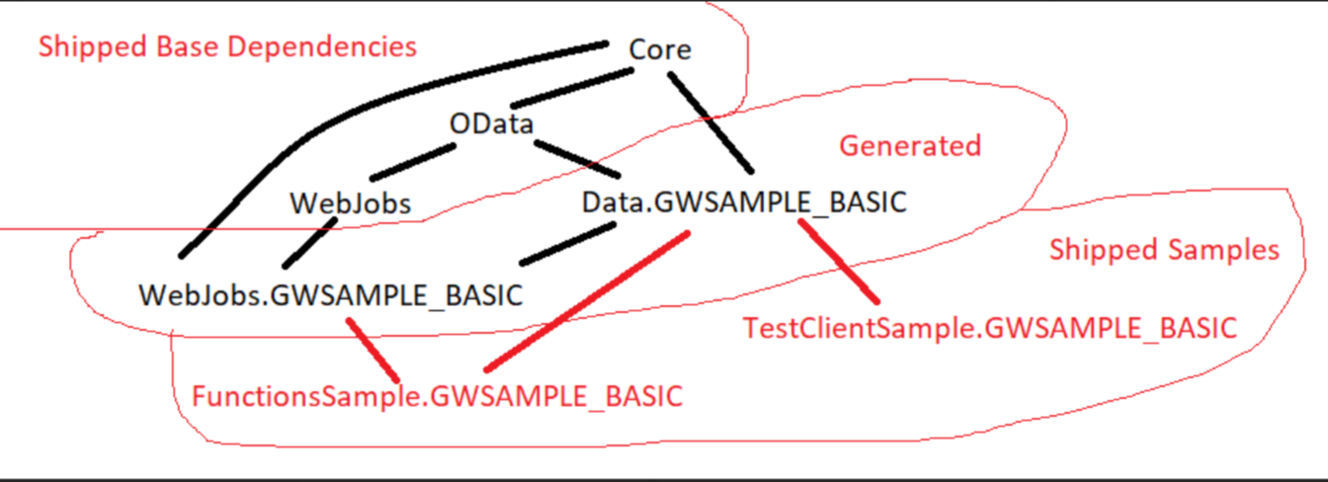
📦 shipped base dependency
WebJobs
OData
Core
🛠️Generated
Data.GWSAMPLE_BASIC
WebJobs.
GWSAMPLE_BASIC
📦Shipped samples
FunctionsSample.GWSAMPLE_BASIC
TestClient.GWSAMPLE_BASIC

