Slide 1
How to leverage 2D display in the Azure Portal to achieve more

Slide 2
Architecture Diagram Analysis

Slide 3
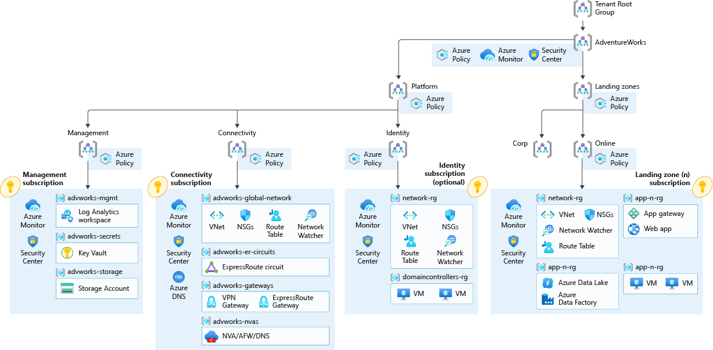
https://github.com/Azure/Enterprise-Scale/blob/main/docs/reference/adventureworks/media/es-hubspoke.png

Slide 4
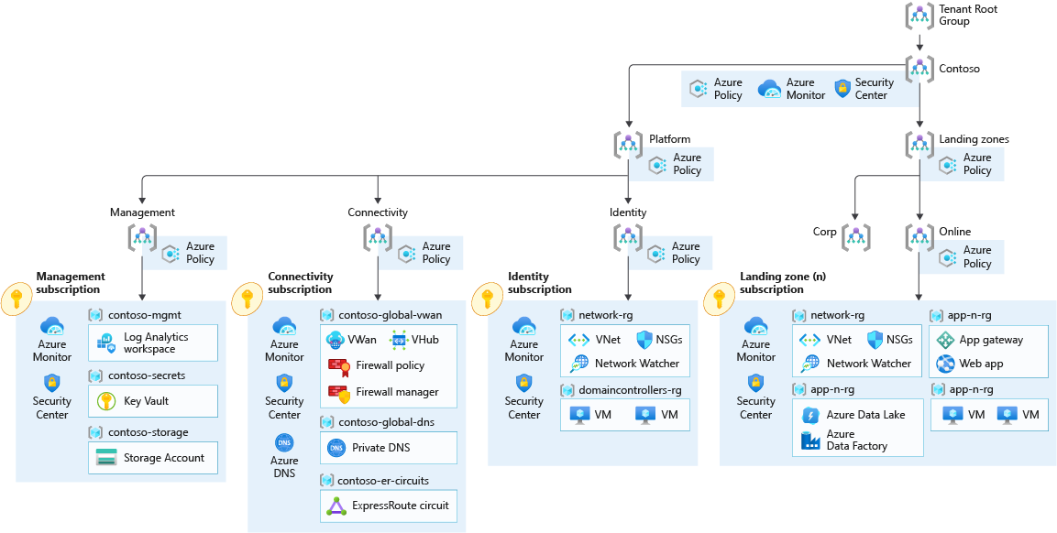
https://github.com/Azure/Enterprise-Scale/blob/main/docs/reference/contoso/media/ns-vwan.png

Slide 5
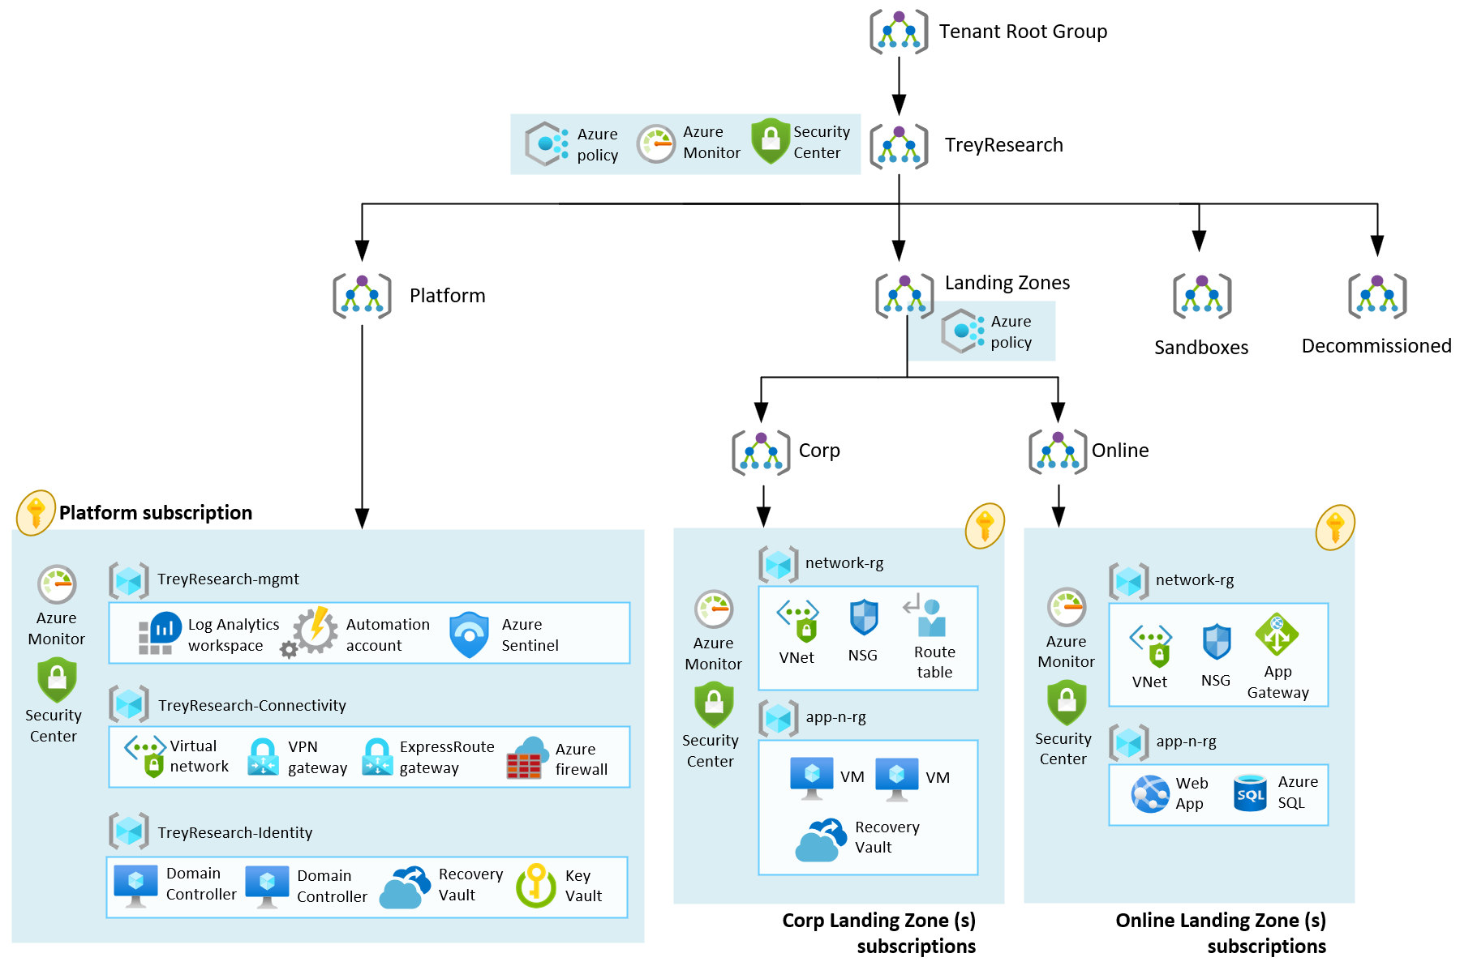
https://github.com/Azure/Enterprise-Scale/blob/main/docs/reference/treyresearch/media/es-lite.png

Slide 6
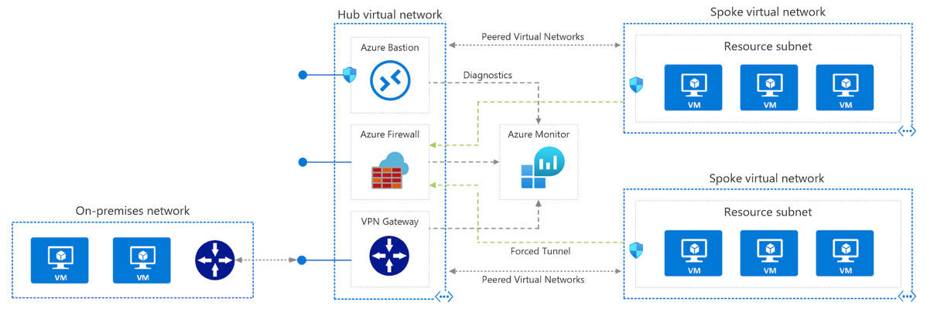
https://docs.microsoft.com/en-us/azure/architecture/reference-architectures/hybrid-networking/hub-spoke?tabs=cli

Slide 7
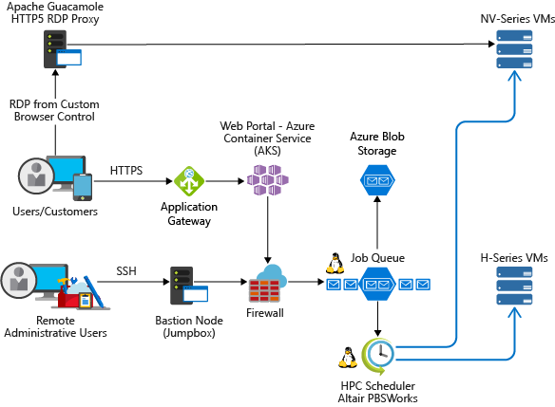
https://docs.microsoft.com/en-us/azure/architecture/example-scenario/apps/hpc-saas

Slide 8
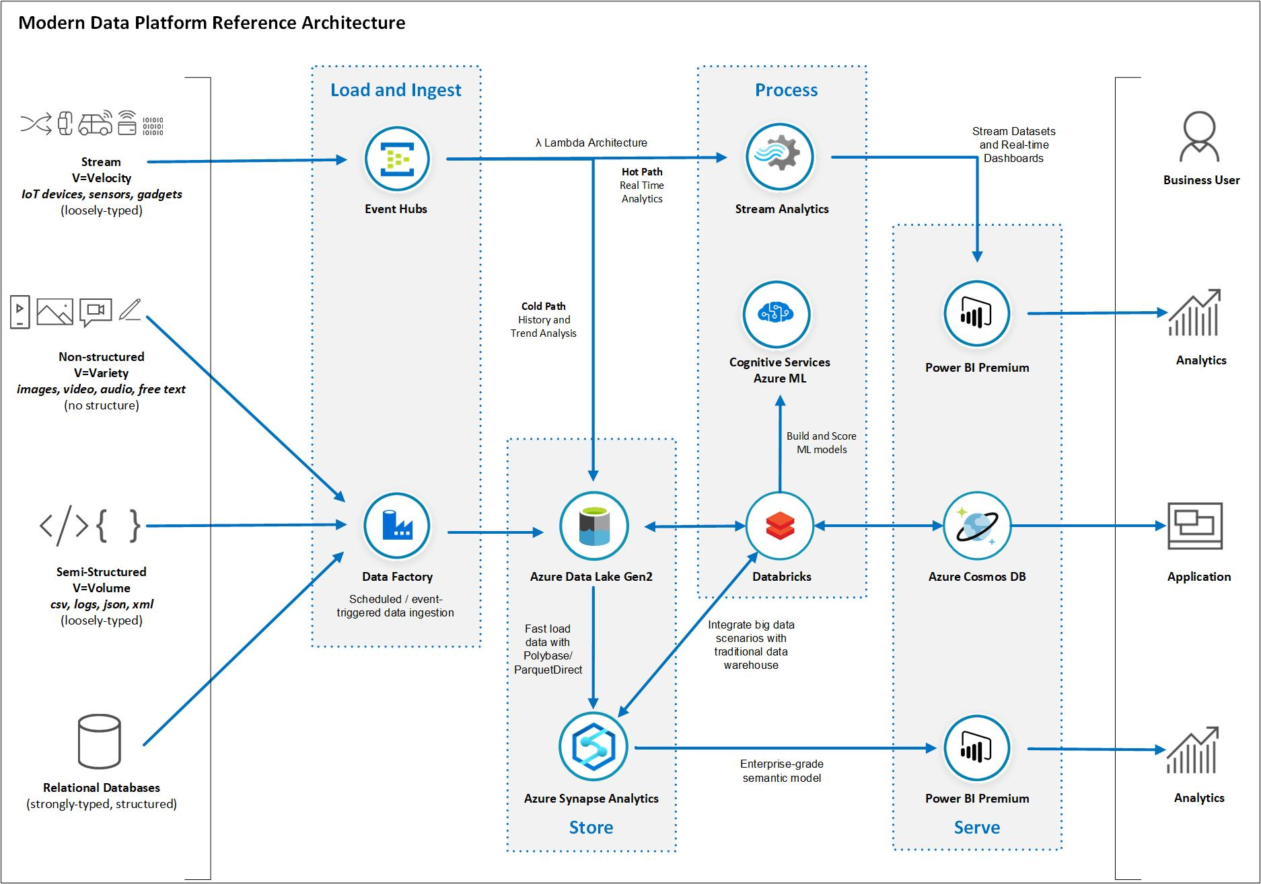
https://docs.microsoft.com/en-us/azure/architecture/example-scenario/dataplate2e/data-platform-end-to-end

Slide 9
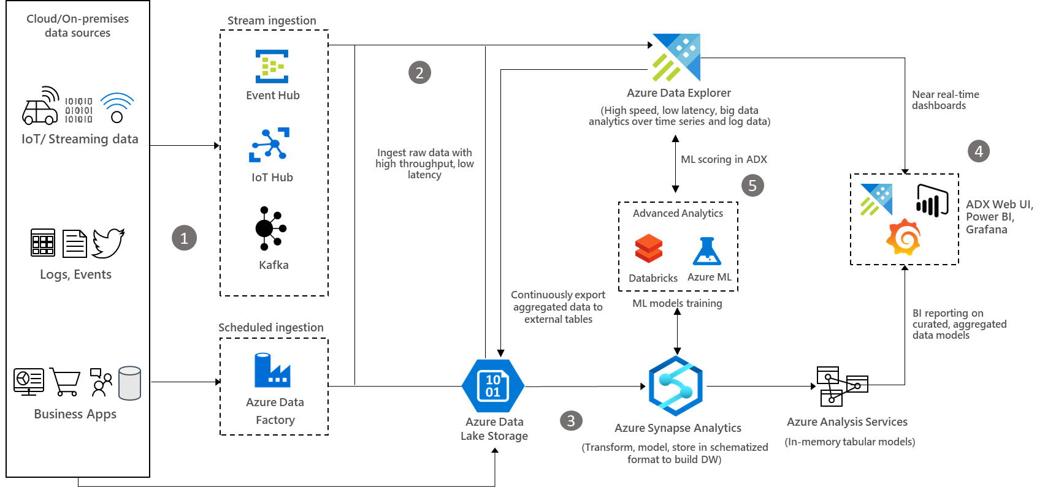
https://docs.microsoft.com/en-us/azure/architecture/solution-ideas/articles/big-data-azure-data-explorer

Slide 10
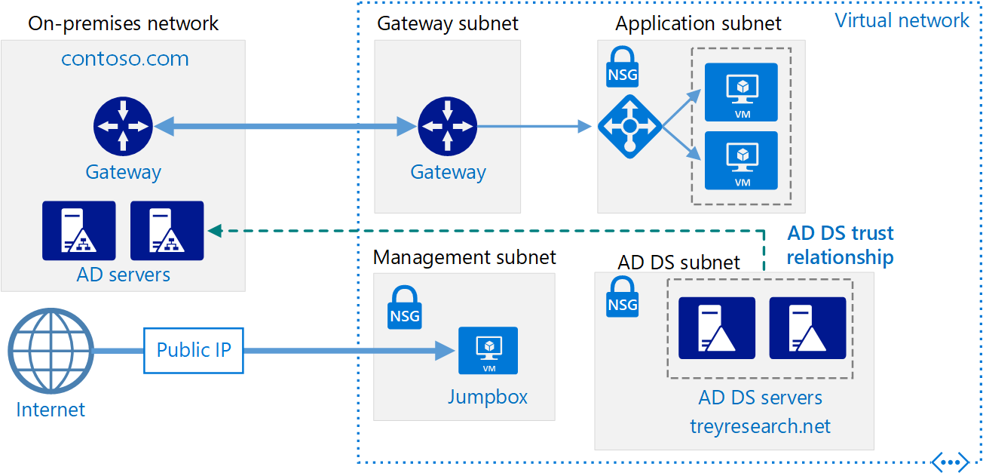
https://docs.microsoft.com/en-us/azure/architecture/reference-architectures/identity/adds-forest

Slide 11
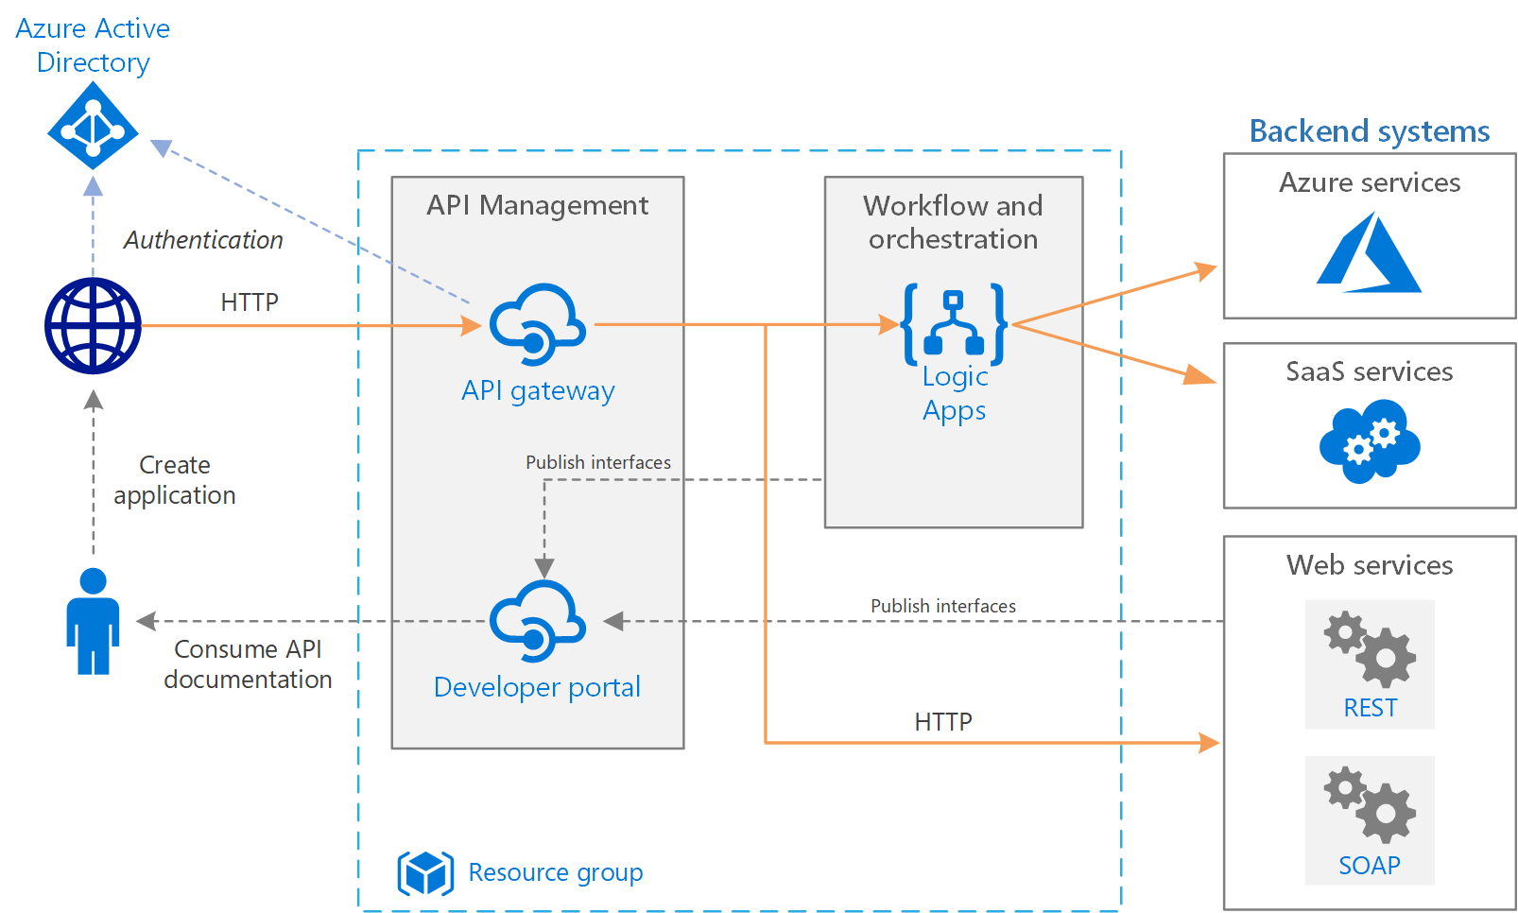
https://docs.microsoft.com/en-us/azure/architecture/reference-architectures/enterprise-integration/basic-enterprise-integration

Slide 12
https://docs.microsoft.com/en-us/azure/architecture/reference-architectures/identity/adds-forest

Slide 13
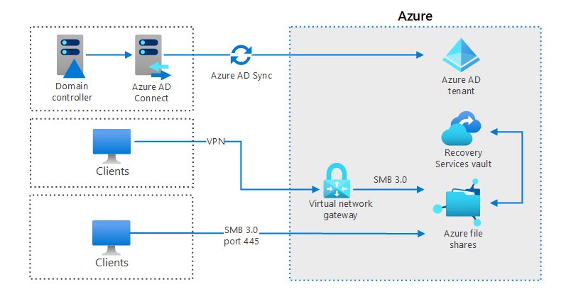
https://docs.microsoft.com/en-us/azure/architecture/hybrid/images/azure-file-share.png

Slide 14
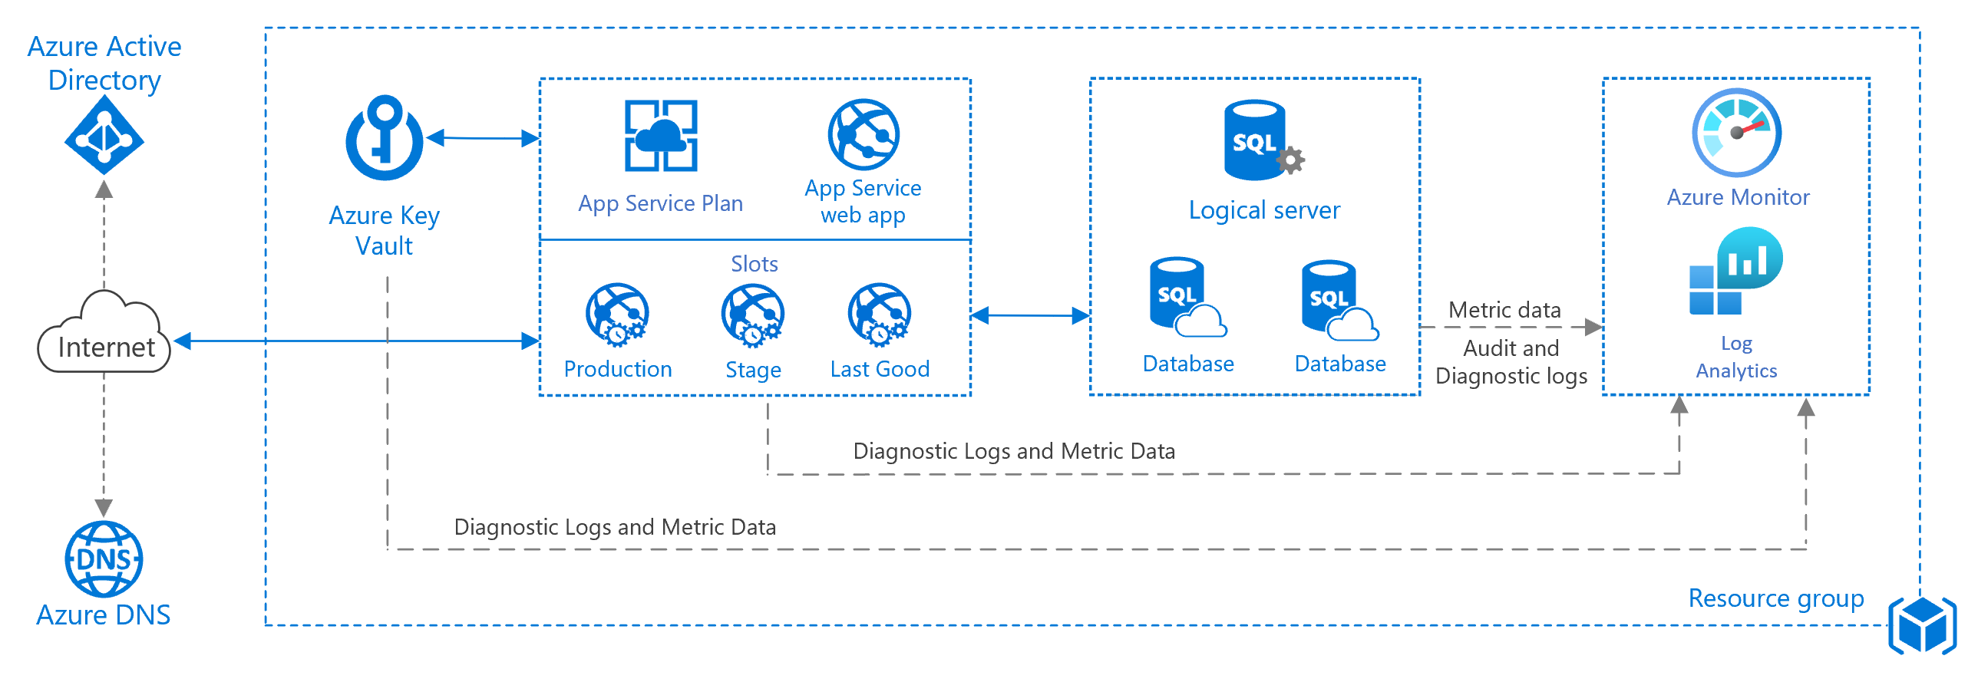
https://docs.microsoft.com/en-us/azure/architecture/reference-architectures/app-service-web-app/images/basic-web-app.png

Slide 15
Analysis – stating the obvious
Good news : Box, box within box, arrows and text can achieve anything ☺
A lot of diagrams already exists
“one diagram for everything” does not prevent “one diagram per topic”
Sometimes underlying resources are hidden for easier display
Some items are concepts rather than Azure resource (Internet, On prem, users…)
We have annotations next to items or arrows
Sometimes we have a step-by-step analysis of the diagram provided
Notes:
Side note: New CAF diagram, while nice, are challenging 50 years of diagram networks

