Slide 1
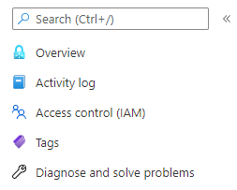




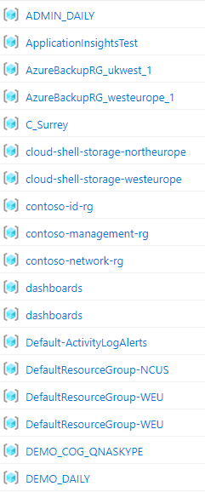
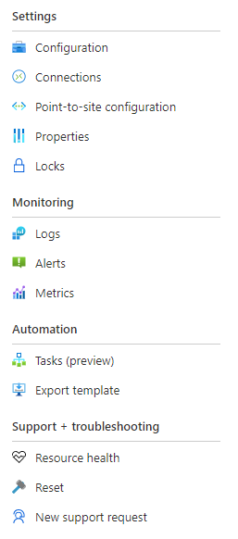








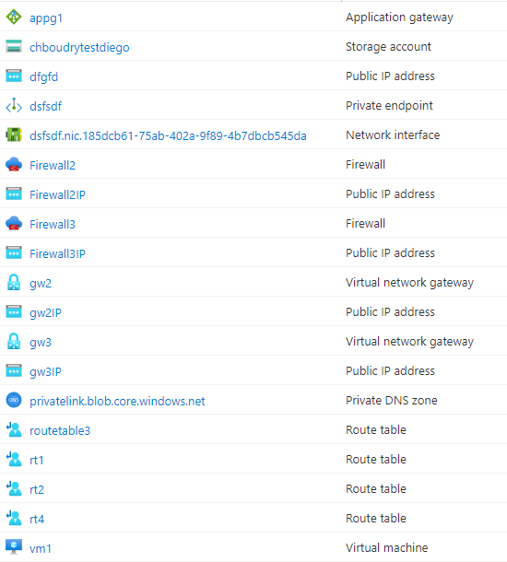



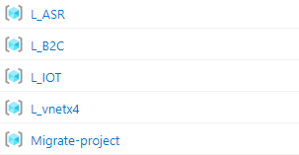
Design
Visual Intelligence
Visualisation
Display
Recommandations
Save
Export
Resource Name
Resource Type
Custom Annotation
Legend
Azure Advisor
Azure Monitor
Azure Policy
Azure Security Center
Custom Recommandation
Network Analysis
Design
Configuration
Display
!
!
12
3
!
!
12
3
!
1
!
Defined Link
Defined Link – Traffic Observed
Undefined Link – Traffic Observed
Legend
Notes:
Incorporate scenario based oriented ?
Like security / monitoring / migration / modernization
Those can be tags
Service health

Slide 2
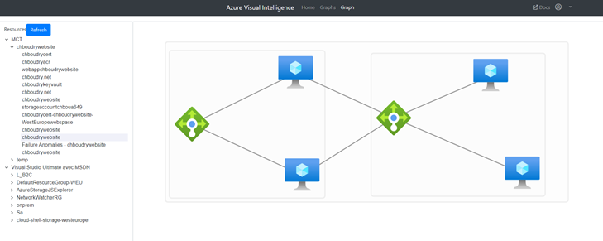

Slide 3
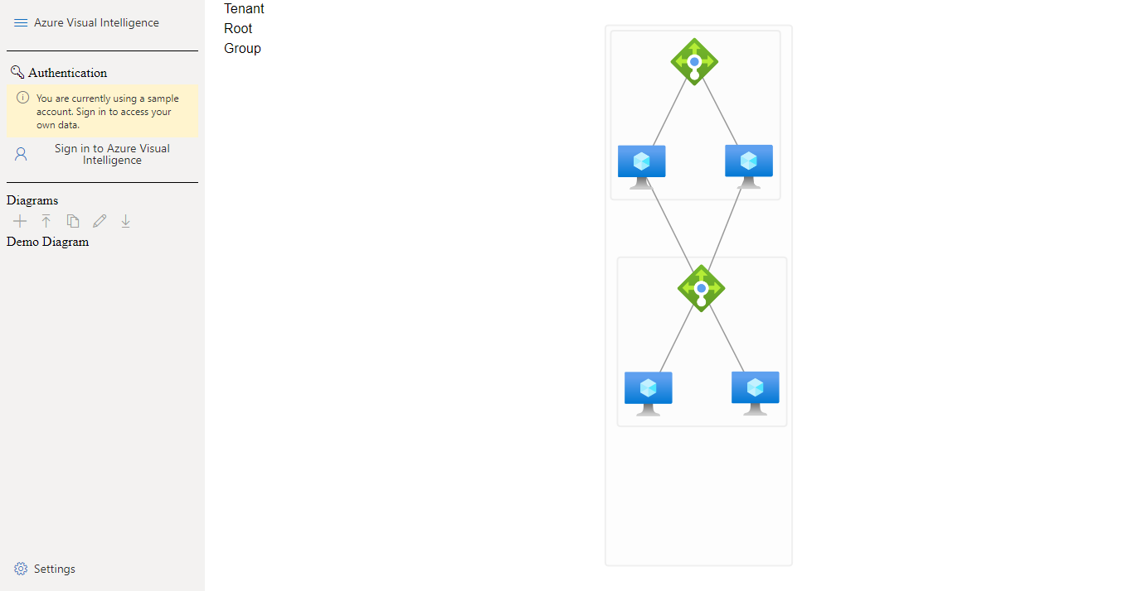

Slide 4
