Slide 1
How to leverage 2D display in the Azure Portal to achieve more

Slide 2

Problem Statement(s):
Azure Resources
Creation
Customer onboarding takes several month due to complexity of Azure
Templates are hard to explore, sort through and understand
There is no visual correlation between reference architecture diagram used and the actual implementation
Monitor
Customer complaints that they are not able to see the big picture easily
Regression from on-prem where customer were using visio diagram with monitoring layout
Improve
Customer are lost by the diversity of tools available to help them (ASC / Advisor / Policy / … )

Slide 3
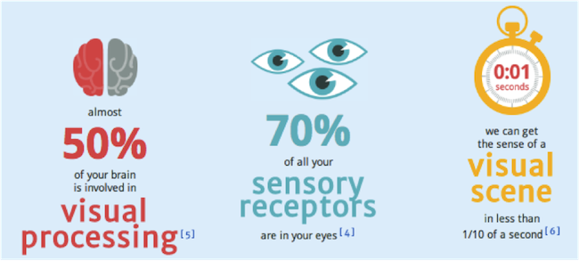
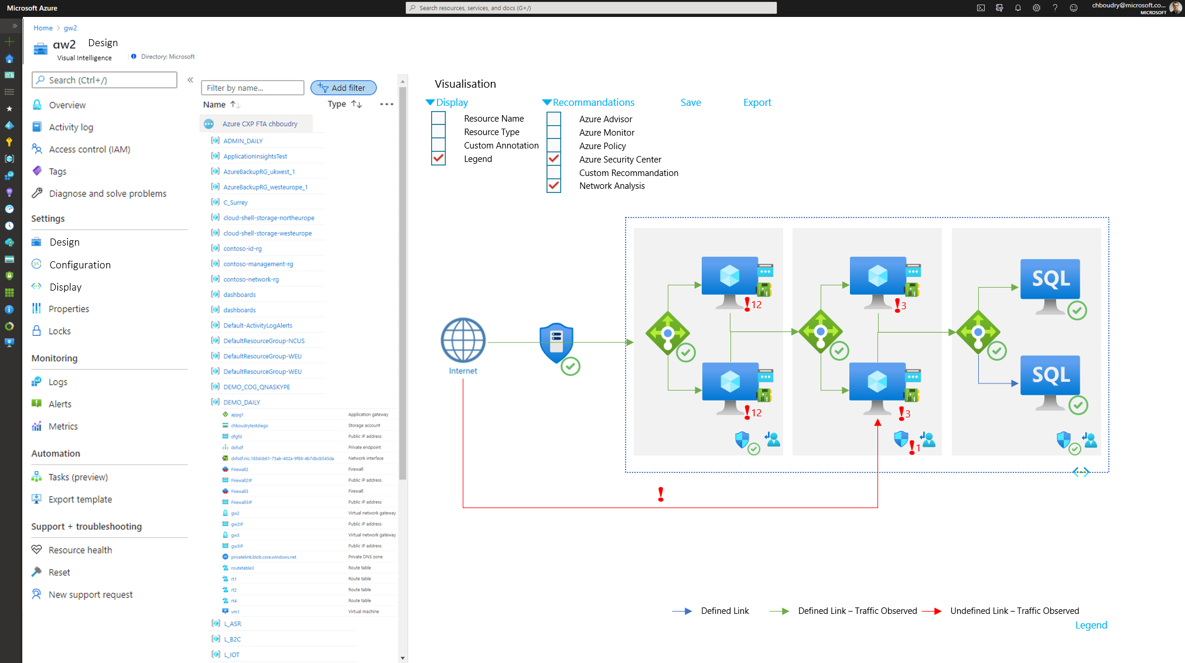
Solution Hypothesis:
A picture is worth a thousand words.
Goal:
Creation
Make it easy to see what is being built + what is existing
Creation view and monitoring view is the same single experience
Monitor
Overlay on top of diagram
Improve
Overlay on top of diagram (ASC / policy / advisor)
Extensible to other topics (cost, partner integration)

Slide 4
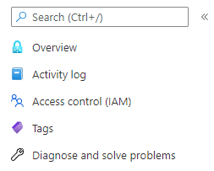




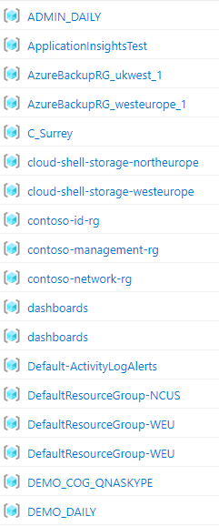
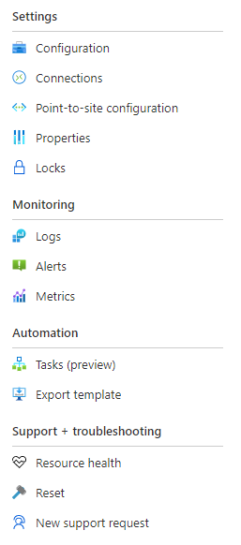








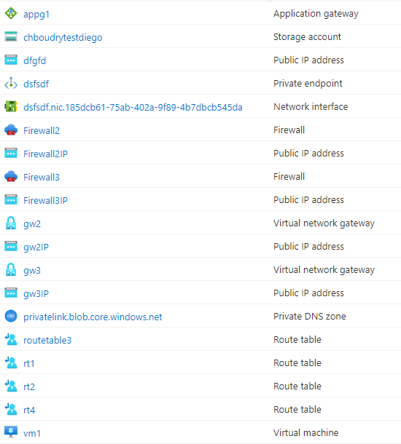



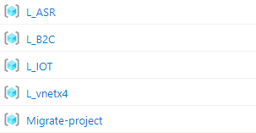
Design
Visual Intelligence
Visualisation
Display
Recommandations
Save
Export
Resource Name
Resource Type
Custom Annotation
Legend
Azure Advisor
Azure Monitor
Azure Policy
Azure Security Center
Custom Recommandation
Network Analysis
Design
Configuration
Display
!
!
12
3
!
!
12
3
!
1
!
Defined Link
Defined Link – Traffic Observed
Undefined Link – Traffic Observed
Legend
Notes:
Incorporate scenario based oriented ?
Like security / monitoring / migration / modernization
Those can be tags
Service health

Slide 5
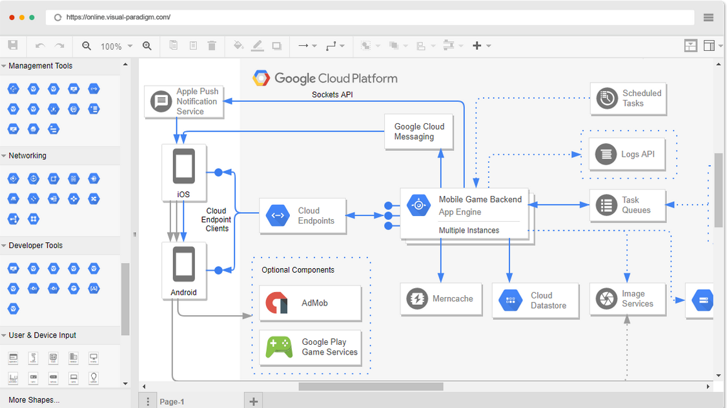
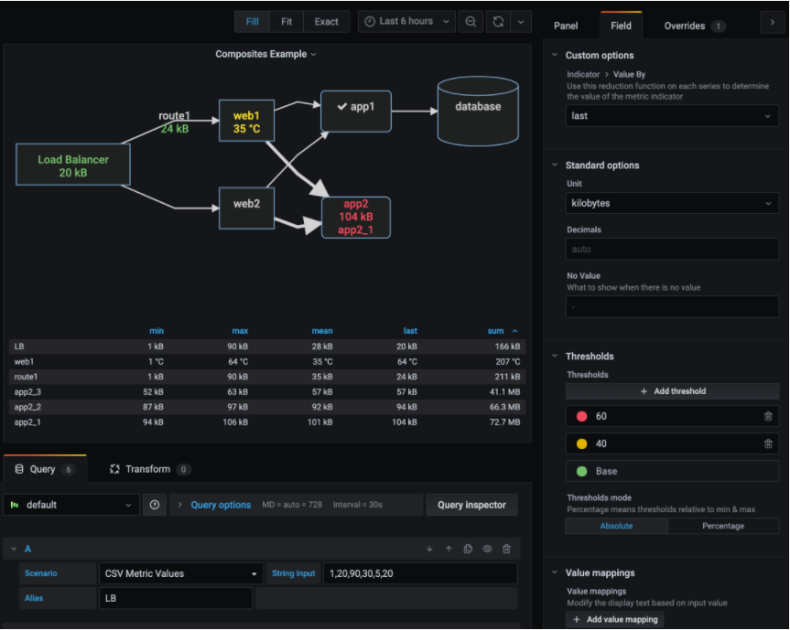
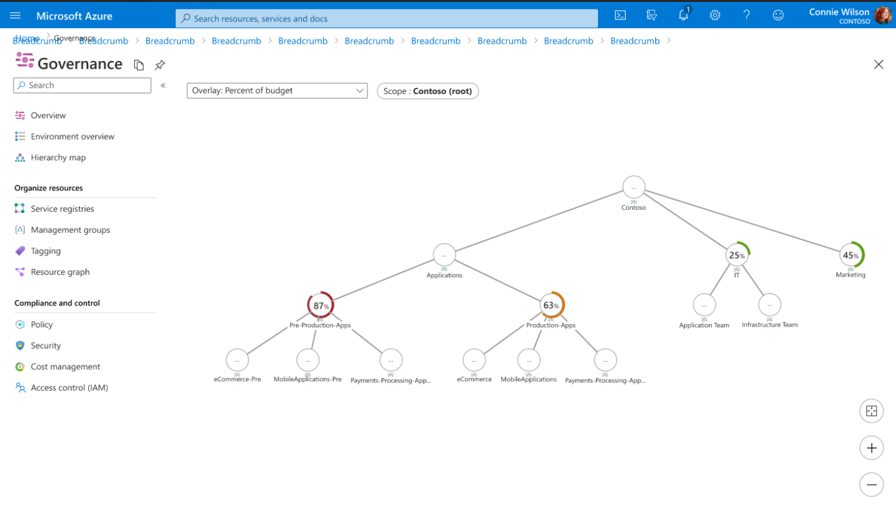
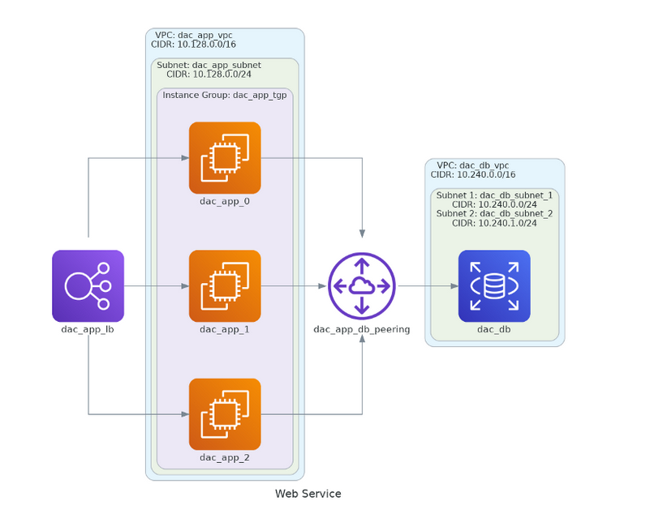
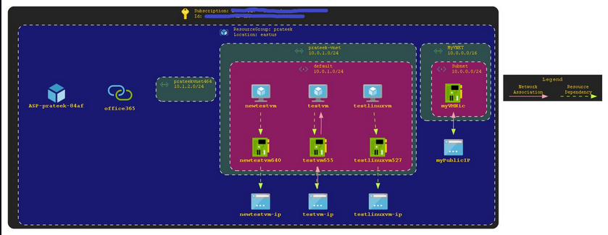
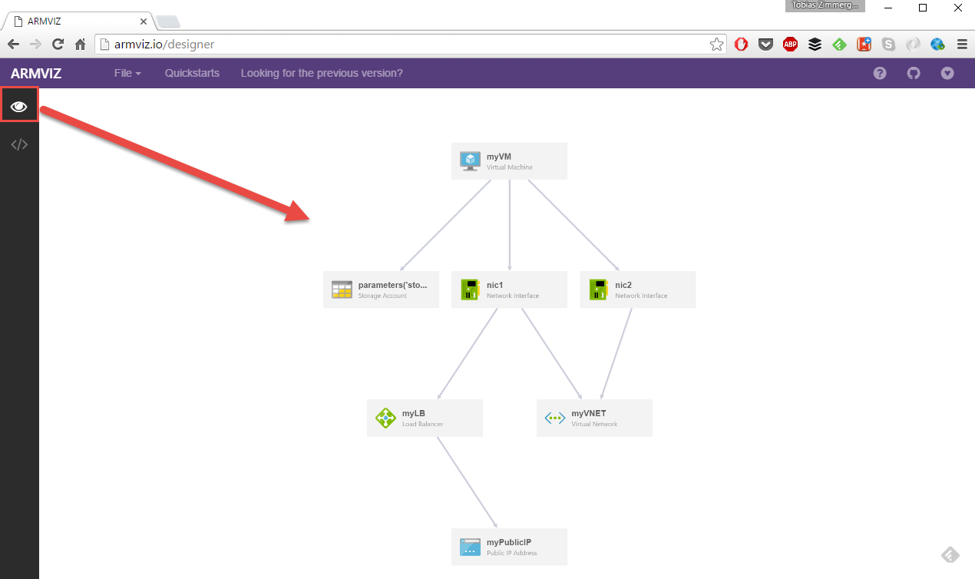
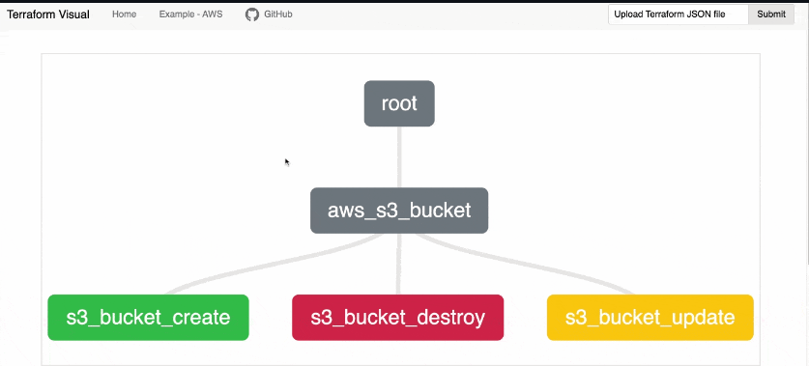
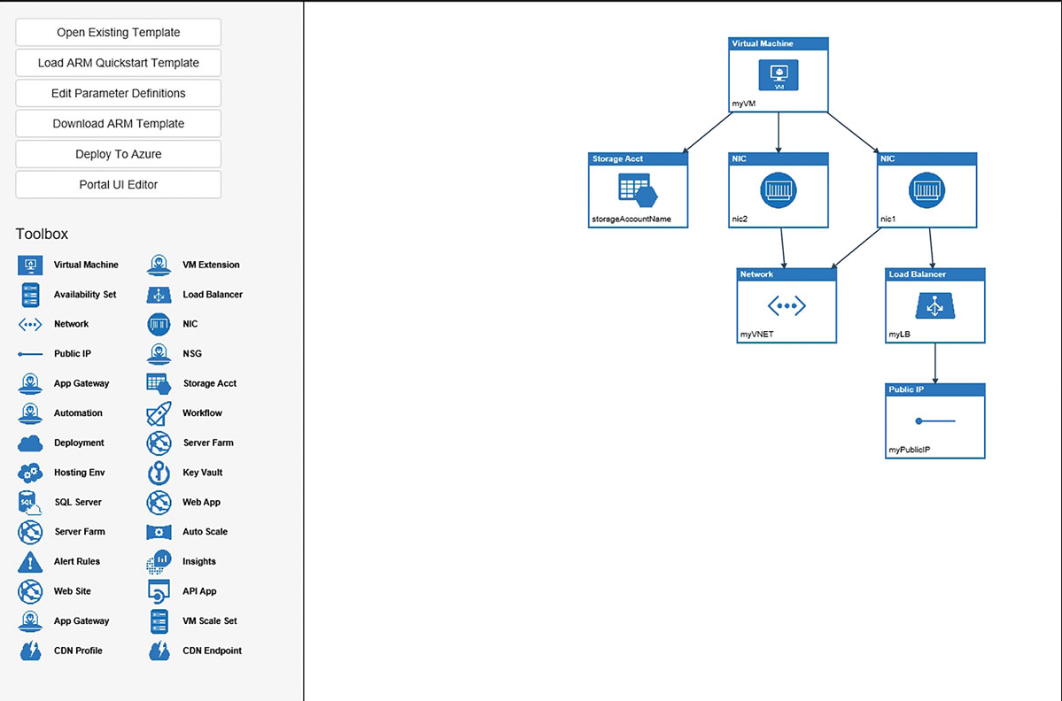
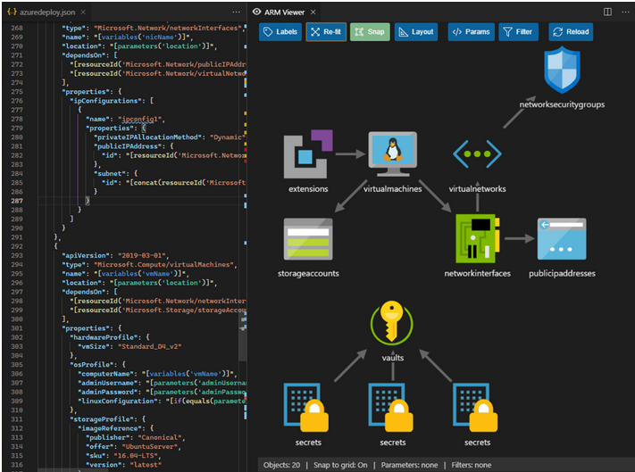
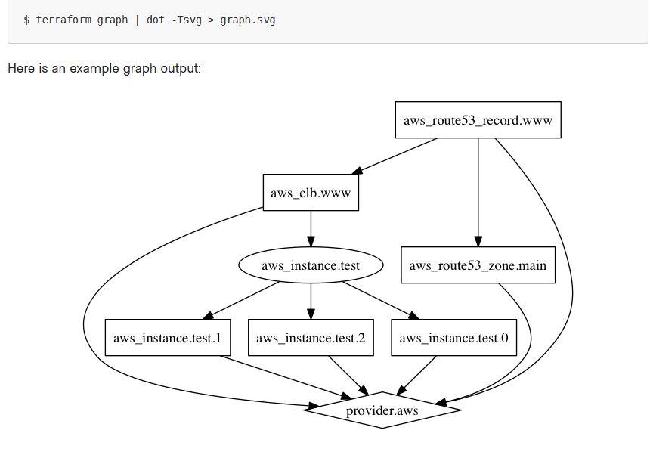
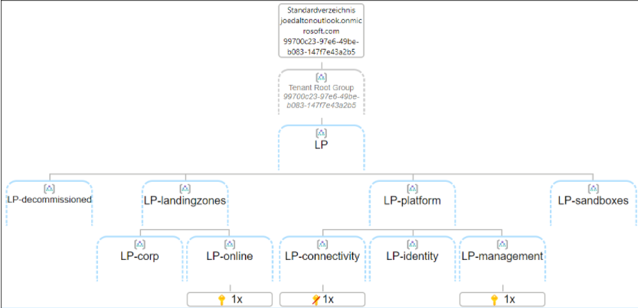
Community ?
A lot of initiatives but integration to the cloud platform is limited
171,869 installs
Notes:
https://marketplace.visualstudio.com/items?itemName=bencoleman.armview
https://github.com/hieven/terraform-visual
https://www.terraform.io/docs/cli/commands/graph.html
http://armviz.io/designer
https://medium.com/analytics-vidhya/terraform-diagrams-provisioning-and-visualizing-a-simple-environment-on-aws-471f5d88c95d
https://grafana.com/grafana/plugins/jdbranham-diagram-panel/
https://github.com/JulianHayward/Azure-MG-Sub-Governance-Reporting
https://github.com/PrateekKumarSingh/AzViz

Slide 6

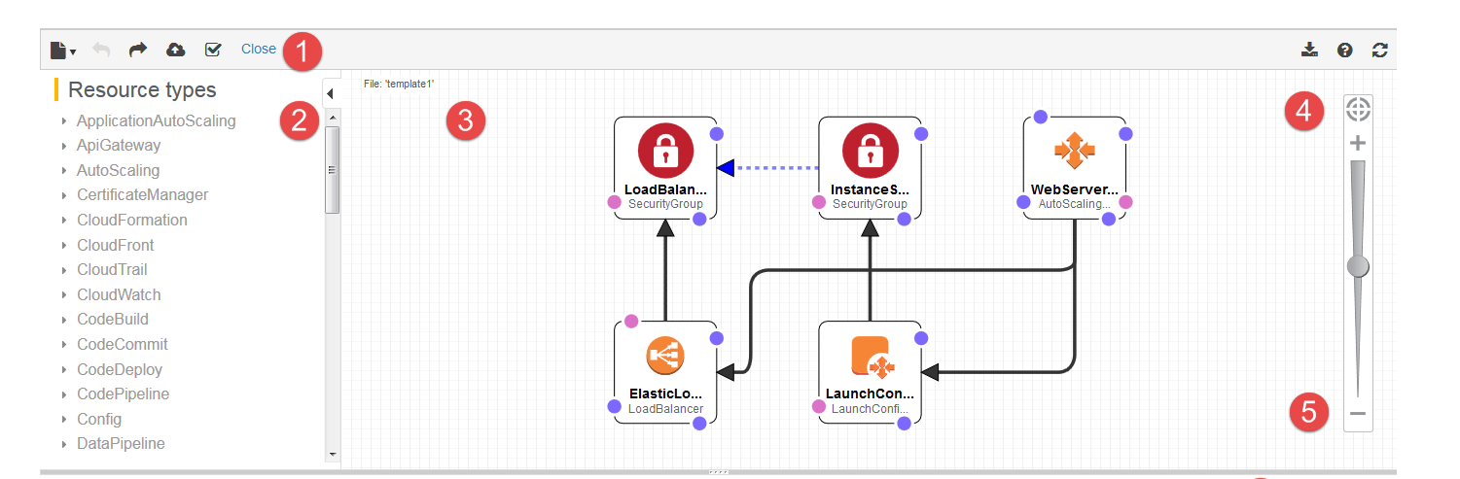
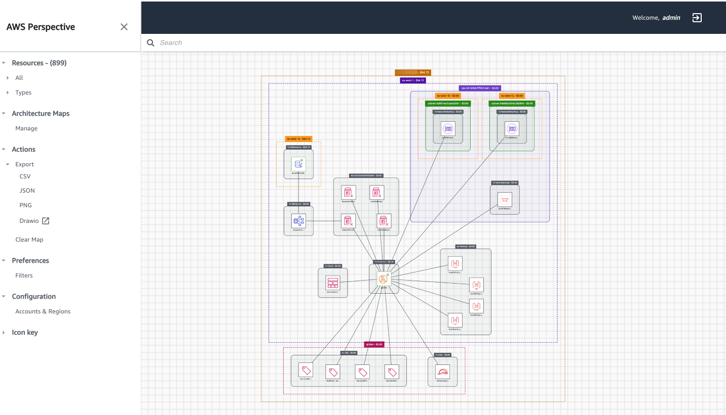
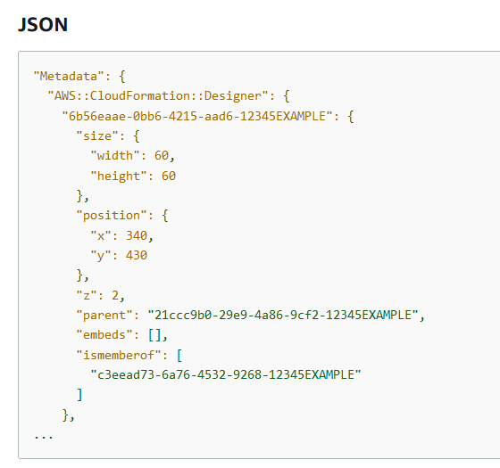
Competitors ?
Already doing it, but partial story : focusing architecture display (new or existing one)
They are working on the overlay, they are able to display real time costs on the diagrams so far
Simplify template authoring
When you author template resources in a text editor, you must manually edit JSON or YAML, which can be tedious and error-prone. By using Designer, you spend less time manually coding your templates and more time designing your AWS infrastructure. In Designer, you drag and drop new resources to add them to your template, and you drag connections between resources to establish relationships. Designer automatically modifies the JSON or YAML.
Notes:
https://docs.aws.amazon.com/AWSCloudFormation/latest/UserGuide/working-with-templates-cfn-designer-overview.html
https://aws.amazon.com/solutions/implementations/aws-perspective/

