Slide 1
Capacity Reservation sharing across subscriptions

Slide 2
Scenario 1: Resource Reuse
Without Capacity Reservation sharing
With Capacity Reservation sharing
Management Group “DR Prod”
Management Group “Web Test”
Management Group “DR Prod”
Management Group “Web Test”
Sub A
Sub B
Sub A
Sub B
CRG X
VM A
CRG X
VM A
Sub B can deploy VM A to CRX
CR X
CR Z
Sub B cannot deploy VM A to CRX
CR X
CR Z
Note:
VM A and CR X both match in terms of VM SKU/location/zone
Sub A and Sub B under same AAD
Notes:
Today, there are

Slide 3

Scenario 2: Centralized Capacity
Without Capacity Reservation sharing
With Capacity Reservation sharing
Management Group “Web Prod”
Person managing centralized quota for both subscriptions
Management Group “Web Test”
Person managing centralized quota for both subscriptions
Management Group “Web Prod”
Management Group “Web Test”
Sub A
Sub B
Sub A
Sub B
CRG X
VM A
CRG X
VM A
CR X
CR Z
Sub B cannot deploy VM A to CRX even though Sub A has quota for VM A size
CR X
CR Z
Sub B can deploy VM A to CRX since Sub A has quota for VM size A
Note:
VM A and CR X both match in terms of VM SKU/location/zone
Sub A and Sub B under same AAD
Notes:
Today, there are

Slide 4
Scenario 3: Scaling/Sharding
Without Capacity Reservation sharing
With Capacity Reservation sharing
Management Group “Web Prod”
Management Group “Web Prod”
Sub A
Sub B
Sub A
Sub B
CRG X
VM A
CRG X
VM A
Sub B can deploy VM A to CRX using Sub A’s capacity objects, data disk etc
:
CR X
CR Z
:
Sub B cannot deploy VM A to CRX even though Sub A has abundant capacity objects
:
CR X
CR Z
:
Sub M
Sub M
Note:
VM A and CR X both match in terms of VM SKU/location/zone
Sub A and Sub B under same environment
Notes:
Today, there are

Slide 5

Scenario 4: ISV customer isolation
Without Capacity Reservation sharing
With Capacity Reservation sharing
SaaS Management Group “Prod Customer A”
SaaS provider hosting customer VMs
SaaS Management Group “Prod Customer B”
SaaS Management Group “Prod Customer A”
SaaS provider hosting customer VMs
SaaS Management Group “Prod Customer B”
Sub A
Sub B
Sub A
Sub B
CRG X
VM A
CRG X
VM A
CR X
CR Z
Sub B can deploy VM A to CRX using Sub A quota and reserved capacity of VM A size while keeping customers isolated in their own subscriptions
CR X
CR Z
Sub B cannot deploy VM A to CRX even though Sub A has quota and reserved capacity of VM A size
Note:
VM A and CR X both match in terms of VM SKU/location/zone
Sub A and Sub B under same AAD
Notes:
Today, there are

Slide 6
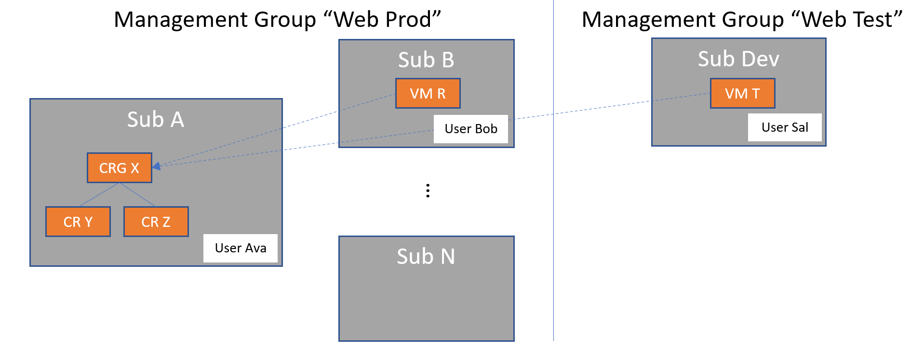
Solution overview
Capacity Reservation Group sharing strategy:
Capacity Reservation Group can be shared between subscriptions under same AAD
Host subscription has to explicitly share with other subscriptions by populating “sharing profile” for a CRG
Host subscription admin has to give read/deploy rights to users of subscription with whom capacity reservation has been shared
Example:
User Ava created CRG X with CRs Y and Z in Sub A.
User Ava shared CRG X with Sub B and Sub Dev.
User Ava granted User Bob and User Sal “read” and “deploy” rights to CRG X.
Sub B/VM R and Sub Dev/VM T both match CR Y in VM SKU/location/zone.
Notes:
This is a deployment by a technical person, not a purchase by finance or ops. This will allow us to support many more use cases in the future where defining an exact deployment topology and related resources is important.
The customer can also purchase Reserved Instance discounts to complement this feature. Thus they will pay a fixed, term-discount price for persistent capacity whether it is used or not.

Slide 7
Other Topics
Usage patterns:
Customer intends to grant access to all subscriptions in a management group.
Customer intends to share with arbitrary subscriptions/specific environments
Summary of key design considerations:
Usage Control: Customer has control over use of capacity for example evicting VMs
Discoverability: Customer using shared objects must be able to find them via Portal or API
Manageability: Customers have the option to set an object’s share policy and then it operates automatically as their object set changes
At scale: System can manage large set of objects in a streamlined way
Notes:
This is a deployment by a technical person, not a purchase by finance or ops. This will allow us to support many more use cases in the future where defining an exact deployment topology and related resources is important.
The customer can also purchase Reserved Instance discounts to complement this feature. Thus they will pay a fixed, term-discount price for persistent capacity whether it is used or not.

Slide 8
Customer experience of CRG sharing

Slide 9
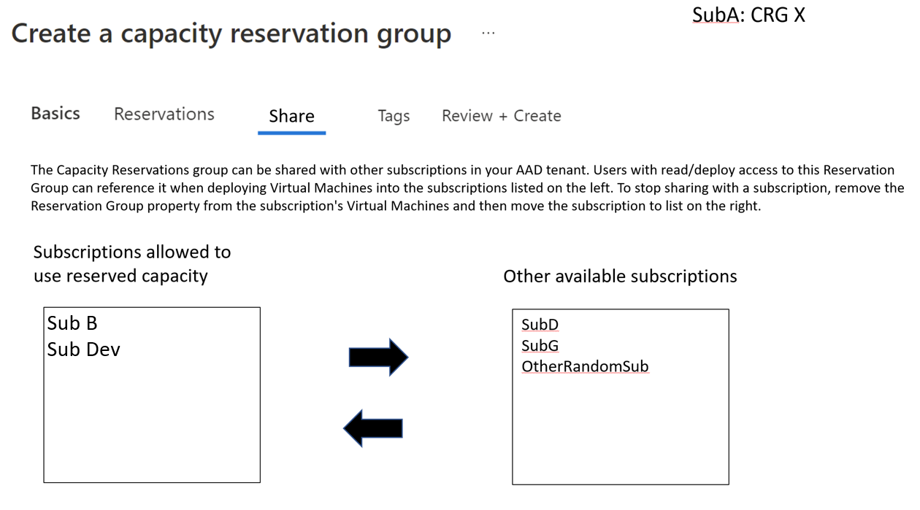
Capacity reservation – “sharing” customer view
API experience: Customer will populate CRG “sharingProfile” with subscription list to be shared with
Portal experience: Customer can move subscriptions from right to left to share a CRG
Notes:
In this example, X=2. Azure emits VM usage for both reserved spots while they are not used. Since the customer purchased a single term discount RI, the first VM cost is zeroed out. The second VM results in a charge for just the VM. We should not be billing for software meters or the like.
The main caveat is that this reservation covers the VM itself. This is normally the scarcest resource and is therefore the most important piece. The customer can create and leave resident things like disks to assure their capacity. They will often need to do so for DR scenarios for example. But there is no requirement to define all of that if not needed before allocation (for example, stateless app servers).
We do plan to expand to other resource types in the future. Timeline is not yet defined.

Slide 10
Role: CRG Admin Delete CRG/CR
CRG Admin can delete CRG X/CR A/CR B
Management Group “Prod”
Management Group “Prod Test”
Sub A
Sub B
x
CRG X
VM A
CRG Admin: User Ava
x
x
CR A
CR B
Note:
VM A and CR X both match in terms of VM SKU/location/zone
Sub A and Sub B under same AAD
Notes:
Today, there are

Slide 11
Role: CRG Admin Evict VMs and remove CRG reference
CRG Admin can evict VMs originating from other subscription
Management Group “Prod”
Management Group “Prod Test”
Sub A
Sub B
x
CRG X
VM A
CRG Admin: User Ava
CR A
CR B
Note:
VM A and CR X both match in terms of VM SKU/location/zone
Sub A and Sub B under same AAD
Notes:
Today, there are

Slide 12
Sharing Template/API

Slide 13
Role: CRG User Read and deploy rights
CRG User Bob can deploy VM A in CRGX
Management Group “Prod”
Management Group “Prod Test”
Sub A
Sub B
CRG X
VM A
CRG Admin: User Ava
CRG User: User Bob
CR A
CR B
Note:
VM A and CR X both match in terms of VM SKU/location/zone
Sub A and Sub B under same AAD
Notes:
Today, there are

