Slide 1
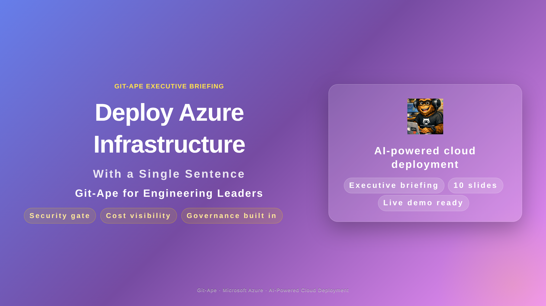

Slide 2
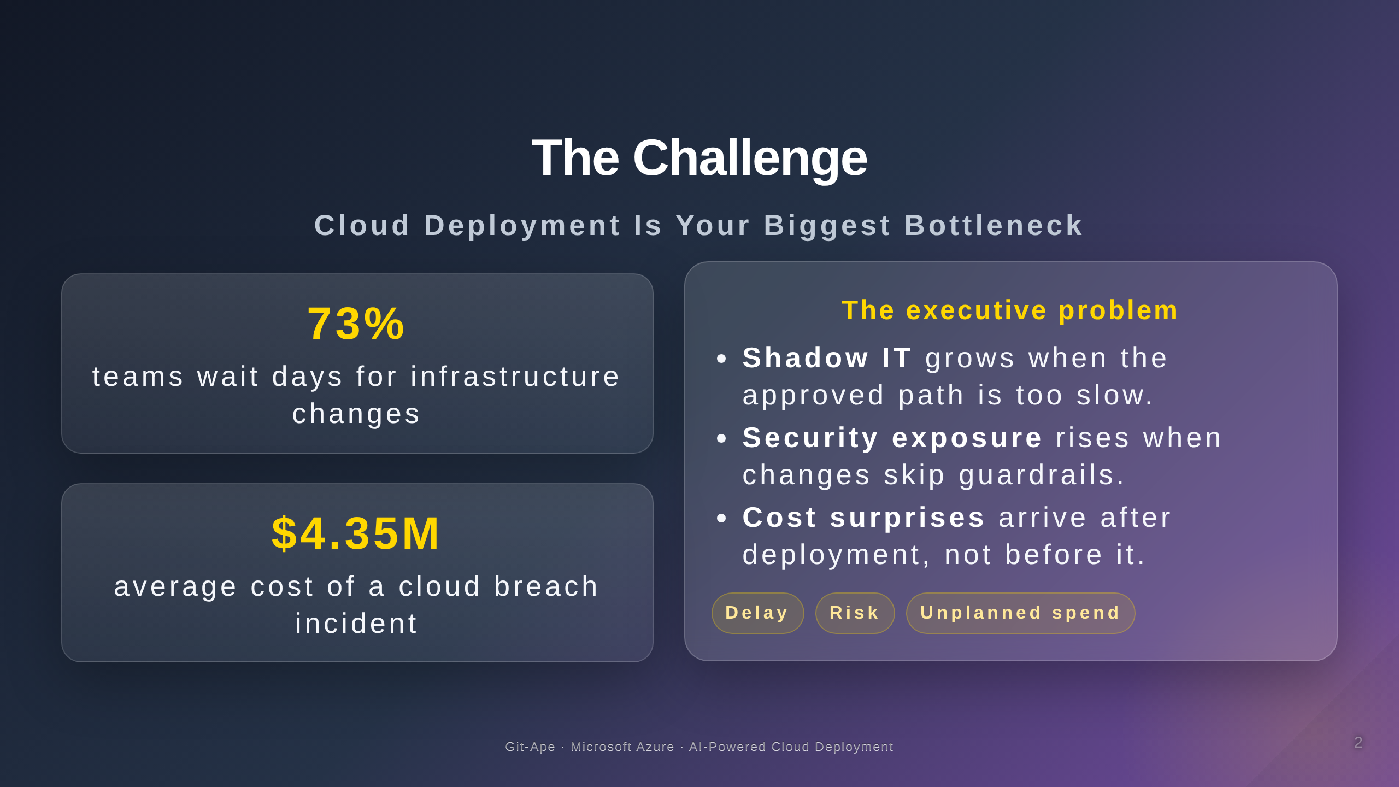

Slide 3
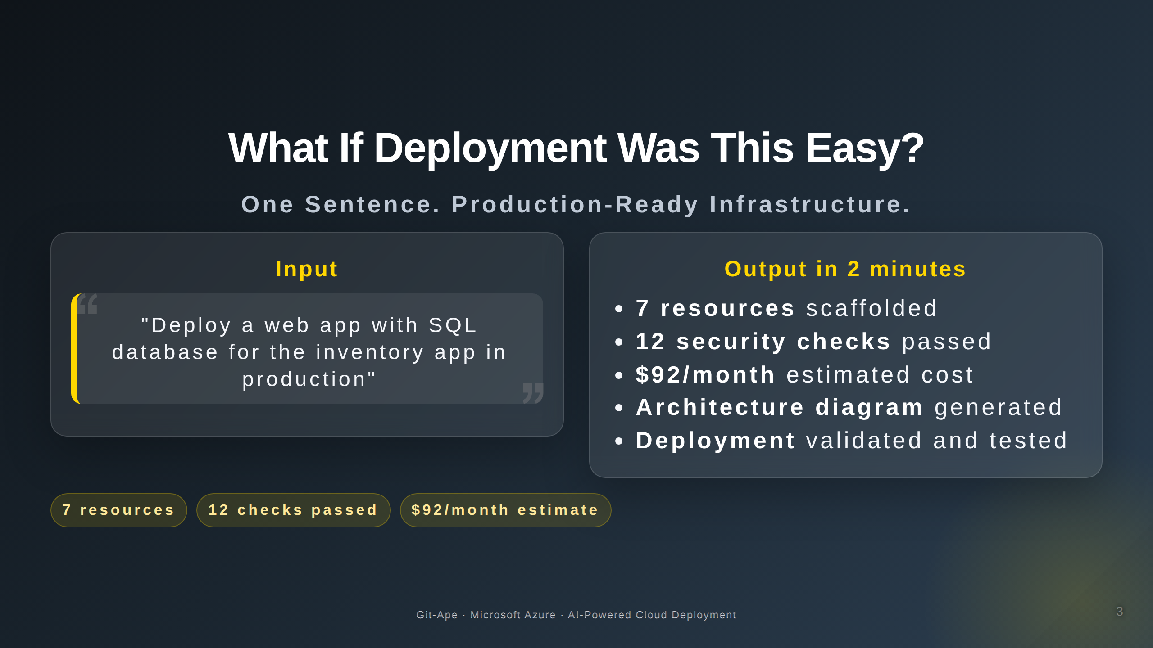

Slide 4
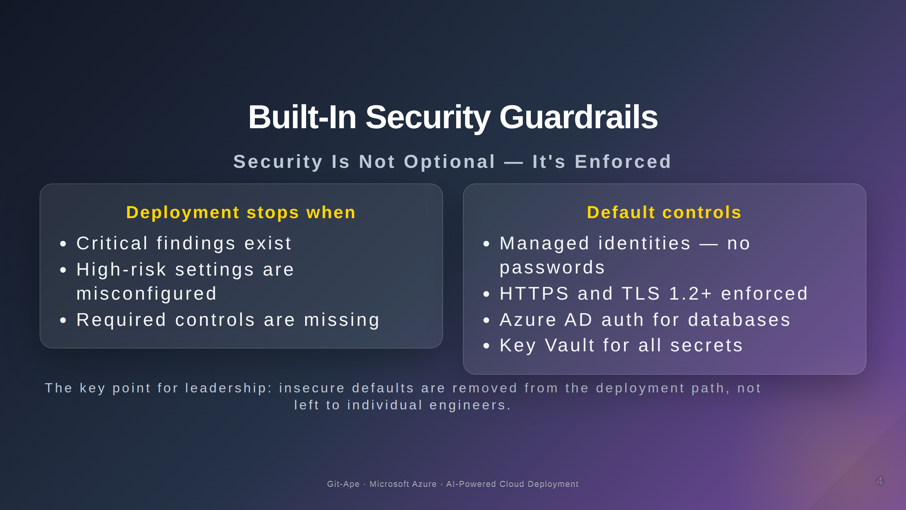

Slide 5
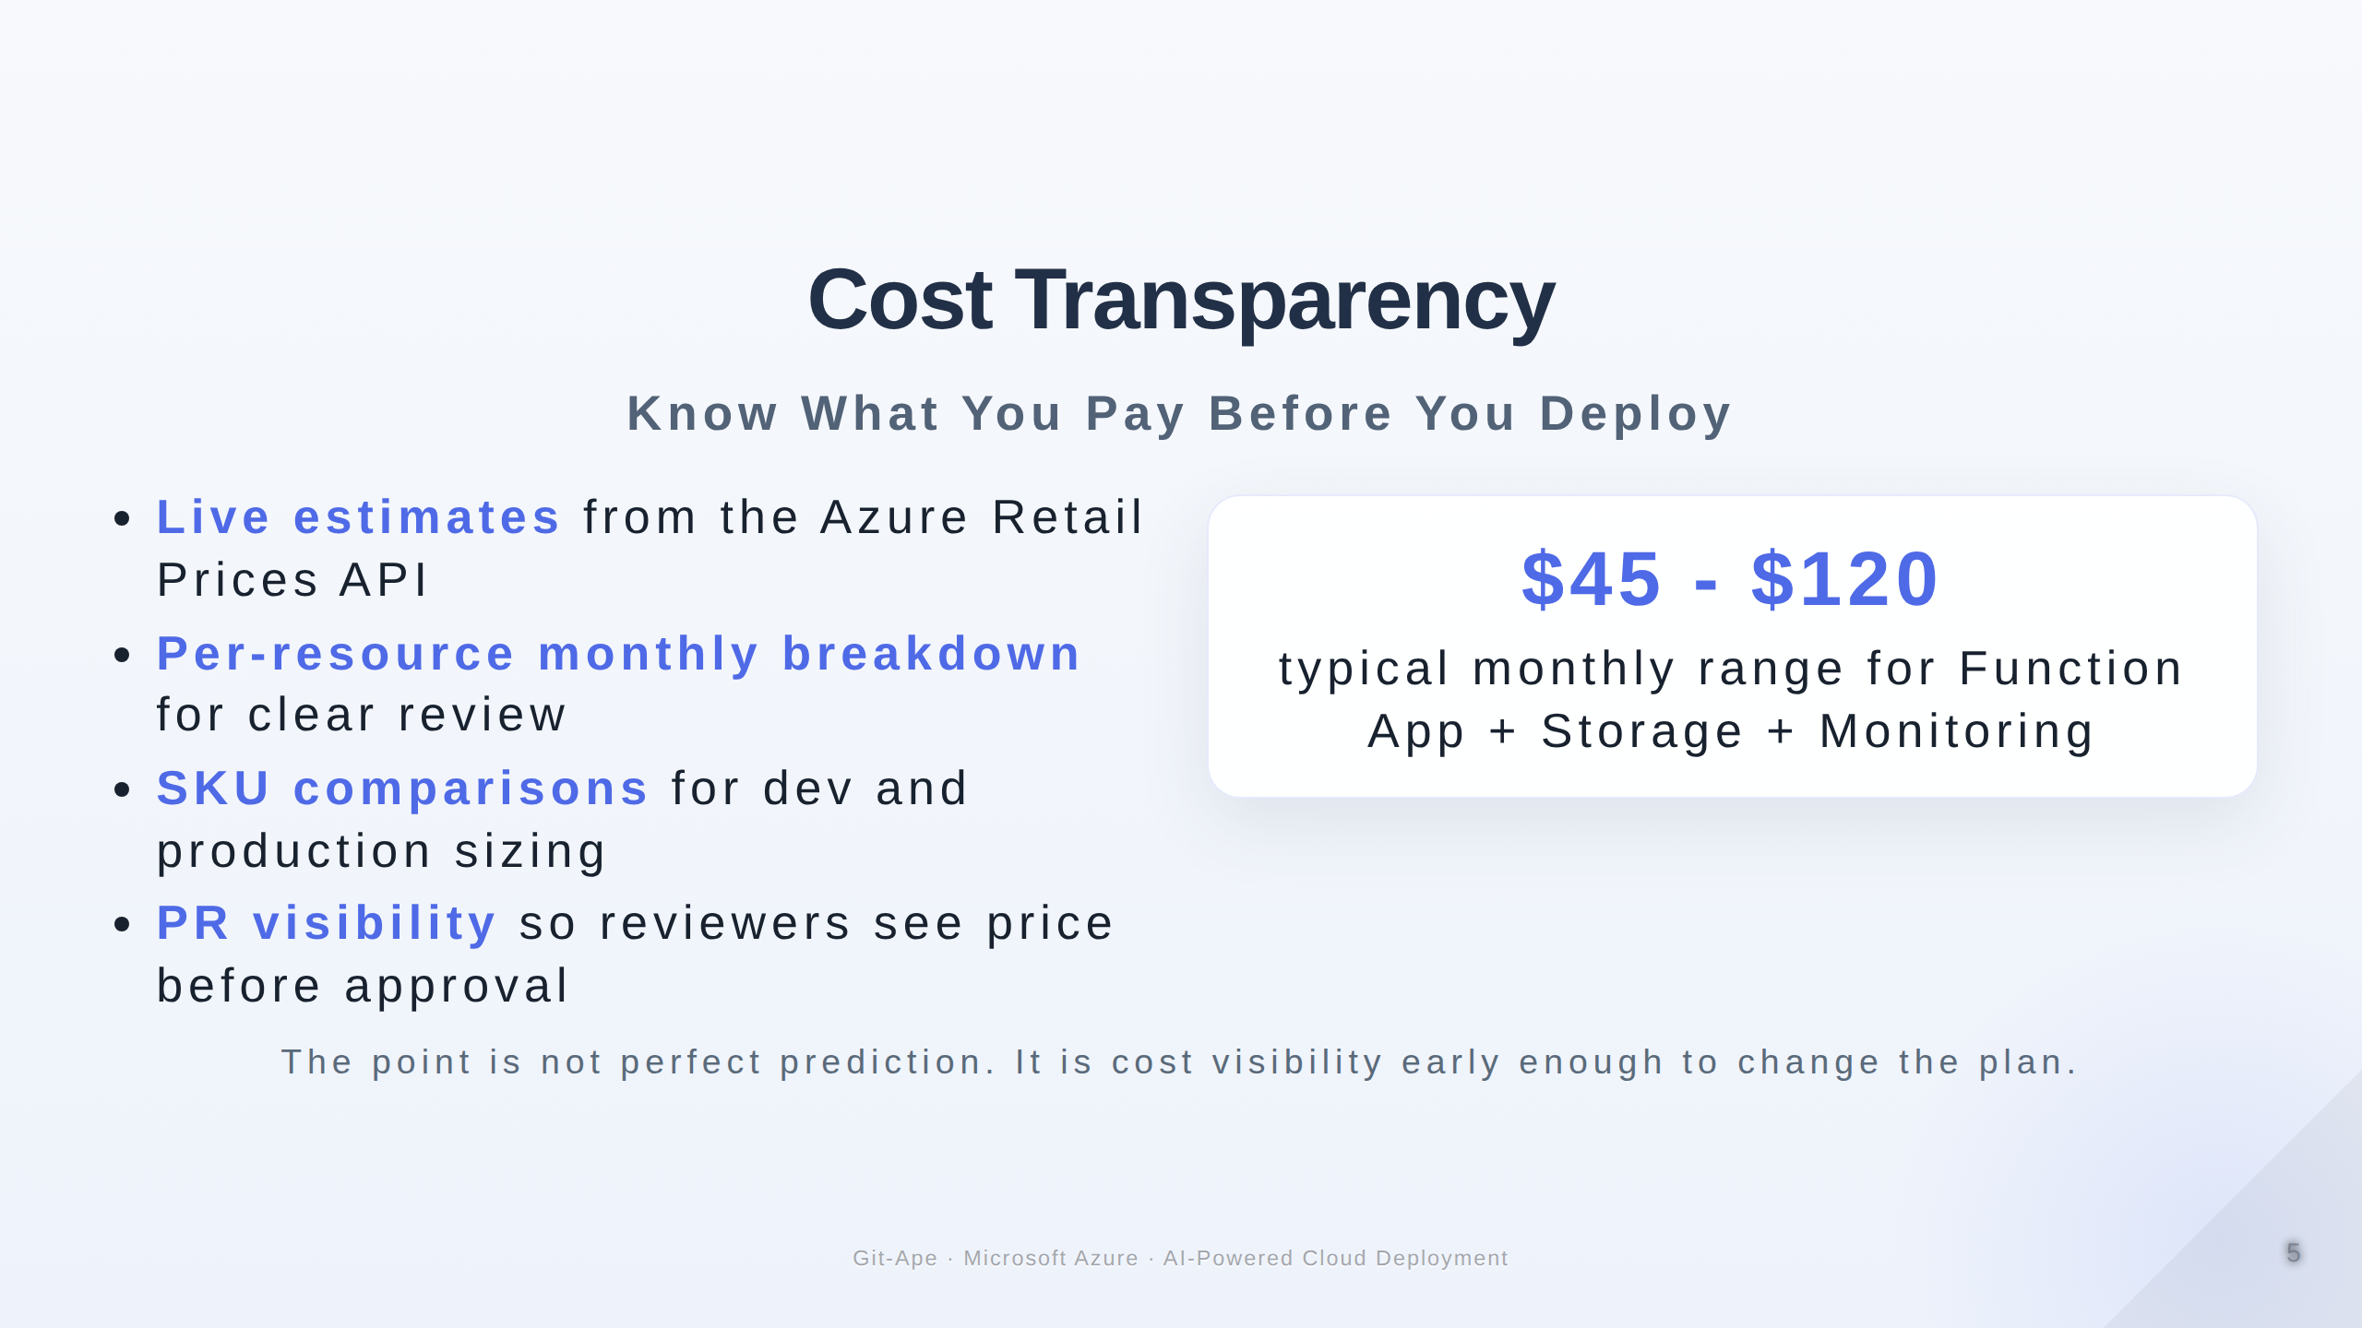

Slide 6
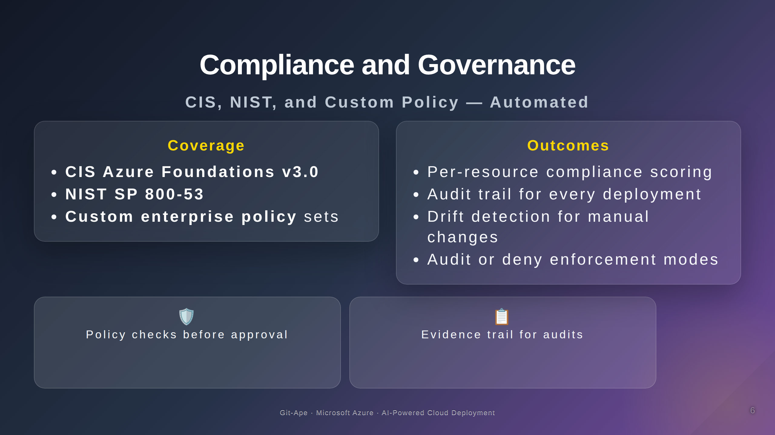

Slide 7
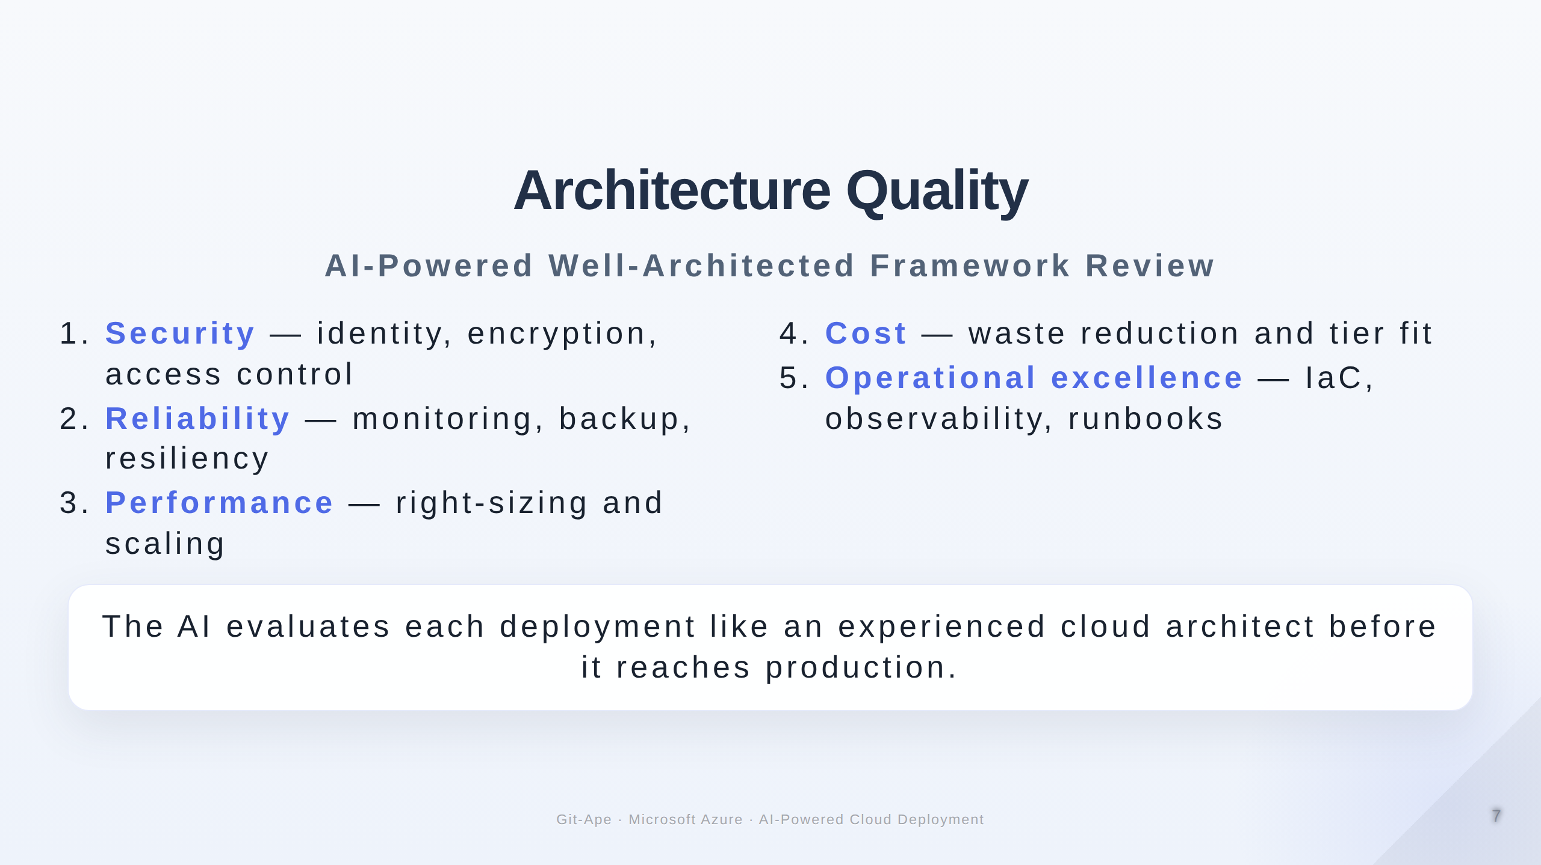

Slide 8
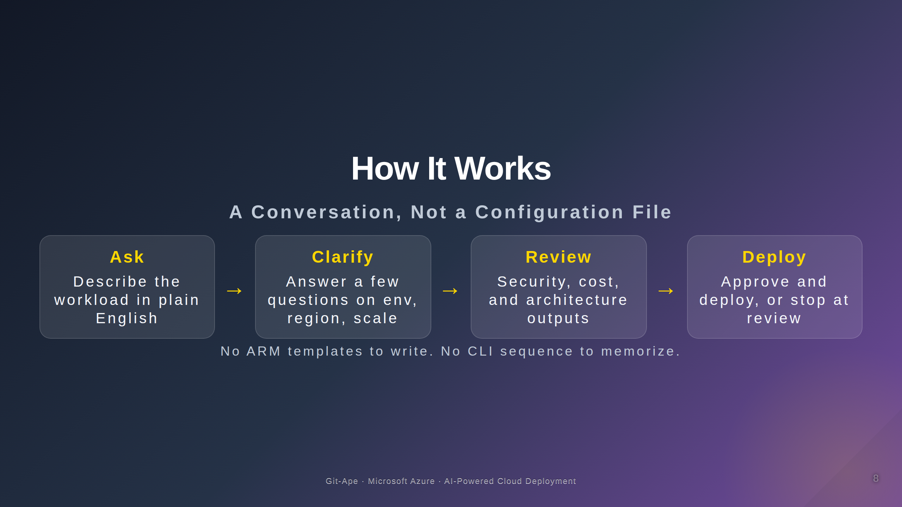

Slide 9
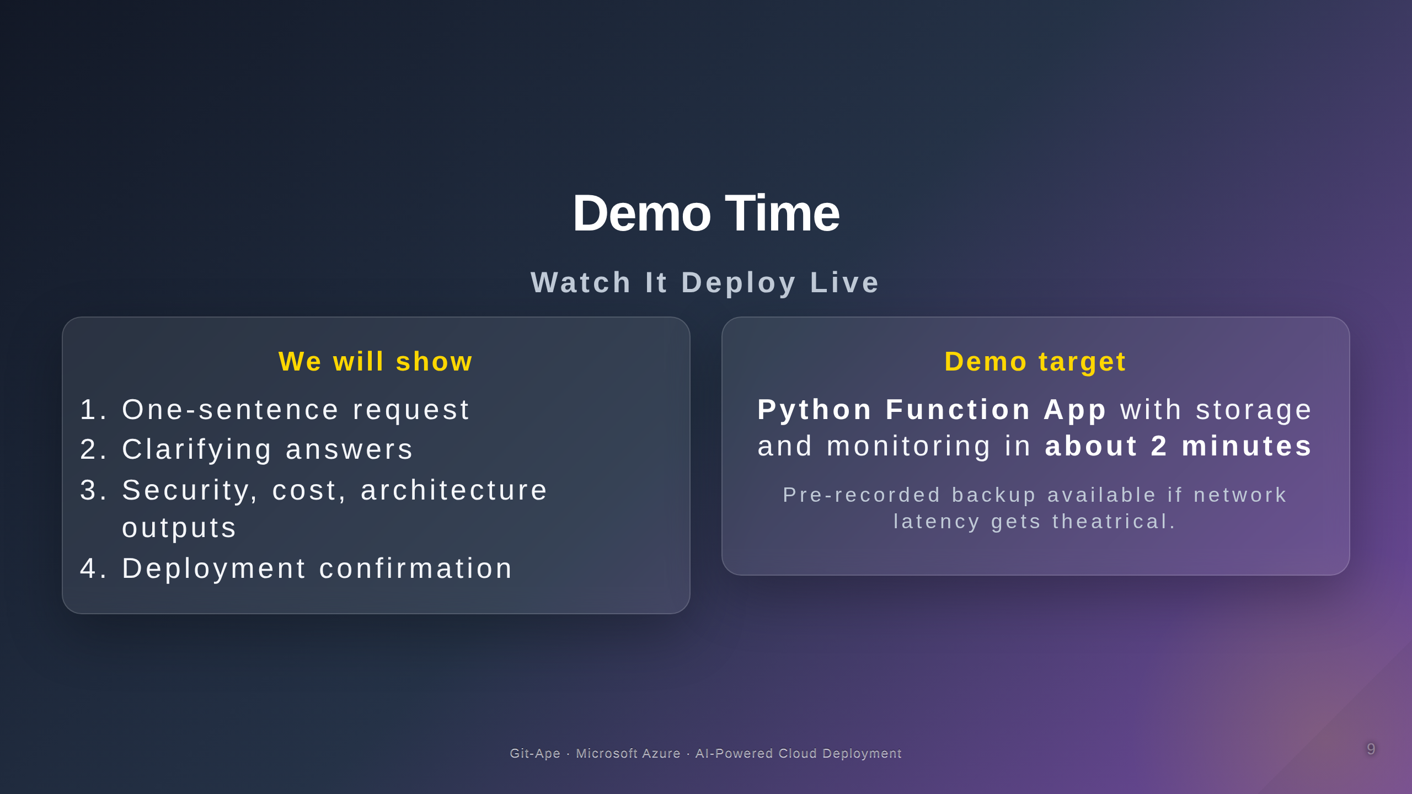

Slide 10
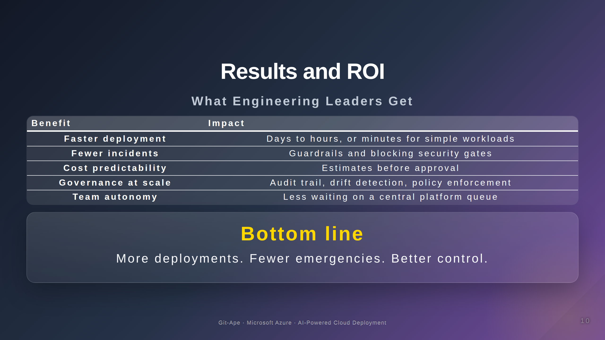

Slide 11

Notes:
Speaker Notes for Slide 1: Title Slide
---
Set the stage. Emphasize this is about solving a real engineering leadership problem.
Say: "In the next 10 minutes, I'll show you how AI can turn infrastructure deployment from a bottleneck into a competitive advantage."
Speaker Notes for Slide 2: The Challenge
---
Pause after each stat. Let the pain sink in.
Internal survey proxy: We can cite IBM, Forrester, or Gartner for 73% if needed.
Shadow IT is often the biggest surprise to executives. They don't realize developers are bypassing governance.
Speaker Notes for Slide 3: What If...
---
This is the "aha" moment. Let silence hang for 2–3 seconds after reading the output.
Say: "What you see here is the result of a single sentence, not hours of engineering work."
Speaker Notes for Slide 4: Security Guardrails
---
This is crucial. Executives are terrified of security incidents. Emphasize:
- "Blocking gate" means the deployment literally cannot proceed if security fails.
- No passwords = no breach surface. Managed identities eliminate the #1 attack vector.
- OIDC federated = GitHub Actions can deploy without storing Azure credentials in secrets.
Speaker Notes for Slide 5: Cost Transparency
---
Say: "Developers see the cost before they deploy, not after it appears on the bill."
This addresses CFO concerns about runaway cloud spend.
Speaker Notes for Slide 6: Compliance and Governance
---
For heavily regulated industries (finance, healthcare, government): This is the slide they care about most.
Drift detection is underrated. It catches the developer who SSHes into a VM and changes config manually.
Audit trail = compliance audit evidence.
Speaker Notes for Slide 7: WAF Review
---
Briefly touch the 5 pillars. Don't dwell unless audience asks.
Say: "The AI evaluates every deployment like a seasoned architect would."
Speaker Notes for Slide 8: How It Works
---
Demystify the process. Emphasize it's a conversation, not a form.
Say: "This is what makes it different from traditional IaC tools. You don't need to know Bicep, Terraform, or ARM template syntax."
Speaker Notes for Slide 9: Demo
---
If live demo:
- Ensure font size is large (Ctrl+= three times).
- Have terminal and Copilot Chat visible.
- Type slowly so audience can read.
- Highlight the three outputs: architecture diagram, security analysis, cost estimate.
If pre-recorded backup:
- Play video.
- Pause at key moments (security gate, cost, architecture).
- Talk through what you're seeing.
Key moments to narrate during demo:
- "One sentence" — emphasize the input is minimal.
- "It asks clarifying questions" — show how it's a conversation.
- "Architecture diagram" — this is auto-generated, not hand-drawn.
- "Security gate PASSED" — this is the most important part.
- "Cost estimate" — executives care about this.
Speaker Notes for Slide 10: ROI
---
Wrap up with business outcomes.
Say: "This isn't just about speed. It's about safety, predictability, and giving your engineering team superpowers."
End with a call to action: "Questions?" or "Let me show you how to get started."

