Slide 1
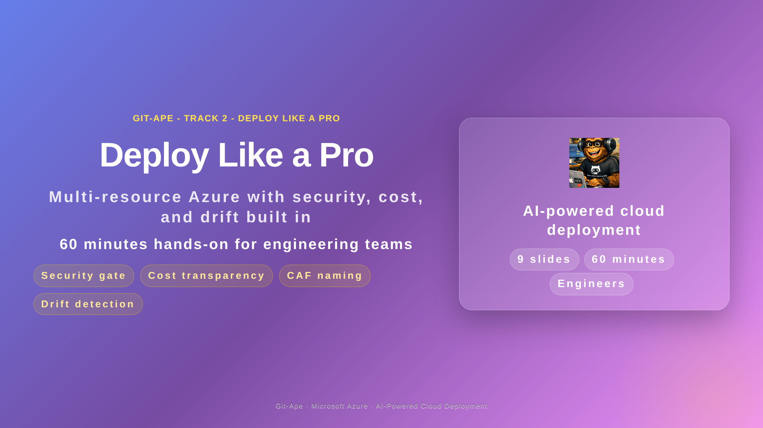
Notes:
Speaker notes (Slide 1 - Hero). Track 2 is for engineers and developers ready to deploy multi-resource architectures. This 60-minute session covers the agent architecture, the blocking security gate, CAF naming, real-pricing cost estimates, drift detection, and finishes with a hands-on lab that deploys a Web App with a SQL Database, Key Vault, and Application Insights. Prerequisites: a sandbox Azure subscription and completed onboarding (OIDC plus RBAC).

Slide 2
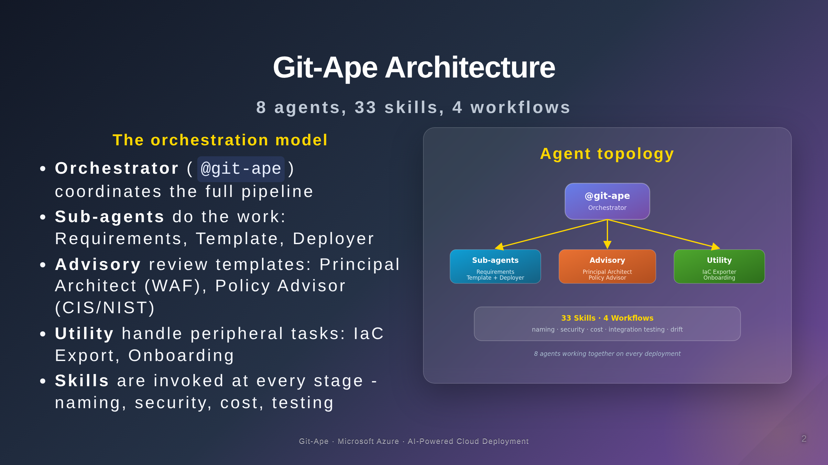
Notes:
Speaker notes (Slide 2 - Architecture). Git-Ape is not one model with one prompt. It is an orchestrated system of eight specialised agents. The orchestrator at the top coordinates the pipeline. Sub-agents do the heavy lifting (Requirements Gatherer, Template Generator, Resource Deployer). Advisory agents review templates (Principal Architect for the Well-Architected Framework, Policy Advisor for CIS and NIST). Utility agents handle peripheral tasks like IaC export and onboarding. Each agent invokes one or more of the 33 skills at the right moment of the pipeline. Emphasise that this is what makes Git-Ape produce trustworthy templates rather than plausible-looking ones.

Slide 3
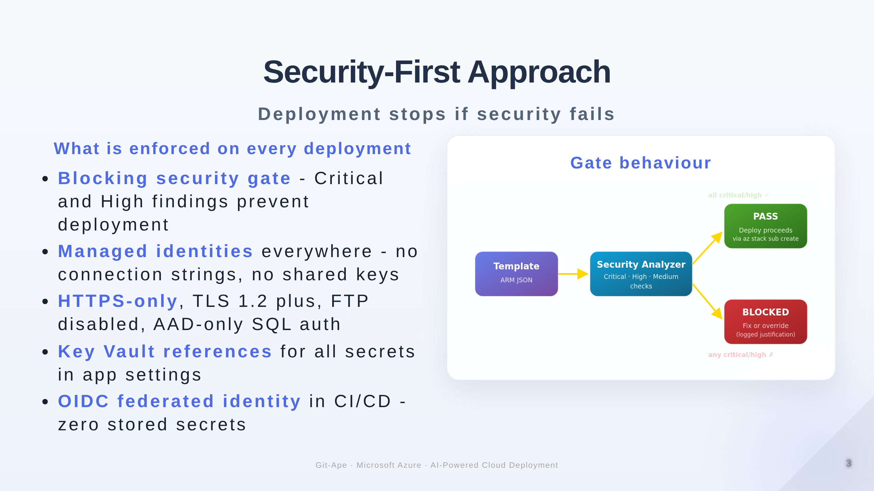
Notes:
Speaker notes (Slide 3 - Security gate). This is the slide that wins enterprise audiences. The security gate is BLOCKING - deployment literally cannot proceed if any Critical or High finding is unresolved. Every deployment ships with managed identities everywhere, HTTPS-only, TLS 1.2 minimum, FTP disabled, AAD-only SQL auth, and Key Vault references for every secret. In CI/CD, OIDC federated identity removes stored secrets entirely. The gate can be overridden but only with an explicit 'I accept the security risk' statement which is logged for audit.

Slide 4
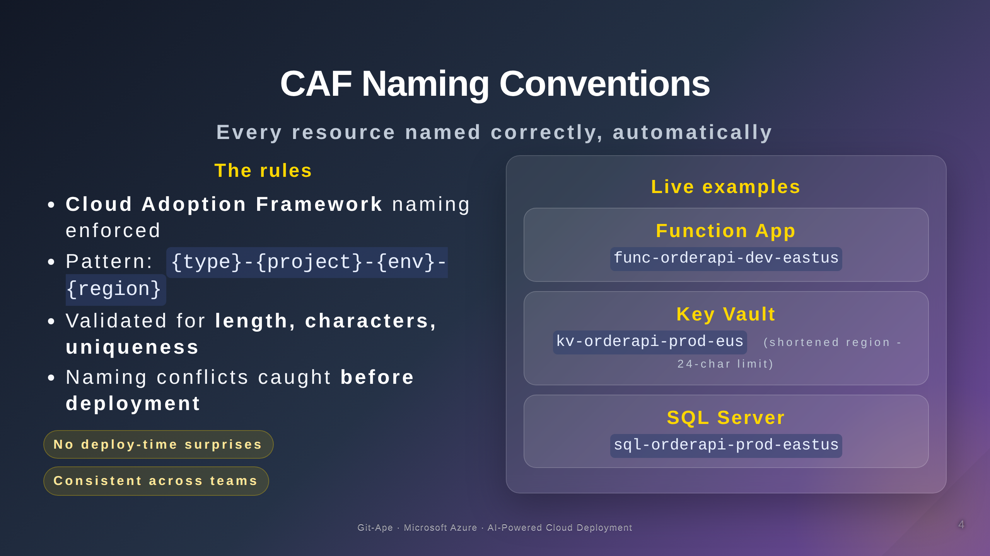
Notes:
Speaker notes (Slide 4 - CAF naming). Cloud Adoption Framework naming conventions are enforced automatically. The pattern is type abbreviation, then project, then environment, then region. Git-Ape validates names against length limits, allowed character sets, and uniqueness scope BEFORE you ever try to deploy. Naming conflicts surface during planning, not during the deployment failure at minute fifteen. This eliminates an entire category of preventable errors.

Slide 5
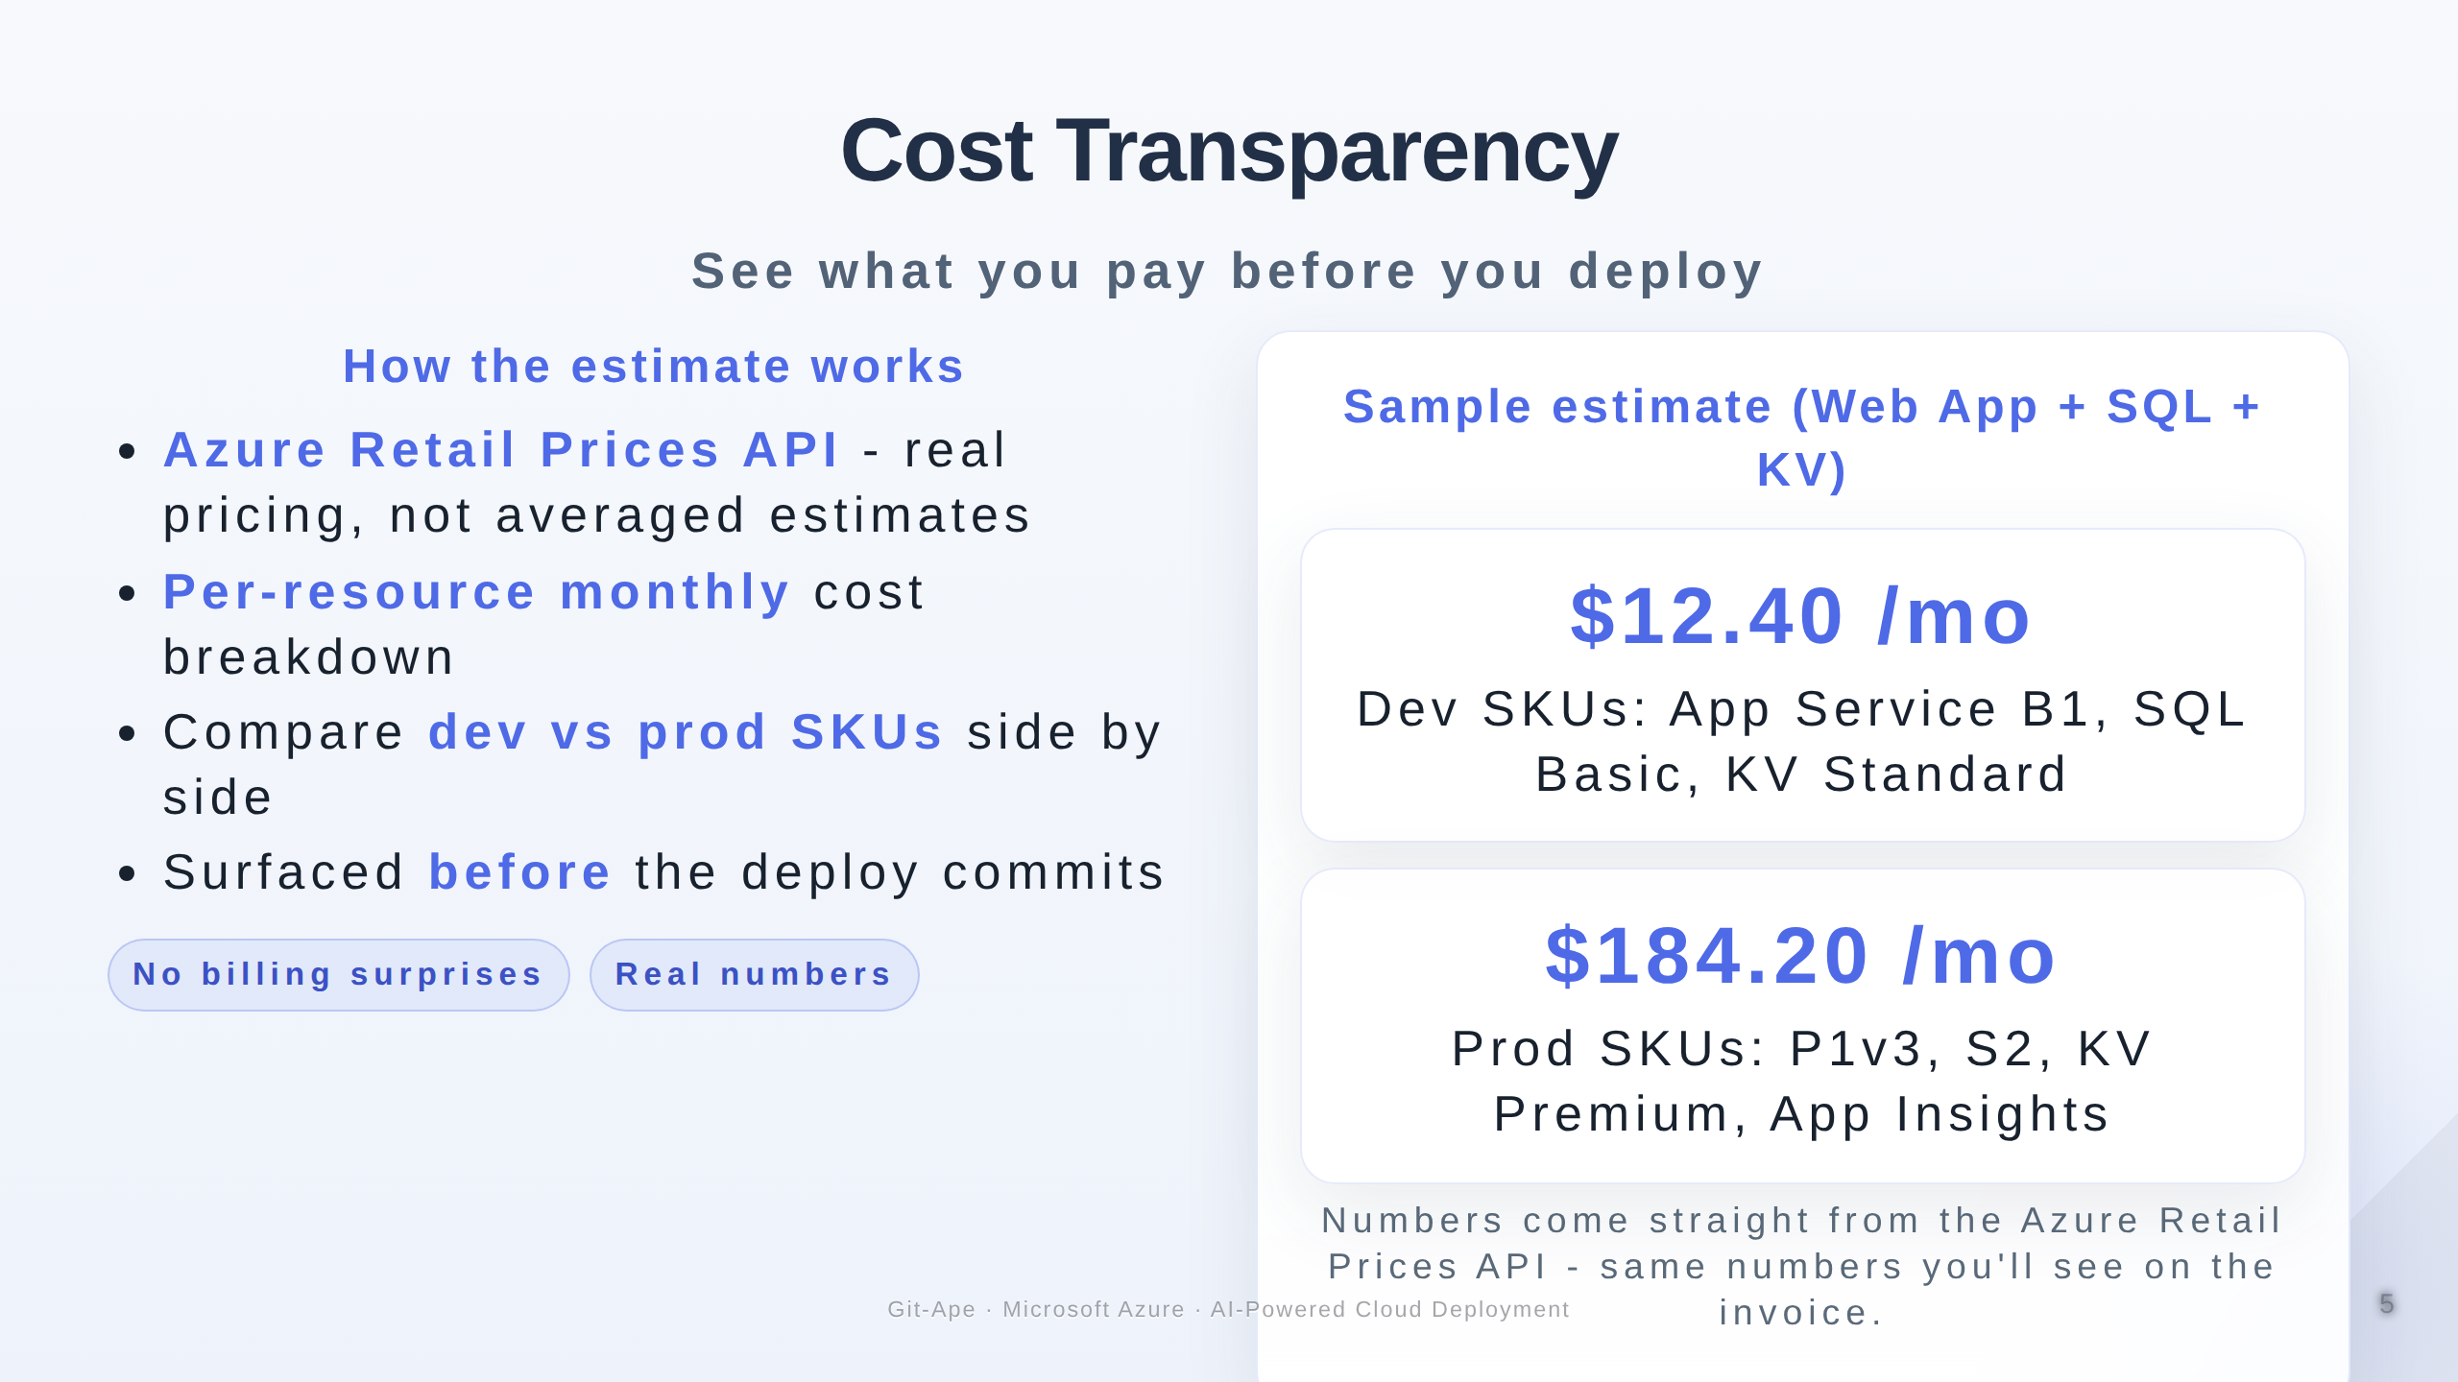
Notes:
Speaker notes (Slide 5 - Cost transparency). The cost estimate uses the Azure Retail Prices API directly, so the numbers you see are the numbers you will be billed. This is not an averaged estimate. Per-resource monthly costs are broken down so you can identify which choices are expensive. The same template deployed at the dev SKU costs cents per month; at the production SKU it costs dollars. Engineers can model these trade-offs before any deployment occurs.

Slide 6
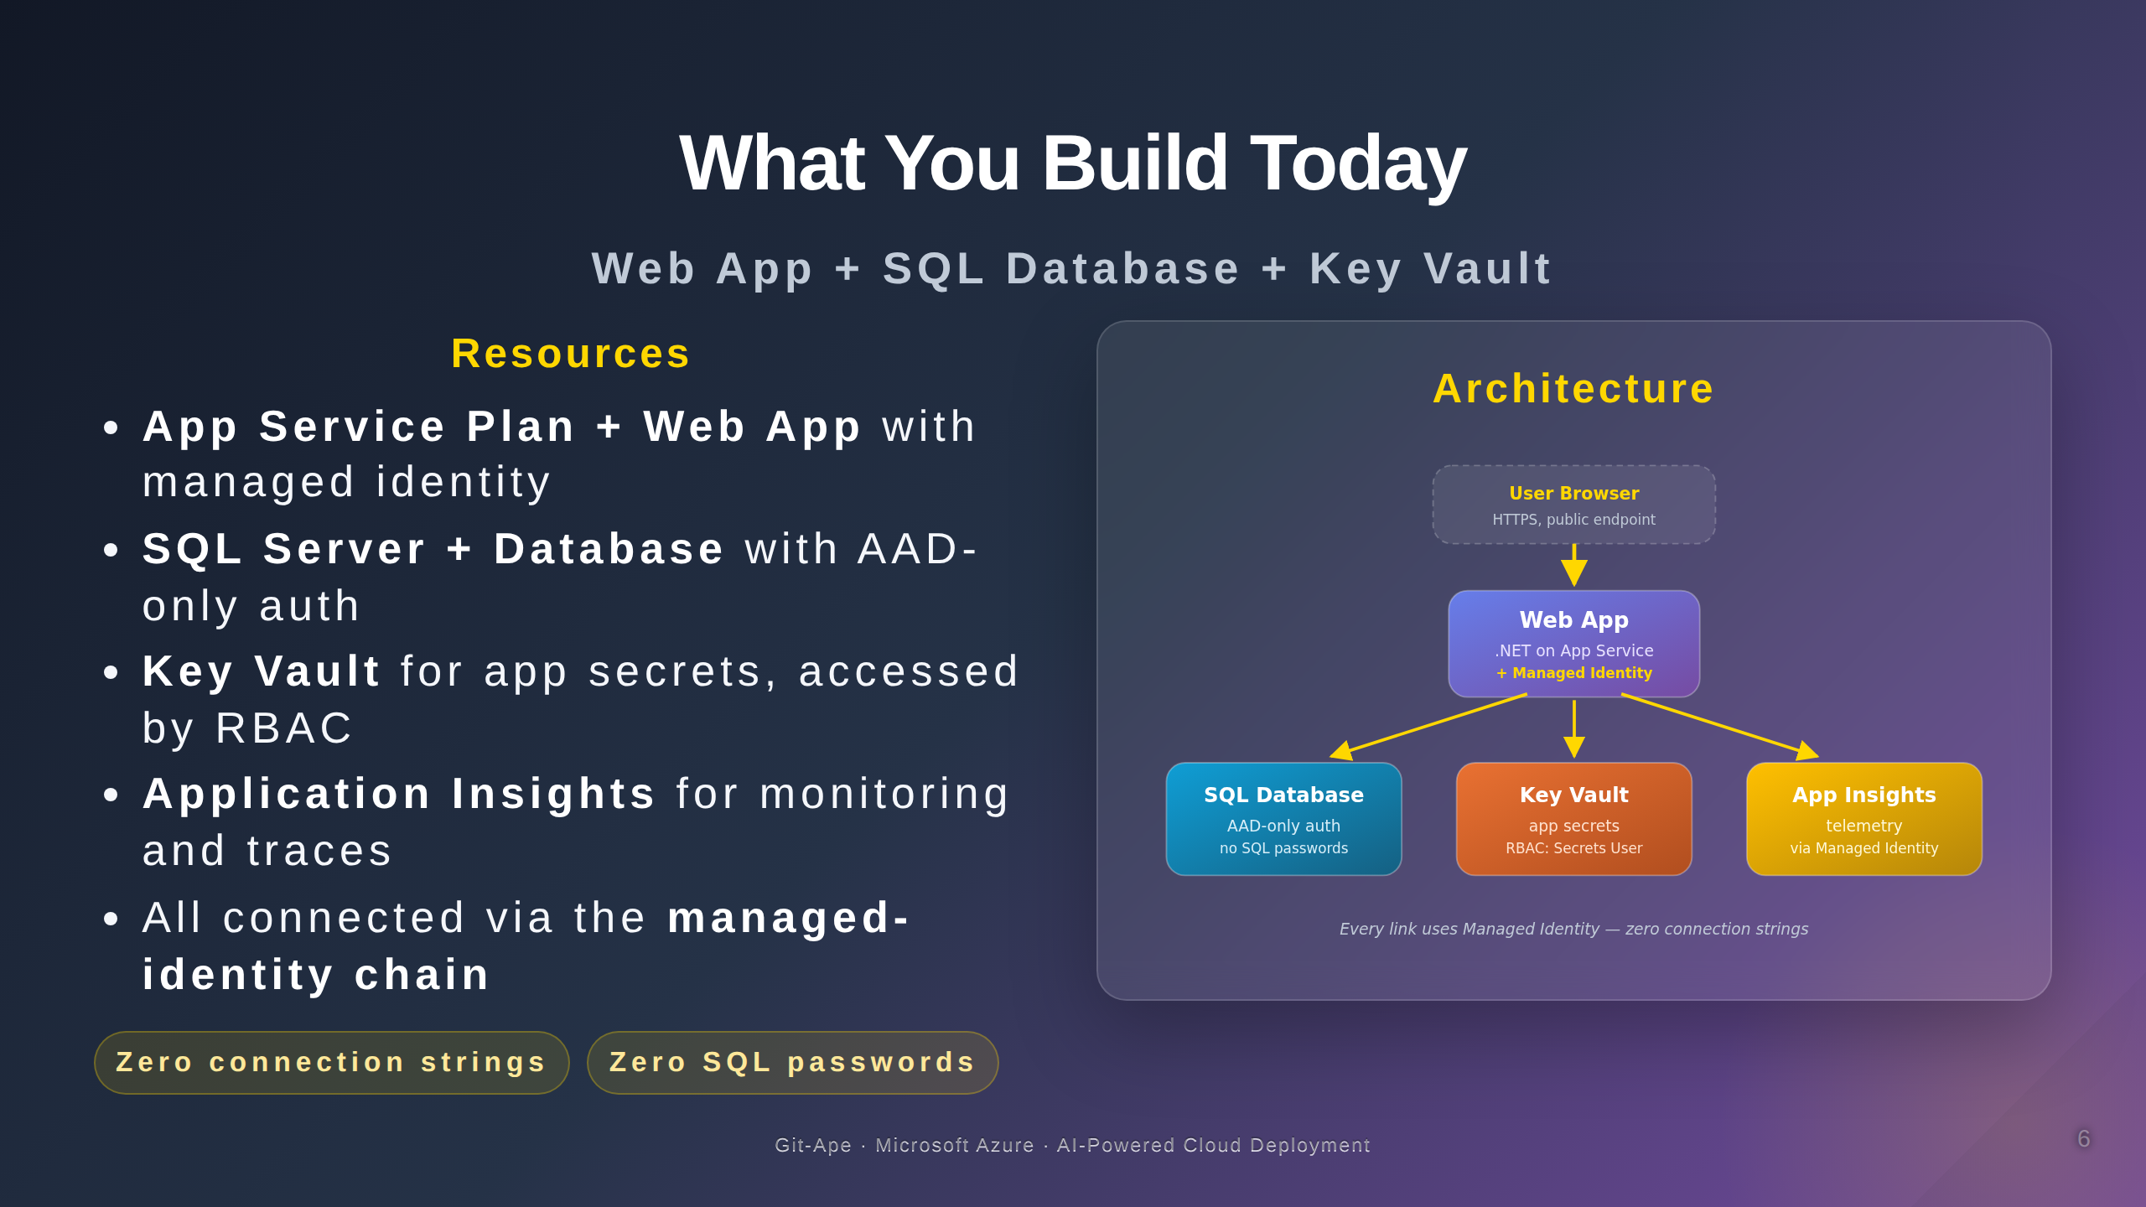
Notes:
Speaker notes (Slide 6 - What you build today). The lab today deploys a four-resource architecture: an App Service Plan and Web App, a SQL Server and Database with AAD-only authentication, a Key Vault for app secrets, and Application Insights for monitoring. Every connection between resources uses managed identity. There is no connection string in app settings, no SQL password anywhere. This is the secure default Git-Ape produces every time.

Slide 7
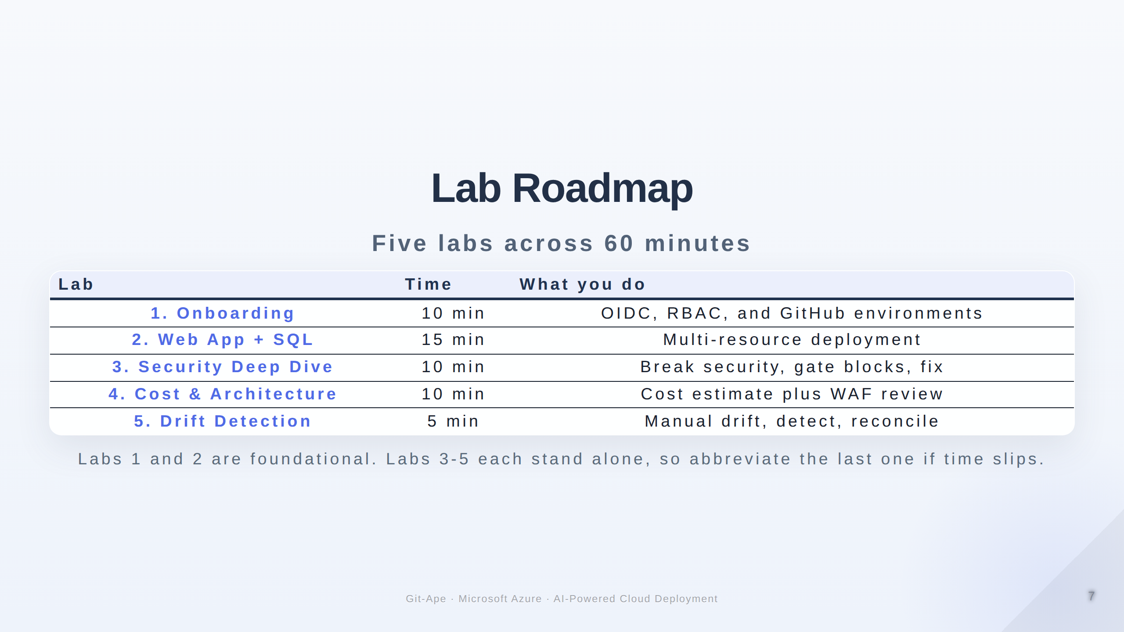
Notes:
Speaker notes (Slide 7 - Lab roadmap). Five labs across sixty minutes. Lab 1 is onboarding - OIDC plus RBAC plus GitHub environments - this is the foundation everything else builds on. Lab 2 is the main deployment - Web App with SQL. Lab 3 is the breaking-change exercise where you intentionally violate security and watch the gate block deployment. Lab 4 covers cost estimation and the WAF architecture review. Lab 5 demonstrates drift detection: change something manually in Azure, then watch Git-Ape find it. Pacing: Labs 1 and 2 are critical; if running short on time, abbreviate Lab 5.

Slide 8
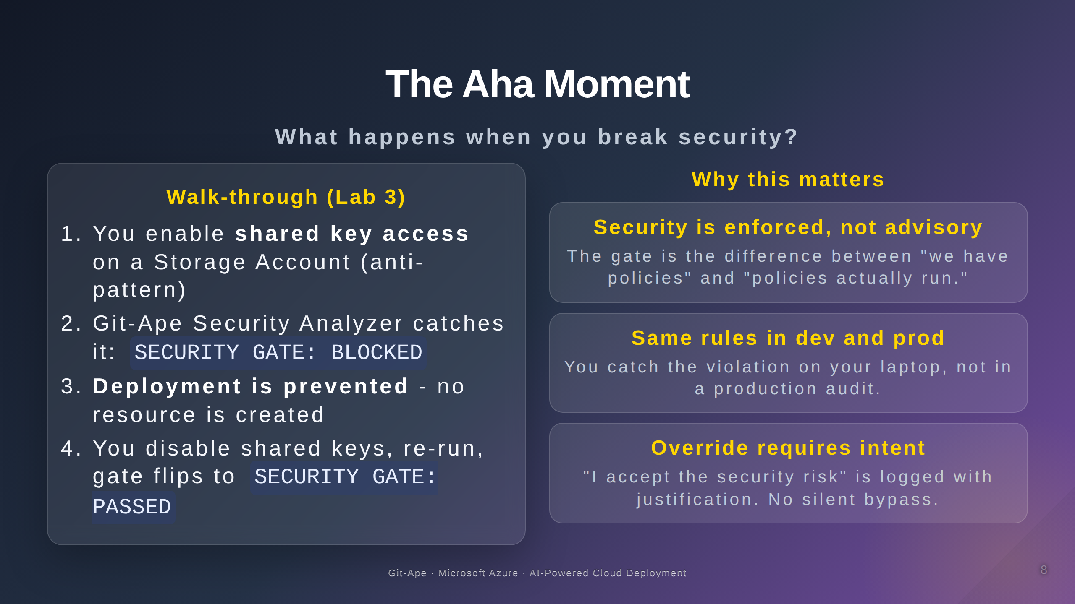
Notes:
Speaker notes (Slide 8 - Aha moment Lab 3). This is the most impactful lab in the track. Engineers see that security is not a report - it is an enforcement mechanism. Walk through the four steps: enable shared key access on a storage account (a common anti-pattern), watch the analyzer surface the finding, see the gate block deployment, then disable shared keys and rerun. The gate flips from blocked to passed. The lesson: security guardrails are real, not advisory.

Slide 9
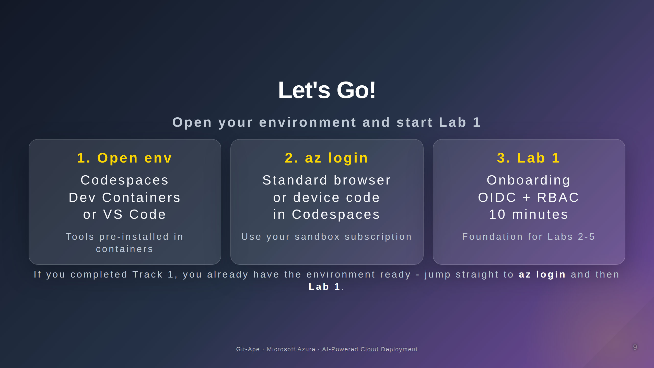
Notes:
Speaker notes (Slide 9 - Let's Go). Three steps to get started. Open your development environment, sign in to Azure, and start with Lab 1. Codespaces and Dev Containers ship with all the prerequisites; local VS Code users should have run prereq-check ahead of time. Allow two to three minutes for environment startup.

