Slide 1
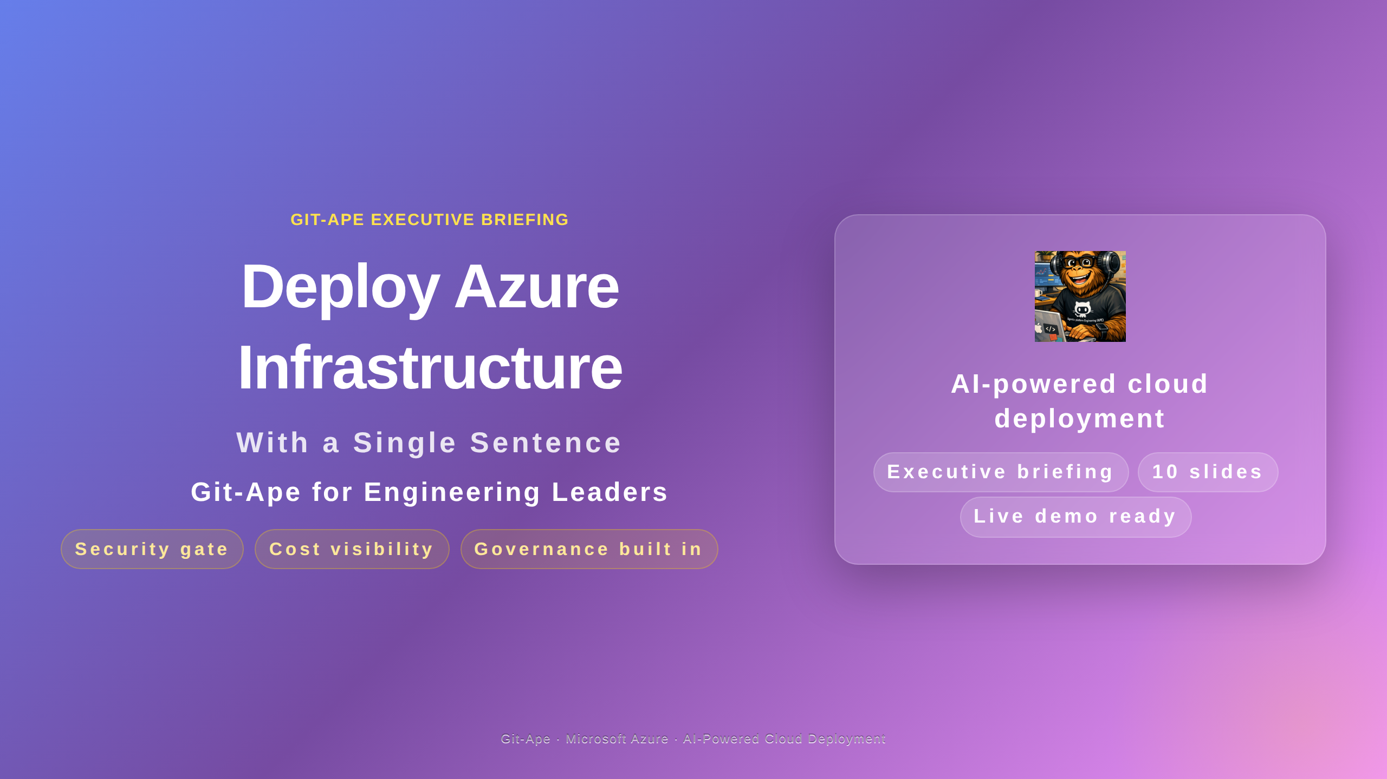

Slide 2
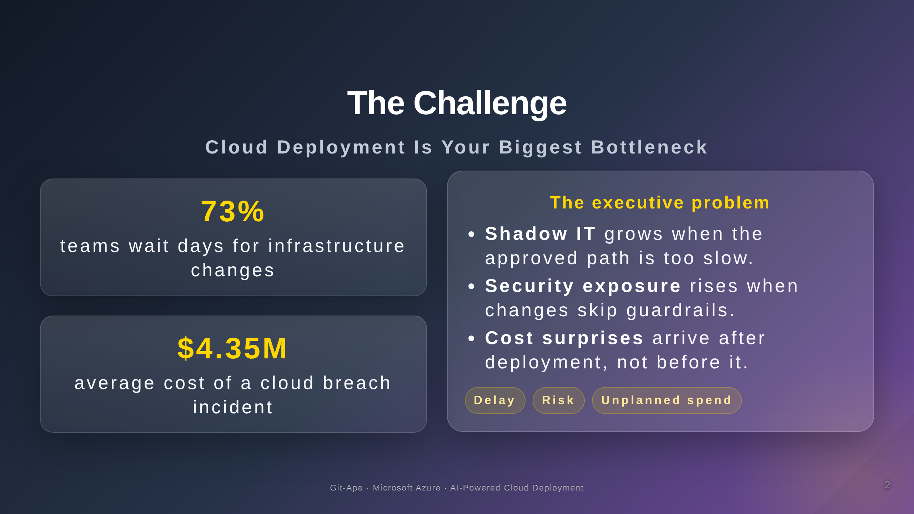

Slide 3
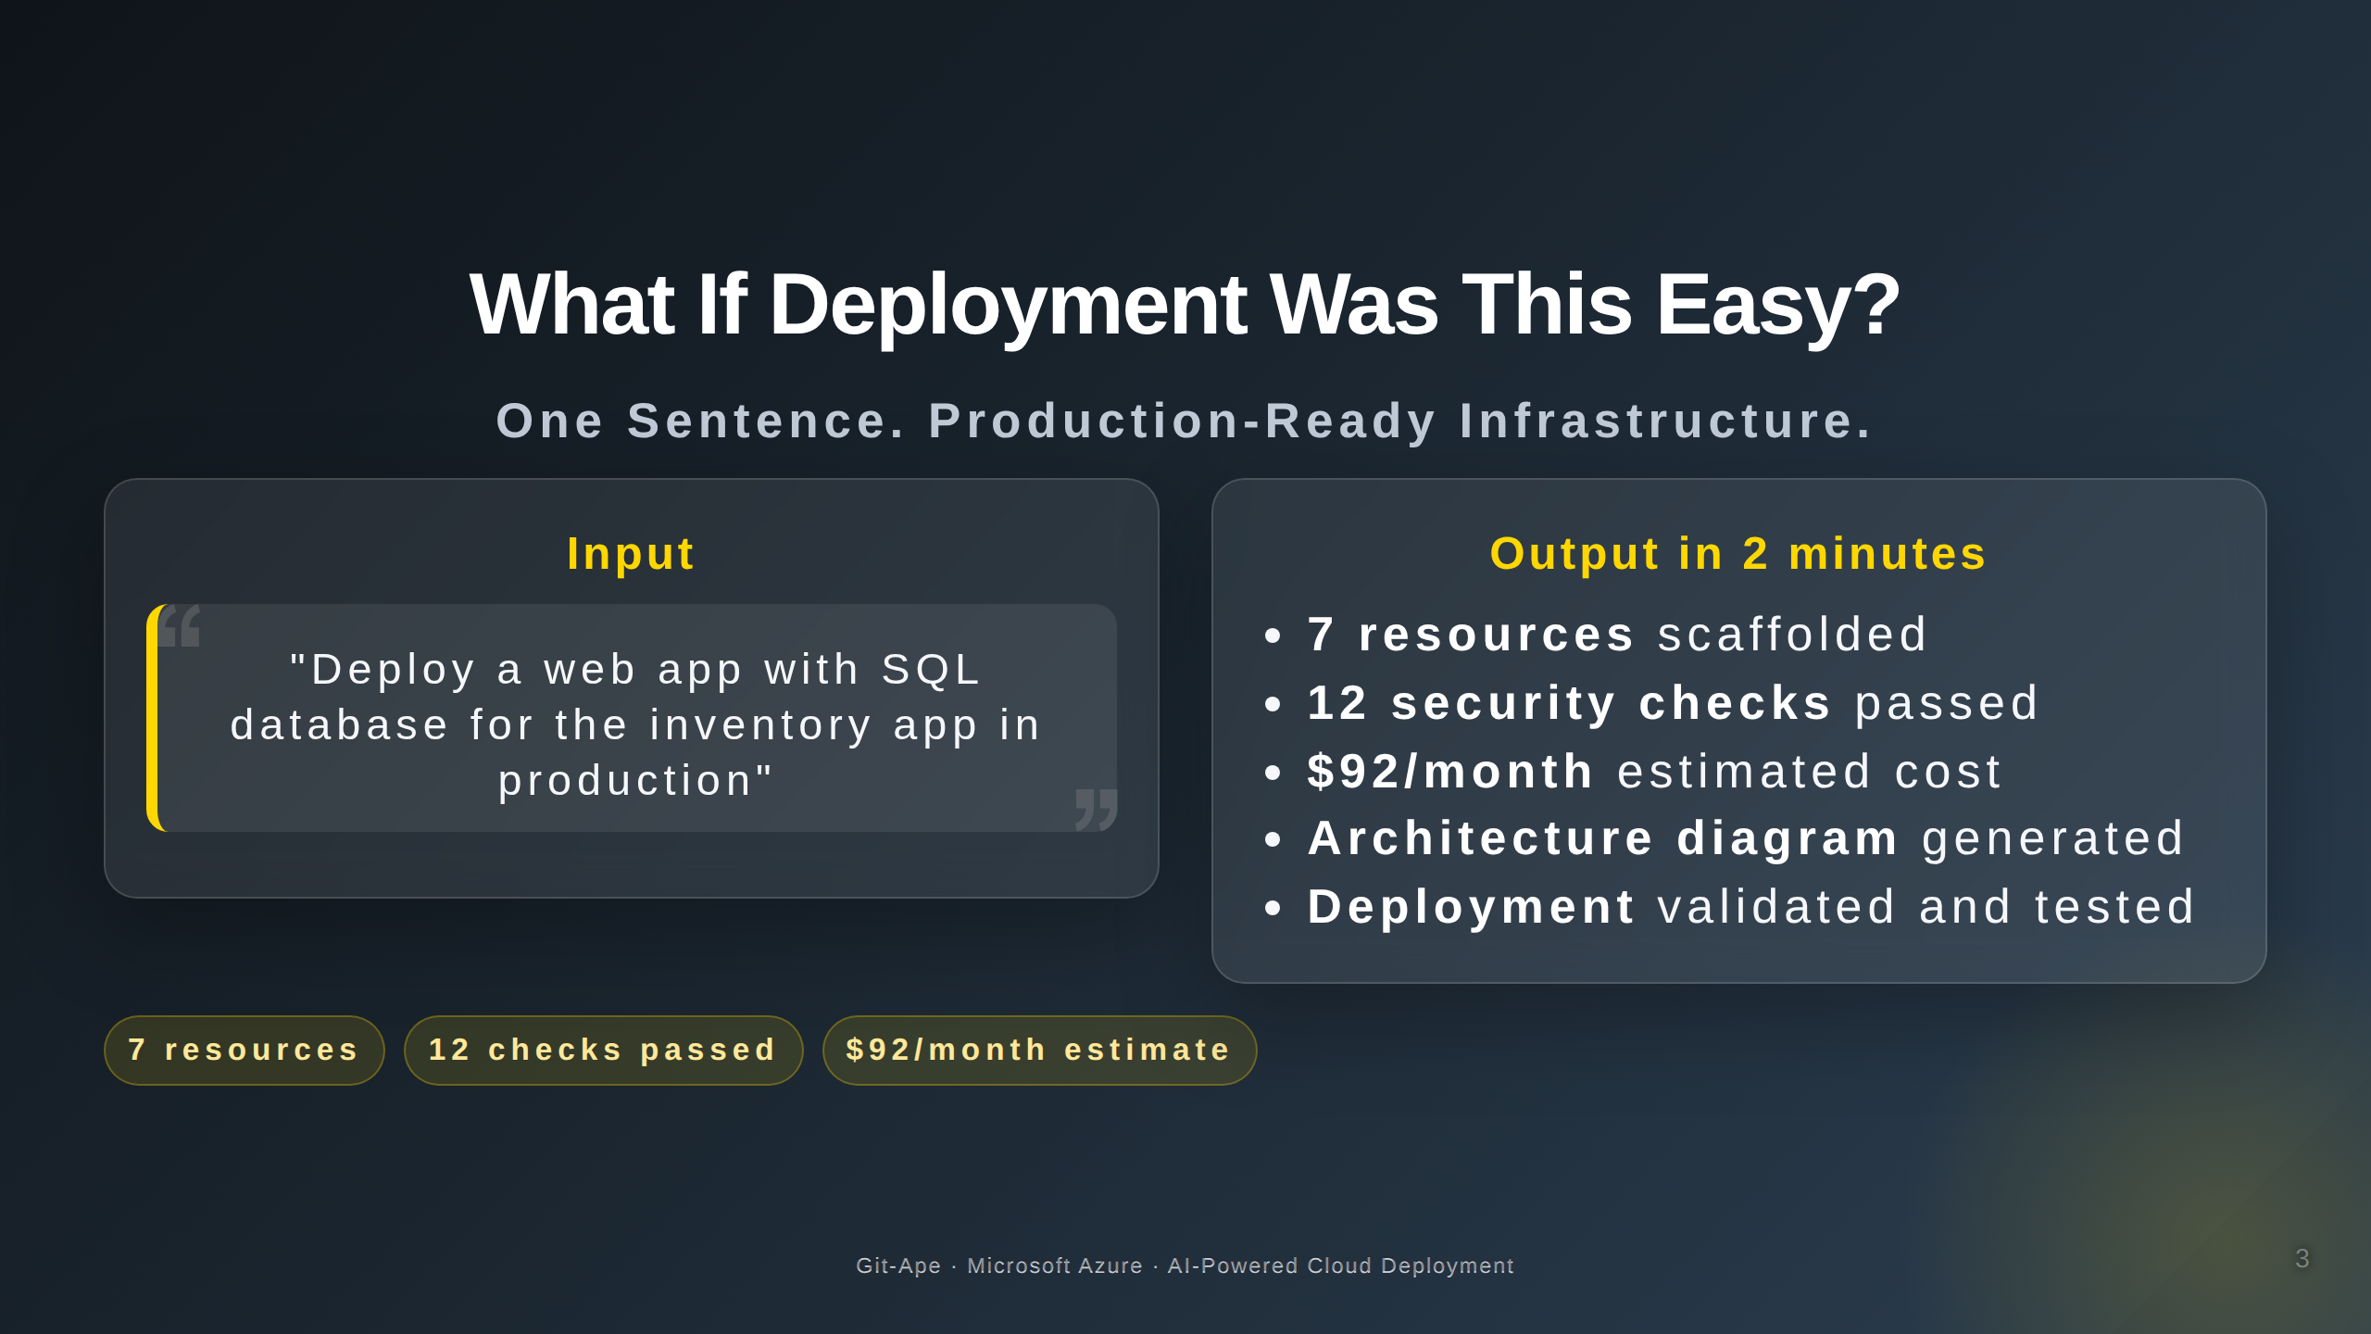

Slide 4
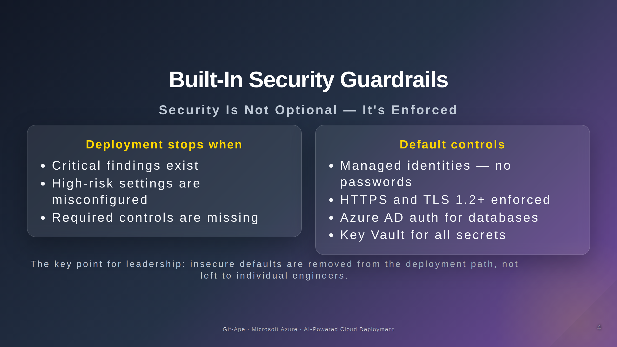

Slide 5
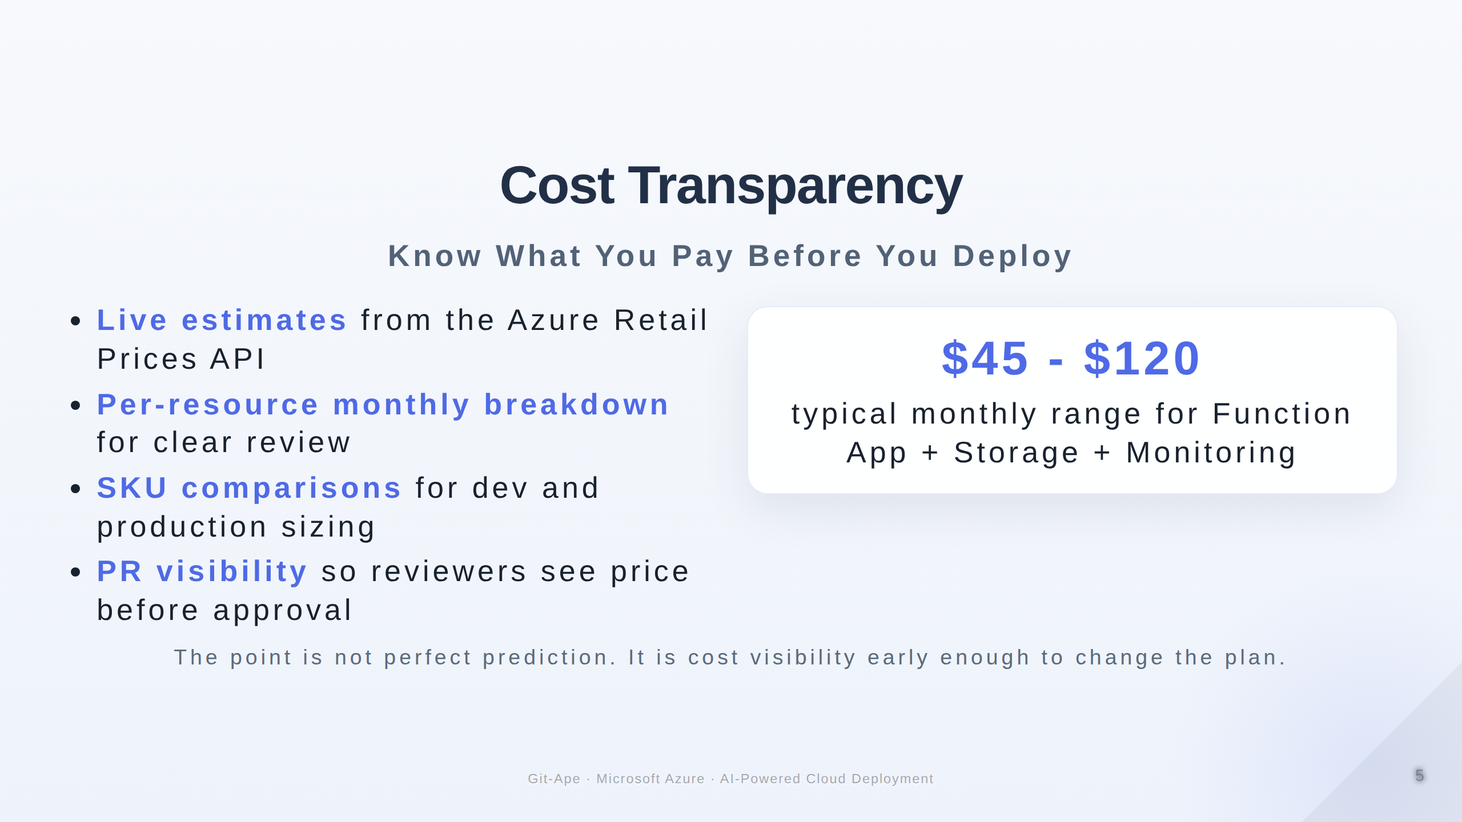

Slide 6
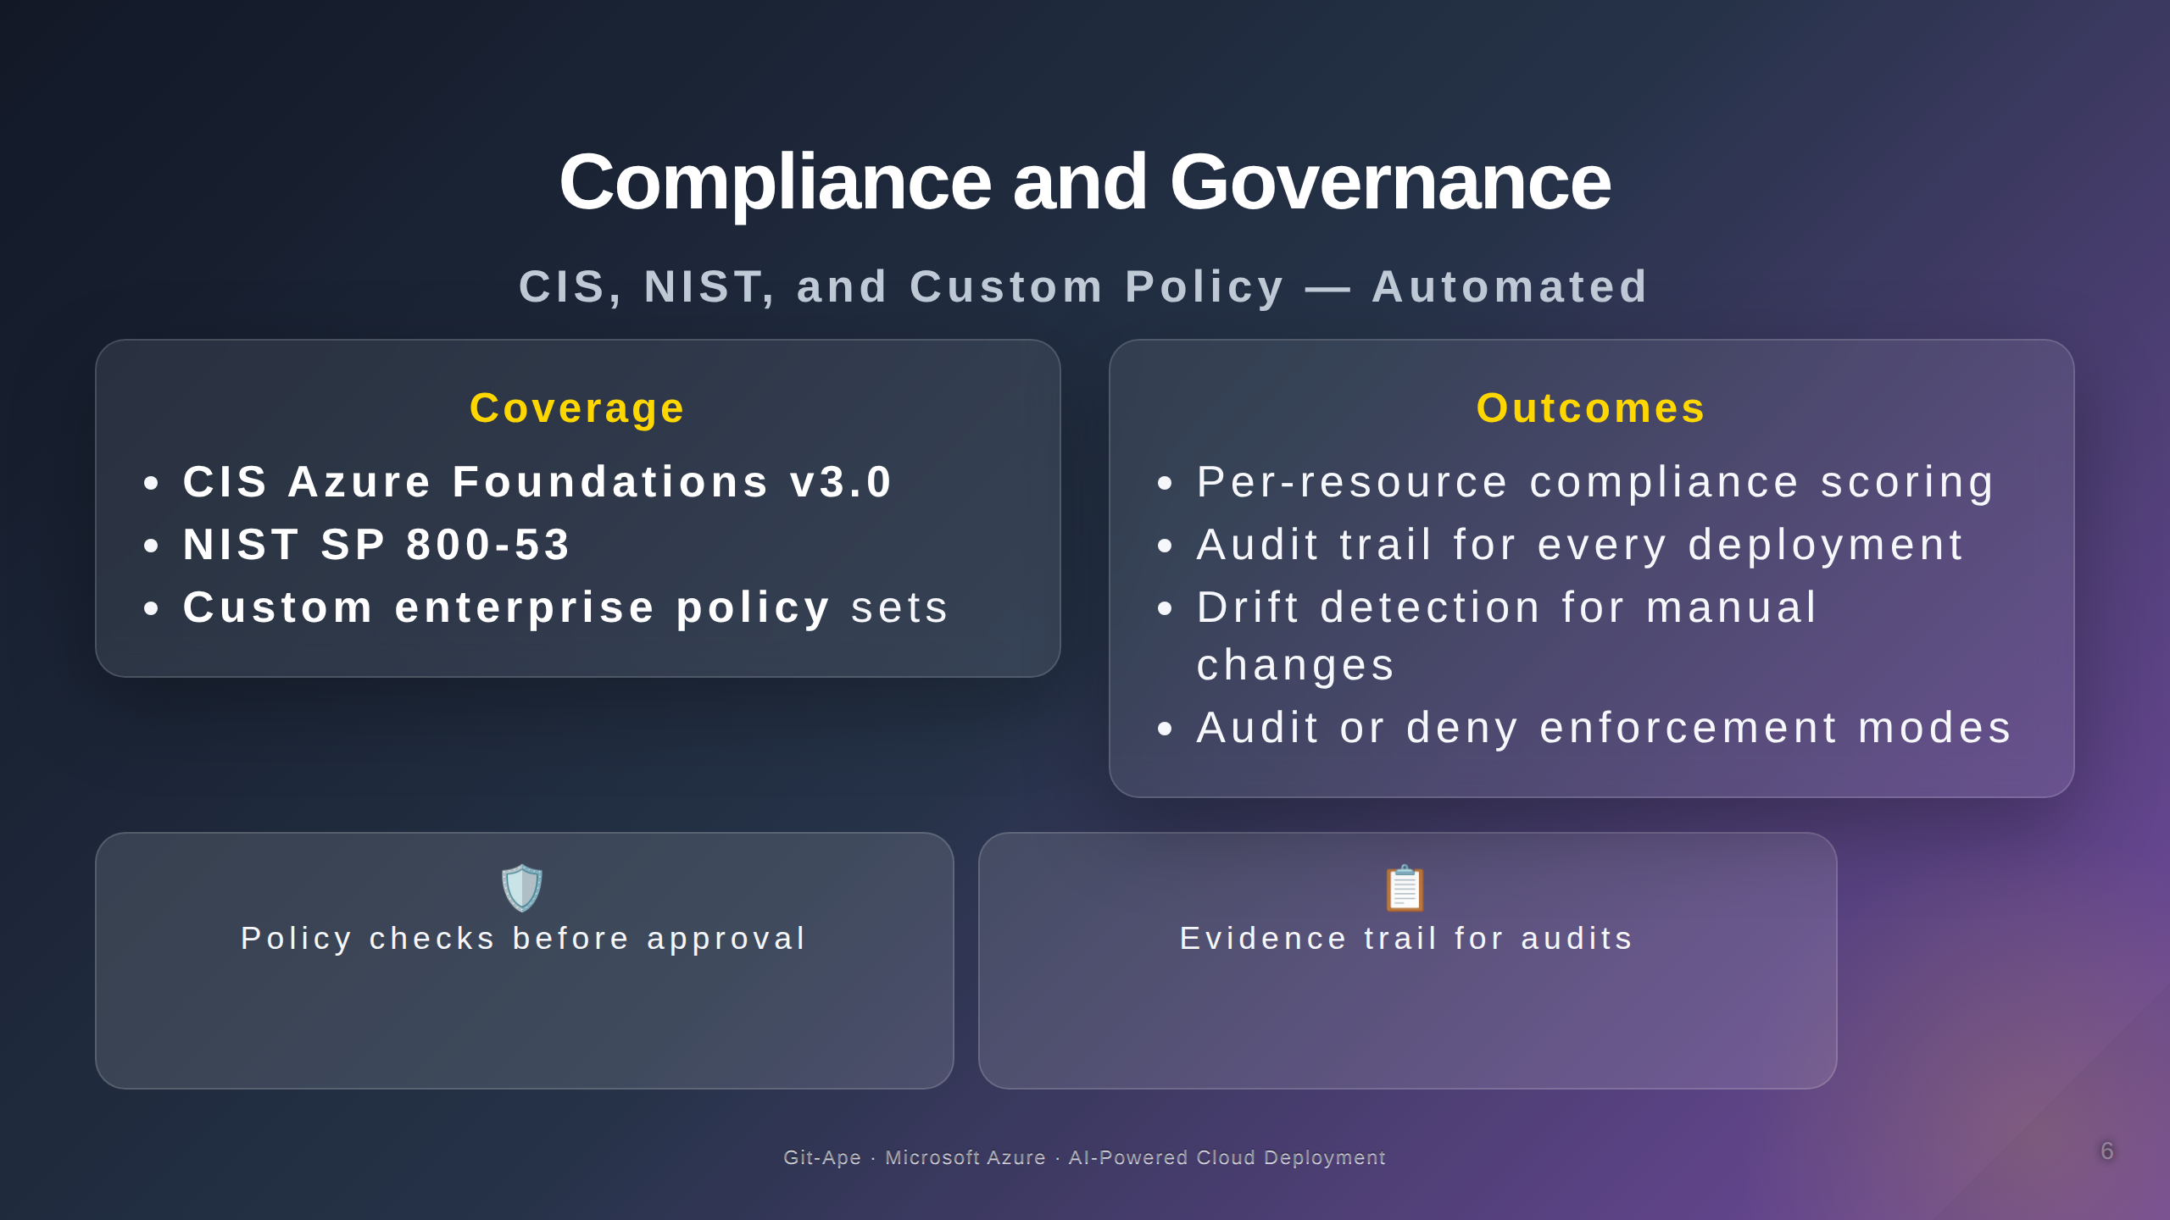

Slide 7
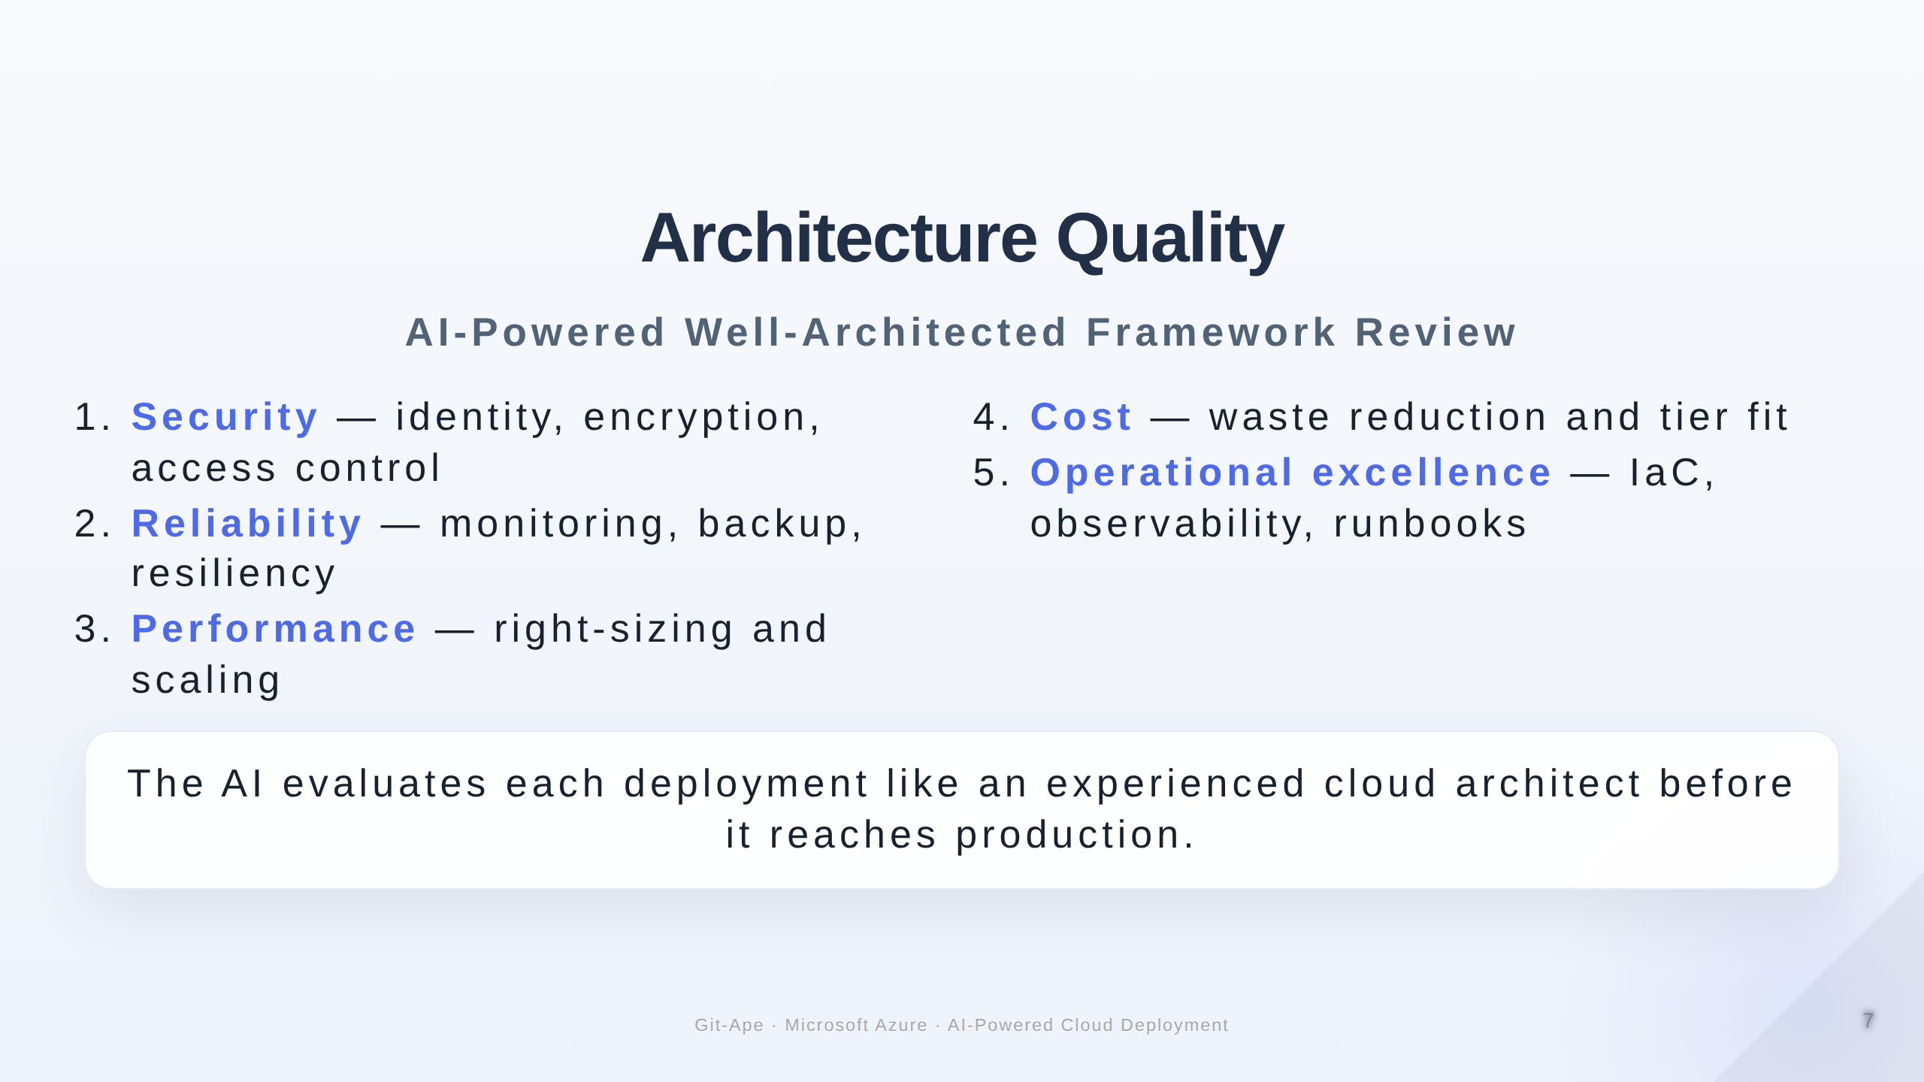

Slide 8
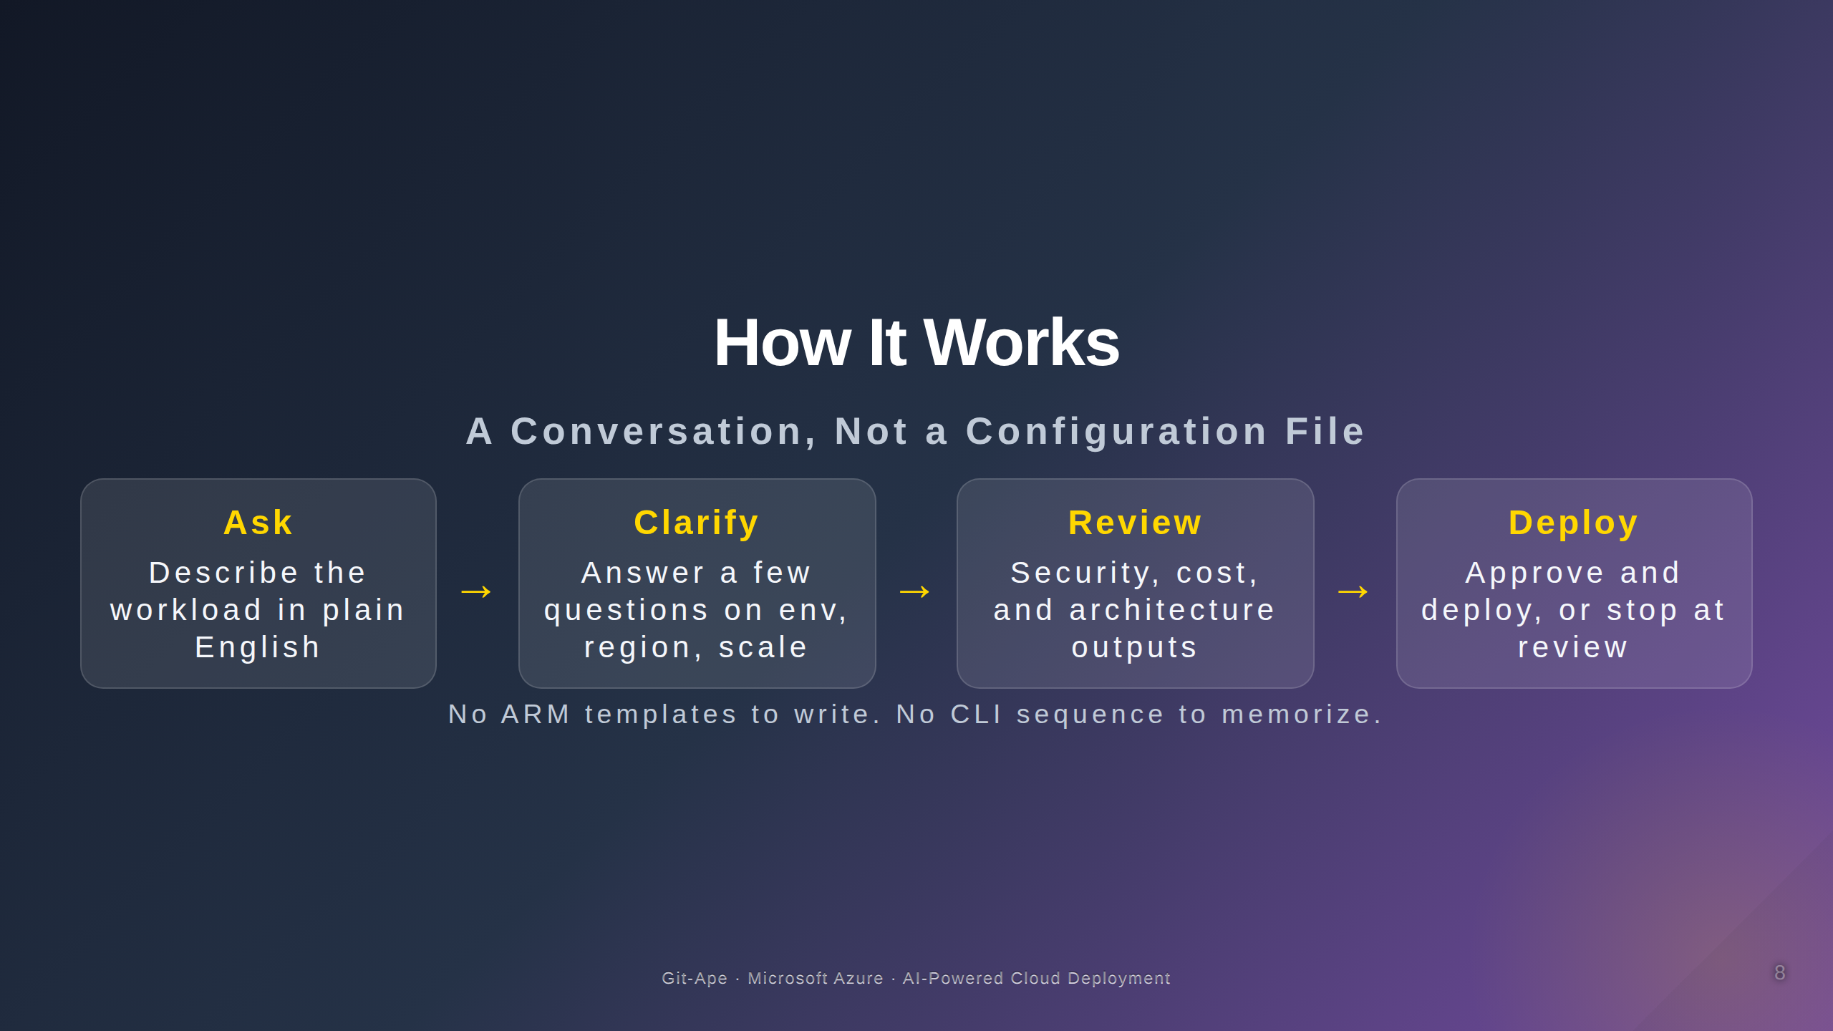

Slide 9
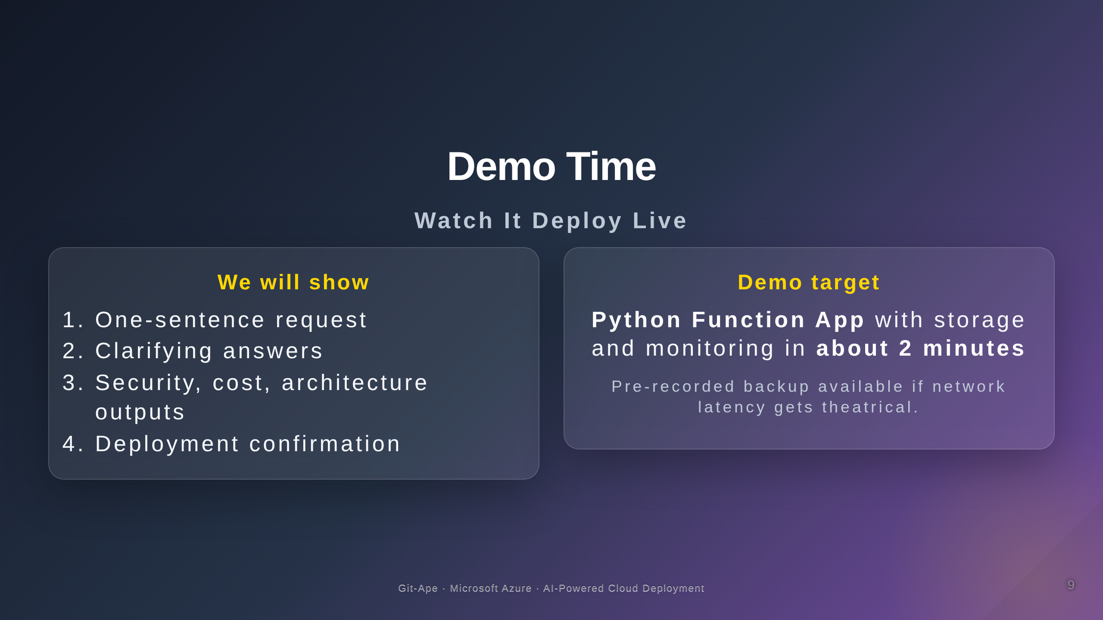

Slide 10
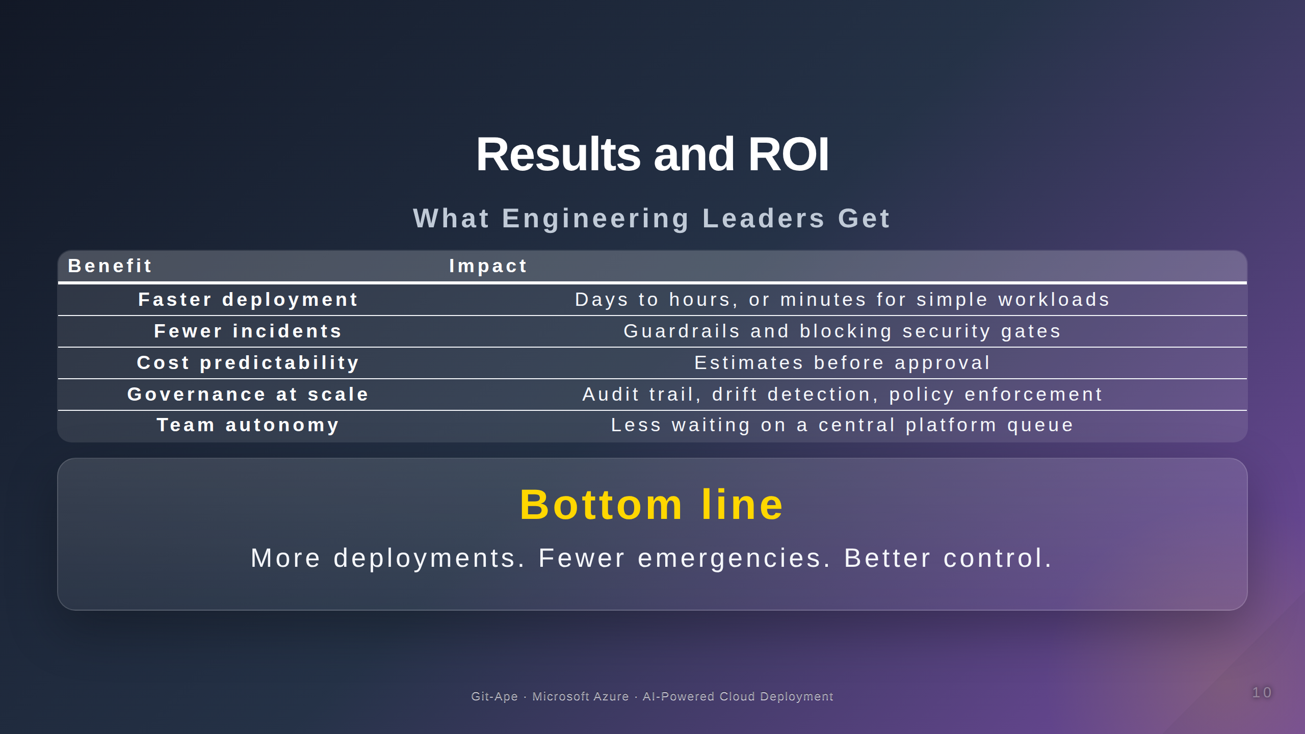

Slide 11

Notes:
Speaker Notes for Slide 1: Title Slide --- Set the stage. Emphasize this is about solving a real engineering leadership problem. Say: "In the next 10 minutes, I'll show you how AI can turn infrastructure deployment from a bottleneck into a competitive advantage." Speaker Notes for Slide 2: The Challenge --- Pause after each stat. Let the pain sink in. Internal survey proxy: We can cite IBM, Forrester, or Gartner for 73% if needed. Shadow IT is often the biggest surprise to executives. They don't realize developers are bypassing governance. Speaker Notes for Slide 3: What If... --- This is the "aha" moment. Let silence hang for 2–3 seconds after reading the output. Say: "What you see here is the result of a single sentence, not hours of engineering work." Speaker Notes for Slide 4: Security Guardrails --- This is crucial. Executives are terrified of security incidents. Emphasize: - "Blocking gate" means the deployment literally cannot proceed if security fails. - No passwords = no breach surface. Managed identities eliminate the #1 attack vector. - OIDC federated = GitHub Actions can deploy without storing Azure credentials in secrets. Speaker Notes for Slide 5: Cost Transparency --- Say: "Developers see the cost before they deploy, not after it appears on the bill." This addresses CFO concerns about runaway cloud spend. Speaker Notes for Slide 6: Compliance and Governance --- For heavily regulated industries (finance, healthcare, government): This is the slide they care about most. Drift detection is underrated. It catches the developer who SSHes into a VM and changes config manually. Audit trail = compliance audit evidence. Speaker Notes for Slide 7: WAF Review --- Briefly touch the 5 pillars. Don't dwell unless audience asks. Say: "The AI evaluates every deployment like a seasoned architect would." Speaker Notes for Slide 8: How It Works --- Demystify the process. Emphasize it's a conversation, not a form. Say: "This is what makes it different from traditional IaC tools. You don't need to know Bicep, Terraform, or ARM template syntax." Speaker Notes for Slide 9: Demo --- If live demo: - Ensure font size is large (Ctrl+= three times). - Have terminal and Copilot Chat visible. - Type slowly so audience can read. - Highlight the three outputs: architecture diagram, security analysis, cost estimate. If pre-recorded backup: - Play video. - Pause at key moments (security gate, cost, architecture). - Talk through what you're seeing. Key moments to narrate during demo: - "One sentence" — emphasize the input is minimal. - "It asks clarifying questions" — show how it's a conversation. - "Architecture diagram" — this is auto-generated, not hand-drawn. - "Security gate PASSED" — this is the most important part. - "Cost estimate" — executives care about this. Speaker Notes for Slide 10: ROI --- Wrap up with business outcomes. Say: "This isn't just about speed. It's about safety, predictability, and giving your engineering team superpowers." End with a call to action: "Questions?" or "Let me show you how to get started."

