Slide 1
10 Extended Events every DBA needs in their Toolkit
Daniel Maenle
He/Him
Sr. SQL Database Administrator
XTIVIA

Slide 2
Explore PASS
Notes:
You can see here that there is a lot of opportunities to learn and grow.
Let me tell you about my experience – How impacted me.
Be active and deliberate about it.

Slide 4

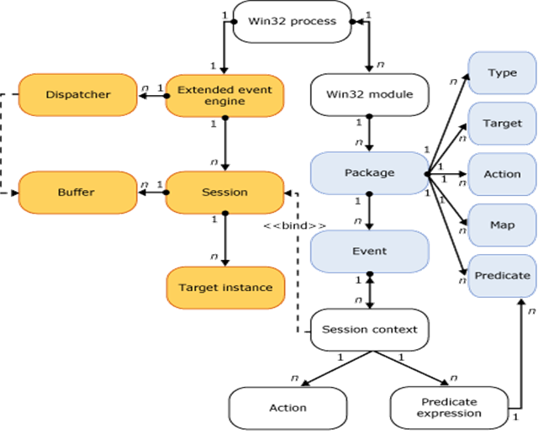
How Extended Events Work
Auditing
SQL Audit built on the engine
Debugging
Troubleshooting
GUI
Notes:
What is Extended Events? (XE)
Borrowing it from Annie, “Anything trace can do, extended events can do better”
Definition - “SQL Server Extended Events has a highly scalable and highly configurable architecture that allows users to collect as much or as little information as is necessary to troubleshoot or identify a performance problem.” -Microsoft
Brief definition: It’s a light-weight event-based monitoring system
How many events you can use it for in each version of SQL? (2019 over 2000?)
XE 2008r2 – 252
XE 2016RTM - 1301
XE 2017RTM – 1503
XE 2019 CU8 - 1827

Slide 5
Section Title 3
More Events!
Short Circuit Filtering
More options for Predicates
More options for Targets
Better performance
Easier to manage/GUI Support
XML FUN!
Extended Events
And why you should use them
Notes:
Events,
Actions
Targets
Maps

Slide 6
Error_reported
Deprecation
TSQL_Stack
Linked Server
System Health, deadlock, wait_info, and script info
Pair matching
Object_Altered
AlwaysOn
Built in SSMS
Sp_humanevents
Notes:
Examples of some of the XE
Error_reported
Deprecation
TSQL_Stack
LinkedServer
System Health, deadlock, wait_info, script info
Pairmatching proc
Object_Altered
AlwaysOn
BuildinSSMS
Sp_humanevents

Slide 7

Resources
https://www.sqlskills.com/blogs/jonathan/ | https://www.sqlsaturday.com/825/Sessions/Details.aspx?sid=86449
https://docs.microsoft.com/en-us/sql/relational-databases/sql-trace/sql-trace?view=sql-server-2017 | http://sqlblog.com/blogs/tibor_karaszi/archive/2017/10/10/ssms-17-3-has-profiler-built-in.aspx
https://docs.Microsoft.com/en-us/sql/relational-databases/extended-events/sql-server-extended-events-engine?view=sql-server-2017 | http://blog.sqlterritory.com/2017/10/08/xe-profiler-new-feature-ssms-v17-3/
https://www.sqlskills.com/blogs/jonathan/category/extended-events/ | https://www.red-gate.com/simple-talk/sql/database-administration/preparing-to-upgrade-your-sql-server/
https://www.sqlskills.com/blogs/jonathan/converting-sql-trace-to-extended-events-in-sql-server-2012/ | https://www.sqlskills.com/blogs/jonathan/understanding-the-sql_text-action-in-extended-events/
https://www.youtube.com/playlist?list=PLt4QZ-7lfQifgpvqsa21WLt-u2tZlyoC_ | https://www.sqlskills.com/blogs/jonathan/looking-at-non-updating-updates-with-extended-events/
https://www.brentozar.com/archive/2015/01/query-extended-events-target-xml/

Slide 8

Thank You
Since diving into SQL 5 years ago, he worked on large-scale health care systems to small independent shops, all the way to Wall Street.
Daniel Maenle
Sr. SQL Database Administrator
XTIVIA
@danthesqlman
danthesqlman@lavabit.com
He enjoys query tuning and has found Extended Events to be an aspect of SQL deserving widespread usage and should be leveraged on a daily basis.
"Saving the world
one SQL query at a time"

