Slide 1
SQL Server Internals and Architecture
Deepthi Goguri
August 6, 2020

Slide 2



About me
Database administrator with 7 years of experience.
Microsoft certified solution expert (MCSE).
Masters in Computer Technology.
Blogger for dbanuggets.com
@dbanuggets
dbanuggets@hotmail.com

Slide 3
Overview
ACID Properties
Life cycle of a query
Relational Engine
Storage Engine
Transaction manager.
Cache

Slide 4
Internals: Why we care
Information about how queries are processed at each stage inside the SQL Engine.
Helps you track down the performance issues and fix them efficiently.
Build confidence when managing database Engine.
Helps in convincing your co-workers/managers of why they should take your ideas seriously.
The more you know, the better.

Slide 5

ACID Properties

Slide 6
All queries in the transaction should either complete successfully or all rollback.
Atomicity
Database should be consistent after every single transaction.
Consistency
ACID
Multiple transactions occur independently without interference.
Isolation
Changes that have been committed to the database should remain even if the system failure occurs.
Durability

Slide 7
What components of SQL Engine ensures ACID property?
Atomicity- Parse component
Consistency- Parse and binder
Isolation- Lock manager
Durability- Transaction log

Slide 8
Example
ID | Balance
1 | $500
2 | $100
Send $100 from Account 1 to Account 2
ID | Balance
1 | $400
2 | $100
BEGIN TRAN
UPDATE ACCOUNT SET BALANCE=BALANCE-100 WHERE ID=1 AND BALANCE >100

Slide 9
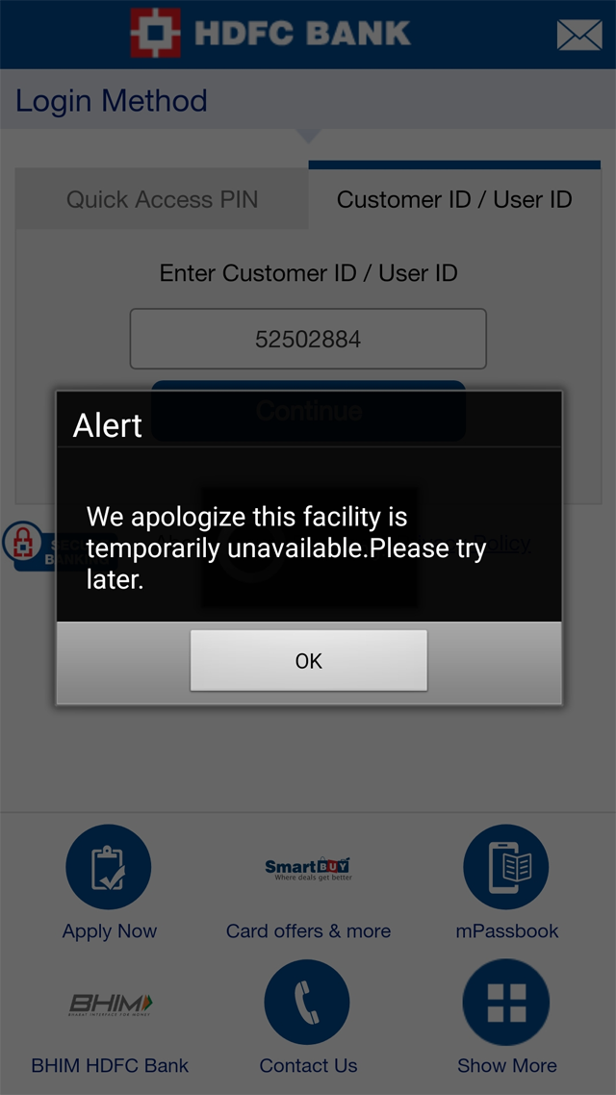
www.bank.com
www.bank.com

Slide 10
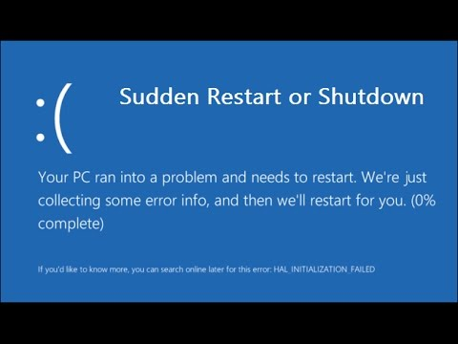

Slide 11
Example
Once the server restarts,
uncommitted transactions are rolled back.
ID | Balance
1 | $400
2 | $100
ID | Amount
1 | $500
2 | $100

Slide 12

Life Cycle of a Query

Slide 13


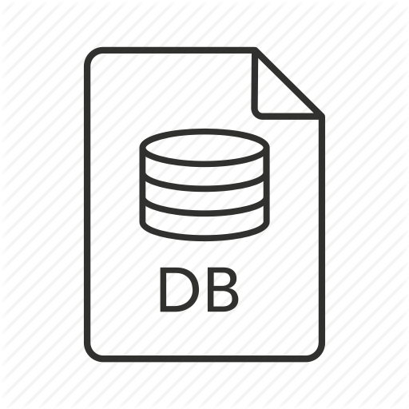
SQL OS
First step
Relational engine
Second step
SNI
Join heuristics
Parser
Binder
Load metadata
Simplification
Trivial plan
Search phases
0, 1, 2
Tran log
Database files
R
RAM
Storage engine
Plan cache
Data
cache
Third step
Access methods
Transaction mgr
Buffer mgr
Success message to user

Slide 14
Select query
SQL OS
SNI
SQL operating system.
Assigns server process id (SPID) to incoming connections.
Unwraps the TDS packet.
SQL Server network interface.
Establishes network connection via network protocol.
TCP/IP, shared memory, named pipes.
SQL query wrapped in tabular data stream packet (TDS).

Slide 15
Parser
Binder
Simplification
Trivial plan
Last step for pre-optimization.
Query considered as simple.
Doesn’t cache the plan.
T8757 disables trivial plans entirely.
T2861 enables forced caching of trivial plans.
Algebrizer/Normalizer.
Metadata discovery, name resolution.
Checks user permissions.
Data type resolution (UNION).
Aggregate binding.
Updates parse tree in the cache.
Simplify query for easy process. For example:
Convert subqueries to joins, convert inner join to outer join.
Contradiction detection.
Updates the parse tree.
Validates syntax.
Identify variable declaration.
Views are expanded.
Builds initial parse tree.
Plan cache
Data
cache
First step
RAM

Slide 16
Load
metadata
Join
heuristics
Search phases
0, 1, 2
Index statistics and histograms.
Auto-created statistics.
Cardinality estimates.
Available memory and CPU.
SQL Server and windows collation.
SET option settings.
Updates the parse tree.
Gets the good enough plan, not the best plan.
Phase 0 – Transactional plan
Phase 1 – Quick plan
Phase 2 – Full plan
Reorders joins in a way that reduces the number of returned rows as early in the process as possible.
Updates the parse tree.
Plan cache
Data
cache
RAM
Hashed
Second step

Slide 17
Optimizer search phases
Transactional Plan
Pre-optimization stage.
Quick plans asap.
Small queries max 3 tables
basic heuristics.
Phase 0
Quick Plan
Queries for max 8 tables.
More transformation rules than phase 0.
Comparing cost of serial plan vs parallel plan.
Phase 1
Full plan
Complex queries.
Parallelism, spills & spools to tempdb.
All transformation rules are unlocked.
Phase 2

Slide 18
Read transaction
Check for required pages in memory.
Any required pages grabbed from database file to data cache.
Acquire shared lock (select).
Access methods
Transaction mgr
Buffer mgr
Lock manager and Log manager
For read transaction, Lock manager will be invoked.
Request buffer pool to acquire shared lock on resources.
Doesn’t perform any operation.
Analyze how the required data can be accessed from database files.
Plan cache
Data
cache
Tran log
Database files
RAM
Third step

Slide 19
Write transactions
Acquire Exclusive lock.
Check for required pages in memory.
Additional required pages grabbed from database file to data cache.
Invokes every few minutes by SQL Server.
Pushes dirty pages to disk and hardens to disk.
Access methods
Transaction mgr
Buffer mgr
Lock manager and log manager.
For write transaction, first log and next lock manager will be invoked.
Request buffer pool to acquire shared lock on resources.
Doesn’t perform any operation.
Analyze how the required data can be accessed from database files.
CHECKPOINT
Plan cache
Data
cache
Tran log
Database files
RAM
Third step

Slide 20
First step
Second step
SNI
Join heuristics
Parser
Bind
Load metaData
Simplify
Trivial plan
Explore search phases 0, 1, 2
T-Log
Database File
R
RAM
Plan cache
Data
cache
Third step
Access methods
Transaction mgr
Message to User
Buffer mgr
Xact Complete

Slide 21



Slide 22
How plan cache is managed?
LRU-K(Least recently used algorithm)
2 processes:
Lazy writer
Ghost cleanup

Slide 23
Plan Cache
Plan 1
Lazy writer
16
18
17
18
Complexity countdown value
Complexity code value
Plan 2
9
8
9
7
9
Ghost Cleanup
Plan 3
2
2
1
0

Slide 24

Data cache
Hold 8kb page.
Indexes
Help reduce I/O.
Speeds up query process.
Data cache
Checkpoint process.
8kb pages

Slide 25
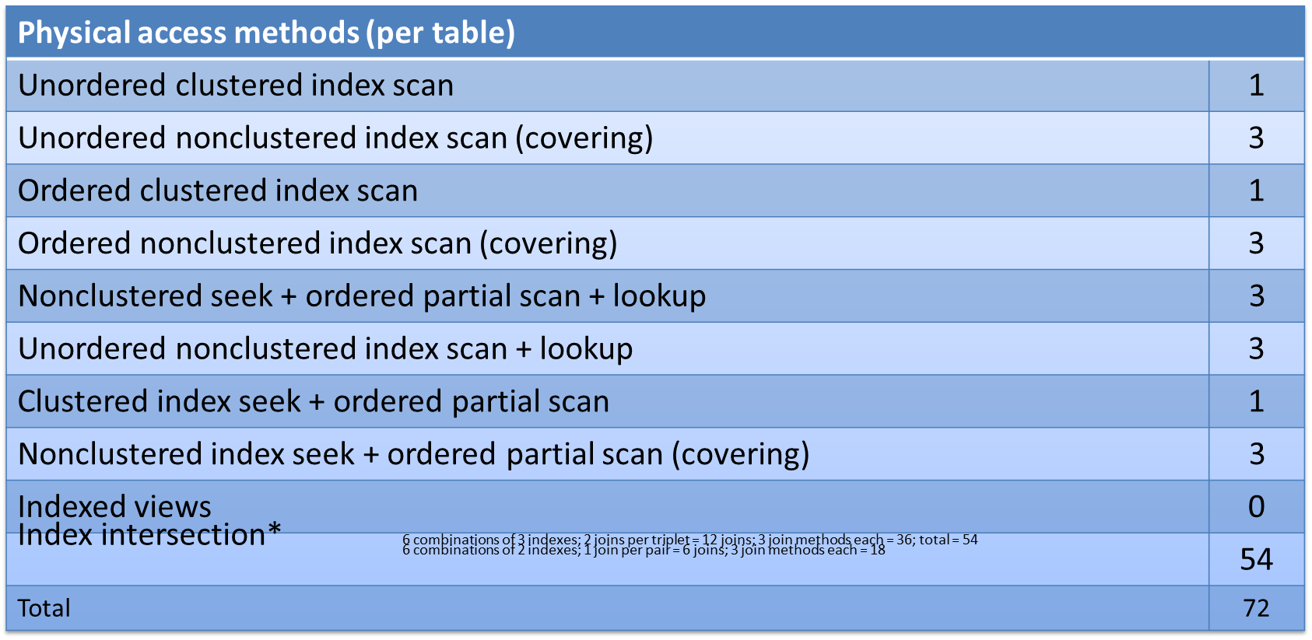
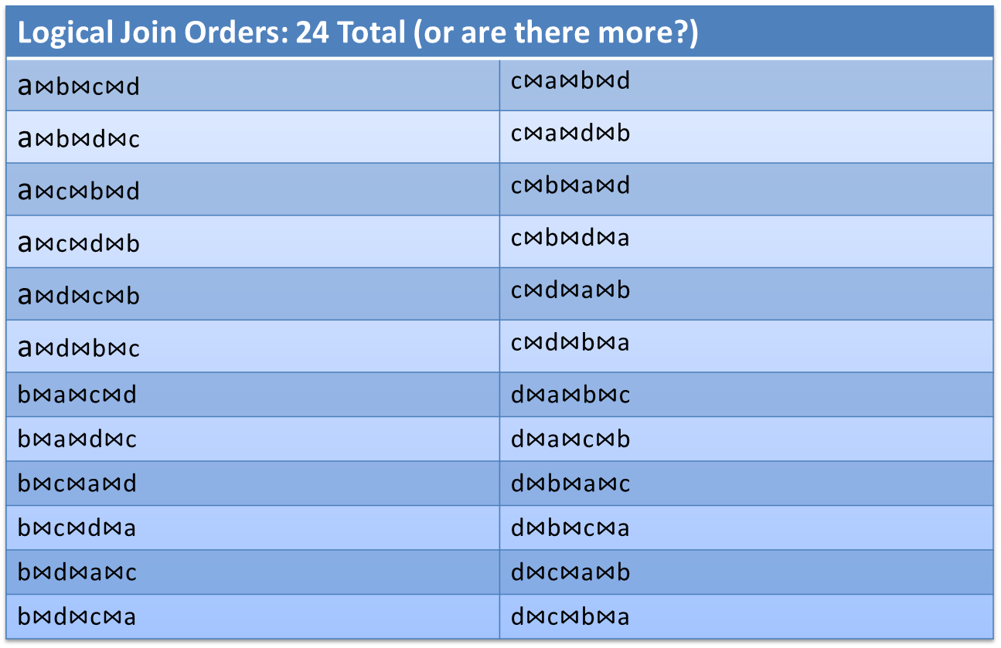
How Optimizer choose Plan?
Good enough plan, not the best plan.
SELECT...
FROM a
JOIN b ON ...
JOIN c ON ...
JOIN d ON ...
Clustered index and 3 non-clustered indexes each.
72 Possible physical data access
methods
120 Possible logical join orders
Physical joins possible per
logical join
+ May require intermediate sort operation
--- --------------------------------
= 25,920 possible plans?!?
Credits: Kevin Kline
Twitter: @kekline

Slide 26
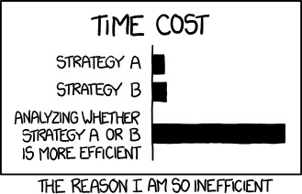
How optimizer choose plan?
Credits: Kevin Kline
Twitter: @kekline
Blog: https://kevinekline.com/ https://www.sentryone.com/blog/author/kevin-kline

Slide 27
Summary
ACID properties.
Life cycle of a query.
Relational engine.
Storage engine.
Transaction manager.
Cache.

Slide 28
Special Thank you
Kevin Kline
Twitter: @kekline
email: kkline@sentryone.com
Blog: www.sentryone.com/blog/author/kevin-kline
Ben Weissman and William Durkin (New Stars of Data)

Slide 29

New Stars Of Data
Free virtual conference introducing new speakers in the Microsoft Data Platform space on August 14th.
Check out the schedule here:
https://www.newstarsofdata.com/schedule/
Register to the online event here:
https://www.meetup.com/New-Stars-Of-Data/events/271179016/

Slide 30

Thank you

