Slide 1
SQL Server 2012: Performance Tuning – Design, Internals and Architecture

Slide 2
Conditions and Terms of Use
This training package is proprietary and confidential, and is intended only for uses described in the training materials. Content and software is provided to you under a Non-Disclosure Agreement and cannot be distributed. Copying or disclosing all or any portion of the content and/or software included in such packages is strictly prohibited.
The contents of this package are for informational and training purposes only and are provided "as is" without warranty of any kind, whether express or implied, including but not limited to the implied warranties of merchantability, fitness for a particular purpose, and non-infringement.
Training package content, including URLs and other Internet Web site references, is subject to change without notice. Because Microsoft must respond to changing market conditions, the content should not be interpreted to be a commitment on the part of Microsoft, and Microsoft cannot guarantee the accuracy of any information presented after the date of publication. Unless otherwise noted, the companies, organizations, products, domain names, e-mail addresses, logos, people, places, and events depicted herein are fictitious, and no association with any real company, organization, product, domain name, e-mail address, logo, person, place, or event is intended or should be inferred.
Copyright and Trademarks
© 2011 Microsoft Corporation. All rights reserved.
Microsoft may have patents, patent applications, trademarks, copyrights, or other intellectual property rights covering subject matter in this document. Except as expressly provided in written license agreement from Microsoft, the furnishing of this document does not give you any license to these patents, trademarks, copyrights, or other intellectual property.
Complying with all applicable copyright laws is the responsibility of the user. Without limiting the rights under copyright, no part of this document may be reproduced, stored in or introduced into a retrieval system, or transmitted in any form or by any means (electronic, mechanical, photocopying, recording, or otherwise), or for any purpose, without the express written permission of Microsoft Corporation.
For more information, see Use of Microsoft Copyrighted Content at http://www.microsoft.com/about/legal/permissions/
Microsoft®, Internet Explorer®, and Windows® are either registered trademarks or trademarks of Microsoft Corporation in the United States and/or other countries. Other Microsoft products mentioned herein may be either registered trademarks or trademarks of Microsoft Corporation in the United States and/or other countries. All other trademarks are property of their respective owners.

Slide 3
Students: How to View this Presentation
Switch to Notes Page view
Click View on the ribbon and select Notes Page
Use page up or page down to navigate
Zoom in or out as needed
Most slides will have supporting text that you can view now or after the delivery
Add notes to your copy of the presentation if you want to.
You take the presentation files home with you.

Slide 4
Introduction and Logistics
Your trainer
You
Your role
Your company
Your SQL Server experience
Your goals for this workshop
Start and end times
Facilities (bathrooms, smoking)
Meals
Computers, phones, tablets, etc.
Please set to vibrate!
What’s on your desk?

Slide 5

Module 1: Architecture
SQL Server Operating System (SQLOS)
Windows memory management
SQL Server Memory Management
SQL Server Disk I/O
SQL Server Process Scheduling

Slide 6
Objective
Understand components of SQL Server internal architecture
Memory Management
Process scheduling
I/O
Relate this information to understanding and troubleshooting performance issues
Discuss methods and tools for analyzing engine resource consumption
Provide the foundation for future lessons on SQL Server 2012 Performance Tuning & Optimization

Slide 7
Lesson 1: SQL Server Operating System (SQLOS)
SQL Server Architecture Overview
SQLOS Overview
SQLOS Components

Slide 8
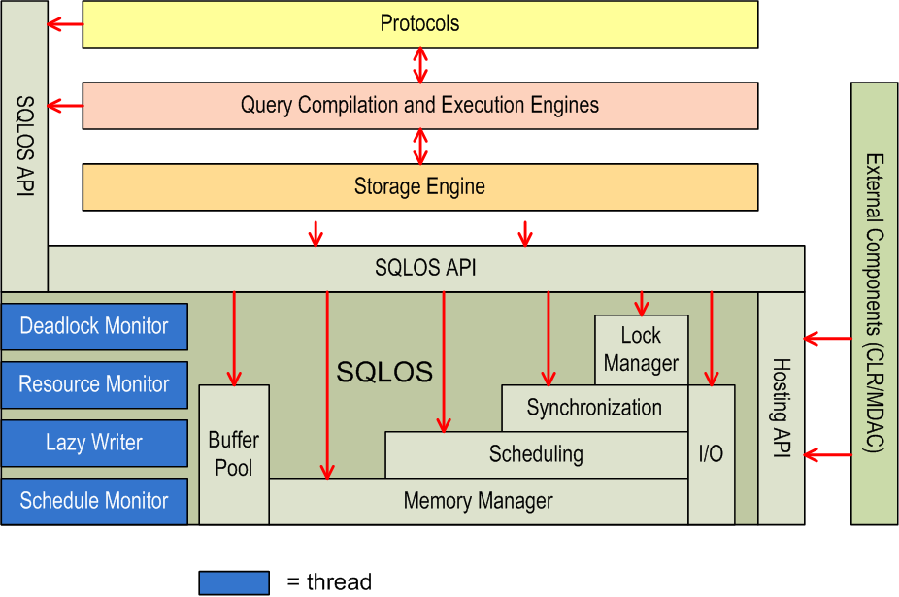
SQL Server Architecture

Slide 9
SQL Server Operating System (SQLOS)
Application layer between SQL Server components and the Windows operating system
Part of the SQLSERVR.exe process
Provides more refined control of resource allocation
Windows is a general purpose OS designed to run many applications
SQLSERVR.exe process treated the same as any other process
Centralizes resource allocation to provide more efficient management and accounting
Abstracts the concepts of resource management from components such as the Query Engine & Query Optimizer
Notes:
Key Points:
Hardware technology and architectures continue to evolve. The introduction of SQLOS allows SQL Server to be able to respond to these new architectures with greater flexibility and control. The SQLOS was created to centralize common low-level tasks within the SQL Server process. Having a central location for these tasks means less duplication of code within the various components of the engine, but it also offers the flexibility to adjust SQL Server to new and advanced hardware architectures without impacting the other areas of SQL Server code.
The SQLOS behaves very much like an operating system. It abstracts the concept of memory management, I/O, scheduling etc. from the other components within the SQL engine. In this way, these components do not need to worry about managing things like NUMA and Resource Governor, they simply make resource allocation calls to the SQLOS via an API.
The SQL engine is still a process like any other process running on a Windows server. It does not have any special privileges or priority over other process. The SQLOS does not bypass Windows, it simply manages the resources within the SQL Server process space in a way that is efficient for SQL Server.
Example:
In the event of memory pressure on the server, Windows will respond by trimming processes’ memory (i.e. moving it from RAM into the paging file). In order to avoid this performance impact, the SQLOS will monitor physical memory levels on the server and pre-emptively trim the SQL Server memory footprint in a way that will have the least effect on performance, thereby returning physical memory to the operating system before it must resort to paging.
Because all the resources are being managed within the SQLOS using a common framework, the job of monitoring resource consumption is simplified, both for the SQL Server process itself and for the DBA.
Additional Reading:
SQLOS Resources
http://blogs.msdn.com/b/sqlosteam/archive/2010/06/23/sqlos-resources.aspx

Slide 10
SQLOS Components
Resource Management
Memory Manager
Process Scheduler
Synchronization
I/O
Support for NUMA and Resource Governor
Monitoring
Resource Monitor
Deadlock Monitor
Schedule Monitor
Lazy Writer (Buffer Pool management)
Extended diagnostics
Dynamic Management Views (DMVs)
Dedicated Administrator Connection (DAC)
Notes:
Key Points:
The two core responsibilities of the SQLOS are Resource Management and Monitoring. All the information used to manage and monitor resources within the SQL Server process space is exposed to the DBA via Dynamic Management Views. These views expose the memory structures used within the SQLOS to account for all the resources in use, thus giving the DBA complete knowledge of the state of the SQL Server process.

Slide 11
Lesson Review
How does the SQL OS improve the efficiency of the SQL Server database engine code?
What are the two main functions of the SQL OS?
Notes:
How does the SQL OS improve the efficiency of the SQL Server database engine code?
By centralizing common low-level tasks within the SQL Server process allowing other components to focus on their main functions and preventing duplication of code. It also makes updating code to respond to hardware and OS changes easier.
What are the two main functions of the SQL OS?
Resource Management
Monitoring

