Slide 1
Lesson 2: Windows Memory Management
Windows Memory Manager
Paging file considerations
NUMA

Slide 2
Conditions and Terms of Use
This training package is proprietary and confidential, and is intended only for uses described in the training materials. Content and software is provided to you under a Non-Disclosure Agreement and cannot be distributed. Copying or disclosing all or any portion of the content and/or software included in such packages is strictly prohibited.
The contents of this package are for informational and training purposes only and are provided "as is" without warranty of any kind, whether express or implied, including but not limited to the implied warranties of merchantability, fitness for a particular purpose, and non-infringement.
Training package content, including URLs and other Internet Web site references, is subject to change without notice. Because Microsoft must respond to changing market conditions, the content should not be interpreted to be a commitment on the part of Microsoft, and Microsoft cannot guarantee the accuracy of any information presented after the date of publication. Unless otherwise noted, the companies, organizations, products, domain names, e-mail addresses, logos, people, places, and events depicted herein are fictitious, and no association with any real company, organization, product, domain name, e-mail address, logo, person, place, or event is intended or should be inferred.
Copyright and Trademarks
© 2011 Microsoft Corporation. All rights reserved.
Microsoft may have patents, patent applications, trademarks, copyrights, or other intellectual property rights covering subject matter in this document. Except as expressly provided in written license agreement from Microsoft, the furnishing of this document does not give you any license to these patents, trademarks, copyrights, or other intellectual property.
Complying with all applicable copyright laws is the responsibility of the user. Without limiting the rights under copyright, no part of this document may be reproduced, stored in or introduced into a retrieval system, or transmitted in any form or by any means (electronic, mechanical, photocopying, recording, or otherwise), or for any purpose, without the express written permission of Microsoft Corporation.
For more information, see Use of Microsoft Copyrighted Content at http://www.microsoft.com/about/legal/permissions/
Microsoft®, Internet Explorer®, and Windows® are either registered trademarks or trademarks of Microsoft Corporation in the United States and/or other countries. Other Microsoft products mentioned herein may be either registered trademarks or trademarks of Microsoft Corporation in the United States and/or other countries. All other trademarks are property of their respective owners.

Slide 3
Students: How to View this Presentation
Switch to Notes Page view
Click View on the ribbon and select Notes Page
Use page up or page down to navigate
Zoom in or out as needed
Most slides will have supporting text that you can view now or after the delivery
Add notes to your copy of the presentation if you want to.
You take the presentation files home with you.

Slide 4
Objectives
Understand components of SQL Server internal architecture
Memory Management
Process scheduling
I/O
Relate this information to understanding and troubleshooting performance issues
Discuss methods and tools for analyzing engine resource consumption
Provide the foundation for future lessons on SQL Server 2012 Performance Tuning & Optimization

Slide 5
Windows Memory Management
Abstracts the concept of memory to the applications
All applications use Virtual memory
Only a few core kernel process access physical memory directly
Virtual memory is not backed by physical storage until it is “committed”
Each process has a Virtual Address Space (VAS)
Size of VAS varies by architecture
32-bit Native: 4GB (2GB user/2GB kernel)
64-bit Compatibility (WoW): 4GB user (kernel runs outside WoW)
64-bit Native: 16TB (8TB user/8TB kernel)
Notes:
Key Points:
Windows is responsible for managing memory and other resources on a server so that applications do not need to understand the underlying architecture in order to run.
Applications never access physical memory directly, they only have access to virtual memory in their own virtual address space (VAS). Virtual memory is called virtual because it is a logical view of memory that does not necessarily represent how the physical memory is laid out. Virtual memory is not backed by actual physical storage until it has been committed, in this way the operating system can juggle the needs of all the processes running on the server and allocate physical storage only when actually needed.
The size of the VAS is constant across all applications and varies only by system architecture.
Additional Reading:
RAM, virtual memory, pagefile, and memory management in Windows
http://support.microsoft.com/kb/2160852
A look at Virtual Address Space - VAS
http://blogs.msdn.com/b/slavao/archive/2005/01/27/361678.aspx

Slide 6
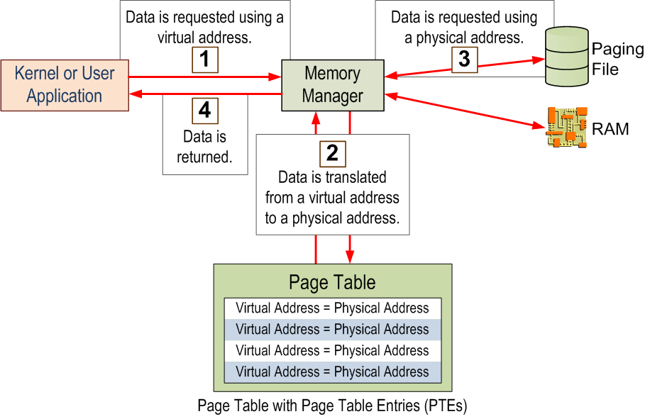
Windows Memory Access
Notes:
Key Points:
The operating system controls the allocation of memory and decides whether data is stored in RAM or Paging File depending on the amount of RAM available. Applications do not need to know where their data resides, nor can they guarantee that it will always be available in RAM.
Windows uses the Page Table to store the mapping of Virtual Addresses to Physical Addresses. Even if there is memory available, if there is no more room in the Page Table no more memory allocations can be made. With modern systems there is likely no need to monitor PTEs, but in 32-bit systems with /3GB and /PAE enabled, running out of PTEs was more common. If students are not interested in 32-bit architecture, you can skip this point.

Slide 7
Paging File
Each process gets the same amount of VAS regardless of the amount of physical RAM installed
Total VAS across all processes may exceed total physical RAM
Windows moves pages from RAM to the page file when physical RAM is exceeded (called trimming)
Systems with large amounts of RAM may not use the page file at all
No need for a large page file in most systems
Notes:
Key Points:
Since all processes running on a server get the same size VAS, and the size of the VAS is larger than the maximum amount of physical RAM supported in Windows, it is possible to allocate more virtual memory than the physical memory installed in the server. In order to accommodate this memory, Windows using a Paging File (which is also referred to as Virtual Memory) to store data that does not fit in physical RAM.
Since accessing the page file is much slower than accessing RAM, Windows will move data that hasn’t been accessed recently out to the page file when needed. This is called trimming.
On modern systems with large amounts of RAM, there is typically plenty of physical memory to support the needs of the applications on the server. Often a large page file is unnecessary and just wastes disk space. Certainly the old recommendation of 1 ½ or 2 times the size of RAM is outdated.
Additional Reading:
How to determine the appropriate page file size for 64-bit versions of Windows
http://support.microsoft.com/kb/889654

Slide 8
Memory Considerations for 32-bit (optional)
32-bit Architecture can only address 4GB of memory (virtual or physical)
Physical RAM can be extended beyond 4GB by using /PAE
User-mode VAS can be extended using /3GB
Converts 1GB of kernel-mode VAS to user-mode leaving only 1GB for kernel-mode
Consider /userva if kernel requires more memory
Some applications such as SQL Server 2008 support Address Windowing Extensions (AWE) to go beyond standard VAS
AWE is no longer supported in SQL Server 2012
Notes:
Key Points:
By default, the 32-bit Windows memory manager uses 32-bit pointers to map the memory. This amounts to 2^32 bytes of memory, which is 4,294,967,296 bytes, or 4 GB. You can use the /PAE switch to enable Windows to use larger pointers and, consequently, to address more memory. You set the /PAE switch in the C:\boot.ini file, and you should turn it ON whenever the server has more than 4 GB of physical memory installed. If this switch is not enabled, the 4 GB limit applies even though more memory is installed.
The 32-bit Windows operating system also uses a virtual memory system based on a 32-bit address space. Even though the 32-bit Windows systems have access to 4 GB of virtual memory per process, this virtual memory is partitioned between user mode and kernel mode. In many cases, Windows does not require a full 2 GB worth of virtual memory for kernel mode. As of Microsoft Windows NT 4.0 Enterprise Edition, Service Pack 3 (SP3), the Windows kernel changed to support a 3 GB user-mode address space and a 1 GB kernel-mode address space. You can enable this feature by using the /3GB switch in the boot.ini file. Programs will not use this extra 1 GB of user-mode address space unless they are explicitly set to do so. SQL Server will take advantage of this extra memory.
When using the /3GB switch, you must consider the following:
Processes that use a large number of handles may use up the page pool memory.
Processes that add users to a large number of security groups will cause the security token for these users to bloat. This may cause the page pool to deplete.
The kernel uses up the Free System page table entries (PTEs) on heavily loaded servers that are configured with the /3GB switch. This results in server instability such as random network problems (the server drops packets or can no longer be reached), which might require a system restart.
Additional Reading:
A description of the 4 GB RAM Tuning feature and the Physical Address Extension parameter
http://support.microsoft.com/kb/291988

Slide 9

Non-Uniform Memory Access (NUMA)
Current trend in processor hardware design
Increases scalability by reducing front-side bus contention
CPUs and memory are divided into NUMA nodes
A foreign memory access is slower than a local one (NUMA ratio)
Processor
Processor
Processor
Processor
Processor
Processor
Processor
Processor
Cache
Cache
Cache
Cache
Cache
Cache
Cache
Cache
Memory
Memory
Memory
Memory
Memory
Memory
Memory
Memory
Node 0
Node 1
Interconnect
Notes:
Key Points:
One major problem with the symmetric multiprocessing (SMP) architecture in high CPU count systems is the contention on the system bus, sometimes referred to as the memory front or front-side bus. This is because with SMP, all CPUs use the same bus to access memory. The more CPUs that use the bus, the more the contention. Increasing the speed of the system bus has only somewhat alleviated the problem. NUMA was designed to bypass the single bus architecture.
NUMA architecture groups CPU and Memory into nodes. Nodes include their own CPUs and memory, and in some cases, their own I/O channels. Each node has its own system bus for the CPUs to reference the node memory. There are interconnects between the nodes to allow the memory to be referenced by other nodes.
Memory local to a node is called local memory. Memory located in another node is referred as foreign or remote memory. Access to foreign memory is often more expensive in time than accessing local memory. The cost of local memory access over the cost of foreign memory access is called the NUMA ratio. A higher NUMA ratio implies a higher performance impact.
Because foreign memory access is slower than accessing memory local to the node, it is important for resource-intensive applications to be NUMA aware. Relying heavily on foreign memory access will make an application run noticeably slower on NUMA hardware. SQL Server is fully NUMA aware.
Currently most servers on the market have a NUMA hardware configuration. Typically each socket represents a NUMA node, although some of the newer hardware hosts 2 nodes per socket.
You can detect if your SQL Server is running on NUMA hardware by examining the startup messages in the SQL Server error log. You will see messages similar to the following:
Node configuration: node 0: CPU mask: 0x000000000000000f:0 Active CPU mask: 0x000000000000000f:0. This message provides a description of the NUMA configuration for this computer. This is an informational message only. No user action is required.
If there are more than just a single message for node 0, the hardware has a NUMA configuration.
Additional Reading: NUMA Support
http://technet.microsoft.com/en-us/query/aa363804
Understanding Non-uniform Memory Access
http://msdn.microsoft.com/en-us/library/ms178144.aspx

