Slide 1

Module 4: Query Optimization
Query Processing
Statistics
Understanding Execution Plans
Identifying Query Issues
Query Performance
Hints and Plan Freezing

Slide 2
Conditions and Terms of Use
This training package is proprietary and confidential, and is intended only for uses described in the training materials. Content and software is provided to you under a Non-Disclosure Agreement and cannot be distributed. Copying or disclosing all or any portion of the content and/or software included in such packages is strictly prohibited.
The contents of this package are for informational and training purposes only and are provided "as is" without warranty of any kind, whether express or implied, including but not limited to the implied warranties of merchantability, fitness for a particular purpose, and non-infringement.
Training package content, including URLs and other Internet Web site references, is subject to change without notice. Because Microsoft must respond to changing market conditions, the content should not be interpreted to be a commitment on the part of Microsoft, and Microsoft cannot guarantee the accuracy of any information presented after the date of publication. Unless otherwise noted, the companies, organizations, products, domain names, e-mail addresses, logos, people, places, and events depicted herein are fictitious, and no association with any real company, organization, product, domain name, e-mail address, logo, person, place, or event is intended or should be inferred.
Copyright and Trademarks
© 2011 Microsoft Corporation. All rights reserved.
Microsoft may have patents, patent applications, trademarks, copyrights, or other intellectual property rights covering subject matter in this document. Except as expressly provided in written license agreement from Microsoft, the furnishing of this document does not give you any license to these patents, trademarks, copyrights, or other intellectual property.
Complying with all applicable copyright laws is the responsibility of the user. Without limiting the rights under copyright, no part of this document may be reproduced, stored in or introduced into a retrieval system, or transmitted in any form or by any means (electronic, mechanical, photocopying, recording, or otherwise), or for any purpose, without the express written permission of Microsoft Corporation.
For more information, see Use of Microsoft Copyrighted Content at http://www.microsoft.com/about/legal/permissions/
Microsoft®, Internet Explorer®, and Windows® are either registered trademarks or trademarks of Microsoft Corporation in the United States and/or other countries. Other Microsoft products mentioned herein may be either registered trademarks or trademarks of Microsoft Corporation in the United States and/or other countries. All other trademarks are property of their respective owners.

Slide 3
Students: How to View this Presentation
Switch to Notes Page view
Click View on the ribbon and select Notes Page
Use page up or page down to navigate
Zoom in or out as needed
Most slides will have supporting text that you can view now or after the delivery
Add notes to your copy of the presentation if you want to.
You take the presentation files home with you.

Slide 4
Lesson 17: Query Processing
Query Plans
Query Optimizer
Query Execution
Query Plan Generation
Optimization Process

Slide 5
Objective
After completing this lesson you will be able to
Explain why SQL Server uses query plans
Describe the Query Compilation Phase
Describe the Query Execution Phase
Describe the use of statistics in query optimization
Perform statistics maintenance in SQL Server
Verify statistics information
Estimate the effects of statistics on queries
Notes:
Introduction
Objectives
After completing this lesson, you will be able to:
Explain why SQL Server uses query plans
Describe the Query Compilation Phase
Describe the Query Execution Phase
Describe the use of statistics in query optimization
Perform statistics maintenance in SQL Server
Verify statistics information
Estimate the effects of statistics on queries

Slide 6
Query Plans and Execution Contexts
Param A = ?
Param B = ?
User = ?
Query Plan
Param A = 12
Param B = ‘xy’
User = Jorge
Param A = 100
Param B = ‘ftr’
User = Nabil
Param A = 11
Param B = ‘sd’
User = Walter
Execution Context 1
Execution Context 2
Execution Context 3
Notes:
A query plan is the actual method SQL Server uses to access data. While a T-SQL statement indicates what the request is, the query plan indicates how to execute the request.
Logical operators describe the relational algebraic operation used to process a statement. In other words, logical operators describe conceptually what operation needs to be performed.
Physical operators actually implement the operation defined by a logical operator using a concrete method or algorithm. For example, "join" is a logical operation, whereas "nested loops join" is a physical operator.
A query plan:
is also known as an execution plan
is a re-entrant, read-only data structure used by any number of users
contains the data access strategy for the query.
does not store any user context
is never stored more than twice in memory. One copy for all serial executions and possibly one copy for all parallel executions. The parallel copy covers all parallel executions, regardless of their degree of parallelism
An execution context is derived from a query plan. Execution contexts:
hold the values needed for a specific execution of a query plan
are cached and reused
are created for each user concurrently executing a batch and will hold data (such as parameter values) specific to their execution.
are not re-entrant. At any point of time, an execution context can be executing only one batch submitted by a session, and while the execution is happening, the context is not given to any other session or user.

Slide 7
Query Optimizer
Query compilation is the process of choosing the fastest execution plan
The query optimizer
parses a query into tree representation
validates the query
evaluates possible query plans
picks a ‘good enough’ plan, based on cost
Notes:
The tree representation of a query contains nodes that represent each logical operator that is to be performed.
The query optimizer chooses the most efficient physical operator for each logical operator.
Usually, a logical operation can be implemented by multiple physical operators. However, in rare cases, a physical operator can implement multiple logical operations as well.
Query validation ensures that the current user has visibility to all tables and columns in the query by verifying them against metadata. Semantic checks are also performed to determine query validity.
Query optimization creates a plan that determines
The indexes, if any, to be used.
The order in which joins are executed.
The order in which constraints, such as WHERE clauses, are applied.
The algorithms that are most likely to lead to the best performance, based on costing information derived from statistics.
SQL Server uses a cost-based optimizer, meaning it tries to generate an execution plan with the lowest estimated resource cost. The execution plan with the lowest estimated cost will be chosen if possible. However, evaluating every possible query plan may take significantly longer than executing the query. The optimizer will pick a ‘good enough’ plan rather than spend inordinate amounts of time evaluating plans. The plan that is chosen is usually optimal, or very close.

Slide 8
Query Execution
The process of executing the plan that is created during query compilation
Not necessarily performed directly after query compilation
May trigger a query recompile
Compilation vs. recompilation
Query recompiles may occur because of
correctness-related reasons
plan optimality related reasons
Notes:
The gap between the time when SQL Server compiles a query and the time that the query is executed can be as short as a few microseconds or as long as several days. Not everything that is true at compilation time will be true at execution time. For example, the query optimizer might take into account the cardinality and distribution of data in a table at compile time. Over time the data may change and the compiled plan may no longer be optimal.
A query recompile occurs directly before execution of a batch of one or more query plans. If the checks for validity (correctness) and/or optimality fail, the statement corresponding to the query plan or the entire batch is compiled again, and a possibly different query plan produced. Such compilations are known as "recompilations.“
Causes of Recompilations
Correctness-related reasons include:
Schema changes for objects referenced in the batch – e.g.
Adding/dropping columns to a table or view
Dropping a statistic
Adding an index to a table or indexed view
SET option reasons - Some of the SET options affect query results. These include:
ANSI_NULL_DFLT_OFF/ANSI_NULL_DFLT_ON
ANSI_NULLS
ANSI_PADDING
ANSI_WARNINGS
ARITHABORT
CONCAT_NULL_YIELDS_NULL
QUOTED_IDENTIFIER
Plan optimality-related reasons – changes in table cardinality or statistics on table columns will trigger recompiles if the Recompilation Threshold is exceeded.
More information:
Batch Compilation, Recompilation, and Plan Caching Issues in SQL Server 2005 - http://technet.microsoft.com/en-us/library/cc966425.aspx#XSLTsection131121120120

Slide 9
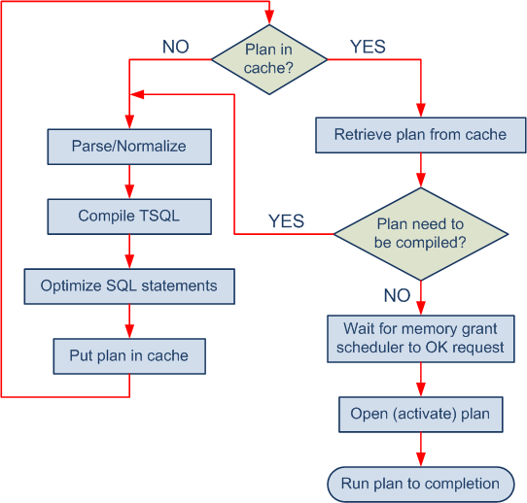
Compilation and Execution overview
Notes:
Memory grant process The server calculates how much memory to grant for a given query, then it uses the internal facility called Resource Semaphore to reserve actual memory, or throttle if too many queries ask for memory. Resource Semaphore is responsible for satisfying memory grant requests while keeping overall memory grant usages within the server limit.
Before a query is executed the server checks if a memory grant is needed or not. If not needed, the server can start the query immediately. For example, a simple serial query without "ORDER BY" or "GROUP BY" may not need a memory grant. The server calculates the memory limit for one query. By default, this is 25% of total query workspace memory. The server calculates the ideal memory for the query and checks if the ideal memory exceeds the per-query limit. If it does, then the server reduces the additional memory until the total fits within the limit. This revised size is called requested memory. The server asks Resource Semaphore to grant the requested memory.
More information: Understanding SQL server memory grant
http://blogs.msdn.com/b/sqlqueryprocessing/archive/2010/02/16/understanding-sql-server-memory-grant.aspx
Running the plan
SQL Server performs a step called opening the plan, which starts the actual execution then the plan runs to completion. If your query is using the default result set model, the plan will actually just run until it has produced all of its rows and these have all been sent back to the client.
However, if you are using the cursor model, the processing is a bit different. Each client requests only one block of rows, not all of them. After each block is sent back to the client, SQL Server must wait for the client to request the next block. While it is waiting, the entire plan is quiesced, which means that some of the locks are released, some resources are given up, and some positioning information is cached. When the next block of rows is requested, this cached information enables SQL Server to resume where it left off.

Slide 10
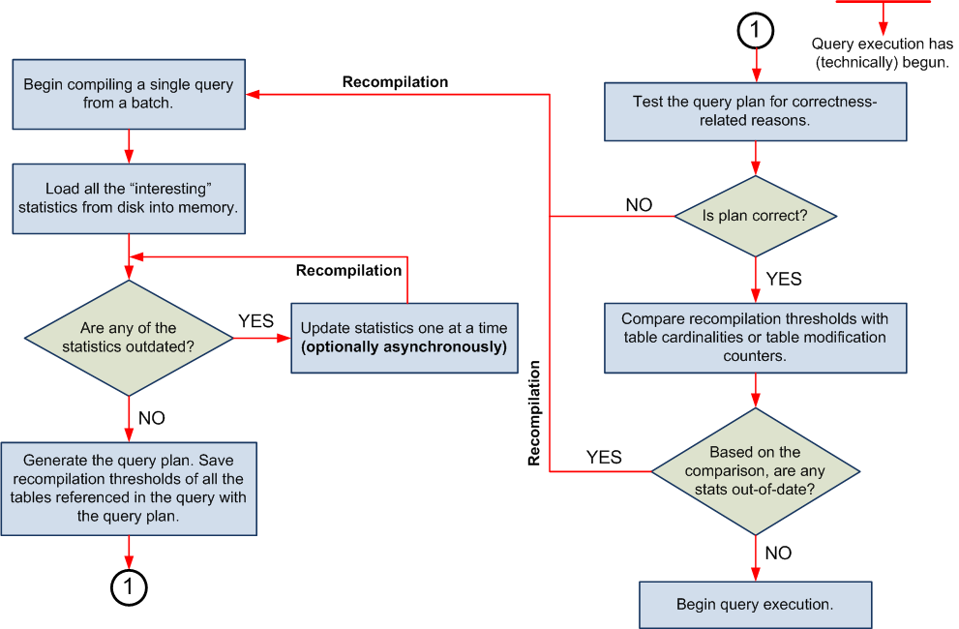
Query Plan Generation
Notes:
The following steps describe the batch compilation and recompilation process in SQL Server at a high level. The main processing steps are as follows:
SQL Server begins compiling a query. (A batch is a unit of compilation and caching, but individual statements in a batch are compiled one after the other.)
All the index or column statistics that may be used to generate an optimal query plan are loaded from disk into memory.
If any of the statistics are out of date they are updated one at a time. The query compilation waits for the updates to finish (unless auto_update_stats_async is enabled).
The query plan is generated. Recompilation thresholds of all the tables referenced in the query are stored along with the query plan. (Refer to Recompilation Threshold slide)
At this point, query execution has technically begun. The query plan is now tested for correctness-related reasons (for example, if the underlying table structure has changed).
If the plan is not correct, for any of the correctness-related reasons, a recompilation is started. Notice that, because query execution has technically begun, the compilation that has just been started is a recompilation.
If the plan is correct, then various recompilation thresholds are compared with either table cardinalities or table modification counters
If any of the statistics are determined to be out-of-date by the comparisons performed in Step 7, it results in a recompilation. (Refer to Statistics module)
If all the comparisons in Step 7 succeed, actual query execution begins.

Slide 11
Recompilation Threshold (RT)
RT is a value which is calculated at compile time
The query plan stores
the RT for referenced tables
a change counter (colmodctr) for referenced statistics
The threshold crossing test is performed to decide whether to recompile a query plan:
| colmodctr(current) – colmodctr(snapshot) | >= RT
If there are no statistics, or none ‘interesting’ then table cardinality is used
| cardinality(current) – cardinality(snapshot) | >= RT
Notes:
The RT is a mechanism used by SQL Server to determine if a table has changed enough to force a recompile of a query plan to determine if a more efficient plan is available for the current data.
colmodctr(current) and colmodctr(snapshot) refer to the value of the modification counter currently and when the query plan was last compiled respectively.
cardinality(current) denotes the number of rows in T at present and cardinality (snapshot) denotes the row count when the query plan was last compiled.
During query compilation, the query processor loads zero or more statistics defined on tables referenced in a query. These statistics are known as interesting statistics. For every table referenced in a query, the compiled query plan contains:
Recompilation threshold
A list of all of the statistics loaded during query compilation. For each such statistic, a snapshot value of a counter that counts the number of table modifications is stored. The counter is colmodctr.
Colmodctr
value is stored for each table column, including persisted computed columns
values are only available to the query processor, not to users
values are an ever-increasing sequence
values are never reset to 0 i.e. a rollback does not decrement the counter
values for non-persisted computed columns do not exist. They are derived from the columns that participate in the computation
values are modified as a table changes.
For more information, refer to:
Plan Caching in SQL Server 2008
http://technet.microsoft.com/en-us/library/ee343986(SQL.100).aspx

Slide 12
Recompilation Threshold Calculation
RT is calculated as follows
Permanent table
If n <= 500, RT = 500.
If n > 500, RT = 500 + 0.20 * n
Temporary table
If n < 6, RT = 6.
If 6 <= n <= 500, RT = 500.
If n > 500, RT = 500 + 0.20 * n.
Table variable
RT does not exist
n = table rows (cardinality) or colmodctr of the leading column of the statistics object
Notes:
If a table or indexed view has 0 rows, then the RT is 1

Slide 13
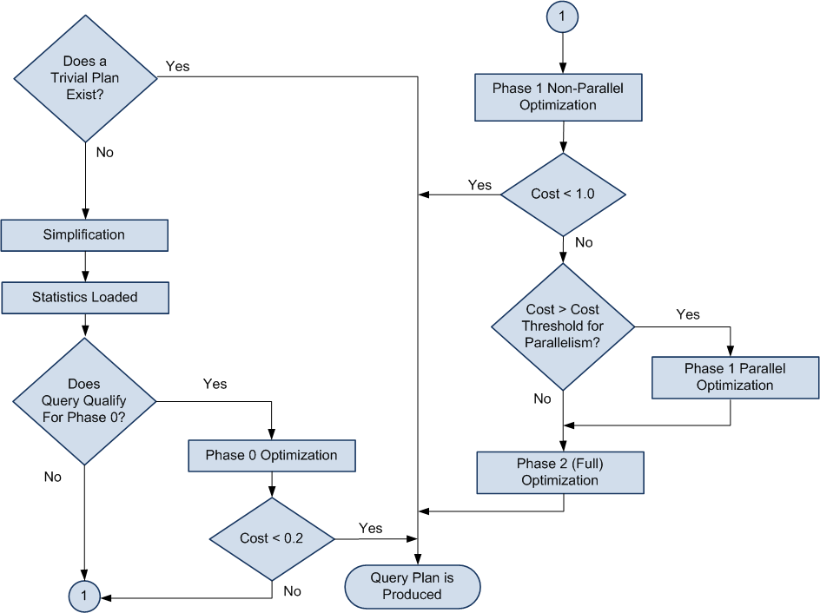
Optimization Process
Notes:
Trivial plan optimization
If SQL Server knows that there is really only one viable plan for a query, a lot of work can be avoided. Examples where there is only one possible plan:
a query that consists of an INSERT with a VALUES clause
a SELECT statement for which all the columns are among the keys of a unique composite index, and that index is the only one that is relevant. No other index has that set of columns in it.
The trivial plan query optimizer finds the really obvious plans that are typically very inexpensive. This saves the query optimizer from having to consider every possible plan, which can be costly and can outweigh any benefit provided by well-optimized queries.
Simplification
If there is no trivial plan the SQL Server will perform a simplification. These are usually syntactic transformations of the query itself, to look for commutative properties and operations that can be rearranged. There is no cost or available index analysis. SQL Server then loads up the metadata, including the statistical information on the indexes.
Cost-based optimization
A set of transformation rules is followed that apply various permutations of data access strategies, join orders, aggregation placement, subquery transformations, and other rules that guarantee that a correct result is returned.
Optimization is broken up into three search phases to prevent the process taking much longer than the execution of the query.
SQL Server evaluates the cost of the cheapest plan after each phase and executes that plan, if the plan is cheap enough. Otherwise, the query optimizer runs the next phase which involves another set of usually more complex rules.
Phase 0 – Transactional Processing Phase: contains a very limited set of rules and is applied only to simple queries with 3 or fewer tables. A limited number of join orders are evaluated which may generate many potential plan candidates. Hash and nested loop join strategies are considered. If a plan with an estimated cost below 0.2 is found, the optimization ends and the query is executed. This phase is also known as the Transaction Processing phase because query plans produced by this phase are typically found for queries in transaction processing (OLTP) applications.
Phase 1 – Quick Plan Optimization Phase: More transformation rules and different join orders are evaluated. If the best plan costs less than 1.0 the optimization ends.
The query optimizer has considered only non-parallel execution plans so far. Phase 1 is repeated with the goal of finding the best parallel plan if:
more than one logical CPU is available to SQL Server
the least expensive plan produced by Phase 1 costs more than the Cost Threshold for Parallelism
The cost is >= 1
Phase 2 – Full Optimization Phase: The cost of the serial and parallel plans are compared and Phase 2 is executed for the cheaper plan. Outer join reordering and automatic indexed view substitution for multi-table views are also considered.

Slide 14
Query Parallelism
Several threads scheduled in parallel for the same query
Used by SQL Server to reduce the run-time of a query
Resource cost is generally higher than a serial plan
A parallel query plan is considered only if a serial plan is expensive enough
The degree of parallelism (DOP)
determines the number of schedulers available to the query
is not part of the cached compiled plan
is determined at the time of execution based on resource availability and Resource Governor settings
does not govern thread count for a query
Queries are parallelized by horizontally partitioning data
Notes:
The goal of executing a query on parallel threads is not to reduce resource usage, only the clock-time of the query.
Parallelization of a query is achieved by horizontally partitioning data into sets. Each set has the same operation performed on it at the same time.
DOP is determined at the start of execution, based on:
the number of logical CPUs available to SQL Server
the Max Degree of Parallelism (MAXDOP) setting
the Max Worker Threads setting
the query MAXDOP hint
Resource Governor Working Group MAXDOP setting
SQL Server chooses a DOP that maximizes parallelism while ensuring that it does not run out of worker threads. MAXDOP= 1 removes all parallelism iterators and executes the query using a serial plan on a single thread.
The number of threads used by a parallel query may exceed the DOP. The DOP determines the number of threads per operator not the total number of threads per query plan. The DOP limits the number of schedulers to the selected DOP. All threads used by the query are assigned to the same set of DOP schedulers and the query uses only DOP CPUs regardless of the total number of threads.
More information:
Introduction to Parallel Query Execution - http://blogs.msdn.com/b/craigfr/archive/2006/10/11/introduction-to-parallel-query-execution.aspx

Slide 15
Lesson Review
What is meant by SQL Server’s query optimizer being “cost based?”
When is a query considered for a parallel execution plan?
Will SQL Server evaluate every possible query plan in the process of optimization? Why?
What is a recompilation threshold?
Notes:
What is meant by SQL Server’s query optimizer being “cost based?”
Answer: Cost based means SQL Server tries to optimize queries based on the estimated resources it will take to execute the query.
When is a query considered for a parallel execution plan?
Answer: SQL Server will consider a parallel execution plan if
more than one logical CPU is available to SQL Server
the least expensive plan produced by Phase 1 costs more than the Cost Threshold for Parallelism
the cost is >= 1
Will SQL Server evaluate every possible query plan in the process of optimization? Why?
Answer: SQL Server will not consider every possible plan, in many cases this could prove to cost more than running the query with a non-optimal plan. SQL Server will choose a plan that is 'good enough'.
What is a recompilation threshold?
Answer: The RT is a mechanism used by SQL Server to determine if a table has changed enough to force a recompile of a query plan to determine is a more efficient plan is available for the current data.

