Slide 1
Lesson 19: Understanding Execution Plans
Analyzing Execution Plans
Graphical Execution Plan
Joins in Graphical Showplan
Query Plan Example
What a Query Plan Shows
Multi-Table Joins
Join Types - Nested Loop Join, Merge Join, Hash Join
Aggregation, Sort, Scan and Seek Operators
Lookups
Suboptimal Plans
Complex Queries

Slide 2
Conditions and Terms of Use
This training package is proprietary and confidential, and is intended only for uses described in the training materials. Content and software is provided to you under a Non-Disclosure Agreement and cannot be distributed. Copying or disclosing all or any portion of the content and/or software included in such packages is strictly prohibited.
The contents of this package are for informational and training purposes only and are provided "as is" without warranty of any kind, whether express or implied, including but not limited to the implied warranties of merchantability, fitness for a particular purpose, and non-infringement.
Training package content, including URLs and other Internet Web site references, is subject to change without notice. Because Microsoft must respond to changing market conditions, the content should not be interpreted to be a commitment on the part of Microsoft, and Microsoft cannot guarantee the accuracy of any information presented after the date of publication. Unless otherwise noted, the companies, organizations, products, domain names, e-mail addresses, logos, people, places, and events depicted herein are fictitious, and no association with any real company, organization, product, domain name, e-mail address, logo, person, place, or event is intended or should be inferred.
Copyright and Trademarks
© 2011 Microsoft Corporation. All rights reserved.
Microsoft may have patents, patent applications, trademarks, copyrights, or other intellectual property rights covering subject matter in this document. Except as expressly provided in written license agreement from Microsoft, the furnishing of this document does not give you any license to these patents, trademarks, copyrights, or other intellectual property.
Complying with all applicable copyright laws is the responsibility of the user. Without limiting the rights under copyright, no part of this document may be reproduced, stored in or introduced into a retrieval system, or transmitted in any form or by any means (electronic, mechanical, photocopying, recording, or otherwise), or for any purpose, without the express written permission of Microsoft Corporation.
For more information, see Use of Microsoft Copyrighted Content at http://www.microsoft.com/about/legal/permissions/
Microsoft®, Internet Explorer®, and Windows® are either registered trademarks or trademarks of Microsoft Corporation in the United States and/or other countries. Other Microsoft products mentioned herein may be either registered trademarks or trademarks of Microsoft Corporation in the United States and/or other countries. All other trademarks are property of their respective owners.

Slide 3
Students: How to View this Presentation
Switch to Notes Page view
Click View on the ribbon and select Notes Page
Use page up or page down to navigate
Zoom in or out as needed
Most slides will have supporting text that you can view now or after the delivery
Add notes to your copy of the presentation if you want to.
You take the presentation files home with you.

Slide 4
Objectives
View and analyze execution plans
Differentiate between an estimated query plan and an actual query plan.
Identify the contents of a query plan.
Explain how the query processor handles multiple-table joins.
Compare the different join algorithms in SQL Server.
Explain the characteristics of nested loop, merge, and hash joins.
Describe the primary task of the aggregation operator.
Describe the purpose of the sort operator.
Differentiate between scans and seeks.
Explain when scans and seeks are helpful and when lookups or scans should be eliminated.
Identify the various options available in a suboptimal execution plan to create a more efficient plan.
Explain why the query optimizer may choose a suboptimal query plan.
List the various considerations for optimizing complex queries.
Notes:
After completing this section, you will be able to:
View and analyze execution plans
Differentiate between an estimated query plan and an actual query plan.
Identify the contents of a query plan.
Explain how the query processor handles multiple-table joins.
Compare the different join algorithms in SQL Server.
Explain the characteristics of nested loop, merge, and hash joins.
Describe the primary task of the aggregation operator.
Describe the purpose of the sort operator.
Differentiate between scans and seeks.
Explain when scans and seeks are helpful and when lookups or scans should be eliminated.
Identify the various options available in a suboptimal execution plan to create a more efficient plan.
Explain why the query optimizer may choose a suboptimal query plan.
List the various considerations for optimizing complex queries

Slide 5
Contents of a query plan
Query plans include
How data is accessed
How data is joined
How data is aggregated
Sequence of operations
Use of temporary worktables and sorts
Estimated rowcounts, iterations, and costs from each step
Actual rowcounts and iterations
Use of parallelism
Notes:
The query plan consists of physical operators which implement the operation described by logical operators.
Each of the physical operators is an object or routine that performs an operation. For example, some physical operators access columns or rows from a table, index or view. Other physical operators perform other types of operations e.g. the Aggregate operator calculates an expression containing MIN, MAX, SUM, COUNT or AVG, and the Merge Join operator performs different types of logical join operations
More information can be found here:
Showplan Logical and Physical Operators Reference –
http://msdn.microsoft.com/en-us/library/ms191158(v=SQL.110).aspx

Slide 6
Obtaining query execution information
Metrics
SET STATISTICS IO
SET STATISTICS TIME
Query Plans
SHOWPLAN_XML
STATISTICS XML
sys.dm_exec_query_plan
SSMS GUI
Estimated vs. Actual
Permissions
Notes:
The amount of I/O SQL Server performed to process a query can be determined by setting the SET STATISTICS IO option to ON. There is one line of output for each query in the batch and includes: Logical, Physical, and Read Ahead Reads; Scan Count, lob logical, lob physical, and lob read-ahead reads
More information
Displaying Execution Plans by Using the Showplan SET Options (Transact-SQL)
http://msdn.microsoft.com/en-us/library/ms180765(v=SQL.110).aspx
Inside Microsoft® SQL Server™ 2005: Query Tuning and Optimization (pg 182)
http://www.microsoft.com/learning/en/us/book.aspx?ID=8565&locale=en-us
SET STATISTICS TIME ON shows the elapsed and CPU time required to process the query. It comprises the time required to parse and compile the query and the time required to run the query. The output may include two sets of data for the parse and compile time. This happens when the plan is being cached for possible reuse.
SET SHOWPLAN_XML and STATISTICS XML both return a well-formed XML document with the execution plan information. The difference between SET SHOWPLAN_XML ON and SET STATISTICS XML ON is that the second SET option executes the Transact-SQL statement or batch. SET STATISTICS XML ON output also includes information about the actual number of rows processed by various operators and the actual number of executes of the operators.
The dynamic management view, sys.dm_exec_query_plan, returns the same information as SET SHOWPLAN XML in the xml data type. This information is returned from the query_plan column of sys.dm_exec_query_plan. For more information, see sys.dm_exec_query_plan (Transact-SQL).
More information
Displaying Execution Plans by Using the Showplan SET Options (Transact-SQL)
http://msdn.microsoft.com/en-us/library/ms180765.aspx
SET SHOWPLAN_XML (Transact-SQL)
http://msdn.microsoft.com/en-us/library/ms187757(v=SQL.110).aspx
sys.dm_exec_query_plan (Transact-SQL)
http://msdn.microsoft.com/en-us/library/ms189747(v=SQL.110).aspx
Permissions must be granted to view execution plans via SHOWPLAN or membership of sysadmin, dbcreator, or db_owner.

Slide 7
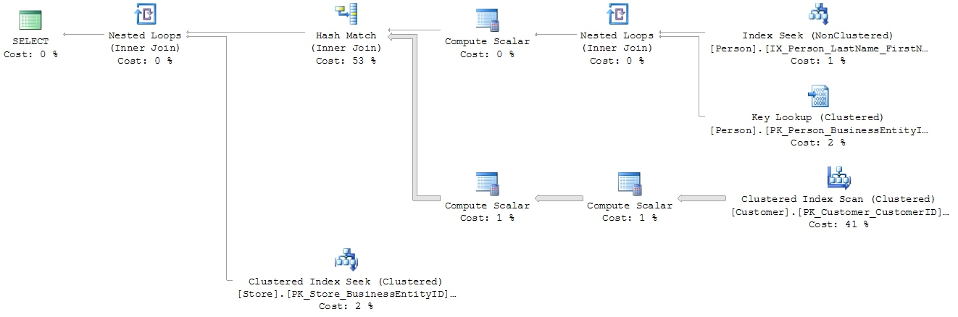

Graphical Showplan flow
Outer Table
5
3
1
2
Inner table
4
6
Resultset 1 and 2 are joined using a nested loops join, creating resultset 3
Resultset 3 and 4 are joined using a hash match join, creating resultset 5
Resultset 5 and 6 are joined using a nested loops join, creating a resultset for the Select clause
Notes:
Flow of data is from right to left
The width of the arrows gives an indication of the number of rows in each dataset
This can often be a clue to high resource usage
For joins:
the outer table appears on top
Resultsets are created from each join pair which is then passed to the next join.
Two crucial facts affect join performance:
Order in which more than two tables are joined
Selection of outer/inner table
Joins producing smaller result sets are performed first
Local predicates are applied before the join
Joins that reduce the number of rows are performed first
Aggregation may be performed before the join
The query plan shown on the slide above was generated from the following statement :
select p.Title + ' ' + p.FirstName + ' ' + p.LastName as FullName, c.AccountNumber, s.Name
from Person.Person p
join Sales.Customer c
on c.PersonID = p.BusinessEntityID
join Sales.Store s
on s.BusinessEntityID = c.StoreID
where p.LastName = 'Koski';

Slide 8
Following a query plan
Query plans are trees, so any join branch can be as substantial as an entire separate query
Examine major sub-branches first by looking top-down at the outermost joins
Examine leaves of the separate significant sub-branches separately
Total Subtree Cost tells you which branches are the most costly
Notes:
The query optimizer only joins two resultsets at a time, creating a new dataset. It then joins the new resultset to another resultset.
When trying to optimize a complex query, identify the most expensive part of the query by using either the estimates from the graphical show plan output or by reviewing the table that has the most IO associated with it.
Optimize only the most expensive part of the query and see if the query performance improves.

Slide 9
Showplan Operators
Operators describe how SQL Server executes a query DML statement
Blocking vs Non-Blocking
Joins will be encountered only if more than one table is accessed. There are three types:
Nested loop -for each row of the outer table find all matching rows in the inner
Merge join - process both tables in the order of the join columns
Hash join - Build a hash table (from the outer) and pass all rows of the inner through the hash table identifying the matches
Notes:
The query optimizer uses operators to build a query plan to create the result specified in the query, or to perform the operation specified in the DML statement.
The query plan is a tree consisting of physical operators. You can view the query plan by using the SET SHOWPLAN statements, the graphical execution plan options in SQL Server Management Studio, or the SQL Server Profiler Showplan event classes.
A blocking operator must retrieve all it’s data before it can produce any output. Reduced concurrency is a symptom of blocking operators. Non-blocking operators can send output as the data is received as input, like a pipeline.
More information:
Showplan Logical and Physical Operators Reference
http://msdn.microsoft.com/en-us/library/ms191158(v=SQL.110).aspx

Slide 10

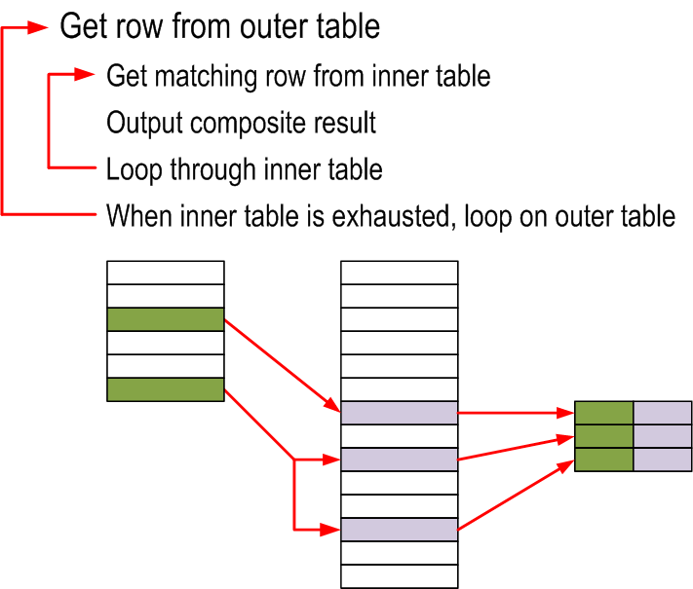
Nested Loops Join
Notes:
A nested loop join:
finds all matches in the inner table for each row of the outer table
requires that the smaller resultset appear as the outer table.
For every iteration of the outer loop one of the following tasks is performed:
Index or table scan, known as a naive nested loops join
Index seek + lookup
Covering index seek
Index spool
A nested loop join operator has two inputs—an outer table (also known as outer loop)
and an inner table (also known as inner loop). The top input to the nested loop join
operator is the outer table, and the bottom input to the nested loop join operator is the
inner table.

Slide 11
Nested Loops Join
Iteration operations
Ideal cases
supporting index on inner table
foreign key joins
Sorts
TOP
SET ROWCOUNT
Avoiding
Resource usage
low memory requirement
low CPU usage requirement
Physical IO varies
Requires that the smaller resultset appear as the outer table.
Notes:
Requires that the smaller resultset appear as the outer table. If the optimizer incorrectly estimates the size of the outer table, this algorithm can become very inefficient.
Nested Loops Join resources:
low memory requirement
low CPU usage requirement
Physical IO varies according to the join participants
A foreign key relationship is often one-to-many, which means that a parent table will have significantly less rows than a child table for a given joining key. SQL Server can make use of the efficient Nested Loops Join operator for table with foreign keys defined if:
the parent is indexed
the parent is a unique constraint or a primary key
SQL Server may sort the outer table to improve the locality of seeks. A nested loop join takes a row from the outer table and uses the join key values from that row to seek or scan the inner table for matching rows. If any matching rows are found in the inner table, the row is returned.
A sort can be avoided by using an index that covers the query.
In some situations, such as the usage of TOP or SET ROWCOUNT, SQL Server may need to sort outer table for seeks. This may not be efficient since resources are used to perform the sort. Also, means all rows have to be read first which may not be necessary when a TOP or SET ROWCOUNT is used. If a sort is performed it will be denoted in the XML Showplan output as:
More information:
Understanding Nested Loops Join - http://technet.microsoft.com/en-us/library/ms191318(SQL.90).aspx
Nested Loops Join - http://blogs.msdn.com/b/craigfr/archive/2006/07/26/nested-loops-join.aspx
<NestedLoops Optimized="1">

Slide 12

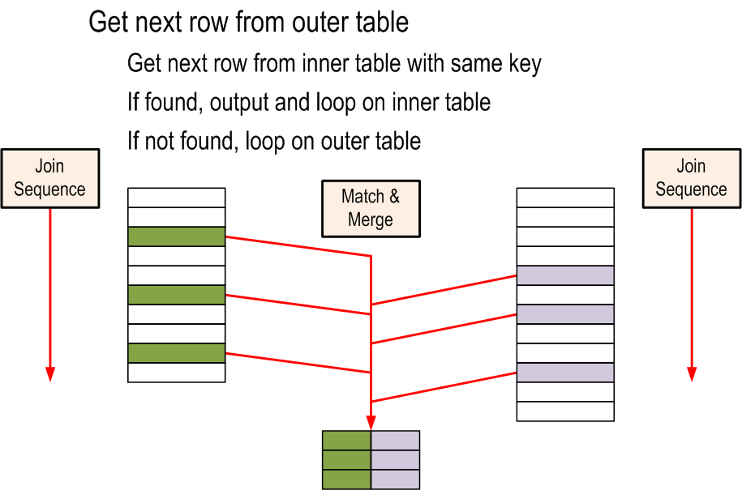
Merge Join
Notes:
A merge join simultaneously passes over two sorted inputs to perform inner joins, outer joins, semi-joins, intersections, and union logical operations.
A merge join exploits sorted scans of B-tree indexes and is generally the preferred method if the join fields are indexed, and if the columns represented in the index cover the query.

Slide 13
Merge Join
Must have sorted inputs
Index is used, otherwise pre-sort is performed
Small or large tables on either side of the join
Output is grouped and ordered
Preferred operator if covering indexes are available
Resource usage
low memory
low CPU
low IO
Notes:
If an input requires sorting then additional resources will be required.
A merge join is preferred if the join fields are indexed and columns are covered.
A merge join has the following resource usage:
low memory, unless there are many duplicates on the inner side
low CPU
low IO
More information
Understanding Merge Joins - http://technet.microsoft.com/en-us/library/ms190967(SQL.90).aspx
Merge Join - http://blogs.msdn.com/b/craigfr/archive/2006/08/03/merge-join.aspx

Slide 14

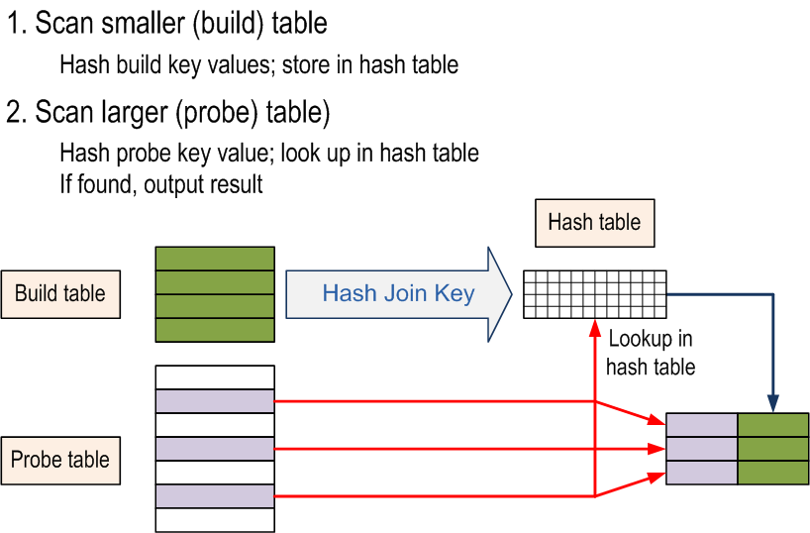
Hash Join
Notes:
The hash join:
Uses the outer table to build the hash table
Completely reads the outer table before accessing the first inner row, which does not occur in nested loop joins.
The smaller table is the outer table
Hash join takes two inputs:
Build input
builds hash buckets by using complicated hash functions that group the data
Each row is inserted into a hash bucket, depending on the hash value computed for the hash key.
The buckets are stored as linked lists where each entry contains only those columns from the build input that are needed.
Probe input
For each record in the probe input, this input evaluates the hash key and checks the appropriate hash buckets in the linked list for matches and returns matching values
The build input is completed before the probe is actually read because the hash tables need to be built first.

Slide 15
Hash Join
Does not use the order provided by indexes
Order is not preserved in either table
Is a blocking operator
Useful for
datasets that do not have indexes
very large datasets
Must wait for memory grant
Resource usage
High memory
High CPU
IO varies
Hash Bailouts
Notes:
The use of a hash match may indicate:
a WHERE clause that cannot use an existing index e.g. data type conversion or the use of a function or calculation
a missing WHERE clause
inadequate indexing on the referenced datasets
A hash join has the following resource usage:
High memory
High CPU, due to the complexity of the hash function.
IO varies. Build and probe costs are hidden and do not count towards logical reads.
Hash bailouts occur because of grace hash joins or recursive hash joins and can be monitored via the Hash warnings event class in SQL Server Profiler. Hash bailouts can potentially be reduced by:
creating or updating statistics on columns that are referenced in the hashing operation
forcing a different join e.g. OPTION(MERGE JOIN) or OPTION(LOOP JOIN). Note that the query plan may not be as efficient as a hash match but may be faster because of reduced tempdb usage.
as a last resort, increasing the physical memory available to SQL Server
Hash join types:
In-Memory Hash Join
The hash join first scans or computes the entire build input and then builds a hash table in memory.
Grace Hash Join
If the build input does not fit in memory, a hash join proceeds in several steps. This is known as a grace hash join. The entire build and probe inputs are consumed and partitioned into multiple files.
Recursive Hash Joins are used if the build input is so large that multiple merge levels, multiple partitioning steps and multiple partitioning levels are required. Large asynchronous I/O operations are used so that a single thread can keep multiple disk drives busy.
SQL Server starts with an in-memory hash join and transitions to grace hash join, and recursive hash join, depending on the size of the build input.
More information:
Understanding Hash Joins - http://technet.microsoft.com/en-us/library/ms189313(SQL.90).aspx
Hash Join - http://blogs.msdn.com/b/craigfr/archive/2006/08/10/687630.aspx

Slide 16



Scan and Seek operators
Scans are generally more expensive than seeks
Table Scan
All rows in a heap table are searched
Clustered Index Scan
All rows in a clustered index are scanned
Results may be ordered
Clustered Index Seek
Looks up each row via the clustered index key
Similar to looking up name in a telephone book
Results may be ordered
Notes:
A scan may be more efficient than a seek operator – refer to the section containing ‘tipping point’ in this course for more information.
Table Scan
A table scan means that SQL Server will search each row of a table to determine which rows are to be returned.
Table scans on small tables may be efficient, however large table scans may be an indication of missing indexes or an inefficient query plan.
Clustered Index Scan
A Clustered Index Scan means that SQL Server will search each row of a clustered index to determine which rows are to be returned. Since the clustered index contains the data, this is essentially a table scan
The scan may be ordered, the tool-tip for the operator will show Ordered = True is this is the case.
If there is no ORDERED clause SQL Server will be able to scan the data in an optimal fashion.
Although not always an issue, large clustered index scans may indicate a problem with the filtering of results.
Clustered Index Seek
A Clustered Index Seek means that SQL Server will use the clustered index key for only the rows it needs.
The scan may be ordered, the tool-tip for the operator will show Ordered = True is this is the case.
If there is no ORDERED clause SQL Server will be able to scan the data in an optimal fashion.

Slide 17


Scan and Seek operators
Index Scan
All rows in a nonclustered index are scanned
Index Seek
Looks up each row via the clustered index key
Similar to looking up name in a telephone book
Results may be ordered
Notes:
Index Scan
An Index Scan means that SQL Server will search each row of a nonclustered index to determine which rows are to be returned.
Generally much more efficient than a table or clustered index scan because a nonclustered index usually contains a subset of the columns present in the base table.
Even more efficient if the nonclustered index being scanned contains a small subset of columns
May be a by-product of good covering index usage
Index Seek
An Index Seek means that SQL Server will use a nonclustered index key for only the rows it needs.
The scan may be ordered, the tool-tip for the operator will show Ordered = True is this is the case.
If there is no ORDERED clause SQL Server will be able to scan the data in an optimal fashion.

Slide 18


Lookups
Retrieves rows from the base table after a nonclustered index seek
Expensive for large row counts
Can be avoided with a covering index
Key Lookup operator
Lookup on a clustered index
Uses the clustered index key to locate each row
RID lookup operator
Lookup on a heap
Uses the rowID to locate each row
Notes:
A lookup operator refers to rows in a base table that have been identified by a nonclustered index seek. A Leaf-level pointer of the nonclustered index is followed to find the row in the table data.
The base table may be a heap or clustered index.
Unlike a clustered index seek, a nonclustered index may not have all the columns required to satisfy a particular operation. A lookup into the base table provides the columns that are not present in the nonclustered index.
Using a covering index will remove the lookup. It may not be appropriate if additional columns make index very wide. For more information on covering indexes, refer to the module: Table and Index Structure.
Lookups
incur extra I/O and CPU resource costs due to the extra seek activity on the base tables
Sometimes referenced generally as a bookmark lookup. Not to be confused with the Bookmark Lookup operator in previous versions of SQL Server.
uses a rowID to look up rows in a heap table
will always be used with a nested loop join
Key Lookup
A key Lookup is used when the base table has a clustered index. The clustering key is used to look up rows in a clustered index via seeks.
In many cases, Key Lookups may not be particularly efficient . Each lookup means the index tree must be traversed, which introduces extra reads for every lookup.
RID Lookup
A RID Lookup is used when the base table is a heap. The rowID is used to directly reference pages in a heap and look up rows. The rowID consists of the FileID, PageID and SlotID.

Slide 19
Tipping Point
The limit where the query optimizer chooses a table scan over several index seeks
Applies to nonclustered index seeks with a lookup
Occurs when the number of seeks is equal to approx. 30% of the page count of the underlying table
Options
First determine if the scan is actually slower than the seek
create a covering index
apply query hints
FORCESEEK
INDEX hint
OPTIMIZE FOR
RECOMPILE
Notes:
The query optimizer in SQL Server must make a decision a some point when to favour a table scan over a nonclustered index seek with lookups, known as the tipping point. The query optimizer does this to minimise the logical reads.
The tipping point occurs when the number of lookups is in the range of 25-33% of the number of pages in the underlying table.
In many cases it is more efficient to do a table scan and no action needs to be taken, however if a performance issue is found then there are a few options:
Covering Index
This is the best option in terms of performance and consistency. However, be aware that the covering index is tuning this query in isolation and may affect performance otherwise.
Query Hints are not necessarily the most preferred option but may suit.
The hints WITH (FORCESEEK) and WITH (INDEX(NCIndex)) will prevent SQL Server from performing a scan. However, the FORCESEEK is preferred out of the two since it does not tie the optimizer to a specific index.
OPTION(OPTIMIZE FOR @var=x) or OPTION(OPTIMIZE FOR unknown) can be used to prevent the scan. In cases where the cardinality or data distribution in the table change significantly the hint may cause more performance issues than it solves. The biggest benefit of these hints is that they provide a consistent plan regardless of the parameter values used for the compilation. This can prevent the situation where you get a “bad plan” stuck in the cache.
OPTION(RECOMPILE) is of partial help. It can be used to make sure queries that are below the tipping point will not inherit a plan that chooses to do a scan. The drawbacks are:
it will not help queries that are beyond the tipping point.
extra compiles will introduce extra CPU resource usage
The query hints are discussed in further depth in Query Optimization - Section 6.

Slide 20

Sort
Must Wait for memory grant
Blocking operator
Query Optimizer usage
ORDER BY
Merge Join and Stream Aggregation
Nested loop
Efficiency
Notes:
The Sort operator
sorts all incoming rows
is a blocking operator. It must consume all rows before it can produce a resultset
is used typically with the ORDER BY statement
The optimizer may introduce a Sort to enable a merge join or prepare for a stream aggregation if it is cheaper than alternatives with unordered sets. The optimizer is less likely to perform a sort operation for stream aggregation on larger datasets.
The efficiency of the Sort operator is reduced as the size of the dataset increases. Supporting indexes for ORDER BY clauses increase in importance as table size increases.

Slide 21

Columnstore
Useful for large amounts of data
Not good for highly selective queries
Columnstore Scan operator
no seek operator
can be used with a FORCE hint
can be ignored by the query optimizer
has unordered results
Notes:
The query optimizer must now choose between execution modes. One row of data is processed at a time by operators in row execution mode, which has always been the case for versions of SQL Server prior to 2012 and is available to all operators. Batch execution mode is the new mode which processes data in batches, being more efficient for large amounts of data. Not all operators can use batch execution mode.
The query hint WITH (INDEX(csIndex)) can be used force the use of a columnstore index.
The use of query hint OPTION (IGNORE_NONCLUSTERED_COLUMNSTORE_INDEX) will direct the query optimizer to ignore columnstore indexes.
More information:
SQL Server Columnstore Performance Tuning - http://social.technet.microsoft.com/wiki/contents/articles/sql-server-columnstore-performance-tuning.aspx

Slide 22

Aggregation
GROUP BY and DISTINCT
Stream Aggregate operator
Must wait for memory grant
Requires ordered input
Hash Aggregatation
Used for unordered datasets
Must wait for memory grant
Is a blocking operator
Uses the Hash Match physical operator
Notes:
Aggregation is introduced by the query optimizer based on the columns listed in a GROUP BY or DISTINCT clause. The query optimizer has the choice of Stream Aggregation or Hash Match Aggregation
Stream Aggregation is performed only on sorted data sets. The optimizer query may choose to do a sort on a dataset before Stream Aggregation.
The Stream Aggregate operator groups rows by one or more columns and then calculates one or more aggregate expressions returned by the query. The sorted data allows SQL Server to stream the data and when the value of the GROUP BY key changes in the resultset, SQL knows that it is finished with the aggregation of the previous group, and therefore, returns the resulting aggregated row
Hash Aggregation uses the Hash Match physical operator.
Hash aggregations build a hash table and use it to track different values of the GROUP BY keys. Hash aggregation also aggregates the entire dataset before returning any aggregated rows.
More information
Stream Aggregate - http://blogs.msdn.com/b/craigfr/archive/2006/09/13/752728.aspx
Hash Aggregate - http://blogs.msdn.com/b/craigfr/archive/2006/09/20/hash-aggregate.aspx

Slide 23
Suboptimal Plans
Missing statistics
Out-of-date statistics
Miscalculated cardinalities
Missing indexes
Incorrect estimated cost
Notes:
The query optimizer may choose a sub-optimal plan for any of the following reasons:
Missing Statistics
Recall that the histogram on an index is maintained on the first column of an index. If a column in a WHERE clause does not appear in any indexes as the first column it will need to have statistics created.
If AUTO_CREATE_STATISTICS is not enabled on the database then the query plan will show the missing statistics warning. In this case, SQL must use densities to estimate the number of rows to be returned from the seek or scan operation, but will not have any information about the ranges of values that exist.
Out-of-date statistics
If the changes to a table are not sufficient to cross the Recompilation threshold then statistics will not be updated at run time for a query. In some cases the change in data means that the current statistics do not accurately reflect the distribution of the data, or the data is beyond the range of the statistics, leading to an inefficient query plan. If this is the case, then the statistics need to be updated.
Miscalculated cardinalities
Miscalculating the cardinality significantly increases the cost of a query and may lead to an incorrect estimate of whether a query can benefit from parallelism. Miscalculated cardinality can be caused by missing/out of date statistics, parameter sniffing or the use of LIKE, CASE and function calls (implicit or explicit) in WHERE and JOIN clauses.
Missing Indexes
Indexes provide the opportunity to retrieve results with less logical reads. If no indexes exist, the optimizer cannot consider them for query plans and will resort to scanning tables.
Incorrectly estimated cost of the operator
A miscalculated cardinality is often the reason for an incorrect operator cost estimate. The query optimizer will choose an operator, such as a nested loop, partially based on the number of rows in a dataset. If the cardinality is incorrect, say 1000 rows are returned instead of 1, then the cost of the operator may increase significantly. If the true cardinality was know then a more realistic operator cost could have been calculated and the query optimizer may have chosen another operator.

Slide 24
Detecting Plan Issues
Management studio - SET STATISTICS XML ON/OFF
SQL Server query profiler - SHOWPLAN XML STATISTICS event
Extended Events – query_post_execution_showplan
Look for
<MissingIndexes>
Estimated row count vs actual row count
Large row counts, estimated costs or execution counts
Warnings
Join Techniques (Join techniques (hash, loop, merge)
Access techniques (seeks, scans, Key or RID lookups)
Aggregation techniques (hash, stream)
Other operations (sort, top, …)
Notes:
Some queries are expensive either because of the size of the query, or due to missing indexes. Look at expensive nodes in the query plan to find the reasons they are expensive, and analyze what can be done to change the plan. For example, a hash join may be changed to a less expensive operation by the addition of a covering index.
Some operations are inherently expensive. Extract Transform and Load (ETL) queries are often performed to extract large datasets. Such queries expect a large number of rows. Analyze the query plans with an understanding of the extraction requirements.

Slide 25
Steps to optimize queries
Look for stale or missing statistics
Run Database Tuning Advisor
Check for index hints or query hints
Look for stored procedures that need to be recompiled
Look for queries that can be parameterized
Look for plans that can be forced for consistency
Look for miscalculated cardinalities
Notes:
Use the following steps when analyzing a showplan:
Are the statistics for all indexes up-to-date? Be especially careful of the NORECOMPUTE clause, which will prevent AUTO_UPDATE_STATISTICS from maintaining statistics.
Look for the Missing Stats warnings in Profiler or SHOWPLAN_XML output.
Run the Database Engine Tuning Advisor (DTA). Given the changes to the way indexes are stored and manipulated, the indexes that you had on the previous version may no longer be optimal.
Are any index hints or query hints being used? If yes, remember:
Any plan containing hints will not be auto-parameterized and cached.
Hints prevent the query optimizer from investigating a better alternative.
Using a join hint prevents the query optimizer from analyzing optimal join ordering.
Are the parameters for a stored procedure being passed in such a way that a different plan should be chosen from one iteration to the next? If so, you should consider using WITH RECOMPILE when the procedure is created, or EXEC … WITH RECOMPILE when the procedure with the unusual values is called. A new option since SQL Server 2005 is to modify the query in the stored procedure and use the OPTIMIZE FOR query hint.
Are there many small, ad hoc queries being used? The best way to handle this is by parameterizing your queries, using parameter markers in OLE DB or ODBC, or using sp_executesql. Use sp_executesql instead of EXECUTE whenever possible, because it avoids recompiles. The server also attempts to minimize the impact by caching plans (this requires fully qualified object names, including the database name) and auto parameterization.
Can you force a plan that is significantly faster? If the elapsed time to process the query is already very short (less than 250 ms), forcing a plan may just eliminate part of the compile time.
Incorrect cardinality estimation can lead to a poor plan decision. Using plan SET STATISTICS PROFILE ON or SET STATISTICS XML ON, compare the estimated rows against the actual rows to see if they are different. If so, this indicates poor cardinality estimation by query analyzer.

Slide 26
Graphical Query Plans
Tooltips
Actual vs. estimated information
Missing Index Information
Parallelism
XML view
Warnings
Finding expensive subtrees
Notes:
Be sure to
hover over nodes on both estimated and actual execution plan
compare point actual vs. estimated rows
The queries should use all 3 join strategies. Point out the 3 join strategies to set up for the next section which will discuss them in detail.
-- Query Optimization
-- Graphical Query Plans
-- use Ctrl-L to view the graphical estimated execution plans on these queries
-- also use the "Include Actual Execution Plan" button
-- Use SET SHOWPLAN_XML ON to view estimated execution plans
-- Use SET STATISTICS XML ON to view actual execution plans
USE AdventureworksPTO
GO
-- Point out
-- which subtrees have the most rows
-- lookup
-- show missing index details
-- which operations cost the most
SELECT p.Title + ' ' + p.FirstName + ' ' + p.LastName AS FullName,
c.AccountNumber,
s.Name
FROM Person.Person AS p
INNER JOIN
Sales.Customer AS c
ON c.PersonID = p.BusinessEntityID
INNER JOIN
Sales.Store AS s
ON s.BusinessEntityID = c.StoreID
WHERE p.LastName = 'Koski';
-- loop joins
SELECT FirstName,
LastName,
a.ModifiedDate
FROM Person.Person AS p
INNER JOIN
HumanResources.Employee AS e
ON p.BusinessEntityID = e.BusinessEntityID
INNER JOIN
Person.BusinessEntityAddress AS a
ON e.BusinessEntityID = a.BusinessEntityID
WHERE e.JobTitle = 'Marketing Assistant';
-- hash match
SELECT soh.BillToAddressID
FROM Sales.Customer AS c
LEFT OUTER JOIN
Sales.SalesOrderHeader AS soh
ON c.CustomerID = soh.CustomerID;
--merge join
SELECT poh.PurchaseOrderID,
poh.OrderDate,
pod.ProductID,
pod.DueDate,
poh.VendorID
FROM Purchasing.PurchaseOrderHeader AS poh
INNER JOIN
Purchasing.PurchaseOrderDetail AS pod
ON poh.PurchaseOrderID = pod.PurchaseOrderID;
-- hash match
SELECT soh.PurchaseOrderNumber,
soh.AccountNumber,
sod.OrderQty,
sod.LineTotal,
c.CardNumber
FROM Sales.SalesOrderHeader AS soh
INNER JOIN
Sales.SalesOrderDetail AS sod
ON soh.SalesOrderID = sod.SalesOrderID
INNER JOIN
Sales.CreditCard AS c
ON soh.CreditCardID = c.CreditCardID;
-- hash + parallelism
-- what happens to the cost when the order by is dropped?
SELECT p.Name,
sod.OrderQty,
sod.UnitPrice
FROM Production.Product AS p
INNER JOIN
Sales.SalesOrderDetail AS sod
ON p.ProductID = sod.ProductID
ORDER BY p.Name DESC;
--showplan warning example
-- be sure to turn off Display Actual Execution Plan!
USE tempdb;
GO
IF object_id('tblTest') IS NOT NULL
DROP TABLE tblTest;
-- prepare data
CREATE TABLE tblTest
(
c1 INT PRIMARY KEY CLUSTERED,
c2 INT ,
c3 CHAR (1000)
);
GO
SET NOCOUNT ON;
BEGIN TRANSACTION;
DECLARE @i AS INT;
SET @i = 1;
WHILE @i <= 10000
BEGIN
INSERT INTO tblTest (c1, c2, c3)
VALUES (@i, @i, 'a');
SET @i = @i + 1;
END
COMMIT TRANSACTION;
GO
SET STATISTICS XML ON;
GO
SELECT *
FROM tblTest
WHERE c1 <= 7000
ORDER BY c2
OPTION (MAXDOP 1);
GO
SET STATISTICS XML OFF;

Slide 27
Lesson Review
What are three things that can cause a miscalculated cardinality?
Briefly explain why a lookup might appear in a query plan?
What is a method to eliminate a lookup?
Where can index suggestions be found to improve a query’s performance?
What is a blocking operator?
What are the three join operators?
Under what circumstances would a table scan be more efficient than an index seek on a nonclustered non-covering index?
How would a “Missing Statistics” warnings in a query plan be addressed?
Notes:
What are three things that can cause a miscalculated cardinality?
Answer: A miscalculated cardinality can be cause by:
missing statistics
stale statistics
use of LIKE or CASE in WHERE and JOIN clauses
Briefly explain why a lookup might appear in a query plan?
Answer: A lookup is used when a seek on a nonclustered index does not contain all the required columns in a table.
What is a method to eliminate a lookup?
Answer: A lookup can be eliminated with a nonclustered covering index.
Where can index suggestions be found to improve a query’s performance?
Answer: The missing index section of a query plan will provide index suggestions, if applicable.
What is a blocking operator?
Answer: A blocking operator is a operator that must retrieve all of its data before producing any output.
What are the three join operators?
Answer: The three join operators are hash, merge and loop.
Under what circumstances would a table scan be more efficient than an index seek on a nonclustered non-covering index?
Answer: If the number of logical reads in a table scan is less than the number of logical reads for a seek+lookup for each row required by an operation.
How would a “Missing Statistics” warnings in a query plan be addressed?
Answer: the query optimizer will use densities to estimate the number of rows to be returned from the seek or scan operation instead of information about the ranges of values that exist.

