Slide 1
DocumentDB Overview Slides

Slide 2
What is DocumentDB?
Document database that supports fully manage storage of JSON documents in a highly performant way.
Fully managed distributed database.

Slide 3
Key Features
Schema less, NoSQL document database
Fully managed, with provisioned capacity
Allows for SQL like queries on Semi structured data (i.e. JSON files)
Supports strong consistency for transactional applications
Designed to scale into petabytes
Includes libraries for Node,.NET, REST,Javascript (Client & Server),Python
Includes Hekaton technologies (In Memory SQL)

Slide 4
Great. How do I Manage?
Supported in new portal
Manage database account, collections, users etc
View consumption statistics
http://portal.azure.com
Use tools like
Query explorer (Azure Portal)
Document explorer (Azure Portal)
DocumentDB studio (3rd Party Free tool)
LinqPad / VS (Why not?)

Slide 5
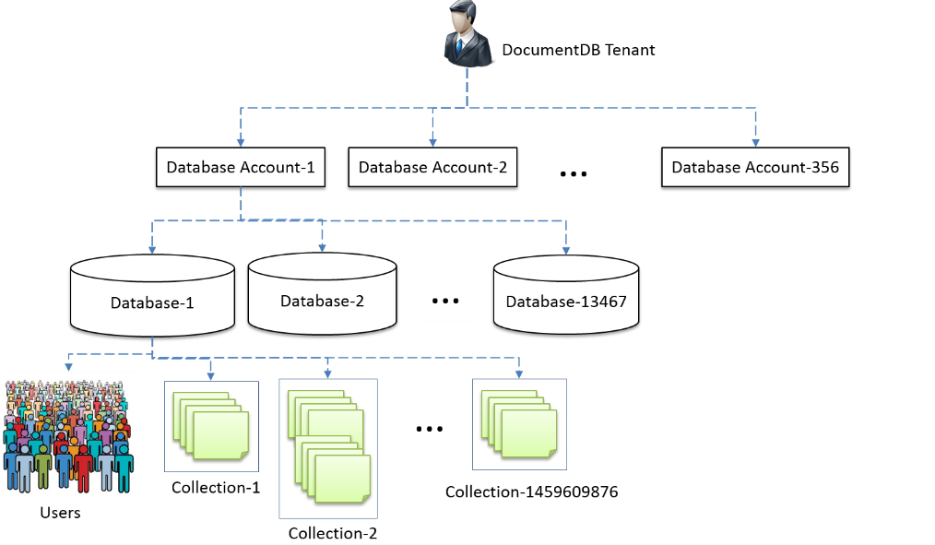
Overview of DocumentDB

Slide 6
Resource Addresssing
Restful
Unique ID
API Url:
https://{databaseaccount}.documents.azure.com
Document Path
/dbs/{database id}/colls/{collectionid}/docs/{documentid}
Client libraries
.NET
Javascript
Python

Slide 7
Resource Model
Database Account
Database
Collection
Document
Attachment
Stored Procedure
Trigger
User-defined functions
User
Permission
Media

Slide 8
Request Unit
Single measure for the resources required to perform various database operations and service and application request
Each collection comes with a defined amount of Request Units of throughput.
Can purchase higher level throughput
Notes:
In Preview, collections quota can be between 0-10GB
http://azure.microsoft.com/en-us/documentation/articles/documentdb-manage/
CU: Measure of Provisioned Storage(GB) and Throughput (Req/s)

Slide 9
Pricing
Collections | SSD Storage | Request Units | Scale Out Limits | SLA | Price
S1 | 10 GB | 250/s | Up to 100- call support for more | 99.95% | Starting 4c/hour
S2 | 10 GB | 1000/s | Up to 100- call support for more | 99.95% | Starting 8c/hour
S3 | 10 GB | 2500/s | Up to 100- call support for more | 99.95% | Starting 17 c/hour
Notes:
Currently available in East US, West US, North Europe , West Europe , East Asia & South East Asia.
DocumentDB is billed based on the number of collections contained in a database account. Each account can have one or more databases and each database can have a virtually unlimited number of collections, although there is an initial default quota of 100. This quota can be lifted by contacting Azure support.
DocumentDB collections are available in the Standard service tier. Collections are billable entities, each billed hourly, based on the performance level assigned to the collection. Collections are set to one of three performance levels - S1, S2 or S3. You can also dynamically change the performance level of a collection—for example, create an S1 collection, scale up to S3, then back to S2.
Each time you create a collection you incur a charge for at least one hour of use, as determined by the specified performance level of the collection. If you create a collection and delete it within an hour, you are still charged for one hour of use. A database account that contains no databases or collections incurs a cost equivalent to an S1 collection per hour. To avoid this charge the database account itself, not just the databases within that account, must be deleted. Learn more about collections and performance levels.

Slide 10
Limits and Quotas
Database accounts comes with administrative quota of
5 Database Accounts*
100 databases
500,000 users (Number of users per database account – across all databases)
2,000,000 permissions (Number of permissions per database account – across all databases)
Notes:
In Preview, collections quota can be between 0-10GB
http://azure.microsoft.com/en-us/documentation/articles/documentdb-manage/
CU: Measure of Provisioned Storage(GB) and Throughput (Req/s)

Slide 11
Limits and Quotas..
Attachment storage per database account : 2GB
Max Request Units / second / Collection : 2500
No of stored procedures, triggers and UdFs per collection : 25 each
Maximum execution time for stored procedure and trigger: 5 seconds
Provisioned document storage/collection: 10GB
Max collections per database account: 100
Max document storage per database (100 collections) : 1TB
Maximum length of the Id property : 255 characters
Maximum items per page: 1000
Maximum request size of document and attachment: 512KB
Maximum request size of stored procedure, trigger and UDF: 512KB
Notes:
In Preview, collections quota can be between 0-10GB
http://azure.microsoft.com/en-us/documentation/articles/documentdb-manage/
CU: Measure of Provisioned Storage(GB) and Throughput (Req/s)

Slide 12
Limits and Quotas Continues..
Maximum Response size: 1MB
String: All strings must conform to the UTF-8 encoding. Since UTF-8 is a variable width encoding, string sizes are determined using the UTF-8 bytes
Maximum length of property or value: no practical limit
Maximum number of UDFs per query *: 1
Maximum number of JOINs per query *: 2
Maximum number of AND clause per query*: 5
Maximum number of OR clause per query *: 5
Maximum number of values per IN expression *: 100
Maximum number of collections creates per minute *: 5
Maximum number of scale operations per minute *: 5
Notes:
In Preview, collections quota can be between 0-10GB
http://azure.microsoft.com/en-us/documentation/articles/documentdb-manage/
CU: Measure of Provisioned Storage(GB) and Throughput (Req/s)

Slide 13
REST API
Standard Operations
Create,Delete,Put,Get,Post
Permanent Uri on Create
HMAC authentication using management or resource key
DocumentDB request headers

Slide 14
.NET Development
You need following from the portal after provision a database
Endpoint Url
Authorization key
Nu-get package
Install-Package Microsoft.Azure.DocumentDB
Use them to create DocumentClient

Slide 15
Demo

