Slide 1
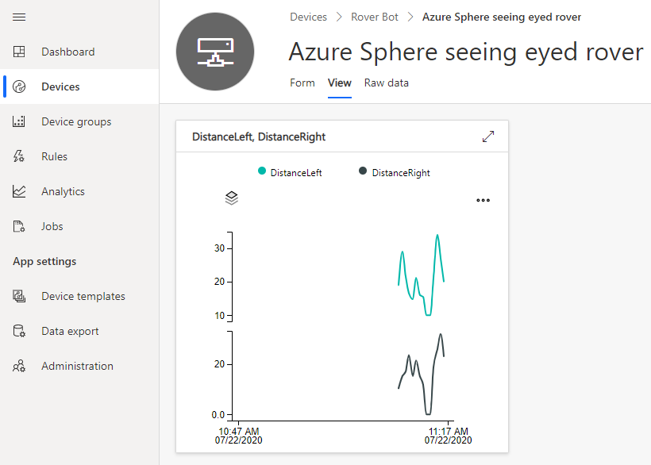
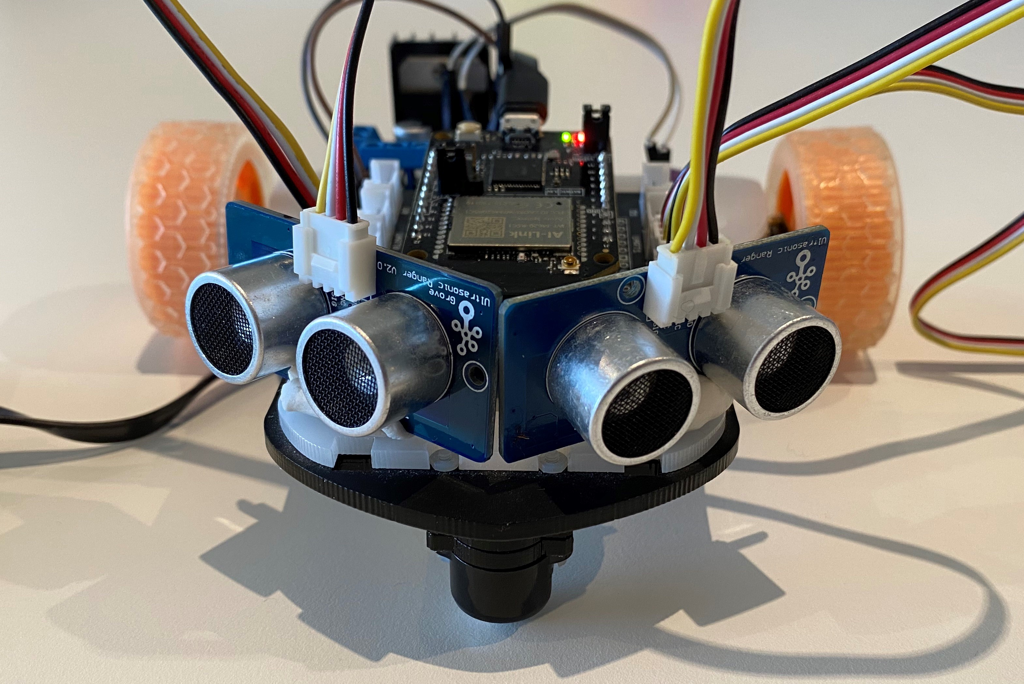
Realtime Azure RTOS ThreadX Azure IoT Integration Architecture
Azure Sphere MT3620 MCU
Azure RTOS ThreadX
Task
A7
Highlevel
core
IoT Central
Azure RTOS ThreadX
Thread
Ultrasonic distance sensor HC-SR04
Intercore bridge
M4
Realtime
core
Azure RTOS ThreadX
Thread
Intercore messaging
Intercore bridge
Azure RTOS ThreadX
Azure RTOS ThreadX
Thread
LED UI
M4
Realtime
core
MTK M4 drivers

Slide 2
Seeing Eyed Rover demo
Realtime Azure RTOS ThreadX Highlevel Azure IoT Integration Architecture
Azure Sphere MT3620
Azure RTOS ThreadX
Task
A7
Highlevel
core
IoT Central
Azure RTOS ThreadX
Task
Ultrasonic distance sensor HC-SR04
Intercore bridge
M4
Realtime
core
Azure RTOS ThreadX
Task
Intercore messaging
Intercore bridge
Azure RTOS ThreadX
Azure RTOS ThreadX
Task
LED UI
M4
Realtime
core
MTK M4 drivers

Slide 3
Azure Sphere MT3620 Application Architecture
Azure RTOS ThreadX
Task
A7
Highlevel
core
IoT Central
Azure RTOS ThreadX
Thread
Ultrasonic distance sensor HC-SR04
Intercore bridge
M4
Realtime
core
Azure RTOS ThreadX
Thread
Intercore messaging
Intercore bridge
Azure RTOS ThreadX
Azure RTOS ThreadX
Thread
LED UI
M4
Realtime
core
MTK M4 drivers

