Slide 1




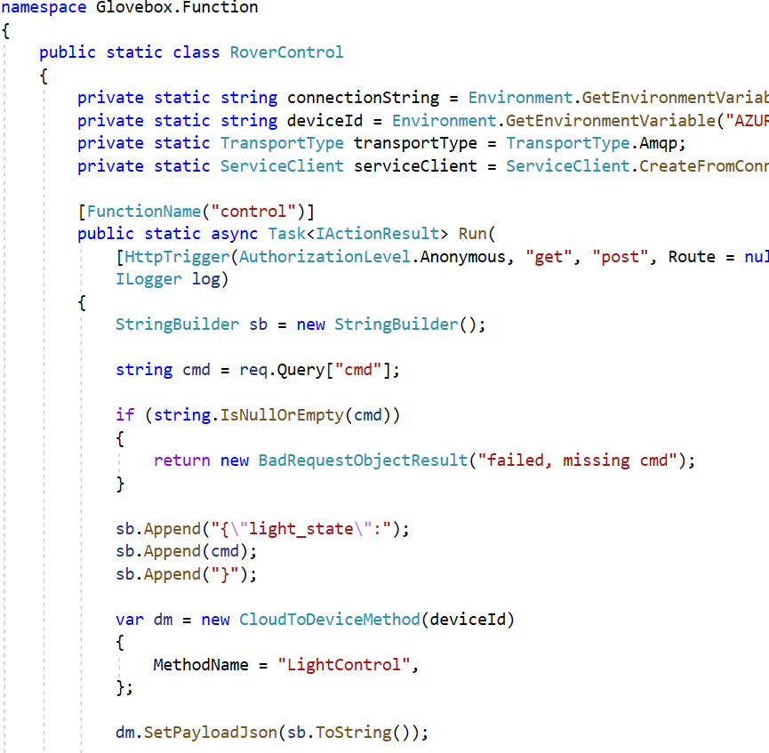
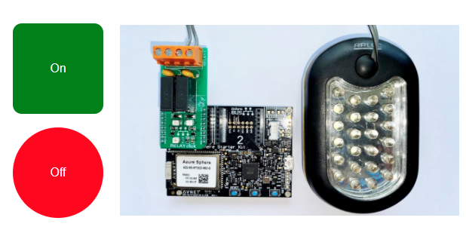
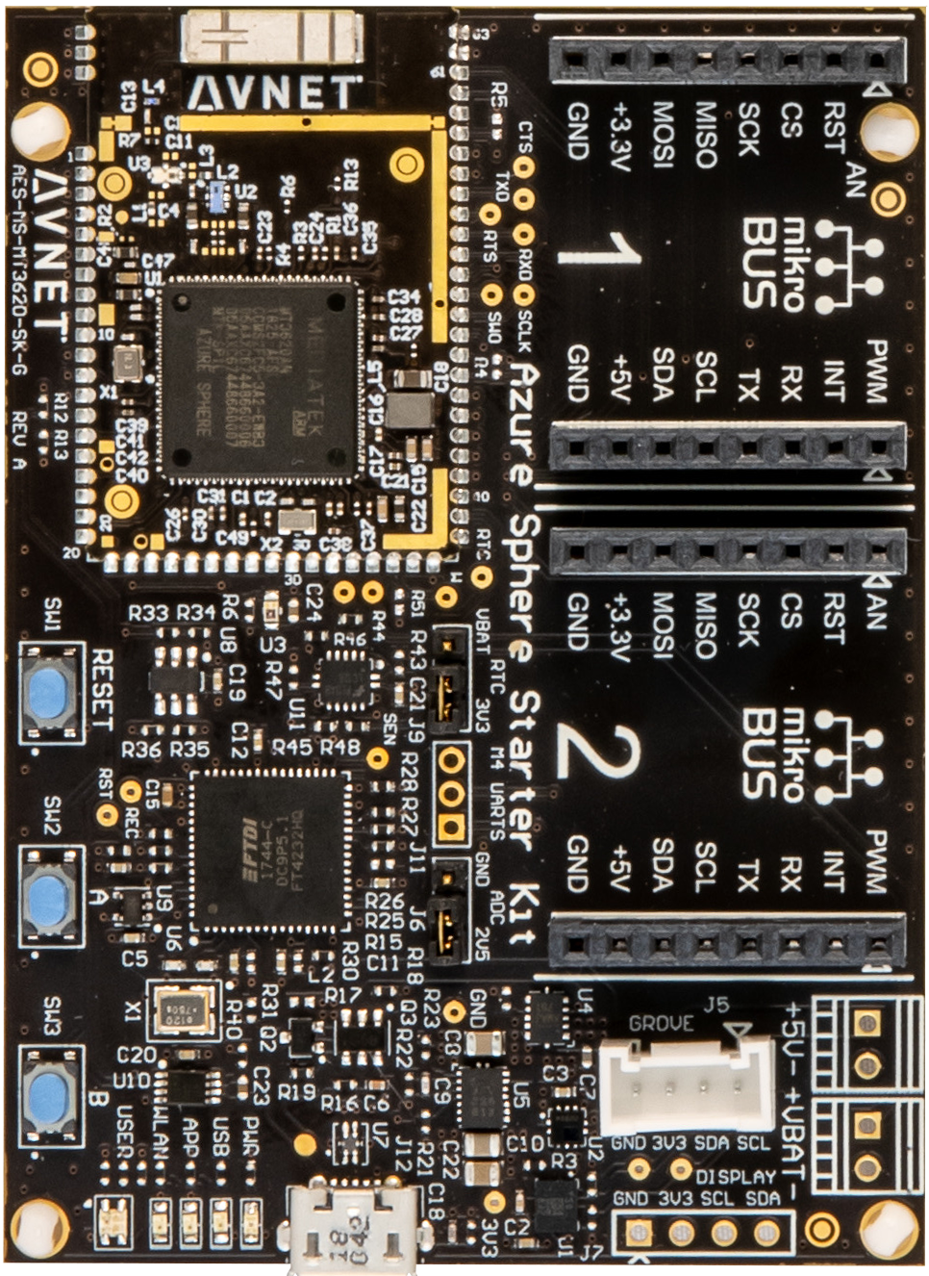
Azure Storage
Static Website
Azure Function “Control”
IoT Hub Direct Methods
Azure Sphere
IoT Hub Client
Azure Function Control
RPi Rover
1
Method Request
Direct method LightControl handler function
Invoke LightControl direct method
2
Apply action
3
Method Response
Direct method handler response
4
Azure Storage Static Website HTML/JavaScript page calls Azure Function HTTP Trigger
Azure Function invokes IoT Hub Direct Method
Azure IoT Hub sends Direct Method “LightControl” msg with payload
Azure Sphere with Azure IoT C SDK

