Slide 1



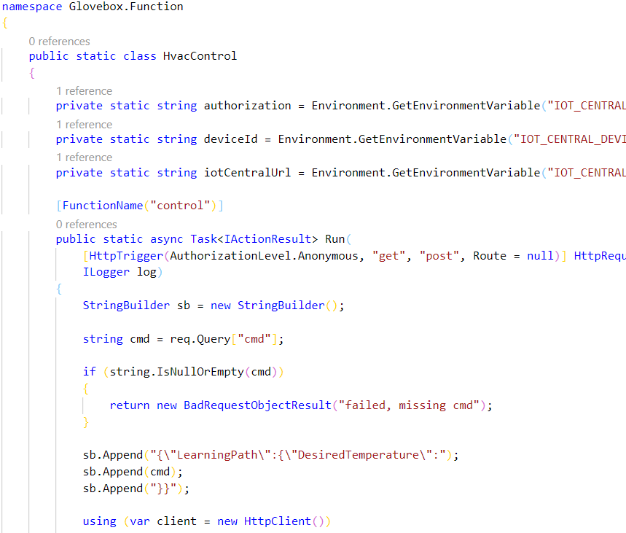
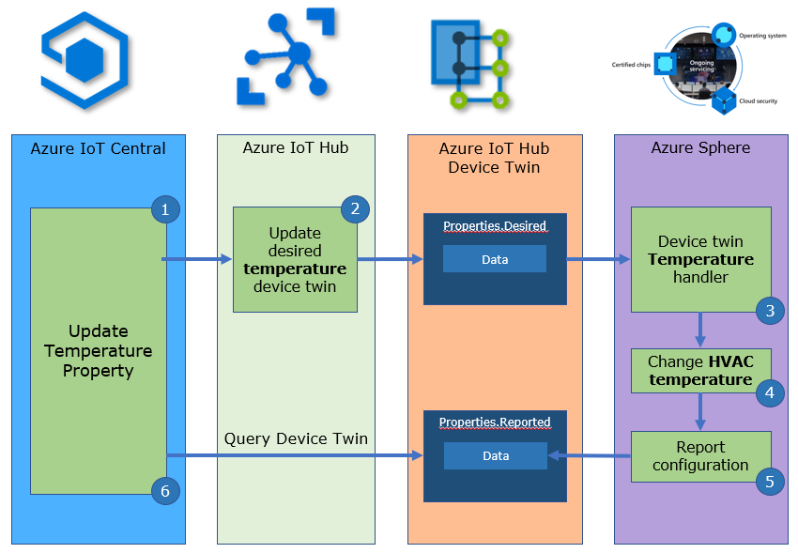
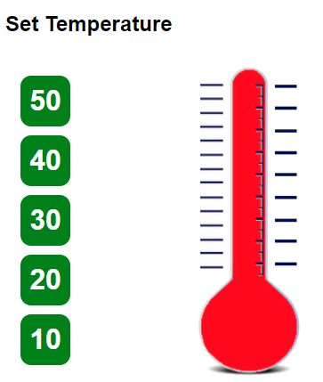
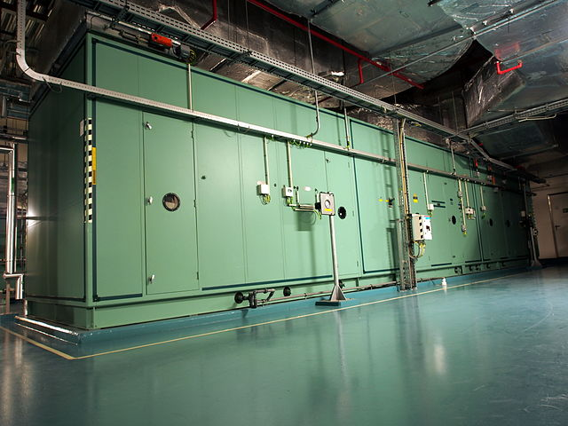
Azure Storage
Static Website
Azure Function “Control”
Azure Sphere HVAC Control
Azure Storage Static Website HTML/JavaScript page calls Azure Function HTTP Trigger
Azure Function invokes IoT Central Update Properties REST API
IoT Central requests Azure IoT Hub to send “desired temperature” device twin
Azure Sphere implements HVAC actions

Slide 2



Azure IoT Central
Azure IoT Hub
Azure IoT Hub Device Twin
Azure Sphere
3
4
Update
temperature
Property
Update desired temperature
device twin
Properties.Desired
Device twin
temperature handler
1
2
JSON
5
Change HVAC temperature
6
Properties.Reported
Query Device Twin
JSON
Report configuration
8
7
Azure Storage Static Website HTML/JavaScript page calls Azure Function HTTP Trigger
Azure Function invokes IoT Central Update Property REST API
Azure IoT Central requests Azure IoT Hub to send “desired temperature” device twin
Azure IoT Hub updates device twin and sends device twin message to Azure Sphere HVAC control device
Azure Sphere implements HVAC actions and reports state
Notes:
Change the rate the sensor os measured

