Slide 1


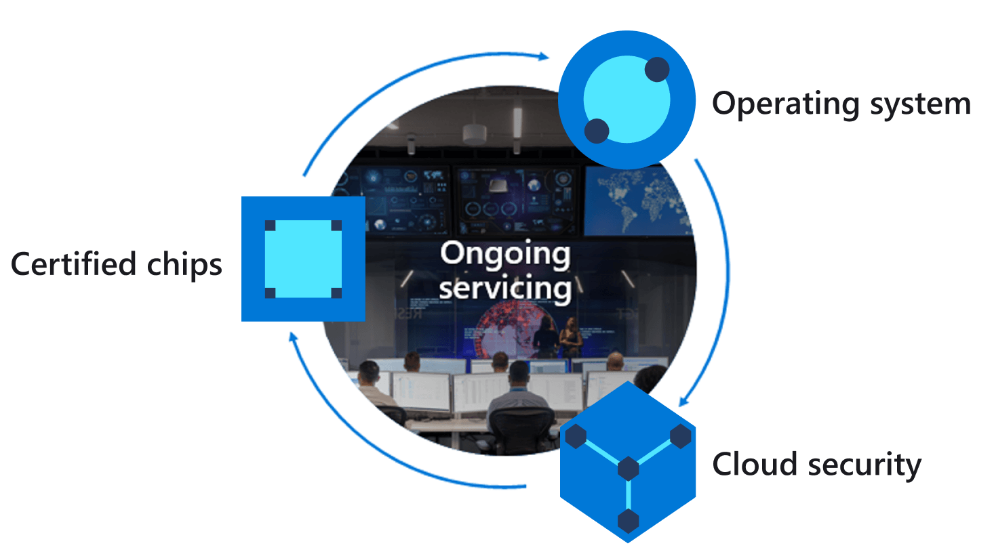
Azure IoT Central
Azure IoT Hub
Azure Sphere
Cortex A7 High-level core
1
2
Telemetry streaming
Device twin virtual HVAC control
Update desired temperature
Property
IoT Hub Messaging
{
“Temperature”:26,
“Humidity”:55,
“Pressure”: 1100
}
5
3
Intercore message bridge
4
Device Twins
Cortex M4 Real-time core
JSON
Environment telemetry service thread
Environment telemetry sense thread
6
Notes:
Change the rate the sensor os measured

Slide 2
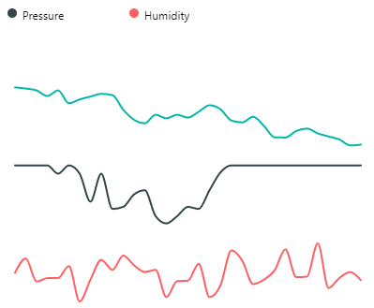
Azure IoT Central
Azure IoT Hub
Azure Sphere
Cortex A7 High-level
Intercore message bridge
Cortex M4 Real-time
1
IoT Hub Messaging
Telemetry streaming
3
4
Environment telemetry service thread
{
“Temperature”:26,
“Humidity”:55,
“Pressure”: 1100
}
2
Device twin
Desired Temperature
Device twin virtual HVAC control
Environment telemetry sense thread
5
5
6
JSON
Notes:
Change the rate the sensor os measured

