Slide 1
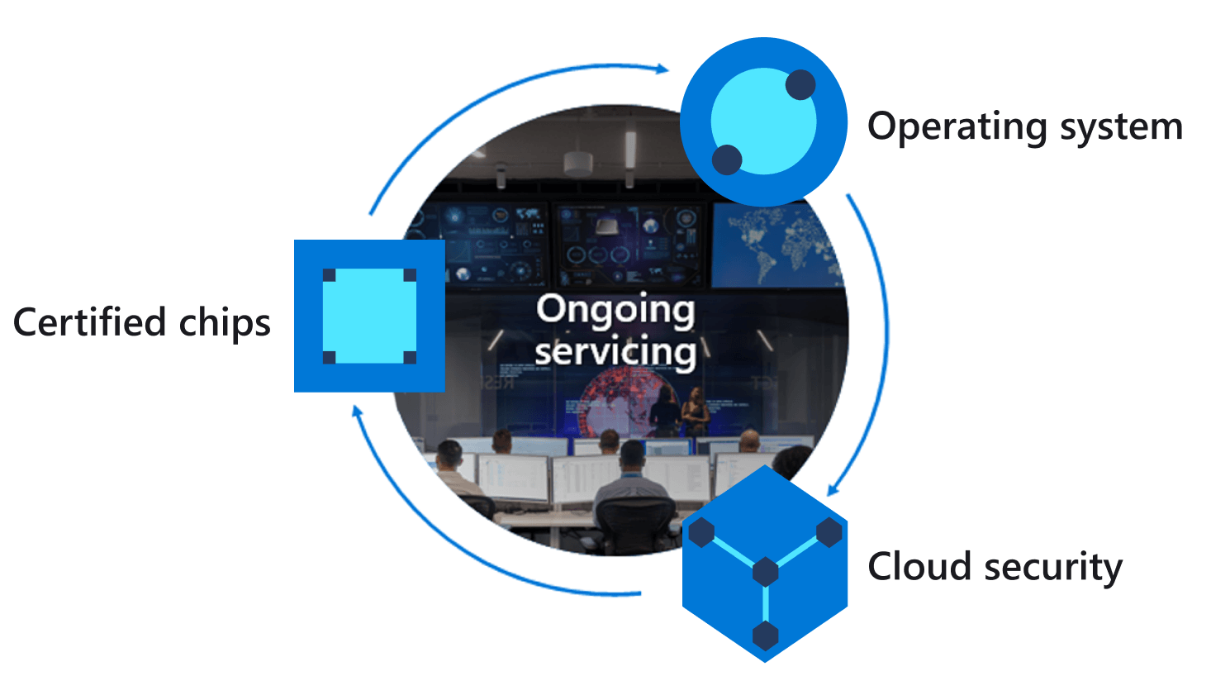
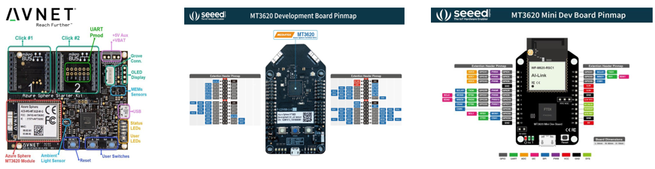
Secure IoT with Azure Sphere, Azure RTOS and IoT Central
Azure IoT Central
IoT Hub & Device Twins
DPS
ASA
TSI
Azure Sphere MT3620
Cortex A7 Application core
Intercore
Message bridge
Cortex M4 Real-time core
High-level application
Azure RTOS ThreadX
5
Request Environment Telemetry
2
Environment telemetry service thread
1
3
Receive Telemetry forward to Azure IoT
Environment telemetry sense thread
4
Notes:
M: Ask Dave why would you run apps on multiple cores and in particular the Cortex M4 Real time core
Running time sensitive code –sensor depends on predictable timing
Scenarios include migrating existing code
Running FreeRTOS and Azure RTOS
Running Time Machine Learning models – for example voice activation

Slide 2
Azure IoT Central
IoT Hub & Device Twins
Device Provision Service
Azure Stream Analytics
Time Series Insights
Azure Sphere MT3620
Cortex A7 Application core
Intercore
Message bridge
Cortex M4 Real-time core
High-level application
Azure RTOS ThreadX
5
Request Environment Telemetry
2
Environment telemetry service thread
1
3
Receive Telemetry forward to Azure IoT
Environment telemetry sense thread
4
Notes:
M: Ask Dave why would you run apps on multiple cores and in particular the Cortex M4 Real time core
Running time sensitive code –sensor depends on predictable timing
Scenarios include migrating existing code
Running FreeRTOS and Azure RTOS
Running Time Machine Learning models – for example voice activation

