Slide 1
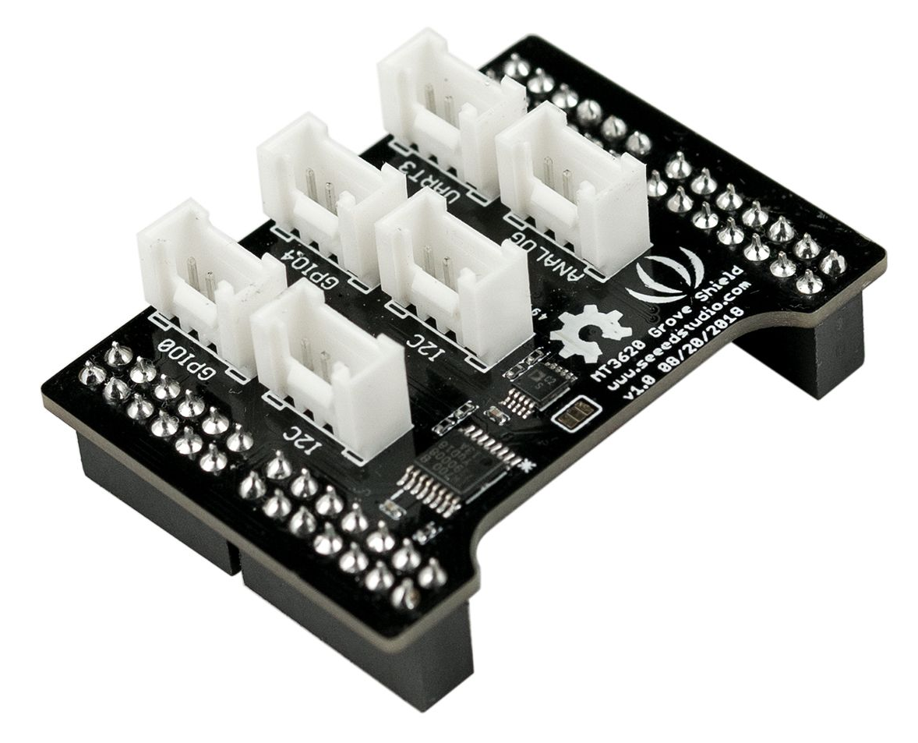
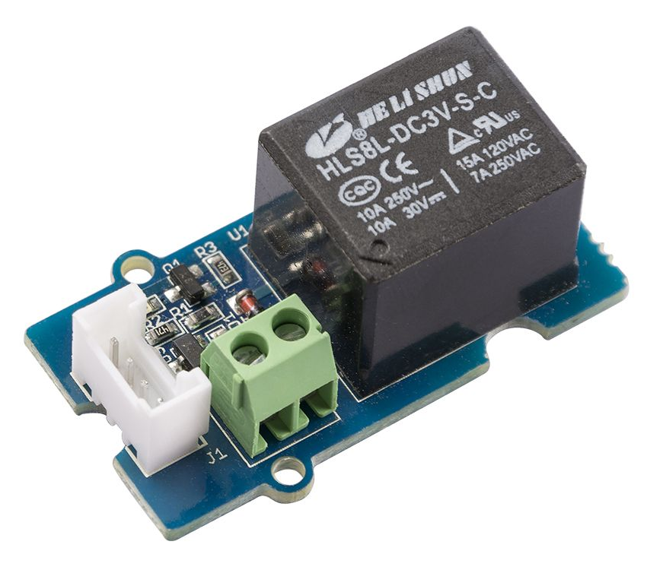
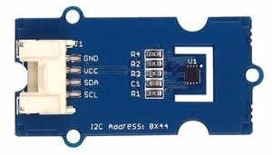
Azure Sphere
Grove Shield
Grove SHT31
Grove Relay

Slide 2
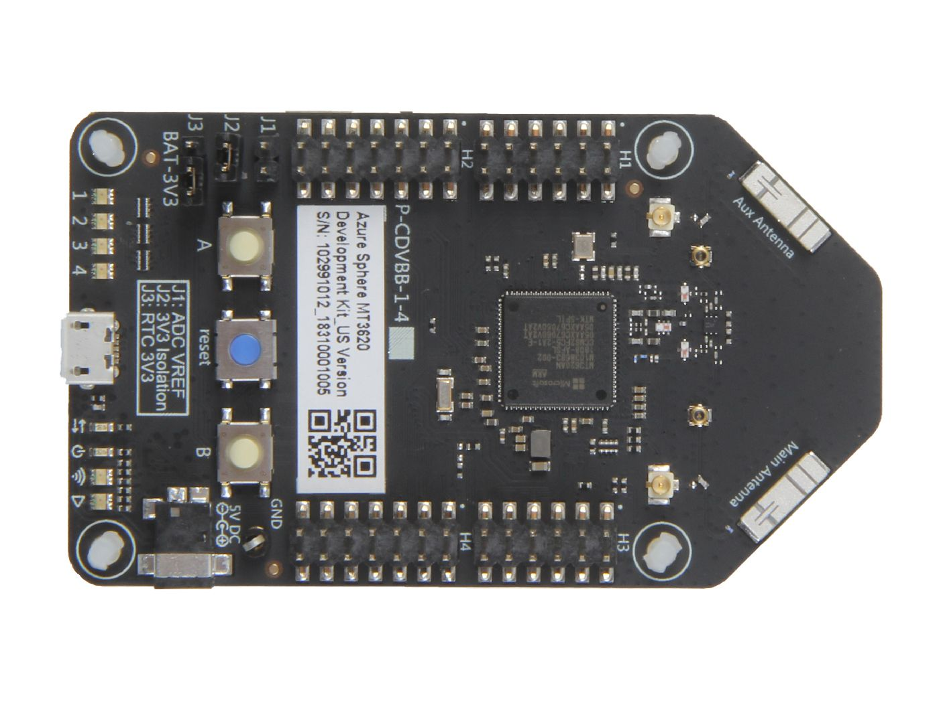
Seeed Studio Azure Sphere

Slide 3
Azure Sphere
Grove Shield
Grove Relay
Grove SHT31
Seeed Studio Azure Sphere

