Slide 1


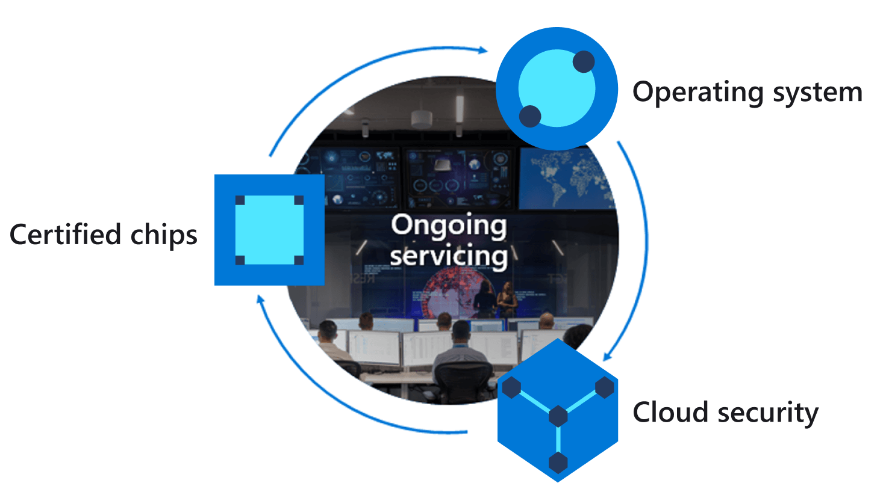
Azure IoT Central
Azure IoT Hub Device Twin
Azure Sphere
1
2
Device twin
temperature handler
Update desired temperature
Property
Properties.Desired
JSON
3
Set HVAC temperature
4
Properties.Reported
Query
Device twin
JSON
Acknowledge configuration
6
5
Notes:
Change the rate the sensor os measured

