Slide 1
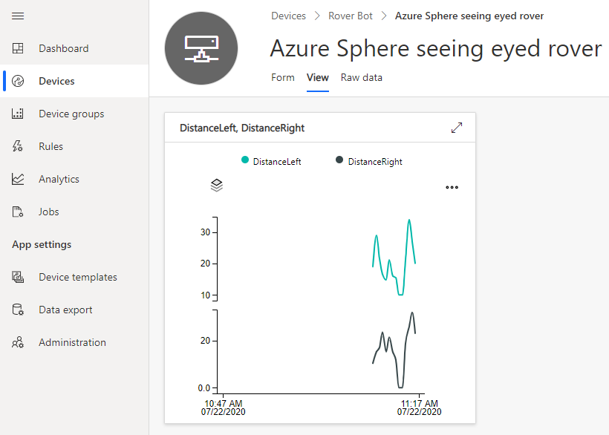
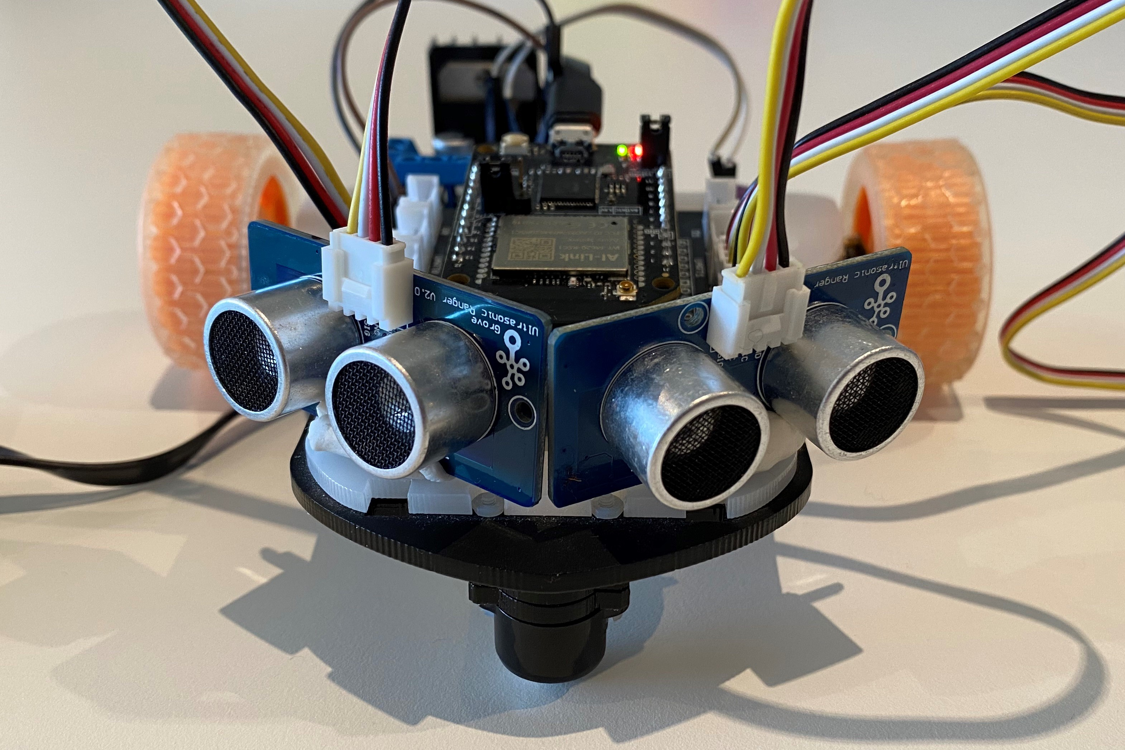
Seeing Eyed Rover demo
Realtime FreeRTOS Highlevel Azure IoT Integration Architecture
Azure Sphere MT3620
FreeRTOS
Task
A7
Highlevel
core
IoT Central
FreeRTOS
Task
Ultrasonic distance sensor HC-SR04
Intercore bridge
M4
Realtime
core
FreeRTOS
Task
Intercore messaging
Intercore bridge
FreeRTOS
FreeRTOS
Task
LED UI
M4
Realtime
core
MTK M4 drivers

Slide 2
Seeing Eyed Rover demo
Realtime FreeRTOS Highlevel Azure IoT Integration Architecture
Azure Sphere MT3620
FreeRTOS
Task
A7
Highlevel
core
IoT Central
FreeRTOS
Task
Ultrasonic distance sensor HC-SR04
Intercore bridge
M4
Realtime
core
FreeRTOS
Task
Intercore messaging
Intercore bridge
FreeRTOS
FreeRTOS
Task
LED UI
M4
Realtime
core
MTK M4 drivers

Slide 3
Azure Sphere MT3620 Application Architecture
FreeRTOS
Task
A7
Highlevel
core
IoT Central
FreeRTOS
Task
Ultrasonic distance sensor HC-SR04
Intercore bridge
M4
Realtime
core
FreeRTOS
Task
Intercore messaging
Intercore bridge
FreeRTOS
FreeRTOS
Task
LED UI
M4
Realtime
core
MTK M4 drivers

