Slide 1

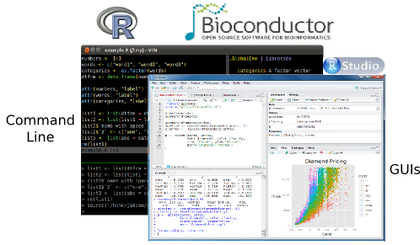

Wed, 4 May at 13:00, Sheffield BAD Days: Bioinformatics Awareness Day – 1 By Luisa Cutillo @ SITraN, Uniersity of Sheffield

Slide 2
Module I Outline
A brief introduction about Data Science
R and Exploratory Data Analysis
Hands on data: produce good graphics!
Tutorial Tutorial.R
Tutorial Comments.R

Slide 3
Are you a Data Scientist?
IDENTIKIT!

Slide 4
DS Identikit, do you:
find and interpret data sources?
manage large amounts of data to create visualizations to aid in understanding data?
show the data insights/findings and produce answers in days rather than months?
CONGRATULATIONS! You are in the right place.

Slide 5

QUESTIONS
ANSWERS
DATA
Exploratory Data Analysis

Slide 6
EDA: Exploratory Data Analysis (Tukey, 1961)
Objectives:
Suggest hypotheses about the causes of observed phenomena
Assess assumptions on which statistical inference will be based
Support the selection of appropriate statistical tools and techniques
Provide a basis for further data collection through surveys or experiments

Slide 7
EDA: A CLEAR PICTURE is worth then a thousand words!
Mostly graphical
Plotting the raw data (histograms, scatterplots, etc.)
Plotting simple statistics such as means, standard deviations, medians, box plots, etc.

Slide 8
How to make a CLEAR graph?
Avoid 3-D graphics
Don’t show too much information on the same graph (color, patterns, etc)
Stay away from Excel, Excel is not a statistics package! It can induce errors (“copy-paste”)!
USE R: it provides a great environment for EDA with good graphics capabilities!!!

Slide 9
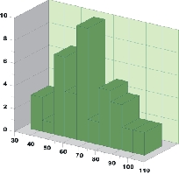
Is this a BAD PLOT?
What's wrong with this one?
What should have been done?
9

Slide 10
Do you want to see few BAD PLOTS?
Try http://www.biostat.wisc.edu/~kbroman/topten_worstgraphs/

Slide 11
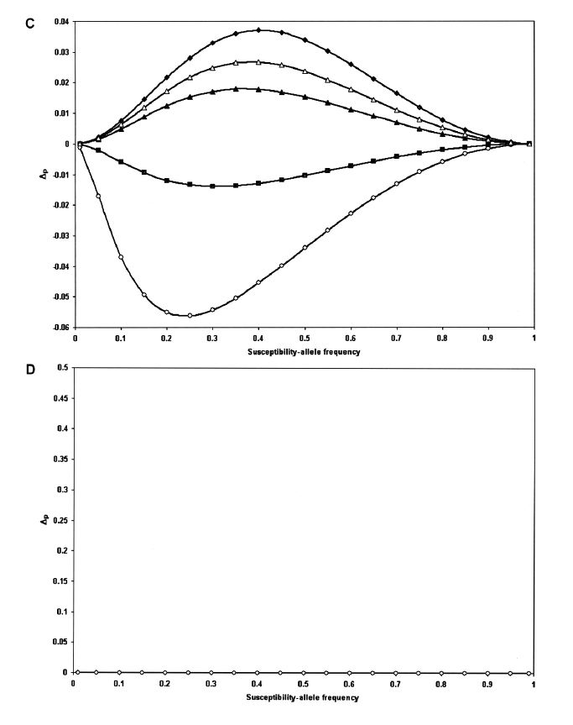
Wittke-Thompson JK, Pluzhnikov A, Cox NJ (2005). American Journal of Human Genetics 76:967-986, Figure 1
What's wrong with this one?
If you want your graph to be published in large format, it seems that the American Journal of Human Genetics is the place to which you should aim. This figure spans two pages. Panel D is most interesting; it takes a while to identify that there is any information there at all.
What should have been done?
Panel D could have been discarded completely!
11

Slide 12
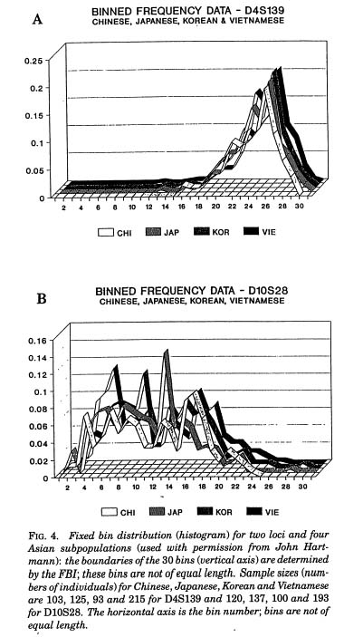
K Roeder (1994). Statistical Science 9(2):222-278, Figure 9
What's wrong with this one?
The 3-dimensional rendering of the curves is unnecessary.
What should have been done?
Displaying multiple curves simultaneously and ensure that the individual curves may be seen is challenging. Colors would be nice, but if color is not allowed, four different line types (solid, dashed, dotted, dash-dotted) might work.
12

Slide 13
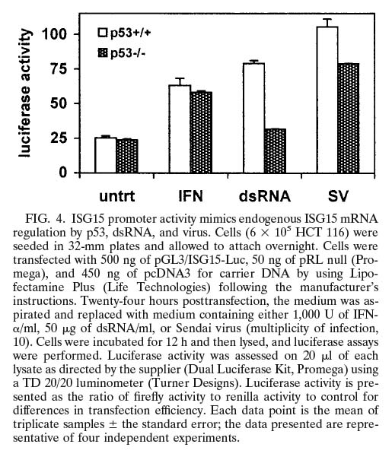
Hummer BT, Li XL, Hassel BA (2001) Role for p53 in gene induction by double-stranded RNA. J Virol 75:7774-7777, Figure 4
What's wrong with this one?
The bars and little antennae represent just three data points each!
What should have been done?
With just three data points in each group, why not just show the data as dots? You could also include line segments at the averages and even confidence intervals...all this in the same amount of space and with less ink.
Want more?
13

Slide 14
Why R?
R is Open source (http://www.r-project.org) language and environment for statistical computing and graphics
Provide many statistical techniques
R provides a great environment for EDA with great graphics capabilities
Highly extensible (e.g. CRAN, Bioconductor)
14

Slide 15
Useful links and material
R pacakge documentation for you research purposes: http://www.rdocumentation.org/
R color charts: http://research.stowers-institute.org/efg/R/Color/Chart/index.htm
Good page for R graphics and others: http://www.statmethods.net/advgraphs/index.html
Books used for this presentation: https://cran.r-project.org/doc/contrib/Krijnen-IntroBioInfStatistics.pdf http://www.biostathandbook.com http://Rcompanion.org/

Slide 16
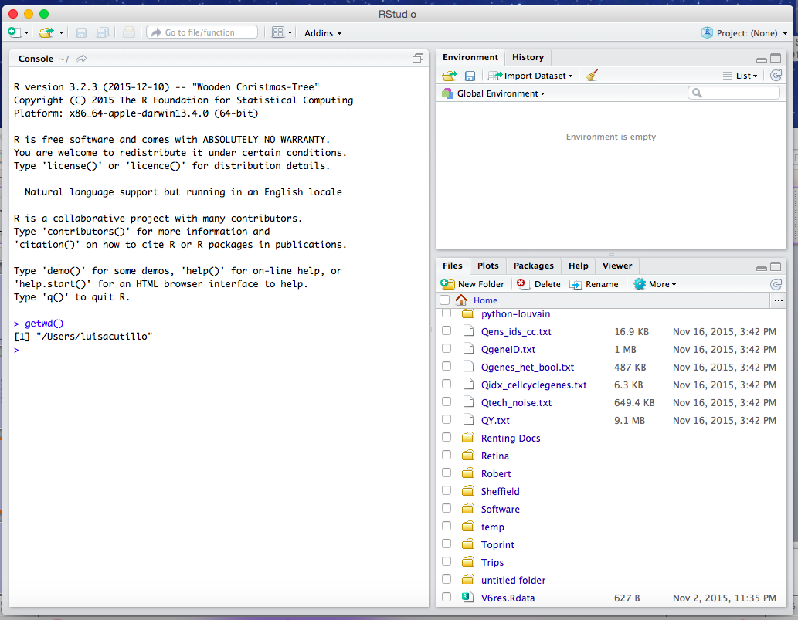
R and Rstudio

Slide 17
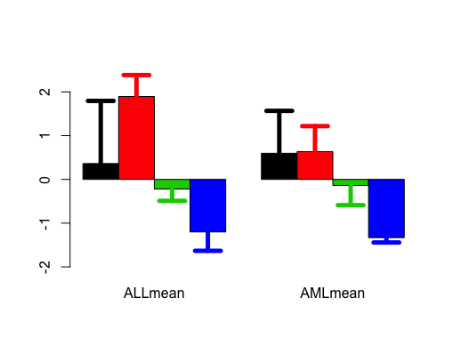
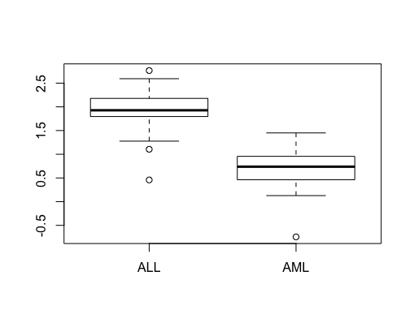
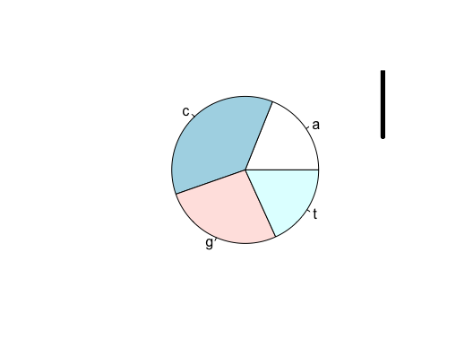
AIM:
Bar Plots
Box Plots
Pie Plots

Slide 18
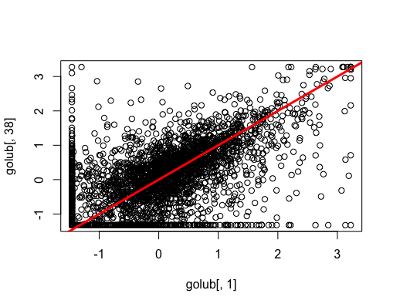
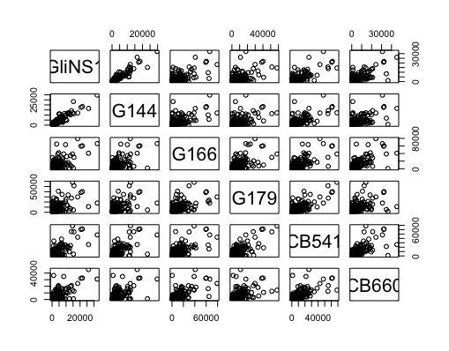
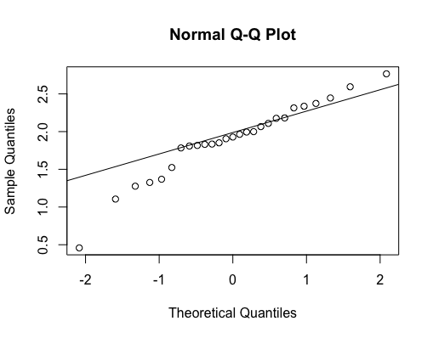
AIM:
Scatter Plots
Quantile-Quantile Plots
Trellis Plots

Slide 19
Instructions to follow the Tutorial
Download the Tutorial.R
Open Rstudio (or just R)

Slide 20
Few more Comments
R script Comments.R

Slide 21
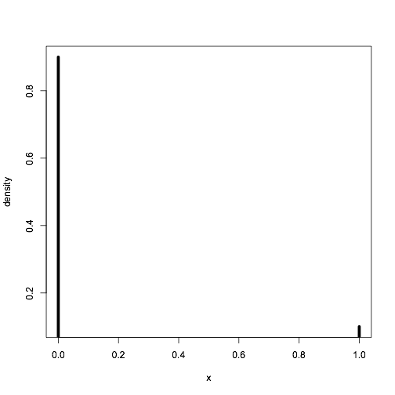
Probability distributions
Can be either discrete or continuous (uniform, bernoulli, normal, etc)
Defined by a density function, p(x) or f(x)
Bernoulli distribution Be(p)
Flip a coin (T=0, H=1). Probability of H is .1.
x<-0:1
f<-dbinom(x, size=1, prob=.1)
plot(x,f,xlab="x",ylab="density",type="h",lwd=5)
Probability of having a 1
21

Slide 22
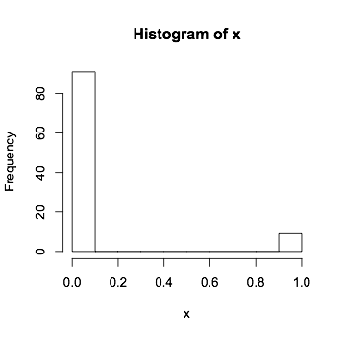
Probability distributions
Random sampling
Generate 100 observations from a Be(.1)
set.seed(100)
x<-rbinom(100, size=1, prob=.1)
hist(x)
22

Slide 23
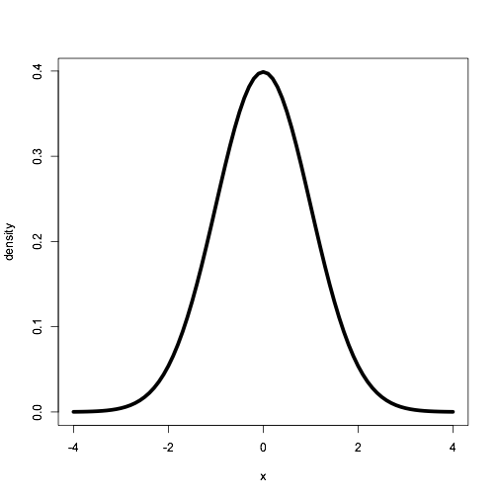
Probability distributions
Normal distribution N(μ,σ²)
μ is the mean and σ² is the variance
x<-seq(-4,4,.1)
f<-dnorm(x, mean=0, sd=1)
plot(x,f,xlab="x",ylab="density",lwd=5,type="l")
Area under the curve is the prob of
having an observation beween 0 and 2.
23

Slide 24
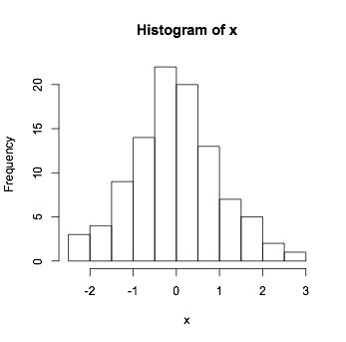
Probability distributions
Random sampling
Generate 100 observations from a N(0,1)
set.seed(100)
x<-rnorm(100, mean=0, sd=1)
hist(x)
Histograms can be used
to estimate densities!
24

Slide 25
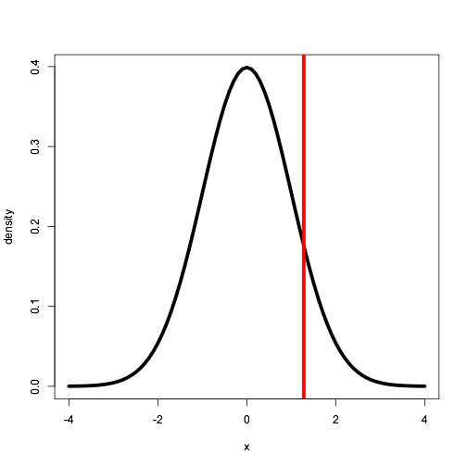
Quantiles
(Theoritical) Quantiles: The p-quantile is the value with the property that there is a probability p of getting a value less than or equal to it.
q90<-qnorm(.90, mean = 0, sd = 1)
x<-seq(-4,4,.1)
f<-dnorm(x, mean=0, sd=1)
plot(x,f,xlab="x",ylab="density",type="l",lwd=5)
abline(v=q90,col=2,lwd=5)
The 50% quantile is called the median
90% of the prob. (area under the curve)
is on the left of red vertical line.
25

Slide 26
Descriptive Statistics
Empirical Quantiles: The p-quantile is the value with the property that p% of the observations are less than or equal to it.
Empirical quantiles can easily be obtained in R.
set.seed(100)
x<-rnorm(100, mean=0, sd=1)
quantile(x)
0% 25% 50% 75% 100% -2.2719255 -0.6088466 -0.0594199 0.6558911 2.5819589
quantile(x,probs=c(.1,.2,.9))
10% 20% 90% -1.1744996 -0.8267067 1.3834892
26

Slide 27
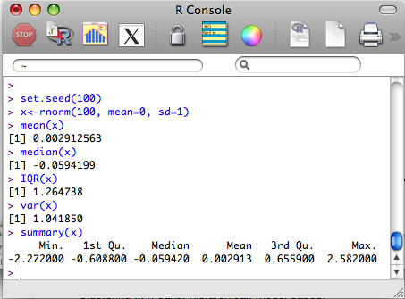
Descriptive Statistics
We often need to quickly ‘quantify’ a data set, and this can be done using a set of summary statistics (mean, median, variance, standard deviation)
set.seed(100)
x<-rnorm(100, mean=0, sd=1)
mean(x)
median(x)
IQR(x)
var(x)
summary(x)
‘summary’ can be used for almost any R object!
R is object oriented (methods/classes).
27

Slide 28
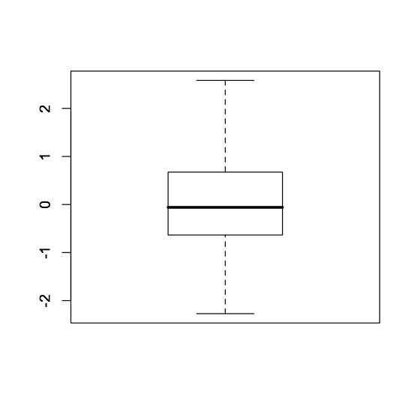
Descriptive Statistics - Box-plot
set.seed(100)
x<-rnorm(100, mean=0, sd=1)
boxplot(x)
75% quantile
1.5xIQR
Median
25% quantile
IQR
1.5xIQR
IQR= 75% quantile -25% quantile= Inter Quantile Range
Everything above or below are considered outliers
28

Slide 29
QQ-plot
- Many statistical methods make some assumption about the distribution of the data (e.g. Normal).
The quantile-quantile plot provides a way to visually verify such assumptions.
The QQ-plot shows the theoretical quantiles versus the empirical quantiles. If the distribution assumed (theoretical one) is indeed the correct one, we should observe a straight line.
29

Slide 30
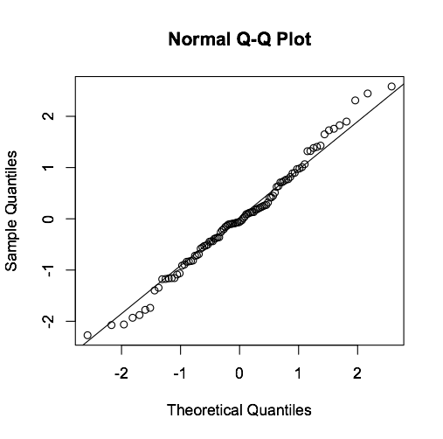
QQ-plot
set.seed(100)
x<-rnorm(100, mean=0, sd=1)
qqnorm(x)
qqline(x)
Only valid for the normal
distribution!
30

Slide 31
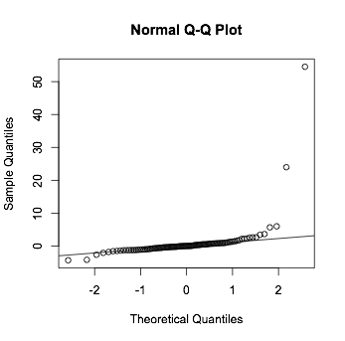
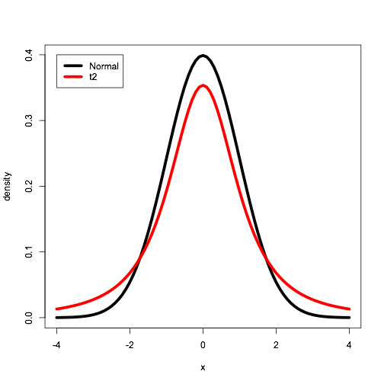
QQ-plot
set.seed(100)
x<-rt(100,df=2)
qqnorm(x)
qqline(x)
Clearly the t distribution with two
degrees of freedom is different from
the Normal!
x<-seq(-4,4,.1)
f1<-dnorm(x, mean=0, sd=1)
f2<-dt(x, df=2)
plot(x,f1,xlab="x",ylab="density",lwd=5,type="l")
lines(x,f2,xlab="x",ylab="density",lwd=5,col=2)
31

Slide 32
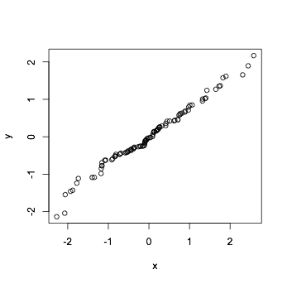
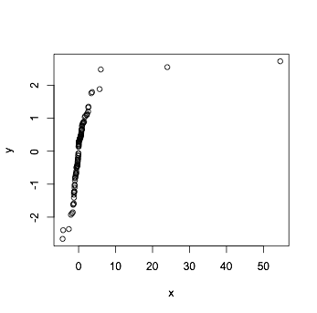
QQ-plot
Comparing two samples
set.seed(100)
x<-rnorm(100, mean=0, sd=1)
y<-rnorm(100, mean=0, sd=1)
qqplot(x,y)
set.seed(100)
x<-rt(100, df=2)
y<-rnorm(100, mean=0, sd=1)
qqplot(x,y)
Ex: Try with different values of df.
Main idea behind quantile normalization
32

Slide 33
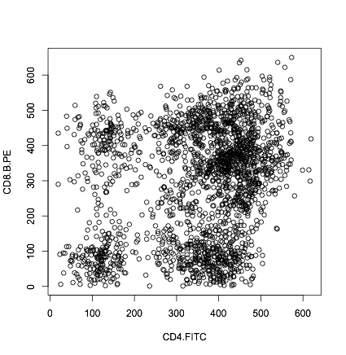
Scatter plots
Biological data sets often contain several variables So they are multivariate.
Scatter plots allow us to look at two variables at a time.
What can you tell about this data?
This can be used
to assess independence!
33

Slide 34
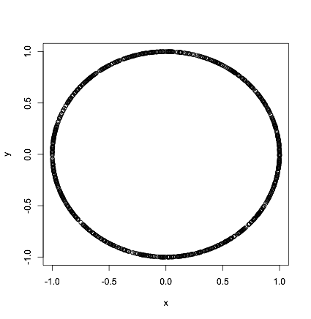
Scatter plots vs. correlations
Note that in the previous example, the correlation between
The two variables was 0.23!
Correlation is only good for linear dependence.
# Quick comment on correlation
set.seed(100)
theta<-runif(1000,0,2*pi)
x<-cos(theta)
y<-sin(theta)
cor(x,y)
plot(x,y)
What is the correlation?
Independence -> Non Correlation
Not viceversa!!!!
34

Slide 35
Module II Outline:
Hypothesis Testing Methodology
p-Value Approach to Hypothesis Testing
Comparative Statistics examples (T-Test, Anova and Statistics for frequency data)
Tutorials: Ttest.R, Frequancy.R, Anova.R
Multiple Hypotesis Testing (FDR)
Application to Golub dataset: MulHypTestOnGolub.R

Slide 36
What is a Hypothesis
Of a test?
A hypothesis is an assumption about the population parameter.
A parameter is a characteristic of the population, like its mean or variance.
The parameter must be identified before analysis.
I assume the mean AGE of this class is 50!!!
Am I correct? TEST IT!
© 1984-1994 T/Maker Co.

Slide 37
The Null Hypothesis, H₀
States the Assumption (numerical) to be tested
e.g. Our class mean age is 50 (H₀: µ=50)
Begin with the assumption that the null hypothesis is TRUE.
(Similar to the notion of innocent until proven guilty)
The Null Hypothesis may or may not be rejected,but our aim is to REJECT the null hypothesis!

Slide 38
The Alternative Hypothesis, H₁
Is the opposite of the null hypothesis e.g. The average age of our class is different from 50 (H₁: µ ≠50)
Is generally the hypothesis that is believed to be true by the researcher!

Slide 39
Identify the Problem
Steps:
State the Null Hypothesis
State its opposite, the Alternative Hypothesis
Hypotheses are mutually exclusive & exhaustive
Sometimes it is easier to form the alternative hypothesis first.

Slide 40
Hypothesis Testing Process
Assume the
population
mean age is 50.
(Null Hypothesis)
Population
The Sample
No, not likely!
Mean Is 20
REJECT
Sample
Null Hypothesis

Slide 41
Reason for Rejecting H₀
Sampling Distribution
Our sample mean (20) falls in the tails! It’s not likely!
we reject the null hypothesis that µ = 50.
H₀
Hypotyzed population mean.
20
µ = 50
Sample Mean
Observed population mean

Slide 42
Level of Significance, α
Defines the Rejection region
Typical value of a is 0.05. It Provides the Critical Value(s) of the Test
Rejection Regions
Critical Value
α
“Area” of the
Rejection region
0

Slide 43
Level of Significance, α and the Rejection Region
One tail (left) test
Critical Value(s)
α
H₀: μ = 0 H₁: μ < 0
0
Rejection Regions
H₀: μ = 0 H₁: μ > 0
One tail (right) test
α
0
H₀: μ = 0 H₁: μ ≠ 0
Two tails test
α/2
0

Slide 44
Errors in Making Decisions
Type I Error
Reject Null Hypothesis when it is True (“False Positive”)
Has Serious Consequences
Probability of Type I Error Is α
Called Level of Significance
Type II Error
Do Not Reject Null Hypothesis when it is False (“False Negative”)
Probability of Type II Error Is β ( Power 1- β )

Slide 45
One possibility: Increase the sample size!!!!
α & β Have an Inverse Relationship
Reduce probability of one error and the other one goes up.
β
α

Slide 46
What is the p Value and how to use it in a Test?
The p-value is the Probability of Obtaining a Test Statistic (under H₀) more Extreme (≤ or ≥) than the observed Sample Value
Used to Make Rejection Decision
If p value < α <=> Reject H₀ <=> SUCCESS
If p value ≥ α <=> Do Not Reject H₀ <=> FAILURE
ObservedSample Value
One tail test
p
0

Slide 47
Random variables: am I observing continuous or discrete data???
Roughly speaking
a “random” variable is a quantity whose values are “random” and to which a probability distribution is assigned
(e.g. a fair dice outcomes have same chance of coming up at each throw ) ;
THE DIFFERENCE BETWEEN CONTINUOUS AND DISCRETE VARIBLES IS FUNDAMENTAL IN CHOOSING THE KIND OF TEST STATISTICS!

Slide 48
Discrete R.V.
If the r.v. X values belongs to a finite set
{x1 ,x2,…, xn}
then X is called DISCRETE (usually counts)
As example the flipping of a coin, the number of red cells counted in an image, the number of success in 100 trials…are observations of a discrete variable!

Slide 49
Continuous R.V.
A continuous random variable is a r.v. which takes an infinite number of possible values.
Continuous random variables are usually measurements. Examples include height, weight, the amount of sugar in an orange, the time required to run a mile,the fluorescence intensity in a microarray, etc.
(A continuous random variable is not defined at specific values
bat over intervals of values)

Slide 50




Which test to use?
First of all you should choose a summary SAMPLE STATISTIC!
As. Example:
T-test!
SAMPLE MEAN
SAMPLE VARIANCE
SAMPLE COVARIANCE
SAMPLE CORRELATION

Slide 51
paired t-Test: s Unknown
(rigth and left eye)
Assumptions
Population is normally distributed
If not normal, only slightly skewed & a large sample taken (Central limit theorem applies)
Parametric test procedure (sample stat. is the sample mean!)
t test statistic, with n-1 degrees of freedom

Slide 52
Rejection Region
(one tail)
H₀: μ ≠ 0 H₁: μ < 0
H₀: μ ≠ 0 H₁: μ > 0
Reject H
0
Reject H
0
α
α
0
t
0
t
Must Be Significantly below μ = 0
Small values don’t contradict H₀ ->Don’t Reject H₀!

Slide 53
Unpaired T-test
The two sample observations are not coupled
Not necessary equal sample numbers
You may distinguish between equal and unequal sample variance

Slide 54
In few words the other tests:
If you want to compare more then two populations means when you observe 1 characteristic: one way Anova Test
If you want to compare more then two populations means when you observe 2 characteristic: two way Anova Test
If you want to compare two populations variance: F-test
If you want to compare two populations proportions: Chi-square test

Slide 55
Remarks
If you have counts…or few data YOU ARE NOT ALLOWED TO USE T-TEST!!!
Any test is build upon conjecture about the shape of the null distributions
If you just want to have a summary about your data, then use the descriptive statistic

Slide 56
Ttest
Example dataset: Gene expression data (3051 genes and 38 tumor mRNA samples) from the leukemia microarray study of Golub et al. (1999). Pre-processing was done as described in Dudoit et al. (2002).
Tutorial: Ttest.R

Slide 57
Anova
Use one-way anova when you have one nominal variable and one measurement variable; the nominal variable divides the measurements into two or more groups.
It tests whether the means of the measurement variable are the same for the different groups
Tutorial: Anova.R

Slide 58
Statistics for frequency data
Sometimes in biology results are not measurements but counts (or frequencies)!e.g. counts of different phenotypes, counts of cell types ...
Task: Compare frequency data in different categories with some expected data
You are NOT ALLOWED to perform a t test! Instead you do a Chi-squared test;

Slide 59
Statistics for frequency data
Three different uses:
Expected calculated from theory: you test if your observed data agree with the theory. E.g. Mendel theory can be used to predict frequencies of different phenotypes: we expect a genetic cross to be 3:1 ratio of red and white flowers.(P>5% data agree with theory)
Expected calculated assuming that the counts in all the categories should be the same: you test whether there is a difference between the observed sets. (P<5% data significantly different from each other)
Investigate association between frequency data in two separate groups. Expected calculated assuming counts in one group are not affected by counts in the other. (P<5% there is a significant association). Data are set in a contingency table. For each cell the expected data is: E=(column total x row total)/grand total

Slide 60
Statistics for frequency data
chi-square test of goodness-of-fit: when you have one nominal variable, you want to see whether the number of observations in each category fits a theoretical expectation, and the sample size is large.
Exact test of GoF: same but the sample size is small.
Chi-square test of independence: when you have two nominal variables and you want to see whether the proportions of one variable are different for different values of the other variable. (sample size is large).
Fisher Exact test of independence: same but sample size is small.
Tutorial: Frequancy.R

Slide 61
MICROARRAY Hypothesis Testing as an example of Multiple Hypothesis Testing
We want to compare two biologically different samples (ex. Wild Type vs Mutant) through the identification of differentially expressed genes
We have to simultaneously test, for each gene, the null hypothesis: gene expression has not changed.
61
Notes:
TIGEM
19/05/16
Luisa Cutillo
61

Slide 62
For each gene j the test is expressed in term of a Statistic
and a p-value
Null Hypothesis
H0 for each gene j:
μj(WT)=μj(KO)
Which is the test to use in this case?
62
Notes:
TIGEM
19/05/16
Luisa Cutillo
62

Slide 63
For each gene the test is expressed in term of a Statistic
and a p-value
Null Hypothesis
Ho: μj(WT)=μj(KO)
T-statistic on gene j --> p-value
p-value
Is true
( α )
Reminder:
The p-value is the probability of finding a false positive (probability of type I error) that is the probability of finding out a differentially expressed gene that actually is not!!!
Ex. If α=0.01 and p<α, then 0.01 represent the probability that the gene detected is a false positive.
63
Notes:
TIGEM
19/05/16
Luisa Cutillo
63

Slide 64
Problems in controlling the errors…
Assume that a chip experiment reveals the expression level of m = 20.000 genes relatively to two different biological conditions.
We want to test, simultaneously for each gene, the null hypothesis that the gene is not differentially expressed against the alternative that it is.
If we test each of the m hypothesis at level p<α=0.01, we would expect about 200 false positive!!!
64
Notes:
TIGEM
19/05/16
Luisa Cutillo
64

Slide 65
Multiple error controlling procedures: Bonferroni
Bonferroni
Correction
(FWER)
In practice for each gene you have to compute a new p-value
pj<Tr=α/m ----> pj*m<α ---> Pbonf<α
and you should retrieve all the genes for which Pbonf=pj*m <α
65
Notes:
TIGEM
19/05/16
Luisa Cutillo
65

Slide 66
Multiple error controlling procedures: Benjamini - Hockberg
Consider the p-values sorted in ascending order:
p(1)<p(2)<... <p(m)
For the j-st gene the new pBH is p(j)*m/j
Detect all the genes whose sorted p-value is s.t.
p(j)*m/j< α
In practice for the j-st gene you have to compute a new p-value Pcorrect(j)=p(j)*m/j
and you should retreive all the genes for which Pcorrect<α
66
Notes:
TIGEM
19/05/16
Luisa Cutillo
66

Slide 67
How to perform the multiple tests in R?
R has built in methods to adjust a series of p-values either to control the family-wise error rate or to control the false discovery rate.
The methods Holm, Hochberg, Hommel, and Bonferroni control the family-wise error rate. (they control the probability of even one false discovery, and so are all relatively strong conservative).
The methods BH (Benjamini–Hochberg, which is the same as FDR in R) and BY control the false discovery rate. These methods attempt to control the expected proportion of false discoveries.

Slide 68
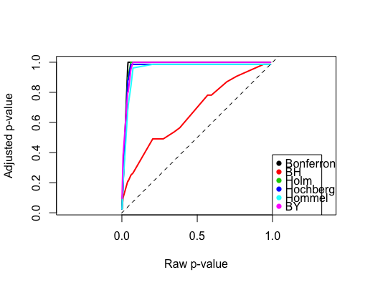
Applications
Apply multiple hypothesis testing to GOLUB dataset.
Tutorial MulHypTestOnGolub.R

