Slide 1
Cloud Scale Machine Learning
An Overview of Machine Learning
Cassie Breviu
Cloud Developer Advocate @ Microsoft
@cassieview

Slide 3
Agenda
An Overview of Machine Learning and the Model Building Process
Demo – Classify Digits with SciKit Learn
An Overview of Azure Machine Learning service
Workshop – Your First Machine Learning Experiment in the Cloud

Slide 4
Setup your AML Service by going to aka.ms/lbsworkshop

Slide 5
What is AI, ML and DL?
Artificial intelligence (AI) is a technique that enables computers to mimic human intelligence. It includes machine learning.
Machine learning (ML) is a subset of artificial intelligence that includes techniques (such as deep learning) that enable machines to improve at tasks with experience.
Deep learning (DL) is a subset of machine learning based on artificial neural networks that permit a machine to train itself.
aka.ms/DeepLearningVSMachineLearning

Slide 6
Programming
Algorithm
Answers
Data
Notes:
When programming, we solve a problem by writing an algorithm
We run data (or input) through that algorithm and get an answer
Importantly, we know (or can work out) how to solve that problem
What happens when we don’t know what that algorithm looks like? E.g. is there a bird in the photo, or what is the probability that an applicant will default on a loan?

Slide 7
Machine Learning
Answers
Algorithm
Data
Notes:
These are the problems machine learning is good at
With machine learning, we solve these problems by flipping it around and providing a whole lot of examples of correct answers and corresponding input, and let the computer decide what that algorithm is

Slide 8
Machine Learning
Answers
Model
Data
Notes:
What we’re doing is letting the computer build a “model” to describe that data

Slide 9
Machine Learning
Answers
Model
Data
Notes:
What’s great about this, is we can use that model in place of the algorithm we would have written, had we known how.

Slide 10
Machine Learning
Answers
Data
Model
Predictions
Data
Notes:
By using the model, we can get predictions
Note: these are predictions - not answers the way we’d think of it
The quality and accuracy of those predictions depends on the techniques and algorithms we used to train the model, and importantly - the data we used to train the model
If you’re using biased data to train the model, you’ll get a biased model

Slide 11
machine learning
finding (and exploiting) patterns in data
replacing “human writing code” with “human supplying data”
starts with a sharp question
Notes:
system figures out what the person wants based on examples
need to abstract from “training” examples to “test” examples
most central issue in ML: generalization

Slide 12
When should you use machine learning?
Regression: how much / how many
supervised
learning
Classification: which class does it belong to?
Clustering: are there different groups? which does it belong to?
unsupervised
learning
Anomaly Detection: is this weird?
Recommendation: which option should I choose?

Slide 13
The Model Building Process
Prepare Data
Find, Select and/or Create Data
Train Model
Apply learning algorithm
Test Model
Test Candidate Model with unseen data
Deploy Model
Deploy Chosen Model
Apply preprocessing
Select Candidate model
Select good enough model
Application posts to API
Feature Engineering
Notes:
Lets talk about the model building process. Here we will discuss the high-level model building process.
Prepare Data: We need to find, select and/or create data, apply preprocessing and fill gaps in data.
Train Model: Once you have your prepared data its time to test different machine learning models to see which gets the best results for your data. This is iterative because you may need to change the data and/or the model until you think you have a candidate for the production model.
Test Model: Now you have a model that you think is going to perform well and you can test it with unseen data. You will process the unseen data the same way the data was processed for training and then test how well it predicts the labels. This is an iterative process as you may need to go back to the beginning and change data features or processing. Its a fail fast process so don’t overthink each step. Get out what you think will work and iterate through until you get a model that performs good enough on your unseen data.
Operationalize Model: Once you have the “chosen one” aka your chosen model. Its time to operationalize it so you can consume it from different applications. In azure machine learning interface this is a super simple process which you will see in our demo.

Slide 14
data example
Class | Outlook | Temp. | Windy
Play | Sunny | Low | Yes
No Play | Sunny | High | Yes
No Play | Sunny | High | No
Play | Overcast | Low | Yes
Play | Overcast | High | No
Play | Overcast | Low | No
No Play | Rainy | Low | Yes
Play | Rainy | Low | No
? | Sunny | Low | No
label (y)
play / no play
features
outlook, temp, windy
values (x)
[Sunny, Low, Yes]
Labeled dataset is a collection of (X, Y) pairs.
Given a new x, how do we predict y?
Notes:
How we make decisions based on data?
We would Play right?
Computers are better at this and this is where machine learning excels

Slide 15


Slide 16
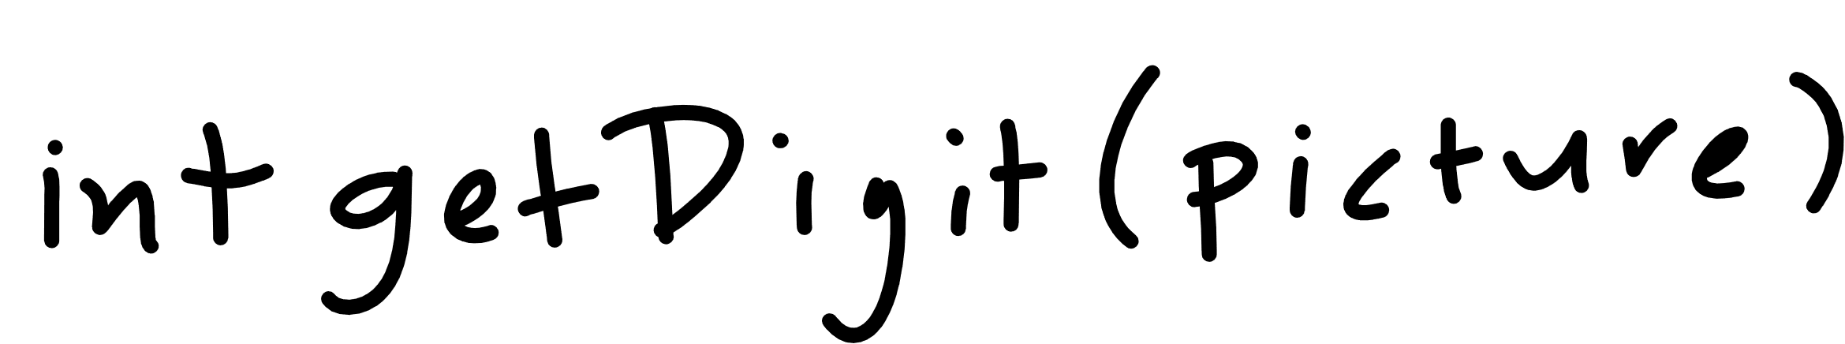
Notes:
A traditional function may look something like this

Slide 17
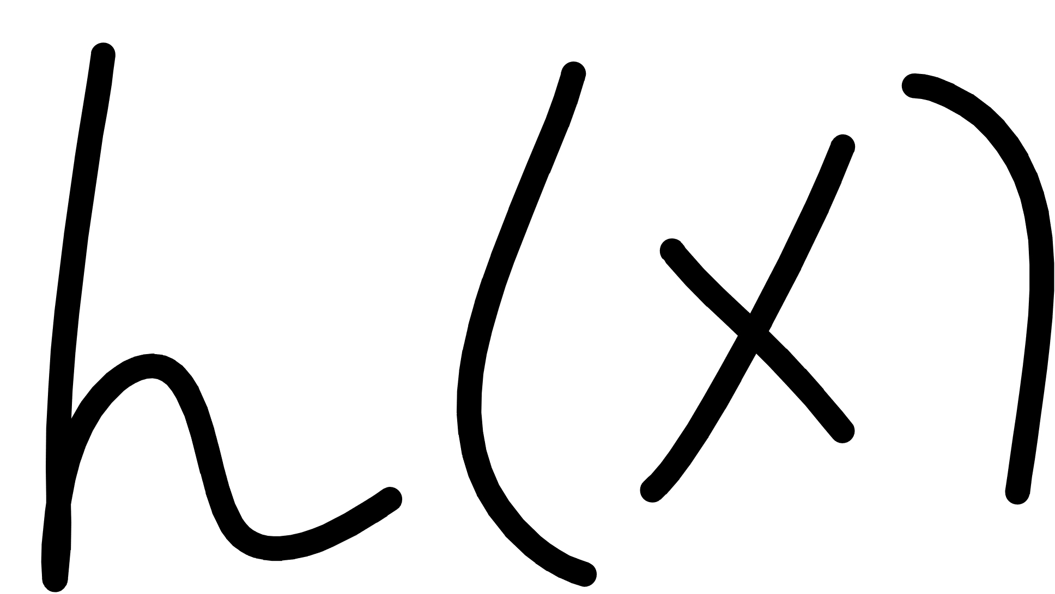
Notes:
With machine learning we want to do something like this
The difference is we aren’t going statically program the function – the computer is

Slide 18


Notes:
X is our feature or our data we are going to use to make a decision

Slide 19
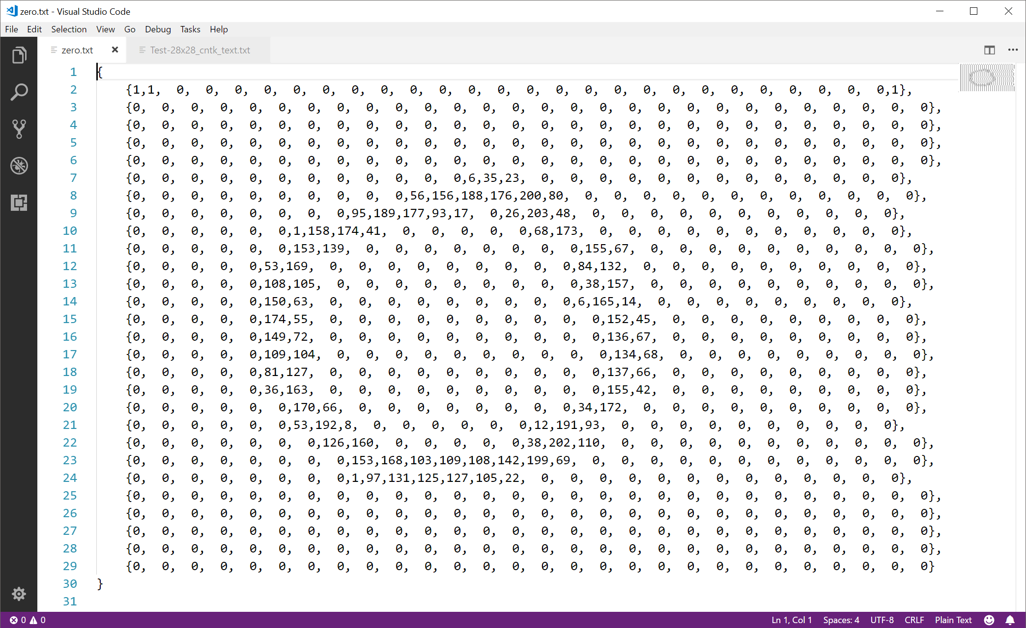
Notes:
X is our data to learn from and predict with
Here is an example of a zero represented as numbers
The computer understands numbers

Slide 20

Notes:
So lets talk about what h is or the function

Slide 21
scikit-learn
Notes:
To do that we need to talk about some machine learning libraries that are out there that make machine learning much easier
Sklearn – is a great library with great docs to get started with ml

Slide 22

scikit-learn – concepts
You “pick” the function “shape” – in scikit-learn these are called classifiers
You “fit” the data to the classifier
scikit-learn classifier
model
data
You use the classifier to predict
code
input
answers
Notes:
Here you can see the steps to creating the function shape

Slide 23
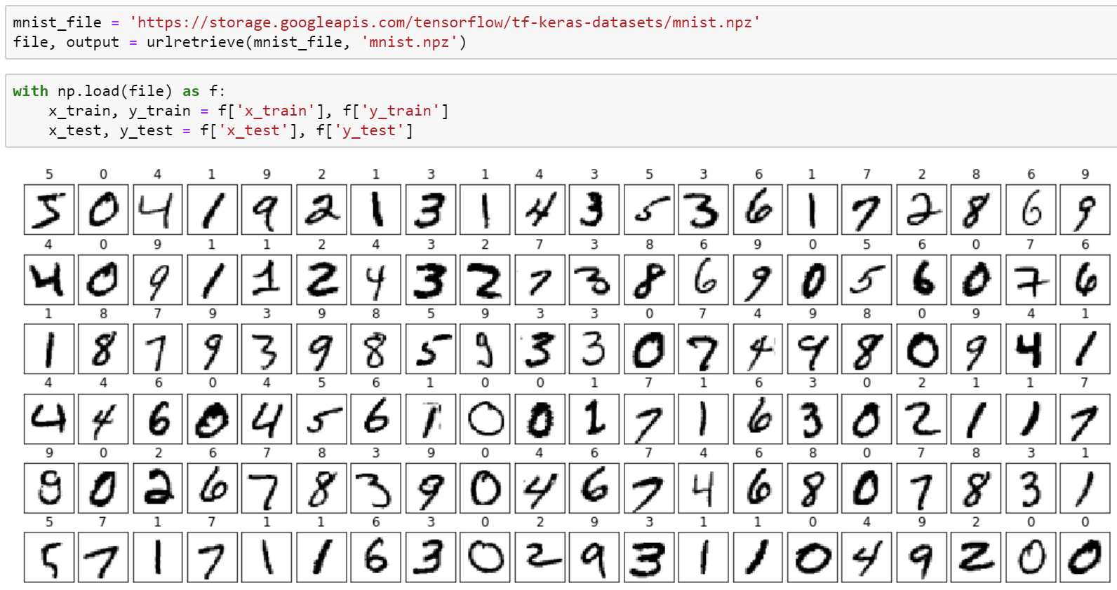
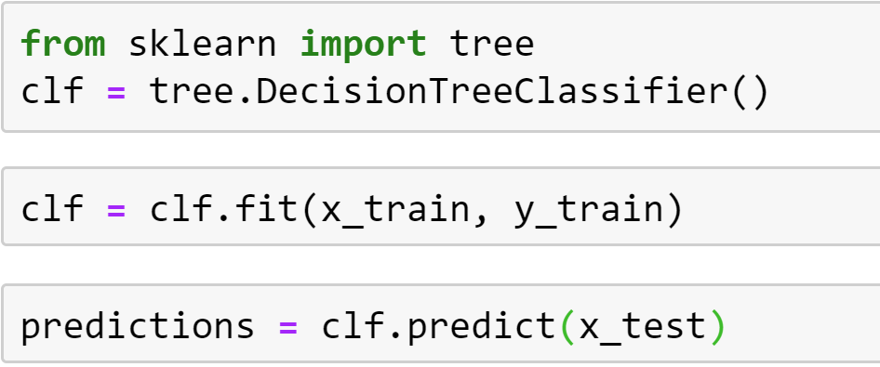
scikit-learn – concepts
You “pick” the function “shape” – in scikit-learn these are called classifiers
You “fit” the data to the classifier
You use the classifier to predict
Notes:
Lets look at what the looks like in code

Slide 24
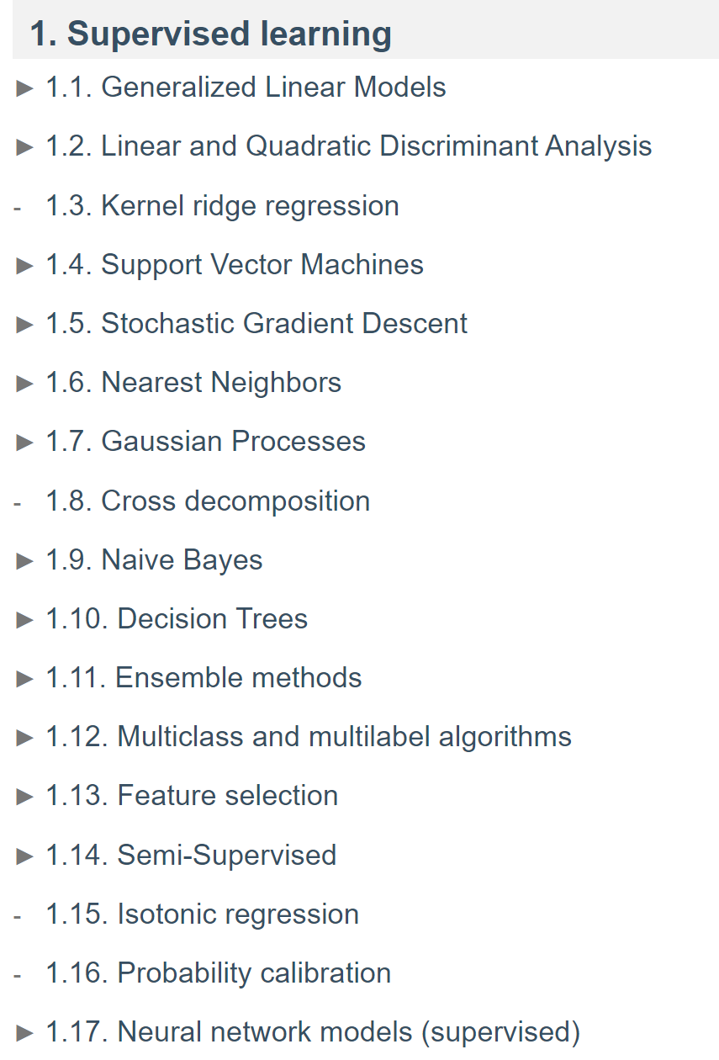
scikit-learn – classifiers
source: https://scikit-learn.org/stable/user_guide.html

Slide 25

scikit-learn – concepts
Questions?

Slide 26
TensorFlow 2.0
Notes:
Lets talk about another library (which you may have heard of)

Slide 27
TensorFlow – concepts
You “craft” the function “shape” – in TensorFlow this is a model
You “optimize” the model using a cost/loss function and optimizer
data
TensorFlow
model
You use the model to predict
code
input
answers
Notes:
TF is a very popular library used for ml
Talk thru steps
Very similar process as we saw with the sk learn package

Slide 28



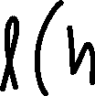

TensorFlow – concepts
model – the function shape we construct
cost/loss function – a function that tells us how bad we are at predicting
optimizer – method for reducing how bad we are at predicting
Notes:
The loss function computes the error for a single training example
cost function is the average of the loss functions of the entire training set.
Optimizers update the weight parameters to minimize the loss function.
Loss function acts as guides to the terrain telling optimizer if it is moving in the right direction to reach the bottom of the valley
Work together to get the best result

Slide 29
TensorFlow – concepts

Slide 30
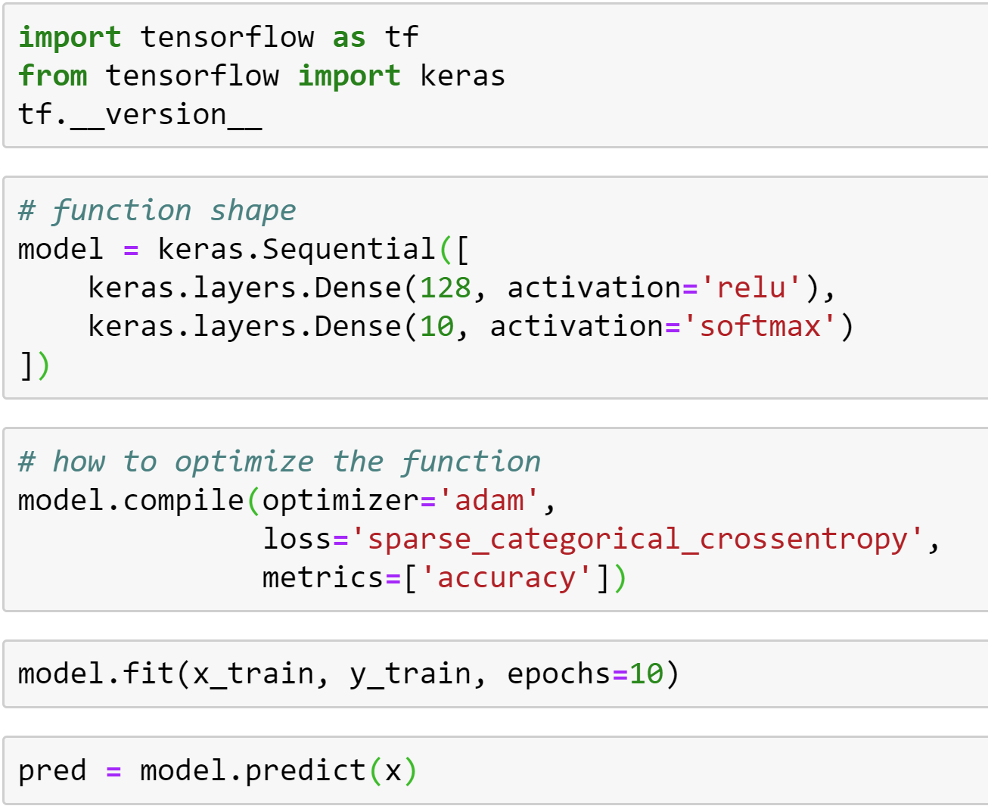
TensorFlow – concepts
You “craft” the function “shape” – in TensorFlow this is a model
You “optimize” the model using a cost/loss function and optimizer
You use the model to predict
Notes:
The Sequential model is a linear stack of layers.

Slide 31
TensorFlow – activation functions
class elu: Exponential linear unit.
class exponential: Exponential activation function.
class hard_sigmoid: Hard sigmoid activation function.
class linear: Linear activation function.
class relu: Rectified Linear Unit.
class selu: Scaled Exponential Linear Unit (SELU).
class sigmoid: Sigmoid.
class softmax: The softmax activation function transforms the outputs so that all values are in
class softplus: Softplus activation function.
class softsign: Softsign activation function.
class tanh: Hyperbolic Tangent (tanh) activation function.

Slide 32
TensorFlow – optimizers
class Adadelta: Optimizer that implements the Adadelta algorithm.
class Adagrad: Optimizer that implements the Adagrad algorithm.
class Adam: Optimizer that implements the Adam algorithm.
class Adamax: Optimizer that implements the Adamax algorithm.
class Ftrl: Optimizer that implements the FTRL algorithm.
class Nadam: Optimizer that implements the NAdam algorithm.
class Optimizer: Updated base class for optimizers.
class RMSprop: Optimizer that implements the RMSprop algorithm.
class SGD: Stochastic gradient descent and momentum optimizer.
Notes:
method for reducing how bad we are at predicting

Slide 33
TensorFlow – loss functions
class BinaryCrossentropy: Computes the cross-entropy loss between true labels and predicted labels.
class CategoricalCrossentropy: Computes the crossentropy loss between the labels and predictions.
class CategoricalHinge: Computes the categorical hinge loss between y_true and y_pred.
class CosineSimilarity: Computes the cosine similarity between y_true and y_pred.
class Hinge: Computes the hinge loss between y_true and y_pred.
class Huber: Computes the Huber loss between y_true and y_pred.
class KLDivergence: Computes Kullback Leibler divergence loss between y_true and y_pred.
class LogCosh: Computes the logarithm of the hyperbolic cosine of the prediction error.
class MeanAbsoluteError: Computes the mean of absolute difference between labels and predictions.
class MeanAbsolutePercentageError: Computes the mean absolute percentage error between y_true and y_pred.
class MeanSquaredError: Computes the mean of squares of errors between labels and predictions.
class MeanSquaredLogarithmicError: Computes the mean squared logarithmic error between y_true and y_pred.
class Poisson: Computes the Poisson loss between y_true and y_pred.
class SparseCategoricalCrossentropy: Computes the crossentropy loss between the labels and predictions.
class SquaredHinge: Computes the squared hinge loss between y_true and y_pred.
Notes:
a function that tells us how bad we are at predicting

Slide 34
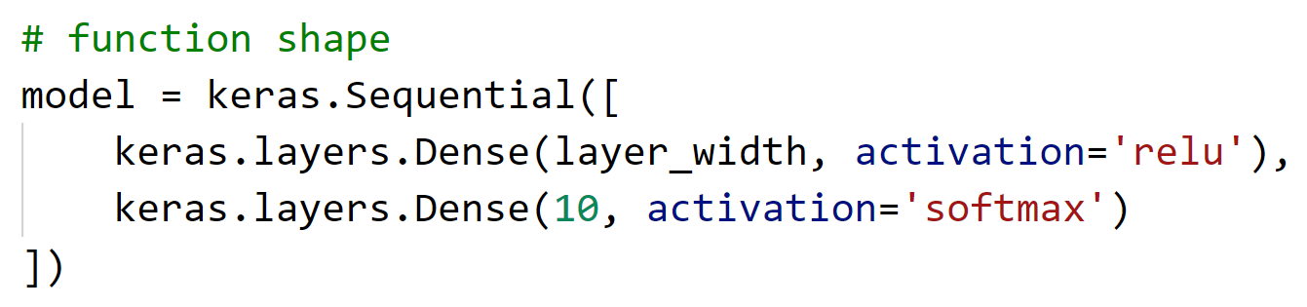
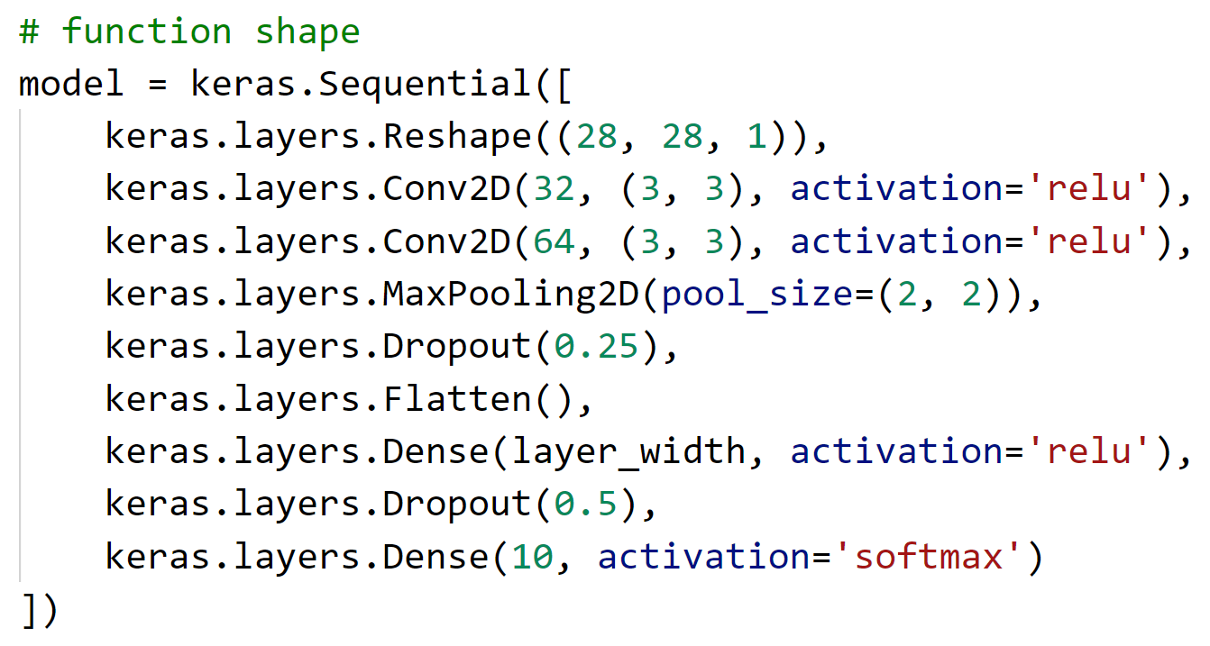
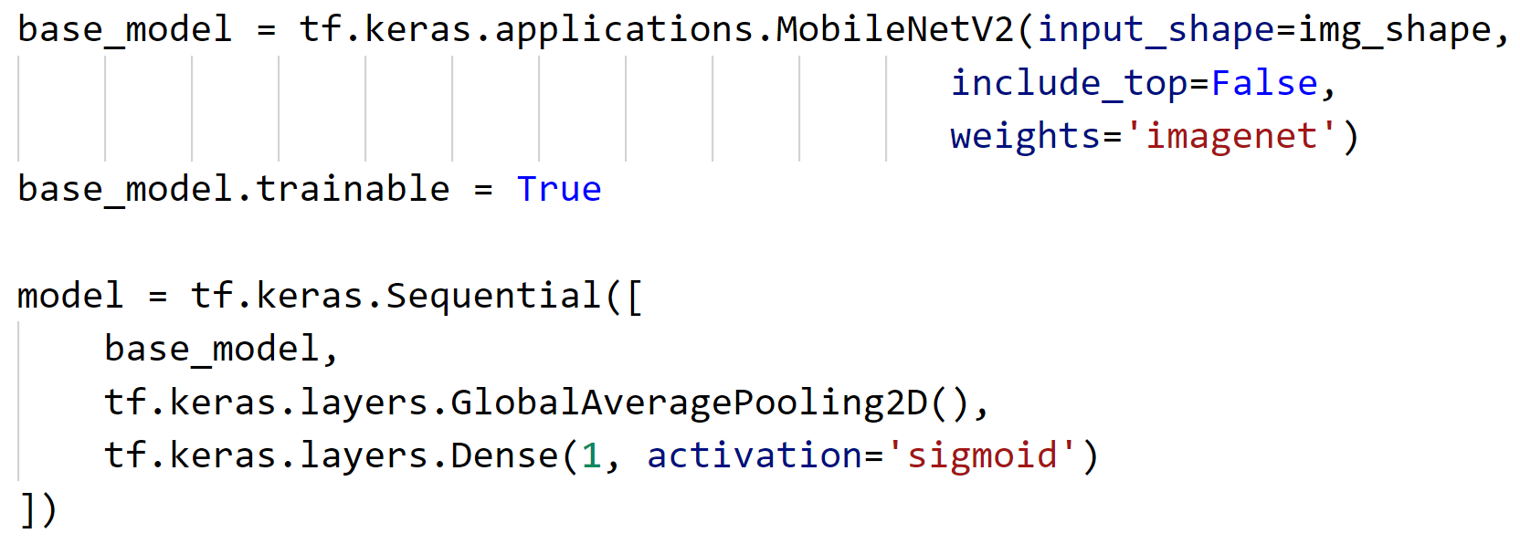
TensorFlow – models
Notes:
Here is the full model
With transfer learning!

Slide 35
TensorFlow – concepts
Questions?

Slide 36
Overview of Azure Machine Learning Service
Hands on with scikit-learn and TensorFlow
Notes:
Did everyone get their resources created?

Slide 37
Azure Machine Learning Service
A service that has all the tools needed to build amazing machine learning solutions.
Notes:
Azure Machine Learning is a cloud service that you use to train, deploy, automate, and manage machine learning models, all at the broad scale that the cloud provides.

Slide 38



Azure Machine Learning Service
Authoring tools: Automated ML, Visual Interface, Notebooks and Files
Assets: Datasets, Experiments, Models, Deployments
Management: Compute, Datastores, Workspaces
Notes:
Give an overview of the different tools in AML service workspace
-Automated ML - Automated machine learning, also referred to as autoML, is the process of automating the tasks of machine learning model development.
-Visual Designer-The visual interface for Azure Machine Learning service enables you to prep data, train, test, deploy, manage, and track machine learning models without writing code.
-Notebooks – jupyter notebooks running on cloud vms for building and testing models with code
-Datasets – shared datasets across multiple azure ML tools
-Experiments - Group of Runs from a Script
-Data Pipelines – ML processing workflows
-Models – history and versioning of the trained models
-Deployments – Endpoints of deployed models to consume from an application
-Compute – a way to manage what compute is created and when its used. Helps with managing costs.
-Datastores – azure storage for azure ml workspace
-Workpaces – The azure resource that contains these amazing features.
We are going to be building with Visual designer which uses many of these features behind the scenes when you are building a model. We will show this in the demo

Slide 39




How Azure ML Works
Azure ML
Workspace
1. Snapshot folder and
send to experiment
2. Create Docker image
Docker Image
6. Stream stdout, logs, metrics
5. Launch script
6. Stream stdout, logs, metrics
3. Deploy Docker and snapshot to compute
7. Copy over outputs
4. Mount datastore to compute
Compute Target
Data Store
My Computer
Notes:
When I need to train an Azure ML model, it works as follows. There are just a few steps that we need to get started.
The first thing that I need to do is I need to take the code that I have for model training and I need to send it to the Azure Machine Learning
Service. The service will then create the configuration for the experiment that I’ve just sent, and it will create a Docker image. It will deploy it to the
compute target that I've configured which will be linked to the data that I’ve uploaded in my dataset. It will then launch the training script that I've configured and
then in real time it will send me back the stream logs and metrics so that I can see how the process goes, as if I were developing on my own computer!

Slide 40
Lab
Hands on with scikit-learn

Slide 41
Thank you!
Cassie Breviu
@cassieview

